Slide 1
Which buildings waste energy?
Predicting building energy use with MATLAB, and turning predictions into a retrofit shortlist
NTU Learn to Hack: MATLAB Edition 2026 · Predicting Building Energy Consumption
github.com/JoshiiWahWah/ntu-matlab-hackathon-2026
Notes:
Buildings are among the largest contributors to energy use and carbon emissions. To fix them we first need to know which buildings are wasting energy. Not which use the most, but which use more than they should, given what they are and where they are. That's what we built in MATLAB.

Slide 2
THE PROBLEM
Not which buildings use the most, but which use more than they should
Buildings are major contributors to global energy use and carbon emissions.
Retrofits pay off most where a building uses far more than its type, size, age and climate explain.
We predict annual site Energy Use Intensity (kBtu/ft²/yr) for 75,757 building-years (WiDS 2022), entirely in MATLAB.
Notes:
Buildings are among the largest contributors to energy use and carbon emissions. To fix them we first need to know which buildings are wasting energy. Not which use the most, but which use more than they should, given what they are and where they are. That's what we built in MATLAB.

Slide 3
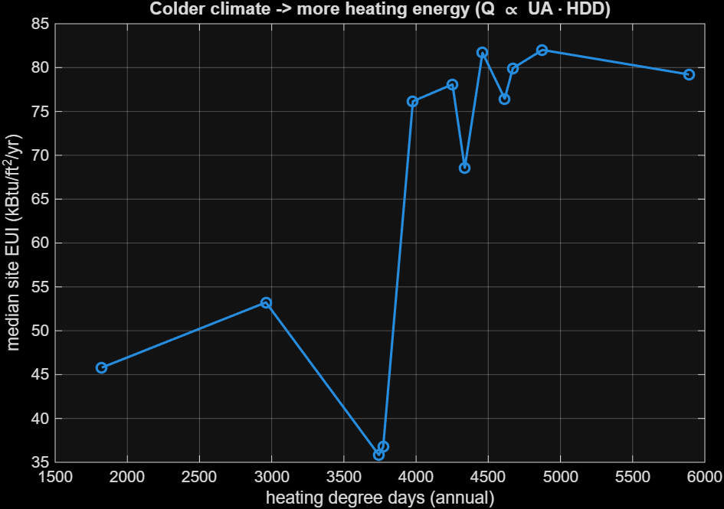
PHYSICS FRAMING
Energy balance: Q ≈ UA · ΔT summed over the year
Heating demand scales with heating degree days, cooling with cooling degree days.
Features we engineered:
winter & summer mean temperature · annual temperature range · total degree days · cooling share · log floor area · building age
Raw data: median EUI ≈ 36–53 in milder climates vs ≈ 68–82 in colder ones.
Notes:
(fig. 05 EUI vs HDD) "A building's heating energy follows an energy balance: Q ≈ UA·ΔT summed over the year. So we engineered degree-day and seasonal temperature features. In the raw data, median energy use is roughly 36–53 in milder climates and 68–82 in colder ones.

Slide 4
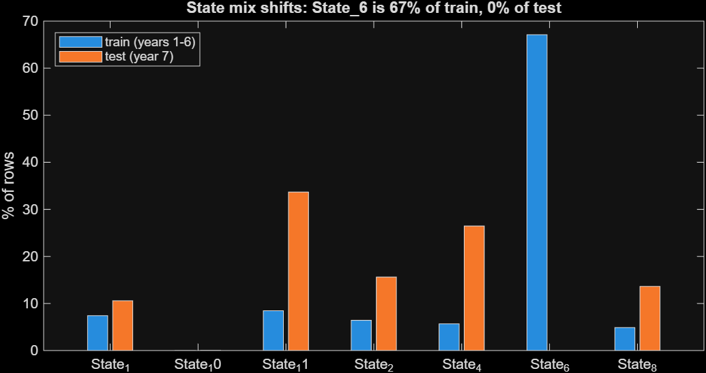
DATA MASTERY
Three findings that shaped the whole design
1 Distribution shift
State_6 is 67.1% of train but 0% of test → we also report a test-like score.
2 Missingness shift
Wind/fog 56.0% missing in train vs 89.8% in test → dropped.
3 Hidden building identity
Reconstructed 63,907 buildings → past energy use as a feature, from earlier years only (unit-tested).
Notes:
(fig. 02 state shift, results/decisions.csv) "Before modelling we looked hard at the data. Three findings drove our design: 1. State_6 is 67% of the training data and *0%* of the test data. So besides the normal score we report a 'test-like' score on non-State_6 buildings. 2. The wind and fog columns are 56% missing in train but 90% in test. That's a missingness shift a model would wrongly learn from, so we dropped them. 3. The same buildings appear in several years without an id. We reconstructed one (63,907 buildings), so a building's *past* energy use becomes a feature. It is computed only from earlier years, and a unit test proves it.

Slide 5
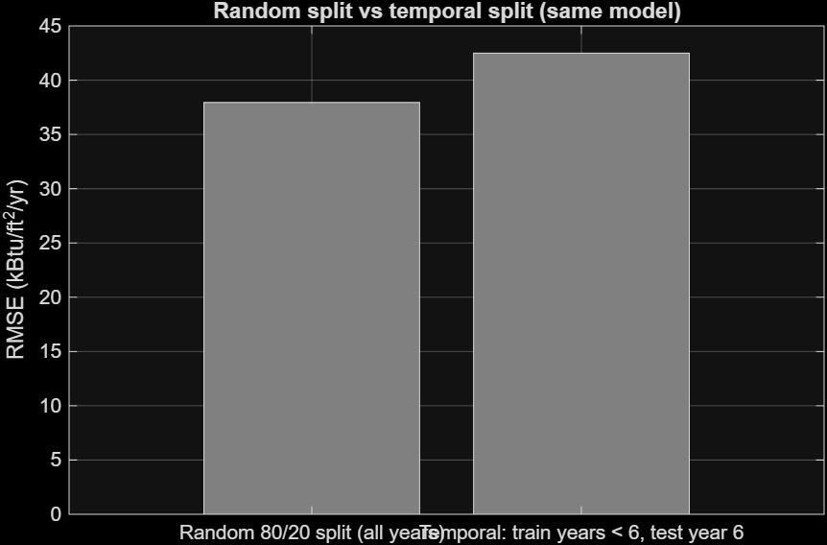
HONEST VALIDATION
Validate the way the task works: train on the past, predict an unseen year
Train: years 1–5
Validate: year 6 (test is year 7)
Same model, same features:
Random split 37.9
Temporal split 42.5
A random split flatters by ~12%: other years of the same building leak into training.
Notes:
(fig. 06, fig. 09) "We validate the way the task works: train on years 1–5, predict year 6, never seen. Same model, a random split would have told us RMSE 37.9; the honest temporal split says 42.5. Then we climbed a ladder of 10 models, each answering one question: - linear regression 46.2, a single tree 40.9: interactions matter; - adding building history brought buildings with a track record down to RMSE 20; - blending raw- and log-scale boosted trees gave our best model: RMSE 37.6, 34% better than the naive baseline, R² 0.57. One MATLAB-specific lesson: MATLAB trees without surrogate splits stop rows that are missing a split variable. Our first run barely learned from buildings without a rating. Encoding missing values explicitly took us from 46.8 to 37.6.

Slide 6
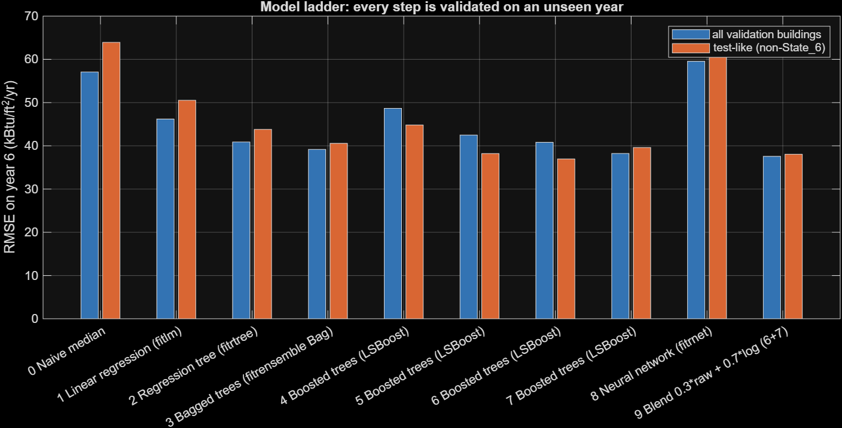
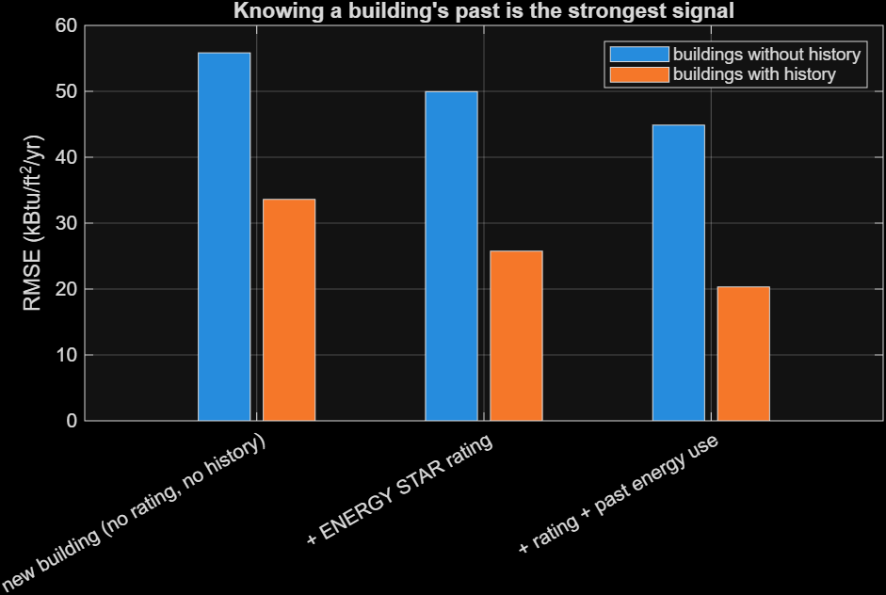
USE OF MACHINE LEARNING
10-model ladder: each rung answers one question
Best: blend of raw + log boosted trees
RMSE 37.6
−34% vs naive (57.1) · R² 0.57
Buildings with history: RMSE 20.3
Linear 46.2 → tree 40.9: interactions matter. + ENERGY STAR rating, + building history, raw/log blend.
Notes:
(fig. 06, fig. 09) "We validate the way the task works: train on years 1–5, predict year 6, never seen. Same model, a random split would have told us RMSE 37.9; the honest temporal split says 42.5. Then we climbed a ladder of 10 models, each answering one question: - linear regression 46.2, a single tree 40.9: interactions matter; - adding building history brought buildings with a track record down to RMSE 20; - blending raw- and log-scale boosted trees gave our best model: RMSE 37.6, 34% better than the naive baseline, R² 0.57. One MATLAB-specific lesson: MATLAB trees without surrogate splits stop rows that are missing a split variable. Our first run barely learned from buildings without a rating. Encoding missing values explicitly took us from 46.8 to 37.6.

Slide 7
WHAT WE LEARNED THE HARD WAY
How MATLAB trees treat missing values
Without surrogate splits, a row missing the split variable stops at that node.
ENERGY STAR rating (35% missing) and history (~60% missing) were our strongest features, so those buildings were barely learned.
Fix: encode missing as an out-of-range sentinel (src/treeInputs.m) and keep explicit missing flags.
blend RMSE
46.8 → 37.6
first full run → after the fix
Notes:
(fig. 06, fig. 09) "We validate the way the task works: train on years 1–5, predict year 6, never seen. Same model, a random split would have told us RMSE 37.9; the honest temporal split says 42.5. Then we climbed a ladder of 10 models, each answering one question: - linear regression 46.2, a single tree 40.9: interactions matter; - adding building history brought buildings with a track record down to RMSE 20; - blending raw- and log-scale boosted trees gave our best model: RMSE 37.6, 34% better than the naive baseline, R² 0.57. One MATLAB-specific lesson: MATLAB trees without surrogate splits stop rows that are missing a split variable. Our first run barely learned from buildings without a rating. Encoding missing values explicitly took us from 46.8 to 37.6.

Slide 8
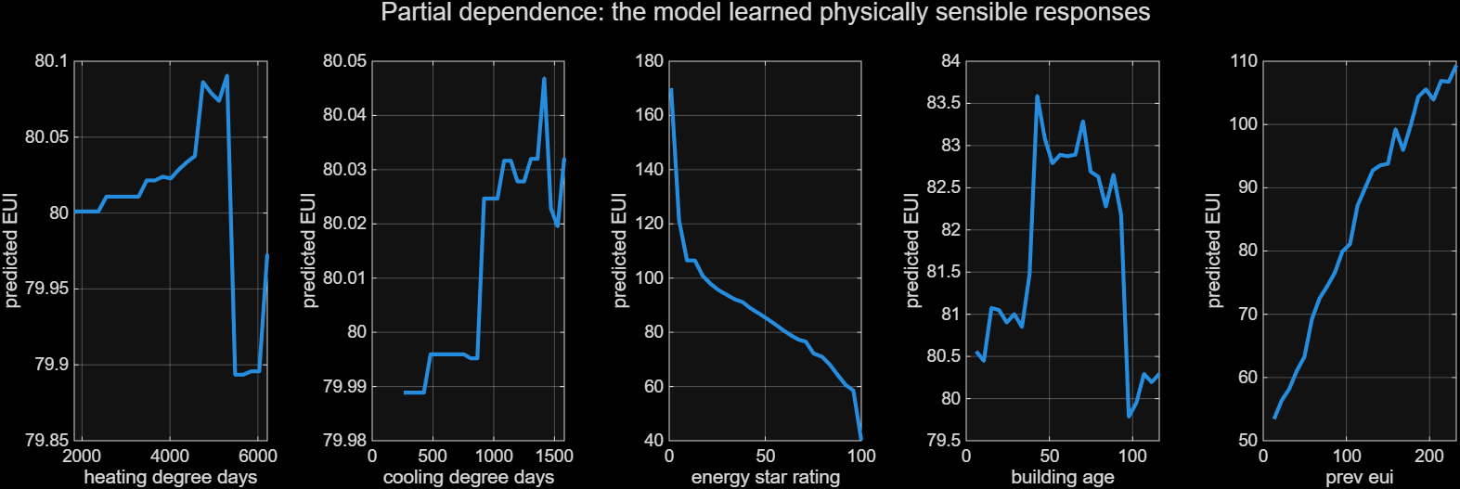
INTERPRETABILITY
What drives energy use
Higher ENERGY STAR score → lower EUI; past use predicts future use. Top drivers: facility type, ENERGY STAR rating, previous-year EUI, floor area.
Honest caveat: weather is recorded per state and year, so once the state is known the degree-day features add little.
Notes:
(fig. 11, fig. 12) "Partial dependence shows clean responses: a higher ENERGY STAR score means lower energy use, and past use predicts future use. Honest caveat: once the model knows the state, the degree-day features add little, because weather is recorded per state and year. Then we turn predictions into action. A cold-start model predicts what a typical building of the same type, size, age and climate *should* use. Buildings far above that are retrofit candidates: 1,123 buildings, 5% of the stock, using 1.55×10¹⁰ kBtu a year more than expected, 5.3% of all energy used. Ranked by absolute excess energy, so an organisation knows where a retrofit pays off most.

Slide 9
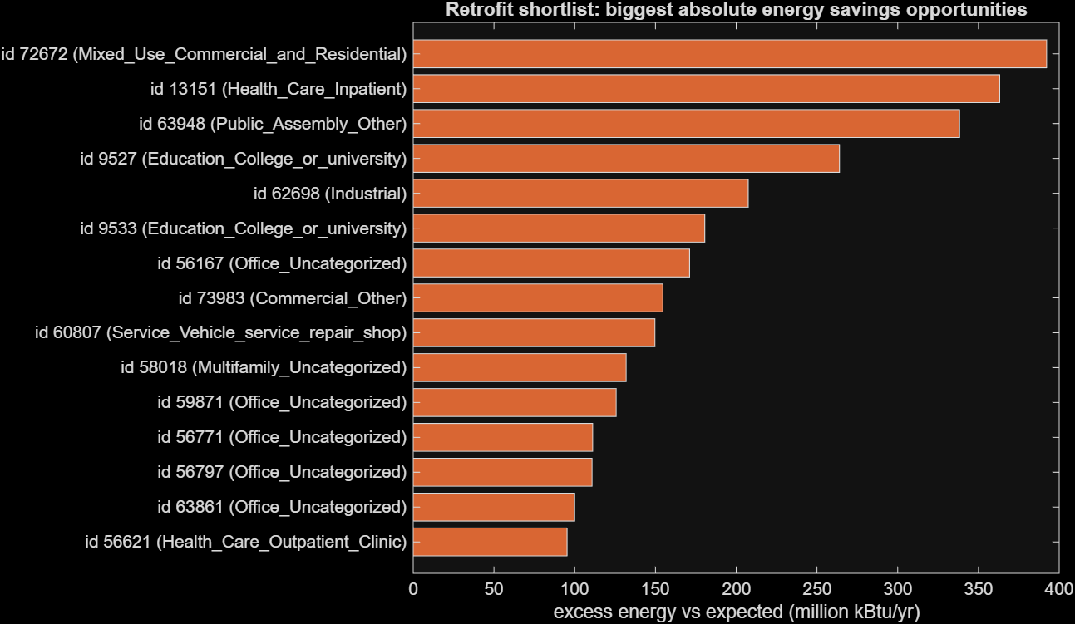
IMPACT
From prediction to action: the retrofit shortlist
A cold-start model predicts what a typical building of the same type, size, age and climate should use.
Candidates: top 5% excess within each facility type, ranked by excess EUI × floor area.
1,123 buildings
1.55 × 10¹⁰ kBtu/yr above expected
5.3% of all energy used, concentrated in ~5% of buildings
Notes:
(fig. 11, fig. 12) "Partial dependence shows clean responses: a higher ENERGY STAR score means lower energy use, and past use predicts future use. Honest caveat: once the model knows the state, the degree-day features add little, because weather is recorded per state and year. Then we turn predictions into action. A cold-start model predicts what a typical building of the same type, size, age and climate *should* use. Buildings far above that are retrofit candidates: 1,123 buildings, 5% of the stock, using 1.55×10¹⁰ kBtu a year more than expected, 5.3% of all energy used. Ranked by absolute excess energy, so an organisation knows where a retrofit pays off most.

Slide 10
ENGINEERING QUALITY
One command, reproducible, tested
>> main
Raw CSV → cleaning → features → 10-model ladder → validated submission + 12 figures
Modular functions in src/ with argument validation
matlab.unittest tests, including proof that history features are causal
Every number in the README is printed by MATLAB
Next steps
Monthly meter data and occupancy
Optimise which retrofits to fund under a budget
Per-building uncertainty
Thank you
github.com/JoshiiWahWah/ntu-matlab-hackathon-2026
Notes:
Everything runs with one command, `main`, from raw CSV to submission and figures. The code is modular functions with argument validation, unit tests in `matlab.unittest`, a validated submission file, and every number in our README is printed by MATLAB. Next steps: monthly meter data, occupancy, and optimising which retrofits to fund first. Thank you.

