Slide 1

Unit-4
Assembly Language Programming
Computer Organization & Architecture
(BE04000251)
Vrunda Dave
Assistant Professor
IT Department
V.V.P. Engineering College, Rajkot

Slide 2
Outline
Machine Language
Assembly Language
First Pass of Assembler
Second Pass of Assembler
Subroutines
I-O Programming

Slide 3
Machine Language

Slide 4
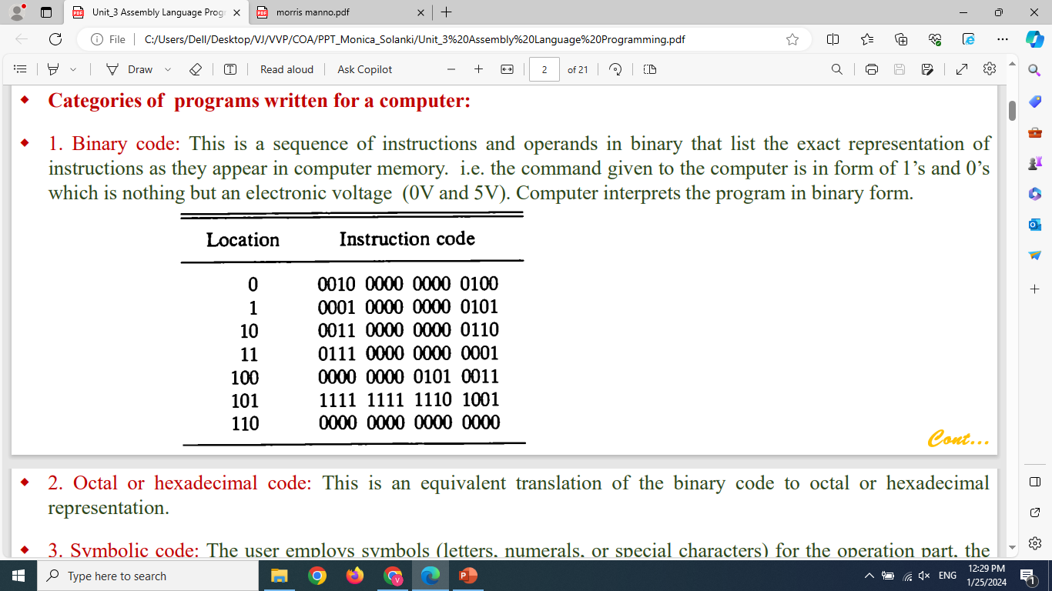
Machine Language
Program:
A program is a list of instructions or statements for directing the computer to perform a required data-processing task.
Programs written in any other language must be translated to the binary representation of instructions before they can be executed by the computer.
C Code → Compiler → Assembly → Assembler → Machine Code → Execution
Categories of programs written for a computer:
Binary code:
This is a sequence of instructions and operands in binary that list the exact representation of instructions as they appear in computer memory. i.e. the command given to the computer is in form of 1’s and 0’s which is nothing but an electronic voltage.
LDA
ADD

Slide 5
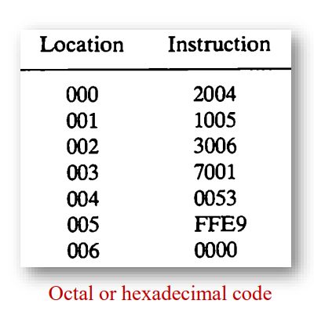

Machine Language
2. Octal or hexadecimal code:
This is an equivalent translation of the binary code to octal or hexadecimal representation.
3. Symbolic code:
The user employs symbols (letters, numerals, or special characters) for the operation part, the address part, and other parts of the instruction code.
Each symbolic instruction can be translated into one binary coded instruction. This translation is done by a special program called an assembler and the language is called as assembly language program.

Slide 6
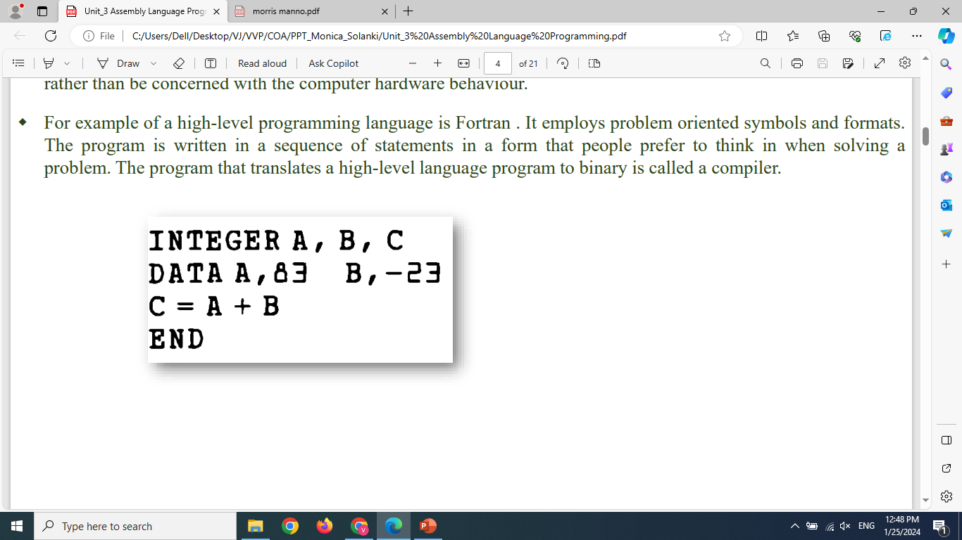
Machine Language
4. High-level programming languages:
It is developed to reflect the procedures used in the solution of a problem rather than be concerned with the computer hardware behaviour.
Example: a high-level programming language is Fortran(FORmula TRANslating-1957). It employs problem oriented symbols and formats. The program is written in a sequence of statements in a form that people prefer to think in when solving a problem.
The program that translates a high-level language program to binary is called a compiler.

Slide 7
Assembly Language

Slide 8
Assembly Language Programming
Assembly language is a low-level language that helps to communicate directly with computer hardware.
It uses mnemonics to represent the operations that a processor has to do. Which is an intermediate language between high-level languages like C++ and the binary language.
It uses hexadecimal and binary values, and it is readable by humans.
It enables the programmer to communicate directly with the hardware such as registers, memory locations, I/O devices or any other hardware components.
Assembly language is platform-dependent because it is closely tied to the specific architecture of the computer's processor. (Example: MUL instruction in 8086)
Each processor architecture has its own assembly language instructions. Therefore, code written in assembly language for one processor will not work on a different processor unless it supports the same instruction set.

Slide 9
Assembly Language
A programming language is defined by a set of rules.
Users must conform to all format rules of the language if they want their programs to be translated correctly.
Almost every commercial computer has its own particular assembly language.
The rules for writing assembly language programs are documented and published in manuals which are usually available from the computer manufacturer.
Rules of the Language :
Each line of an assembly language program is arranged in three columns called fields.
The fields specify the following information:
1. The label field may be empty or it may specify a symbolic address.
2. The instruction field specifies a machine instruction or a pseudo instruction.
3. The comment field may be empty or it may include a comment.

Slide 10
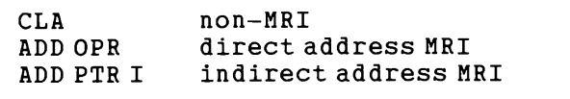
Assembly Language
Assembler: It is a program that accepts a symbolic language program and produces its binary machine language equivalent.
The instruction field in an assembly language program may specify one of the following items:
1. A memory-reference instruction (MRI)
2. A register-reference or input-output instruction (non-MRI)
3. A pseudo instruction with or without an operand
Memory-reference instruction(MRI):
It occupies two or three symbols separated by spaces.
The first must be a three-letter symbol defining an MRI OPCODE.
The second is a symbolic address.
The third symbol, which may or may not be present, is the letter I. If I is missing, the line denotes a direct address instruction. The presence of the symbol I denotes an indirect address instruction.

Slide 11
Assembly Language
Register-reference or input-output instruction (non-MRI):
A non-MRI is defined as an instruction that does not have an address part.
It is recognized in the instruction field of a program by any one of the three-letter symbols for the register-reference and input-output instructions.

Slide 12
Assembly Language
Pseudo instruction:
It is not a machine instruction but rather an instruction to the assembler that helps in the translation process.
They are used to simplify the process of writing and reading assembly language code.
Pseudo Instructions are special commands to the assembler about the positioning of the program.
The pseudo instructions varied from version to version of the assembler.
It is an instruction to the assembler that does not generate any machine code.
It gives basic information about the assembler to the programmer.

Slide 13
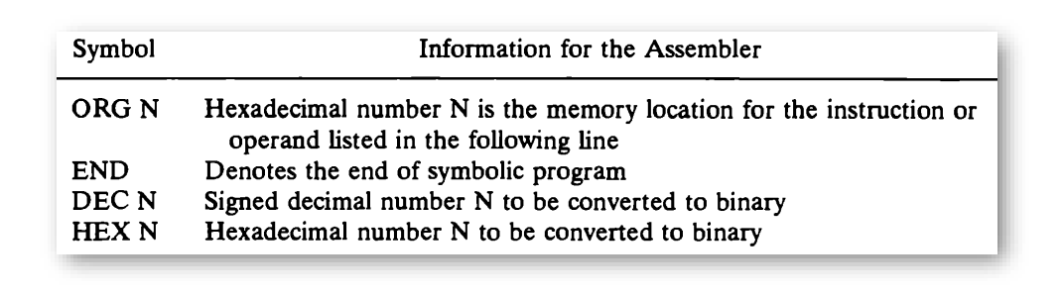
Pseudo instruction
The ORG (origin) pseudo instruction informs the assembler that the instruction or operand in the following line is to be placed in a memory location specified by the number next to ORG.
The END symbol is placed at the end of the program to inform the assembler that the program is terminated.
The other two pseudo instructions specify the radix of the operand and tell the assembler how to convert the listed number to a binary number.

Slide 14
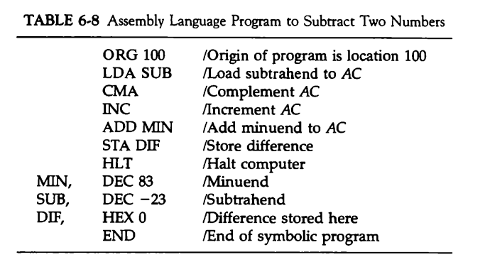
Assembly Language Program to Subtract Two Numbers
The first line has the pseudo instruction ORG to define the origin of the program at memory location (100)₁₆.
The next six lines define machine instructions, and the last four have pseudo instructions.
Three symbolic addresses have been used and each is listed in column 1 as a label.
When the program is translated into binary code and executed by the computer it will perform a subtraction between two numbers.

Slide 15
Assembly Language Program to Subtract Two Numbers
The subtraction is performed by adding the minuend to the 2's complement of the subtrahend.
The subtrahend is a negative number. It is converted into a binary number in signed-2's complement representation because we dictate that all negative numbers be in their 2's complement form.
When the 2's complement of the subtrahend is taken (by complementing and incrementing the AC), - 23 converts to + 23 and the difference is 83 + (2's complement of -23) = 83 + 23 = 106.

Slide 16
Assembly Language Program to Subtract Two Numbers
Here, To store -23, we take 2’s complement of +23(00010111 ):
Step A: 1’s complement 00010111 → 11101000
Step B: Add 1 11101000 + 1 = 11101001
So, -23 = 11101001
Operation | Binary | Meaning
Initial (SUB) | 11101001 | -23
After CMA | 00010110 | 1’s complement
After INC | 00010111 | +23

Slide 17
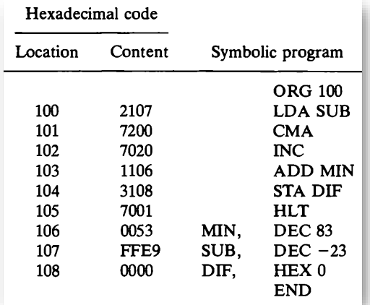
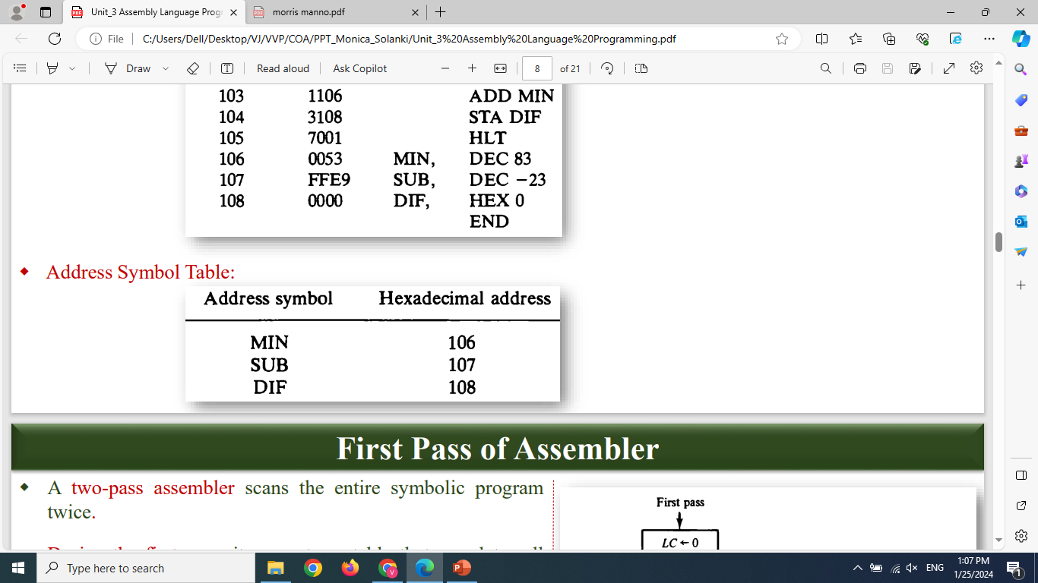
Translation to Binary
The translation of the symbolic program into binary is done by a special program called an assembler.
We scan the entire symbolic program twice.
No translation is done during first scan. We assign a memory location to each machine instruction and operand.
At the end of first scan, we associate with each label its location number and form a table that defines the HEX value of each symbolic address.
Address Symbol Table:
Hex equivalent of 83
Hex equivalent of -23

Slide 18
Translation to Binary
During the second phase, we refer to the address symbol table to determine the address value of a memory reference instruction.
Example: LDA SUB is translated during the second scan by getting the HEX value of LDA and the HEX value of SUB from address symbol table.
We then assemble the two parts into a four digit HEX instruction.
Address Symbol Table:
Hex equivalent of 83
Hex equivalent of -23

Slide 19
First Pass of Assembler

Slide 20
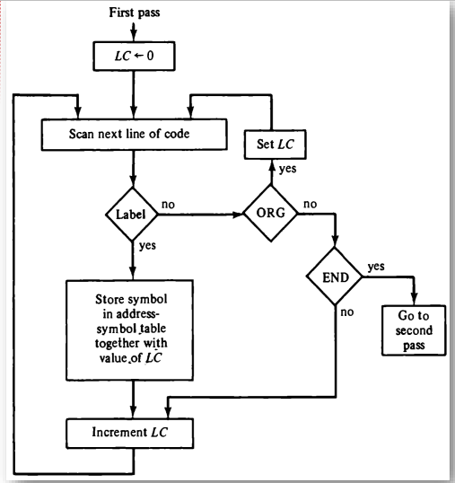
First Pass of Assembler
A two-pass assembler scans the entire symbolic program twice.
During the first pass, it generates a table that correlates all user-defined address symbols with their binary equivalent value and with its location. The binary translation is done during the second pass.
To keep track of the location of instructions, the assembler uses a memory location counter (LC) word called a location counter. (Which instruction is currently being translated to binary)
The content of LC stores the value of the memory location assigned to the instruction or operand presently being processed.

Slide 21
The ORG pseudo instruction initializes the location counter to the value of the first location. Since instructions are stored in sequential locations, the content of LC is incremented by 1 after processing each line of code. In case if ORG is missing, the assembler sets the location counter to 0 initially.
LC is initially set to 0. A line of symbolic code is analyzed to determine if it has a label (by the presence of a comma).
If the line of code has no label, the assembler checks the symbol in the instruction field.
If it contains an ORG pseudo instruction, the assembler sets LC to the number that follows ORG and goes back to process the next line.

Slide 22
If the line has an END pseudo instruction, the assembler terminates the first pass and goes to the second pass. (Note that a line with ORG or END should not have a label.)
If the line of code contains a label, it is stored in the address symbol table together with its binary equivalent number specified by the content of LC.
Nothing is stored in the table if no label is encountered.
LC is then incremented by 1 and a new line of code is processed.

Slide 23
109
Address Symbol Table
Symbol | HEX Address | Binary Equivalent
MIN | 106 | 0000 0001 0000 0110
SUB | 107 | 0000 0001 0000 0111
DIF | 108 | 0000 0001 0000 1000

Slide 24
Second Pass of Assembler

Slide 25
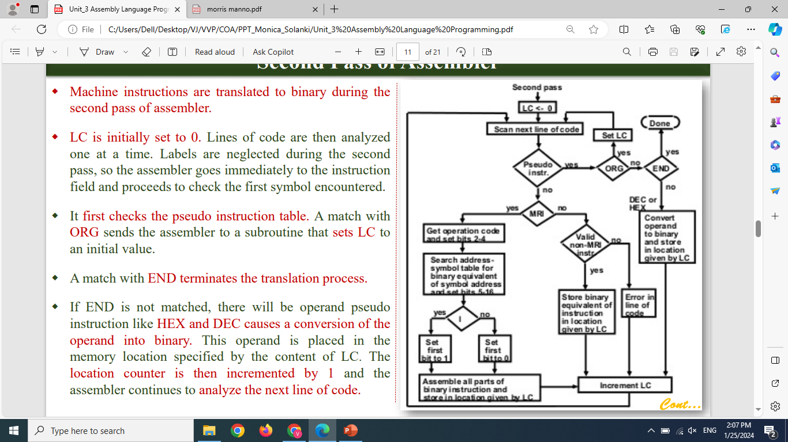
Second Pass of Assembler
Machine instructions are translated to binary during the second pass of assembler.
LC is initially set to 0. Lines of code are then analyzed one at a time. Labels are neglected during the second pass, so the assembler goes immediately to the instruction field and proceeds to check the first symbol encountered.
It first checks the pseudo instruction table. A match with ORG sends the assembler to a subroutine that sets LC to an initial value.
A match with END terminates the translation process.

Slide 26
If END is not matched, there will be operand pseudo instruction like HEX and DEC causes a conversion of the operand into binary. This operand is placed in the memory location specified by the content of LC. The location counter is then incremented by 1 and the assembler continues to analyze the next line of code.
But if the symbol encountered is not a pseudo instruction, the assembler refers to the MRI table corresponds to memory reference instruction.
If the symbol is not found in this table, the assembler refers to the non-MRI table. A symbol found in the non-MRI table corresponds to a register reference or input-output instruction.

Slide 27
The assembler stores the 16-bit instruction code into the memory word specified by LC. The location counter is incremented and a new line analyzed.
When a symbol is found in the MRI table, the assembler extracts its equivalent 3-bit code and inserts it in bits 2 through 4 of a word.
A memory reference instruction is specified by two or three symbols. The second symbol is a symbolic address and the third, which may or may not be present, is the letter I. The symbolic address is converted to binary by searching the address symbol table. The first bit of the instruction is set to 0 or 1, depending on whether the letter I is absent or present.

Slide 28
The three parts of the binary instruction code are assembled and then stored in the memory location specified by the content of LC.
The location counter is incremented and the assembler continues to process the next line.
One important task of an assembler is to check for possible errors in the symbolic program. This is called error diagnostics. It is an invalid machine code symbol which is detected if it is not the MRI and non-MRI tables.

Slide 29
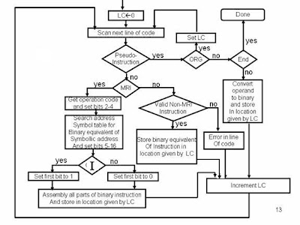
Address Symbol Table
Symbol | HEX Address | Binary Equivalent
MIN | 106 | 0000 0001 0000 0110
SUB | 107 | 0000 0001 0000 0111
DIF | 108 | 0000 0001 0000 1000

Slide 30
Location Counter | Binary Equivalent |  |  |  | HEX Equivalent | HEX Code
100 | 0010 | 0001 | 0000 | 0111 | 2107 | LDA SUB
101 | 0111 | 0010 | 0000 | 0000 | 7200 | CMA
102 | 0111 | 0000 | 0010 | 0000 | 7020 | INC
103 | 0001 | 0001 | 0000 | 0110 | 1106 | ADD MIN
104 | 0011 | 0001 | 0000 | 1000 | 3108 | STA DIF
105 | 0111 | 0000 | 0000 | 0001 | 7001 | HLT
106 | 0000 | 0000 | 0101 | 0011 | 0053 | DEC 83
107 | 1111 | 1111 | 1110 | 1001 | FFE9 | DEC -23
108 | 0000 | 0000 | 0000 | 0000 | 0000 | HEX 0

Slide 31
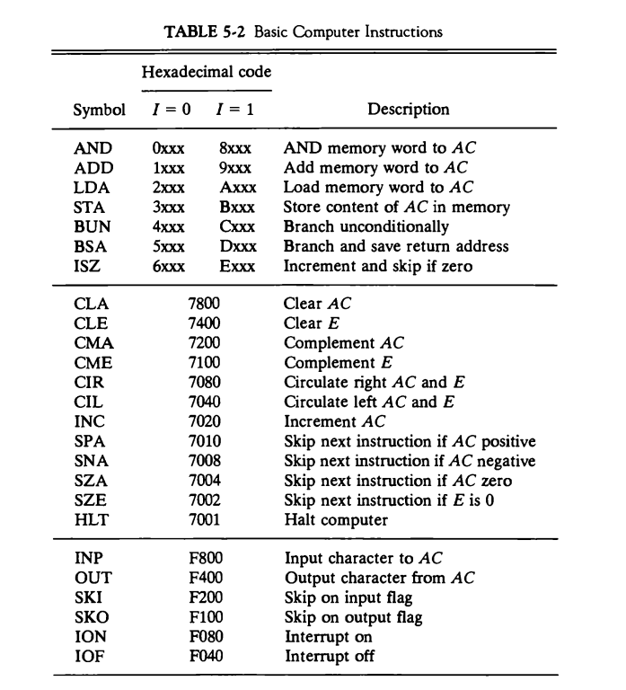
For reference only

Slide 32
Program Loops

Slide 33
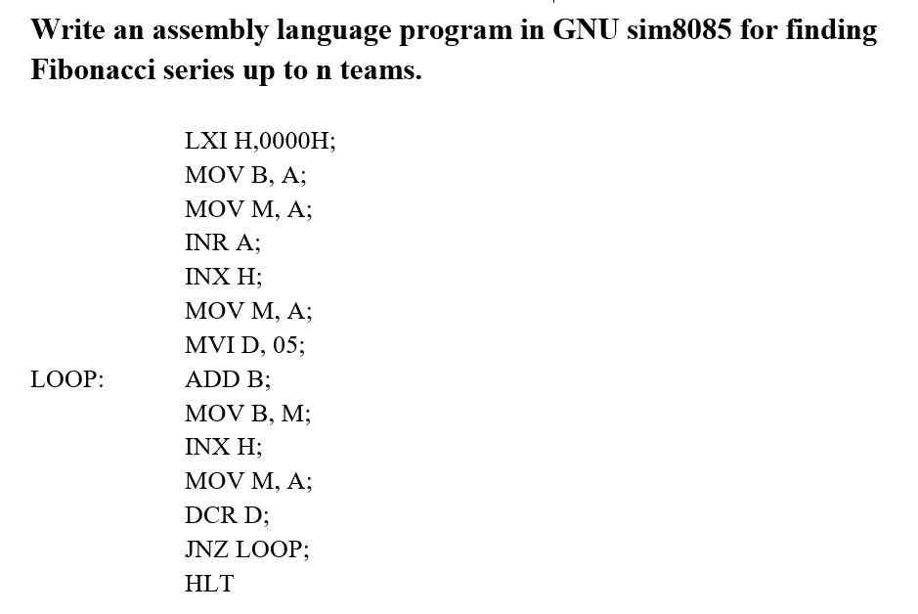
Program Loops
A program loop is a sequence of instructions that are executed many times, each time with a different set of data.

Slide 34
Subroutine

Slide 35
Subroutine
A set of common instructions that can be used in a program many times is called a subroutine.
Each time that a subroutine is used in the main part of the program, a branch is executed to the beginning of the subroutine.
After the subroutine has been executed, a branch is made back to the main program.
A subroutine consists of a self-contained sequence of instructions that carries out a given task.
A branch can be made to the subroutine from any part of the main program.
Now how the subroutine knows which location to return to, since many different locations in the main program may make branches to the same subroutine.
It is therefore necessary to store the return address somewhere in the computer for the subroutine to know where to return.
The link between the main program and a subroutine is the BSA instruction (branch and save return address).

Slide 36
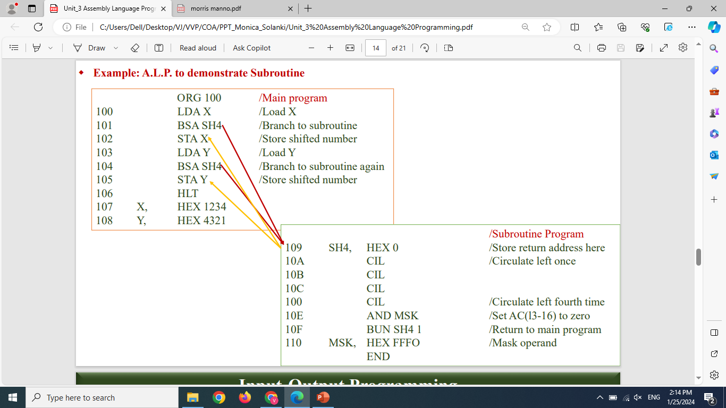
Subroutine (Example)
Example: A.L.P. to perform shift left operation four times.

Slide 37
Subroutine vs Program Loop
A program loop simply instructs the control unit to repeat a series of program statements a specified number of times.
A subroutine is a separate program called by another program. It is a sequence of program instructions that perform a specific task.

Slide 38
I-O Programming

Slide 39
Input-Output Programming
Users of the computer write programs with symbols that are defined by the programming language employed.
The symbols are strings of characters and each character is assigned an 8-bit code so that it can be stored in computer memory.
A binary-coded character enters the computer when an INP (input) instruction is executed. A binary-coded character is transferred to the output device when an OUT (output) instruction is executed.
The output device detects the binary code and types the corresponding character.

Slide 40
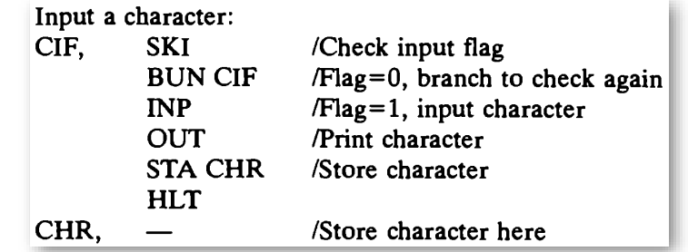
Input-Output Programming
Example: A.L.P. to input one character
To input a character, a binary-coded character enters the computer when an INP (input) instruction is executed.
The SKI instruction checks the input flag to see if a character is available for transfer. The next instruction is skipped if the input flag bit is 1. The INP instruction then transfers the binary-coded character into AC(0-7). The character is then printed by means of the OUT instruction.
But if the SKI instruction finds the flag bit at 0, the next instruction in sequence is executed. This instruction is a branch to return and check the flag bit again.

Slide 41
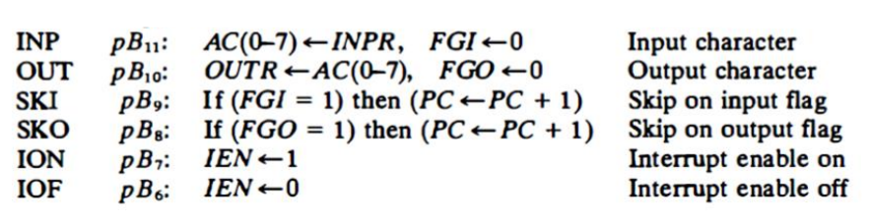
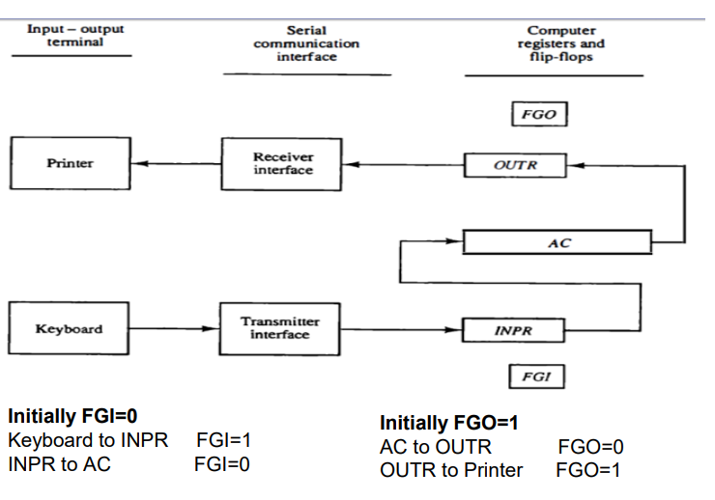
For reference only

Slide 42
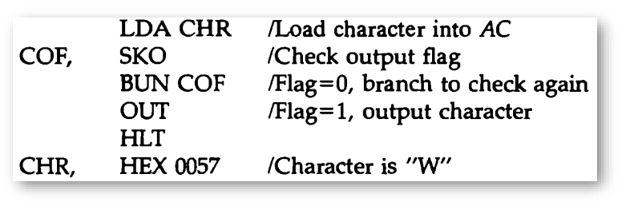
Input-Output Programming
Example: A.L.P. to output one character
To print a character initially stored in memory. The character is first loaded into the AC .
The output flag is then checked. If it is 0, the computer remains in a two-instruction loop checking the flag bit again.
A binary-coded character is transferred to the output device when an OUT (output) instruction is executed.
The output device detects the binary code and types the corresponding character. When the output flag changes to 1, the character is transferred from the accumulator to the printer.

Slide 43
GTU Questions
Q.1 Write an assembly language program to find the Fibonacci series up to the given number.
Q.2 Write an assembly language program to find average of 15 numbers stored at consecutive location in memory.
Q.3 What is assembler? Draw the flowchart of second pass of the assembler.
Q.4 Draw and explain flowchart for first pass of assembler. (6 times)
Q.5 Write assembly level program to subtract two given numbers.
Q.6 Write assembly language program to add two numbers.
Q.7 Write assembly language program to multiply two numbers. OR Write a program in assembly language to multiply two numbers in registers B and C in case the processor has only ADD instruction.
Q.8 Differentiate assembly language and machine language.
Q.9 Write an assembly language program to find whether the given number is prime or not.
Q.10 Write an assembly language program to find factorial of the given number.
Q.11 Write an Assembly level program for addition of 50 numbers. OR Write an assembly language program to add 50 numbers using a loop.

Slide 44
GTU Questions
Q.12 Write an Assembly level program to move one block of data to another location.
Q.13 Write assembly program for the arithmetic shift-left operation on a number stored in register B. Stop the program in case of overflow.

Slide 45
Q.8 Differentiate assembly language and machine language.
Machine Language | Assembly Language
Machine language is only understand by the computers. | Assembly language is only understand by human beings not by the computers.
In machine language data only represented with the help of binary format(0s and 1s), hexadecimal and octal. | In assembly language data can be represented with the help of mnemonics such as Mov, Add, Sub, End etc.
Machine language is very difficult to understand by the human beings. | Assembly language is easy to understand by the human being as compare to machine language.
Modifications and error fixing cannot be done in machine language. | Modifications and error fixing can be done in assembly language.
Execution is fast in machine language because all data is already present in binary format. | Execution is slow as compared to machine language.
There is no need of translator. The machine understandable form is the machine language. | Assembler is used as translator to convert mnemonics into machine understandable form.

Slide 46
Thanking You

