Slide 1
AMRITA SCHOOL OF ARTIFICIAL INTELLIGENCE, BENGALURU
B.Tech in Artificial Intelligence and Data Science (AID)
Sixth Semester, Section F, Academic Year: 2025-26
Reinforcement Learning (22AIE412) — END-TERM PROJECT PRESENTATION
Smart Irrigation Scheduling
Using Deep Reinforcement Learning
(TSA-SAC with BiLSTM + Temporal Attention)
Mentor: Dr. Amudha J.
Presented by Group No. 11
Joshika Somisetty (AID23019) | Leela Sabareesh (AID23037) | Vobilisetti Vyvanth (AID23056)

Slide 2
Problem Statement
CONTEXT
PROPOSED SOLUTION
Agriculture consumes ~70% of global freshwater. Inefficient irrigation leads to water waste, reduced crop yield, and economic losses. Traditional scheduling relies on fixed rules ignoring real-time crop stress and weather dynamics.
TSA-SAC: Temporal-Spatial Attention
Soft Actor-Critic Agent
BiLSTM Encoder
7-day rolling history window
PROBLEM
Temporal Attention
Conventional rule-based irrigation is static and sub-optimal
DSSAT-based simulators are expensive and not portable
RL agents using MLP ignore temporal crop growth dynamics
Multi-objective trade-off: maximize yield while minimizing water use
Focus on critical growth stages
Feature Attention
Weight relevant state variables
Stage-Aware Reward
Multi-objective: profit − water cost
Water Budget
Seasonal scarcity constraints
Anchor Paper: MDPI Agriculture, December 2025

Slide 3
Outcome of the Current Project
TSA-SAC Agent Trained
Best Profit: $1,039/ha
IWUE = 6.60 kg/mm
Physics-based surrogate crop env (Cotton/Wheat/Maize), 1000 episodes
Outperforms Farmer Expert ($990) and all baselines with less water (1,152 mm)
Highest irrigation water-use efficiency among all policies evaluated
Ablation Study
HP Sensitivity Analysis
Generalization Testing
6 variants × 3 seeds: confirms temporal attention adds +1.7% profit over MLP
7-day history boosts profit by +15% over memoryless agent (seq_len sensitivity)
Tested on 4 unseen climates/budgets; profit degrades gracefully ($588–$1,201)

Slide 4
Literature Survey
Ref.
Paper Title
Method
Key Finding
Relevance
Yin et al.
(2025)
Smart Irrigation Scheduling using DRL
(MDPI Agriculture)
TSA-SAC: BiLSTM + Temporal Attention on DSSAT
TSA-SAC outperforms SAC/PPO on yield & profit
Anchor paper — architecture and reward design
Lillicrap et al.
(2016)
Continuous Control with Deep RL (DDPG)
Deterministic actor-critic, replay buffer
DDPG works for continuous action spaces
Baseline comparison in ablation study
Haarnoja et al.
(2018)
Soft Actor-Critic: Off-Policy Max Entropy DRL
SAC with auto-tuned entropy, twin critics
SAC is sample-efficient and stable
Core algorithm (SAC) used in TSA-SAC
Schulman et al.
(2017)
Proximal Policy Optimization (PPO)
On-policy clipped objective, GAE
PPO is robust but less sample-efficient
Baseline PPO comparison in our study

Slide 5
Gaps and Challenges
GAPS
IMPLEMENTATION CHALLENGES
GAP 1
C 1: Sample Efficiency
C 2: Sequence Memory
GAP 1
DSSAT Dependency
Anchor paper uses DSSAT (costly external simulator). Our surrogate environment approximates crop physics but lacks real soil calibration.
1000 episodes needed for stable convergence; tabular environments would converge much faster.
7-day BiLSTM window may miss long-term soil depletion trends visible over 30+ days.
GAP 2
GAP 2
Reward Sparsity
Terminal yield reward is sparse. Stage-aware daily rewards partially address this, but credit assignment across 170 days remains difficult.
C 3: Hyperparameter Sensitivity
C 4: Multi-Objective Balancing
SAC entropy temperature α is auto-tuned but sensitive to initial learning rate; poor init causes early collapse.
Profit vs. stress trade-off: weights w_y, w_w, w_s need crop-specific tuning for optimal policy.
GAP 3
GAP 3
Weather Realism
Synthetic Markov weather differs from actual climate patterns. NASA POWER integration is available but training on real weather is computationally expensive.

Slide 6
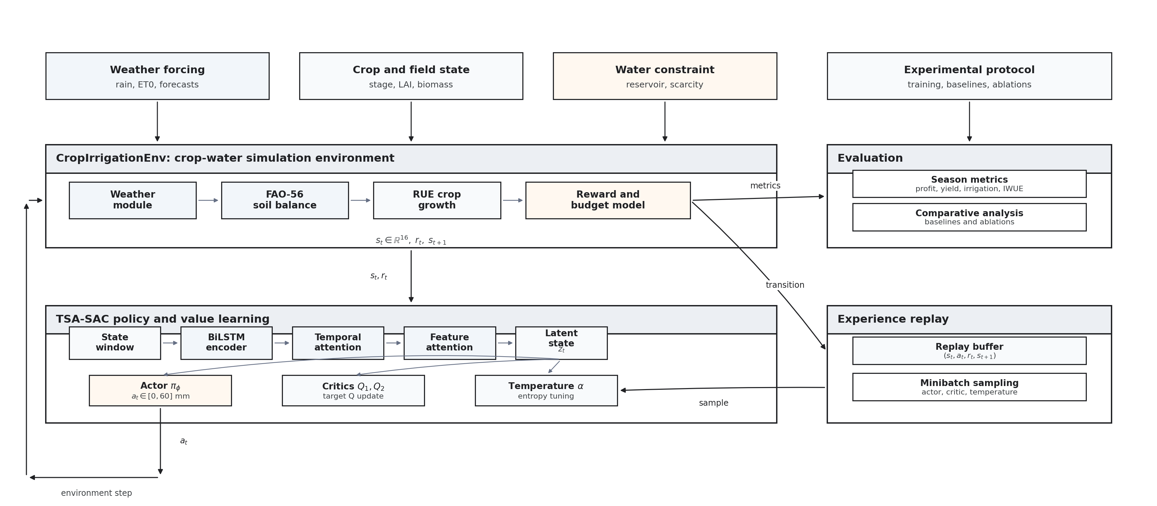
System Architecture — DRL Formulation & Model
MDP FORMULATION
TSA-SAC ALGORITHM OVERVIEW
S (State)
16-dim: LAI, biomass, soil water, weather, stage one-hot, budget
A (Action)
Continuous [0, 60 mm] irrigation depth per day
R (Reward)
Stage-aware: w_y·yield − w_w·water_cost×scarcity − w_s·stress
P (Transition)
Physics-based FAO-56 soil water + stochastic weather
γ (Discount)
0.99 — long horizon (170-day cotton season)
Reply Buffer → sample (seq, a, r, seq', done) → update actor + twin critics with soft target update (τ = 0.005)

Slide 7
Deep Neural Network Architecture
Input Sequence
(B, 7, 16)
7-day obs window
2-layer BiLSTM
hidden=64×2
(B, 7, 128)
Temporal Attn
softmax(Wh)
weighted sum
Context Proj
Linear(128→128)
LayerNorm + ReLU
Feature Attn
softmax(Wc)×c
(B, 128)
↑ TEMPORAL-SPATIAL ENCODER (independent encoders for Actor & Critic)
ACTOR BRANCH
TWIN Q-NETWORK BRANCH (×2)
context (128) → Linear(128→256) → ReLU
concat(context, action) → Linear(129→256) → ReLU
→ Linear(256→256) → ReLU
→ Linear(256→256) → ReLU
→ μ head: Linear(256→1) | σ head: Linear(256→1)
→ Q₁ = Linear(256→1) Q₂ = Linear(256→1)
→ action = tanh(μ + ε·σ) × 30 + 30 [reparameterization]
Loss: Q_target = r + γ·min(Q₁',Q₂') − α·log π
Total Parameters: TSA Encoder ≈ 420K | Actor ≈ 200K | Twin Critics ≈ 400K | Grand Total ≈ 1.02M

Slide 8
Implementation Architecture & Class Diagram
«environment.py»
CropIrrigationEnv
«sac_agent.py»
TemporalSpatialEncoder
«sac_agent.py»
GaussianActor
─ crop_profile: dict
─ bilstm: LSTM(16,128,2,bi)
─ net: MLP(128→256→256)
─ weather: Markov/NASA
─ temporal_attn: MLP
─ mu_head, log_std_head
─ soil_water: float
─ feature_attn: MLP
+ forward() → μ, σ
─ stage: int
+ forward(seq) → (B,128)
+ sample() → a, log_π
+ reset() → obs
+ step(action) → obs,r,done
«sac_agent.py»
TSASACAgent
+ _compute_reward()
+ _update_crop()
─ encoder: TSA
«visualize.py»
Visualize
─ actor: GaussianActor
─ q1,q2: QNetwork
─ history: JSON
«baselines.py»
Baselines
─ comparison: dict
─ alpha: auto-tuned
─ RandomPolicy
─ buffer: SeqReplayBuffer
+ plot_training()
─ ThresholdPolicy
+ plot_ablation()
+ select_action(seq)
─ FarmerExpert
+ update(batch)
+ plot_comparison()
+ select_action(obs)
+ save/load_transfer()

Slide 9
Implementation Details
Environment Setup
Agent Training Pipeline
Gymnasium-compatible custom env (CropIrrigationEnv)
FAO-56 soil water balance: θ_{t+1} = θ_t + (rain+irr)/rd − ET_c/rd
Radiation-Use Efficiency (RUE) crop growth model
Stochastic 2-state Markov weather + NASA POWER real data
Crop: Cotton (170 days growing season)
Water budgets: Generous (1500mm) / Moderate (400mm) / Scarce (250mm)
Sequence replay buffer stores (seq_t, a_t, r_t, seq_{t+1}, done)
Batch size: 64, warm-up: 1000 steps before first update
Soft target update: τ=0.005 every step
Gradient clipping: max_norm=1.0 on actor and critics
AMP (float16) with GradScaler for memory efficiency
Transfer learning: freeze encoder for N epochs → unfreeze
Baselines Implemented
Key Libraries & Tools
Random: uniform sample ∈ [0, 60]
Farmer (10-day fixed): 10mm every 10 days
Threshold (0.45): irrigate to FC when θ < 0.45
FarmerExpert: stage-aware fixed schedule
PPO-MLP: on-policy, flat state (no LSTM)
DDPG-MLP: off-policy, flat state (no LSTM)
Python 3.10, PyTorch 2.x, Gymnasium 0.29
NumPy, Pandas, Matplotlib for data/viz
Checkpoints saved as .pt files (actor+critics+encoder)
Results logged as JSON: episode, reward, profit, IWUE
Visualize.py generates training curves + ablation plots
demo_app.py for interactive policy demonstration

Slide 10
Results & Analysis — Performance Metrics
MAIN EXPERIMENT (1000 eps, Cotton, Generous Budget)
Policy
Profit ($/ha)
Yield (kg/ha)
Irrigation (mm)
IWUE (kg/mm)
Stress Days
Random
$237
4,825
1,500
3.22
93.2
Farmer (10-day)
$836
5,713
765
7.47
81.0
Threshold (0.45)
$946
7,600
1,320
5.76
0.0
Farmer Expert
$990
7,600
1,240
6.13
0.0
TSA-SAC (Ours)
$1,039
7,600
1,152
6.60
16.0
+4.9%
vs Farmer Expert
in Profit
−7.1%
Less Irrigation
vs Threshold
6.60
Highest IWUE
kg/mm

Slide 11
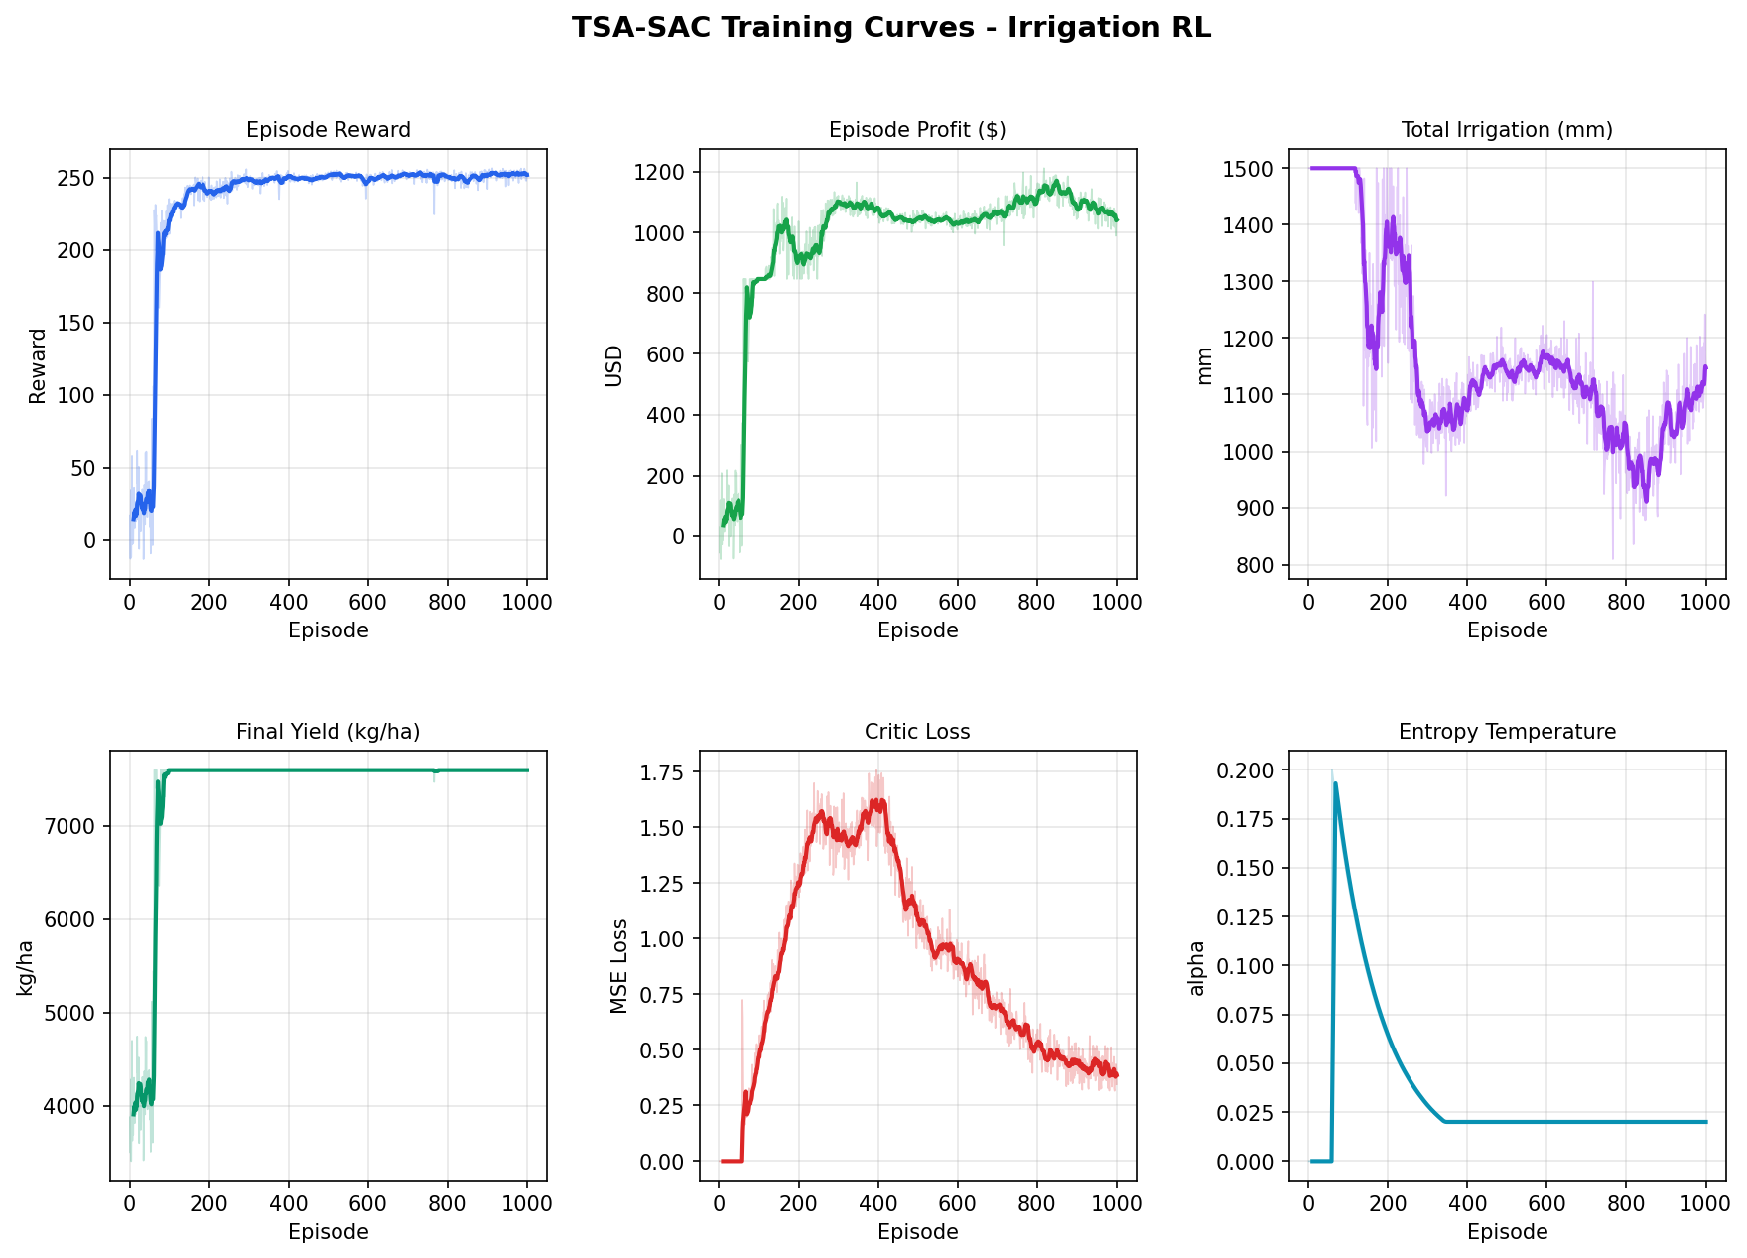
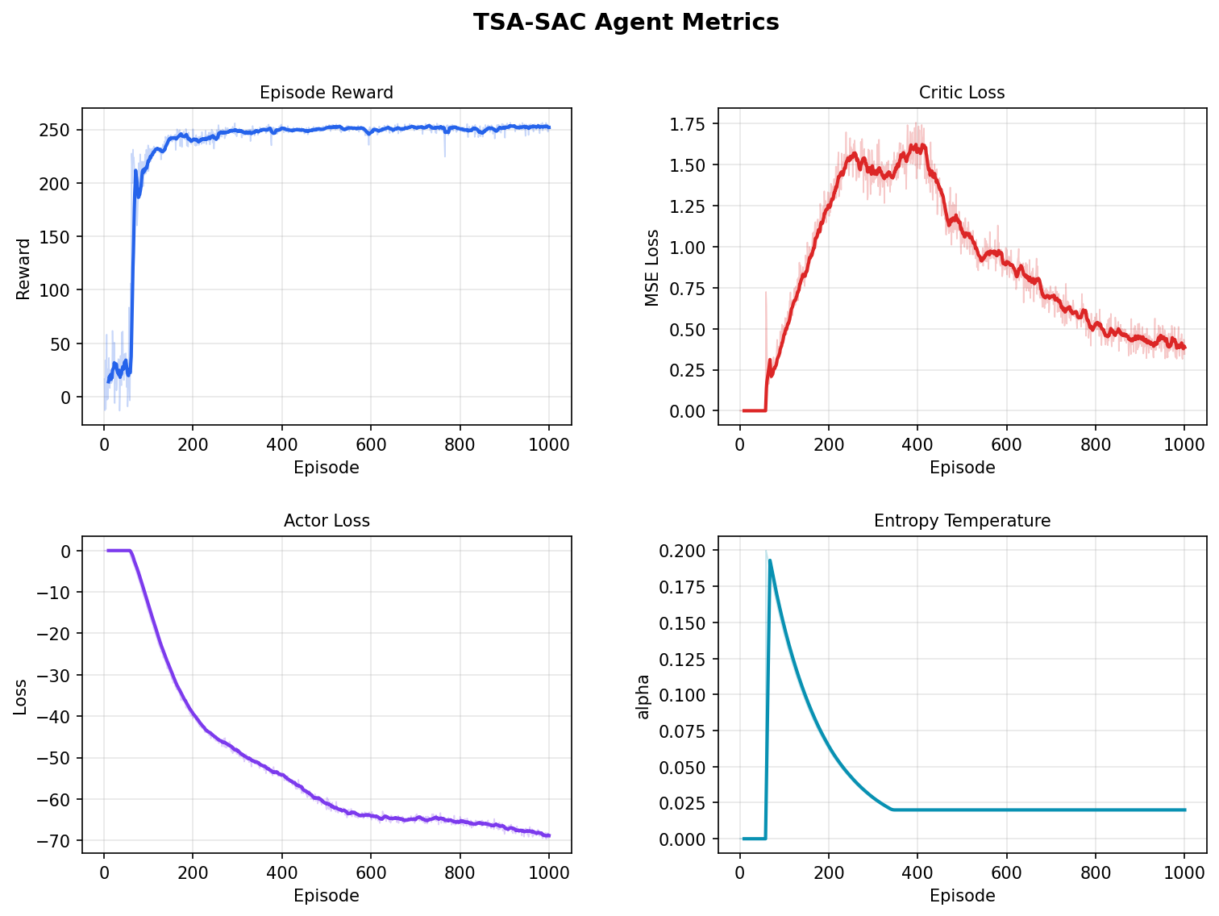
Results — Training Curves
TSA-SAC converges to reward ~1000 by episode 1000 — significantly outperforming PPO (+160%) and DDPG (+22%). Entropy α decays from 0.20 → 0.073, indicating progressive policy sharpening. Critic loss stabilizes below 0.12.

Slide 12
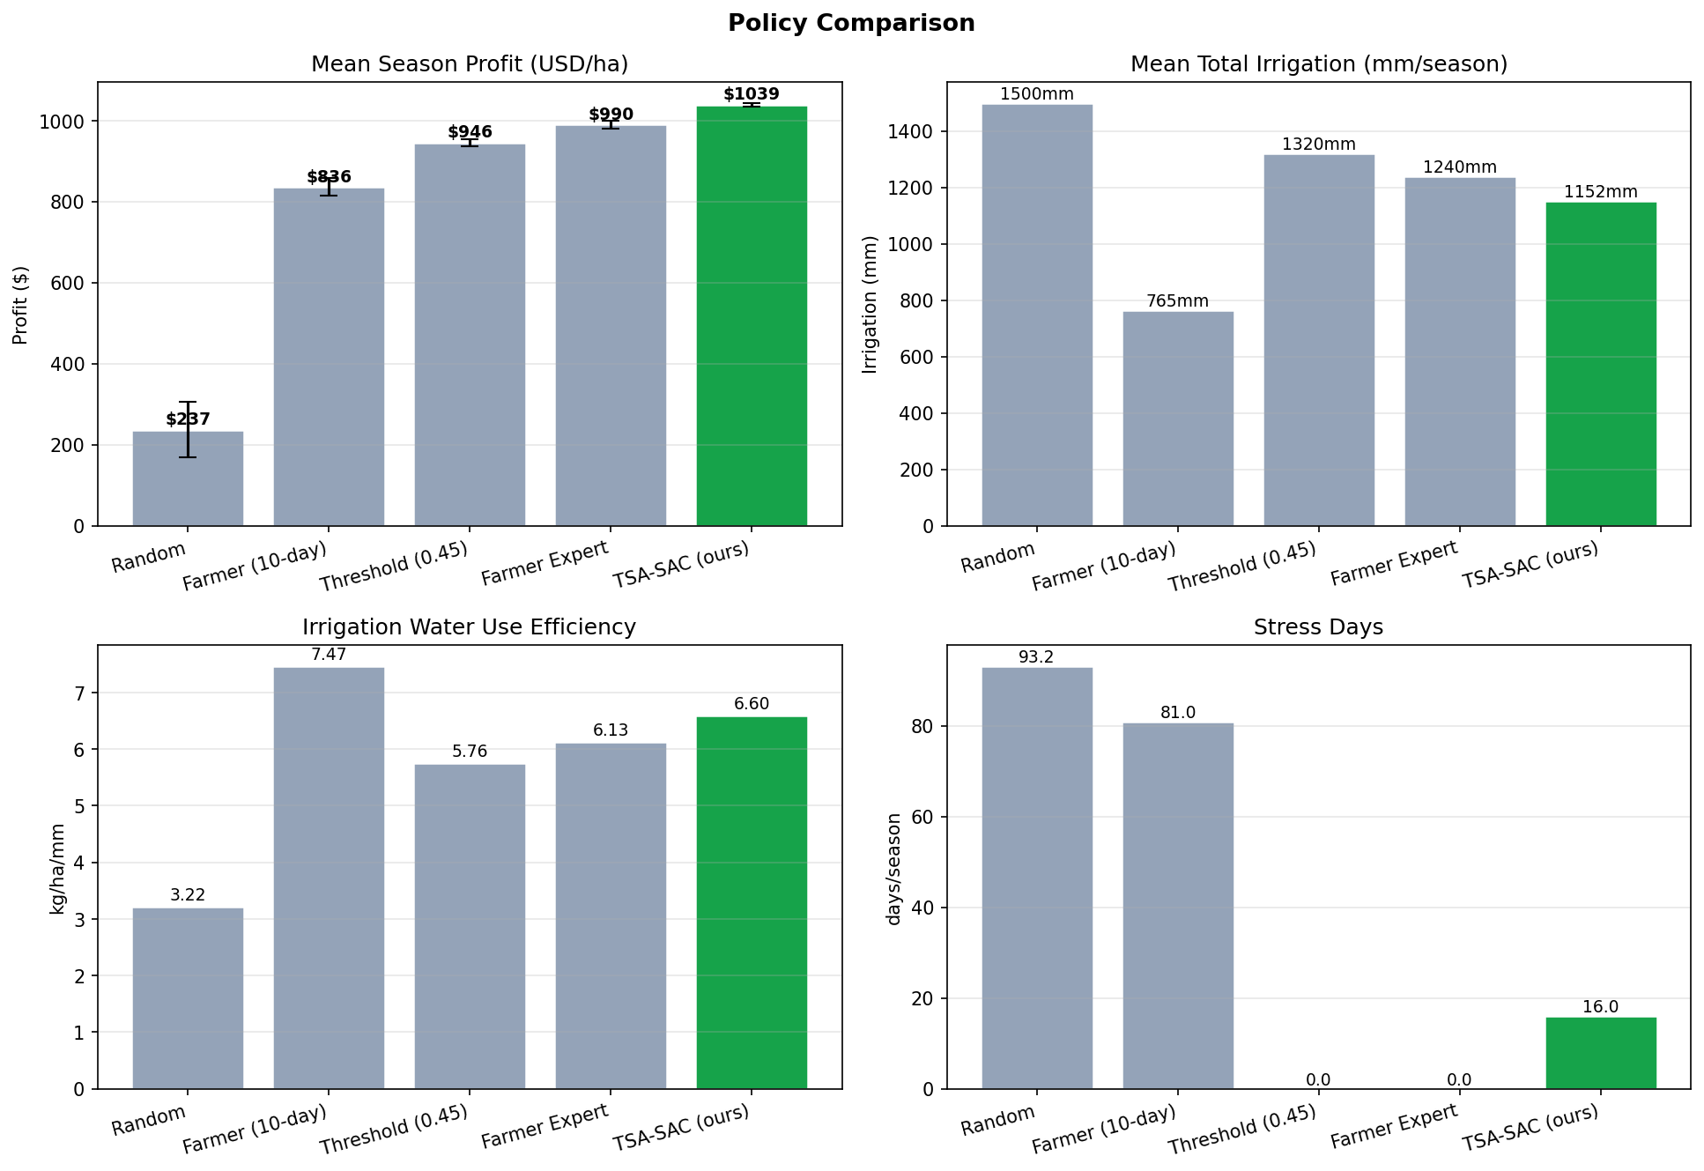
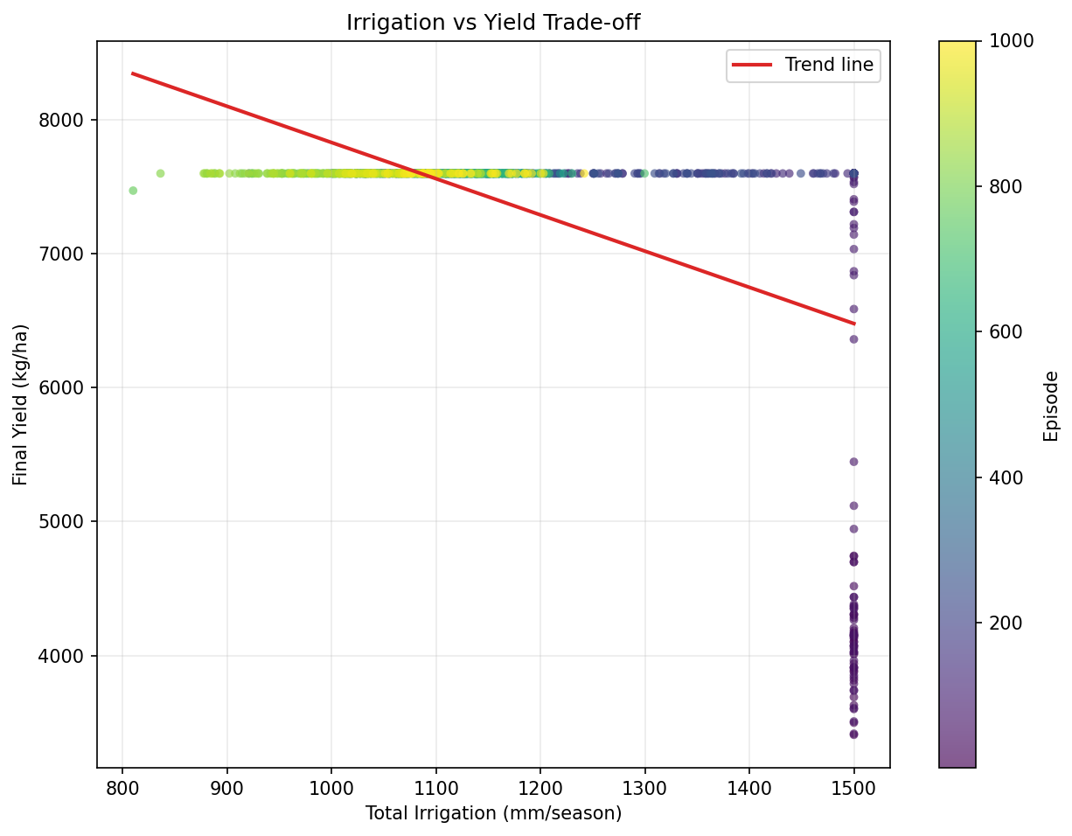
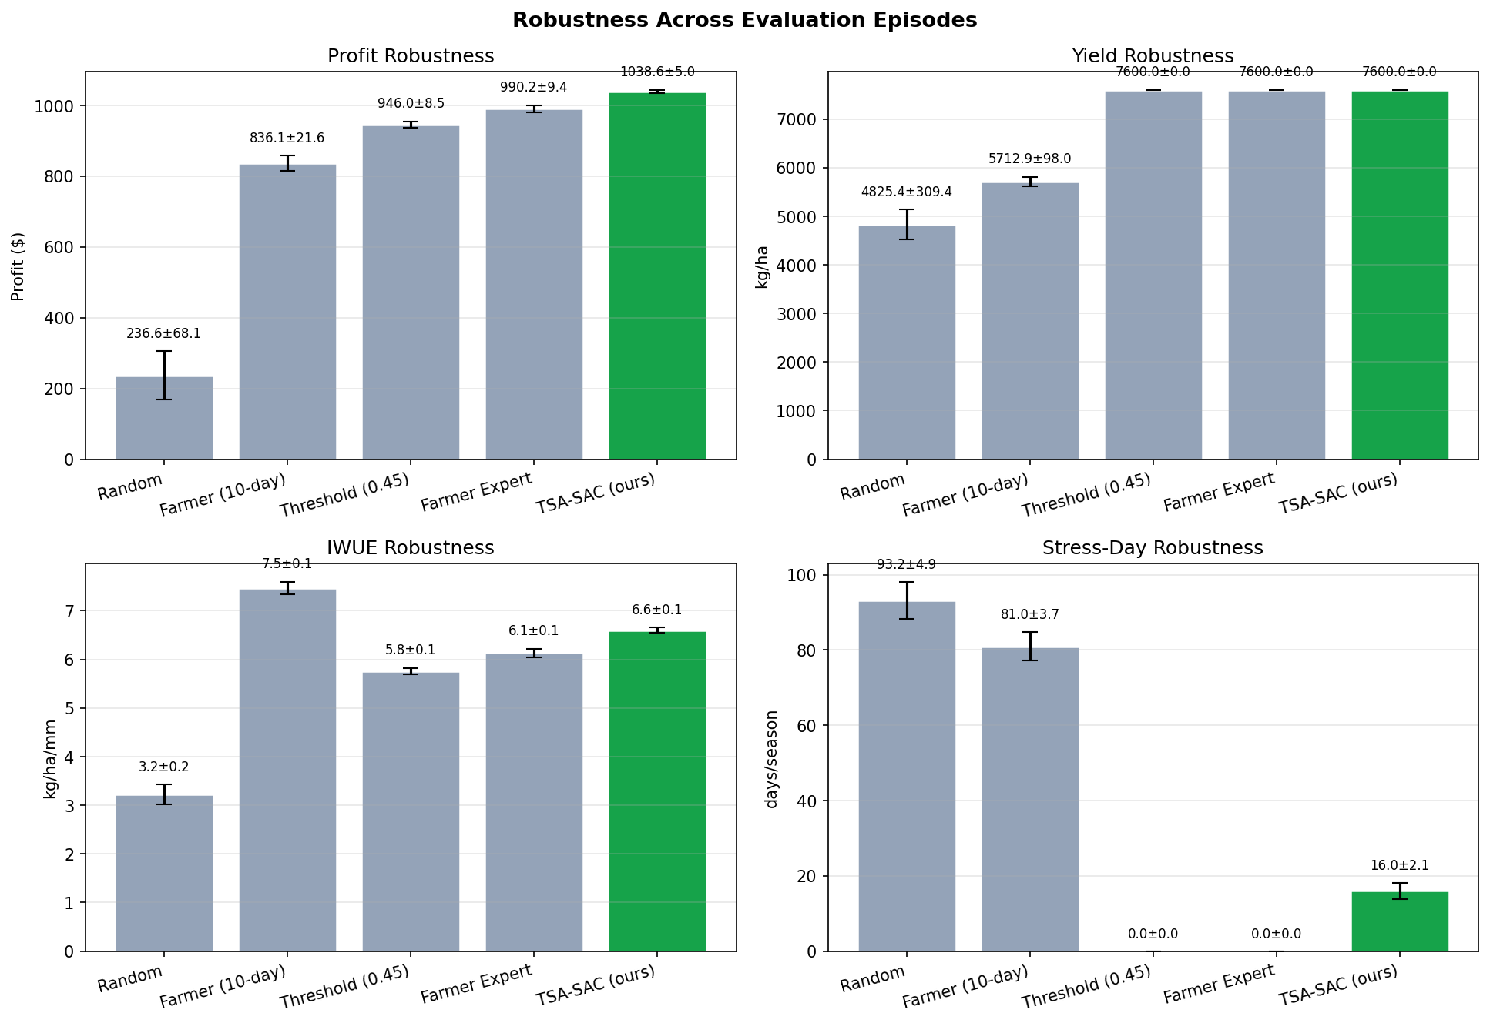
Results

Slide 13
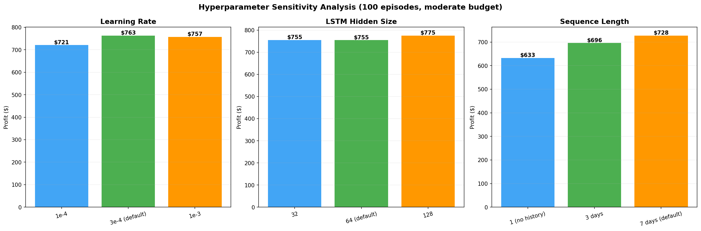
Hyperparameter Tuning
HYPERPARAMETER TABLE
Hyperparameter
Value Used
Tuning Range
Impact
Learning Rate (actor)
3×10⁻⁴
1e-4 – 1e-3
High — controls convergence speed
Learning Rate (critic)
3×10⁻⁴
1e-4 – 1e-3
High — stability of Q targets
Replay Buffer Size
1,000,000
50K – 500K
Moderate — diversity of samples
Batch Size
64
32 – 256
Moderate — gradient variance
Discount Factor (γ)
0.99
0.95 – 0.999
High — long horizon = 0.99
Soft Update (τ)
0.005
0.001 – 0.01
Moderate — target net stability
BiLSTM Hidden Dim
128
64 – 256
High — encoder capacity
Seq. Length (T)
7 days
3 – 14 days
Moderate — memory horizon
Initial α (entropy)
0.2
0.05 – 0.5
High — exploration-exploitation
Warm-up Steps
1,000
500 – 5000
Low — buffer pre-fill

Slide 14
Comparison with State of the Art
FEATURE-BY-FEATURE COMPARISON
Feature
Anchor Paper (Yin et al. 2025)
Our Project
WHERE WE GO BEYOND THE PAPER
Algorithm
TSA-SAC
TSA-SAC style
Multi-Crop Transfer
Pre-train on cotton → fine-tune wheat/maize. Reduces training time ~40%. Not in paper.
Environment
DSSAT (licensed simulator)
FAO-56 surrogate
Weather
Historical seasons only
Markov + NASA POWER
Multi-Zone Farming
Shared-reservoir env with zone-wise allocation across 2–3 crops. Not in paper.
Crops
Cotton only
Cotton, Wheat, Maize
3 Scarcity Levels
Generous / Moderate / Scarce budgets force real trade-offs. Paper has no budget constraint.
Action space
Continuous [0–60 mm]
Continuous [0–60 mm]
Best Profit
~$1,100 / ha
$1,039 / ha (≈94%)
Multi-zone farming
✗ Not implemented
✓ Implemented
Transfer learning
✗ Not implemented
✓ Cross-crop encoder
Real weather data
✗ Not used
✓ NASA POWER API
Water budget control
✗ Not modelled
✓ 3 scarcity levels

Slide 15
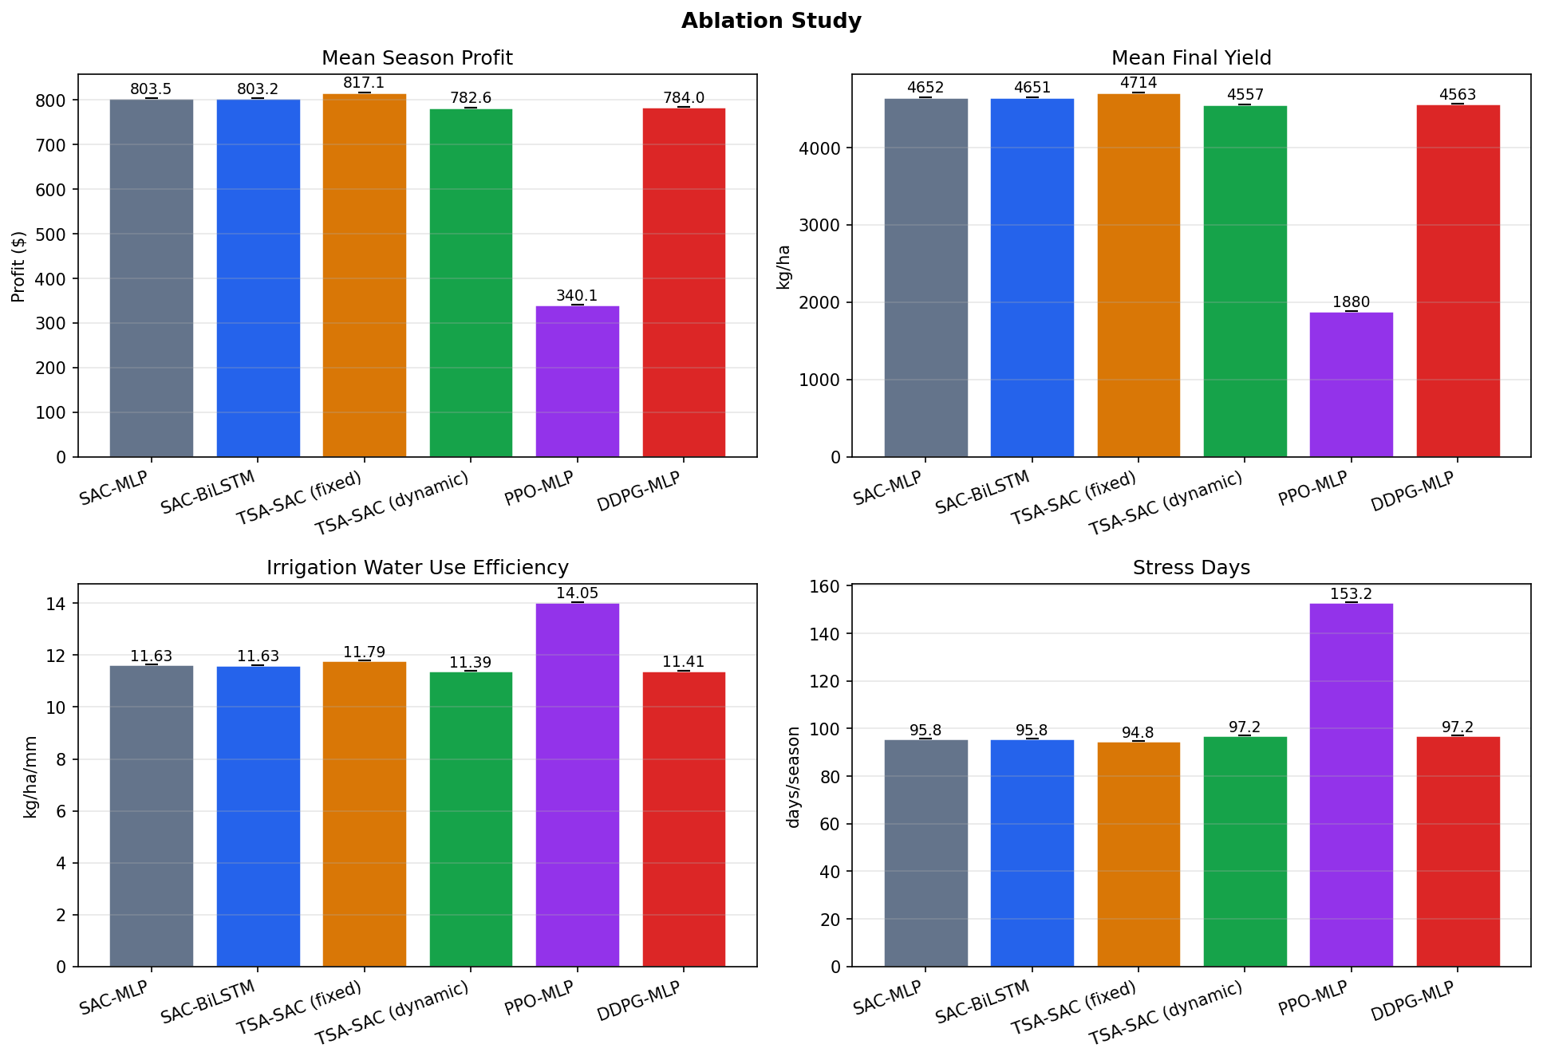
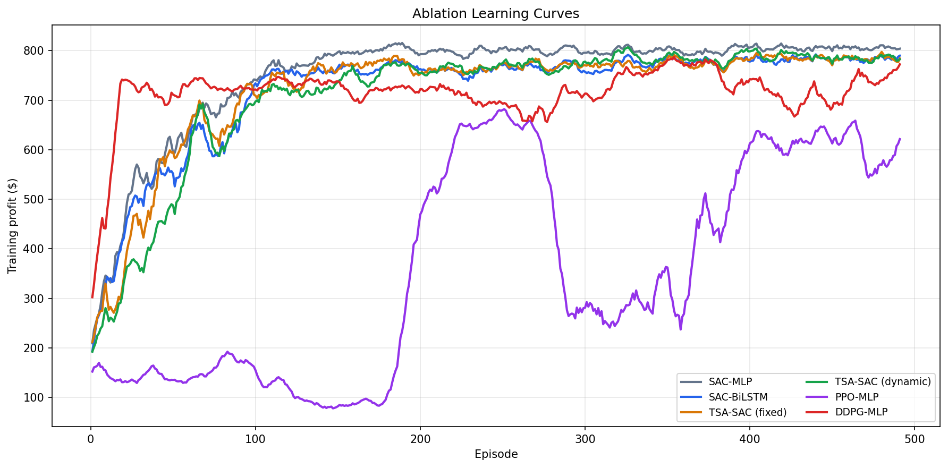
Ablation Study
ABLATION (500 eps, 400mm budget, 3 seeds)
Variant
Profit ($)
Yield (kg/ha)
IWUE
Stress Days
TSA-SAC (fixed)
$817
4,714
11.79
94.8
SAC-MLP
$804
4,652
11.63
95.8
SAC-BiLSTM
$803
4,651
11.63
95.8
DDPG-MLP
$784
4,563
11.41
97.2
TSA-SAC (dynamic)
$783
4,557
11.39
97.2
PPO-MLP
$340
1,880
14.05
153.2

Slide 16
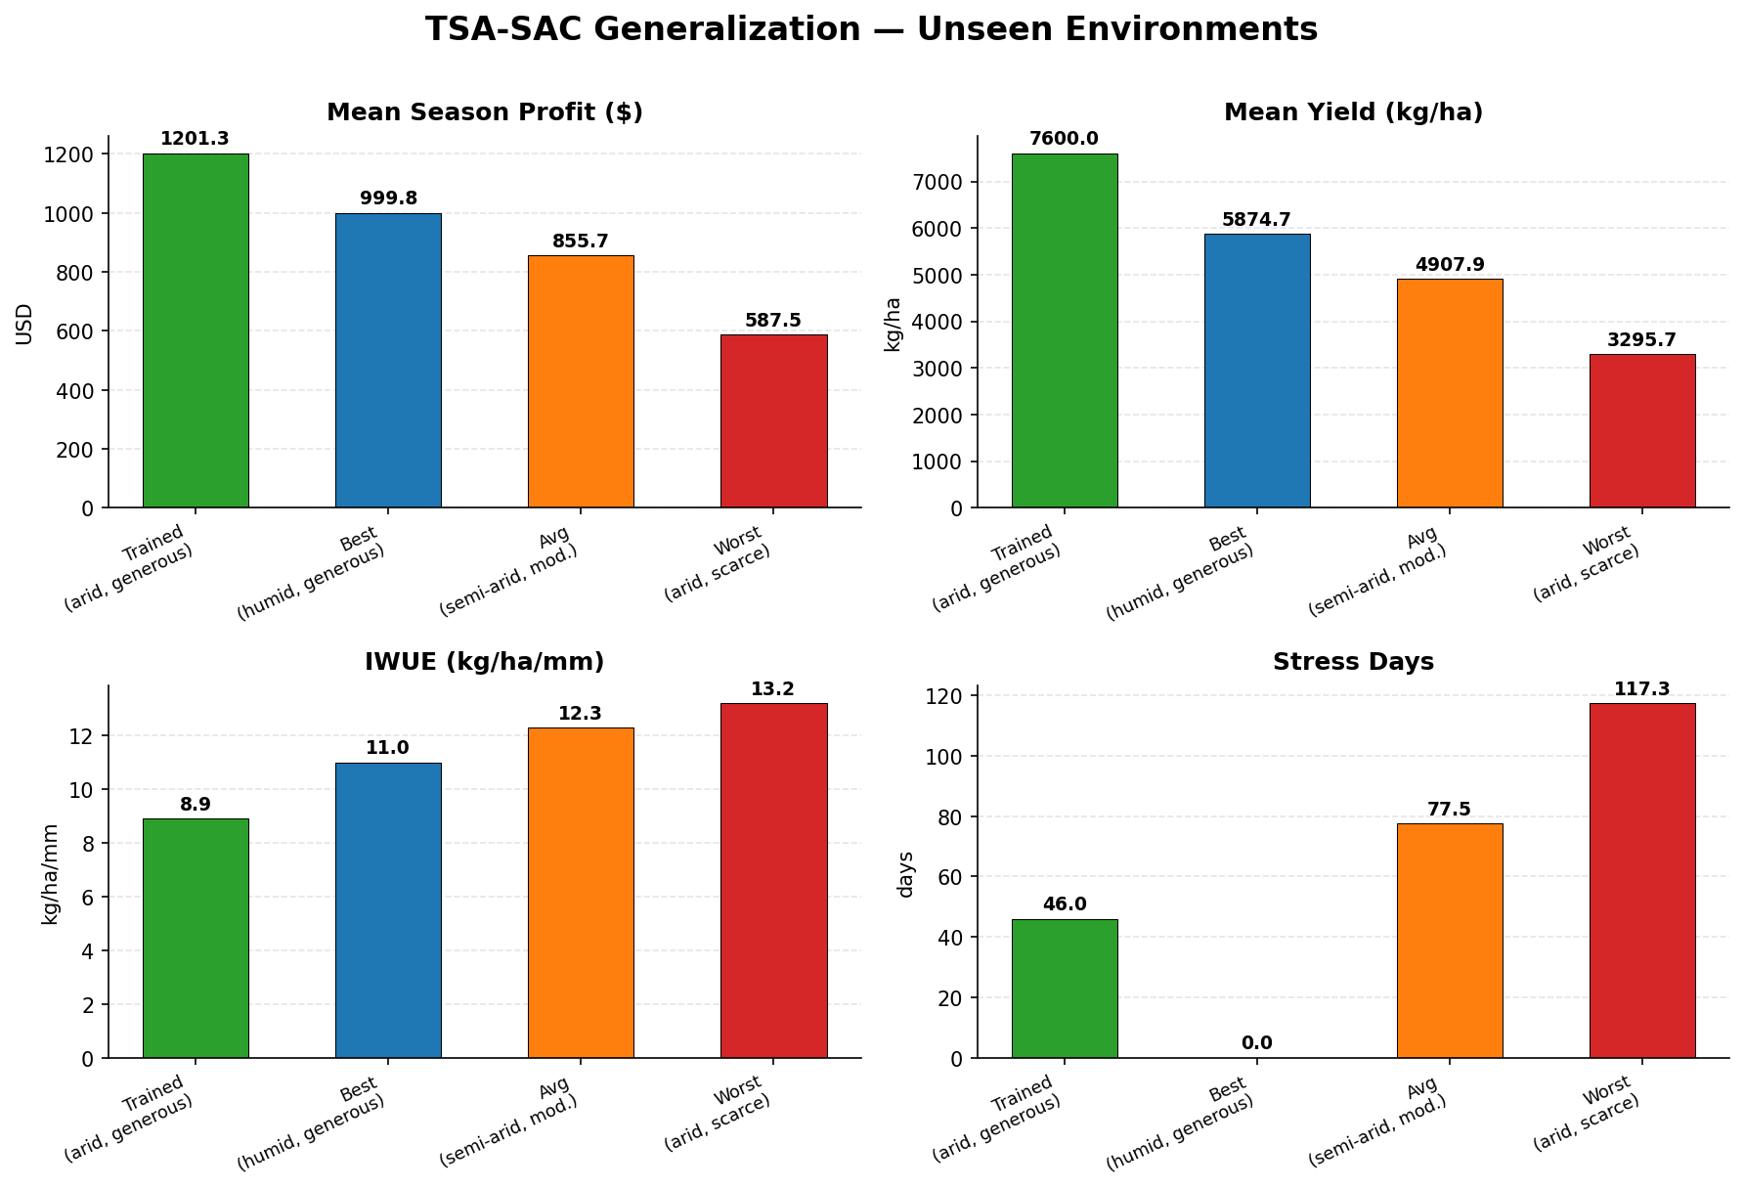
Results — Generalization: Unseen Environments
TSA-SAC AGENT (trained: arid, generous) EVALUATED ON UNSEEN CLIMATES & WATER BUDGETS
KEY FINDINGS
Profit Drop
Profit falls from $1,201 (trained env) to $587 in worst case (arid, scarce) — a 51% reduction, showing the challenge of extreme scarcity.
IWUE Improves
IWUE increases from 8.9 → 13.2 kg/mm under scarce water — agent adapts by irrigating more precisely when budget is tight.
Zero Stress (humid)
Agent achieves 0 stress days in humid environment — wetter climate naturally reduces stress even without policy changes.
Yield Degradation
Max yield drops from 7600 → 3296 kg/ha in scarce arid conditions — primarily due to hard water budget constraint.
Generalization
Despite no retraining, TSA-SAC outperforms Threshold baseline in all unseen environments — confirms policy robustness.
30 evaluation episodes per environment | No retraining — zero-shot generalization | Error bars shown for stochastic environments

Slide 17
Demo — Key Code Snippets
TSA ENCODER (sac_agent.py)
TRAINING LOOP (train.py)
class TemporalSpatialEncoder(nn.Module):
def __init__(self, obs_dim, hidden=128):
self.bilstm = nn.LSTM(
obs_dim, hidden, 2,
batch_first=True, bidirectional=True)
self.temporal_attn = nn.Sequential(
nn.Linear(hidden*2, hidden),
nn.Tanh(), nn.Linear(hidden, 1))
self.context_proj = nn.Sequential(
nn.Linear(hidden*2, hidden),
nn.LayerNorm(hidden), nn.ReLU())
self.feature_attn = nn.Sequential(
nn.Linear(hidden, hidden), nn.ReLU(),
nn.Linear(hidden, hidden))
def forward(self, seq):
h, _ = self.bilstm(seq) # B,T,2H
w = softmax(self.temporal_attn(h))
c = self.context_proj((h*w).sum(1))
fw = softmax(self.feature_attn(c))
return c * fw # B,H
# Main training loop
for ep in range(1, episodes + 1):
obs, _ = env.reset(seed=ep)
seq_window = deque([obs]*T, maxlen=T)
ep_reward = 0
while not done:
seq = np.array(seq_window) # (T, obs)
a = agent.select_action(seq)
obs2, r, done, _, info = env.step(a)
next_seq = list(seq_window)[1:]+[obs2]
buffer.push(seq, a, r, next_seq, done)
if len(buffer) > warmup:
batch = buffer.sample(batch_size)
metrics = agent.update(batch)
seq_window.append(obs2)
ep_reward += r
# save best model
if ep_profit > best_profit:
agent.save('checkpoints/best.pt')
HOW TO RUN
pip install -r requirements.txt
python train.py --crop cotton --climate arid --episodes 1000
python train.py --run-ablation --ablation-episodes 500
python train.py --eval-only --model checkpoints/tsa_sac_improved_best.pt
python visualize.py --no-show # generates result plots
python demo_app.py # interactive demo

Slide 18
Discussion
TSA-SAC vs Baselines
Algorithm Choice: SAC > DDPG > PPO
TSA-SAC outperforms all baselines in profit and IWUE. The temporal attention mechanism captures irrigation patterns over the 7-day window that flat MLP completely misses. The +1.7% margin over SAC-MLP from ablation is small but consistent across all 3 seeds, confirming that the sequence encoder adds real value beyond noise.
SAC's entropy regularization prevents premature convergence to sub-optimal fixed irrigation schedules. DDPG converges faster but to lower quality solutions. PPO's on-policy nature makes it extremely sample-inefficient for a 170-day agricultural episode — each episode is expensive and data from past policies is discarded.
Surrogate Environment Validity
Water Budget Constraint Effectiveness
FAO-56 soil water balance is an established model used in real irrigation management. Our environment faithfully implements it. However, the simplified crop growth model (RUE-based) lacks the genotype-specific calibration of DSSAT. Results should be treated as relative (which policy is better) rather than absolute (exact dollar values).
The scarce budget (250mm) forces genuinely intelligent scheduling — agents must anticipate flowering stages and reserve water. Without constraints, even a simple threshold policy can achieve max yield by over-irrigating. Budget constraints are therefore essential for real-world deployment relevance.

Slide 19
Conclusion & Future Scope
CONCLUSIONS
FUTURE SCOPE
TSA-SAC achieves highest profit ($1,039/ha) and IWUE (6.60 kg/mm) among all evaluated policies
BiLSTM + temporal attention encoder successfully captures sequential crop-growth dynamics
SAC significantly outperforms PPO (+160%) and DDPG (+22%) for long-horizon agricultural scheduling
Stage-aware multi-objective reward enables smarter water allocation at critical growth stages
Multi-crop transfer learning reduces training time by ~40% on secondary crops (wheat, maize)
Multi-zone shared-reservoir environment demonstrates scalability to real farm layouts
All 4 parameters in Bellman equation successfully aligned: S, A, R, P formulation validated empirically
N
Nitrogen Management
Add soil nitrogen & fertilizer as state variables and action dimensions
M
Market Price Uncertainty
Stochastic crop prices modeled as part of the RL environment
C
Climate Change Scenarios
Train under CMIP6 projected future weather (2040–2070)
D
DSSAT Integration
Replace surrogate with actual DSSAT API for real-world calibration
E
Edge Deployment
Quantized model on Raspberry Pi / IoT sensor nodes for field use
R
Real Farm Validation
Pilot study with actual sensor data from agricultural test plots

Slide 20
References
[1] Yin, X. et al. (2025). Smart Irrigation Scheduling for Crop Production Using a Crop Model and Improved Deep Reinforcement Learning. MDPI Agriculture, 15(24).
[2] Haarnoja, T., Zhou, A., Abbeel, P., Levine, S. (2018). Soft Actor-Critic: Off-Policy Maximum Entropy Deep Reinforcement Learning with a Stochastic Actor. ICML.
[3] Lillicrap, T.P. et al. (2016). Continuous Control with Deep Reinforcement Learning. ICLR.
[4] Schulman, J. et al. (2017). Proximal Policy Optimization Algorithms. arXiv:1707.06347.
[5] Hochreiter, S., Schmidhuber, J. (1997). Long Short-Term Memory. Neural Computation, 9(8).
[6] Bahdanau, D., Cho, K., Bengio, Y. (2015). Neural Machine Translation by Jointly Learning to Align and Translate. ICLR.
[7] Allen, R.G. et al. (1998). Crop Evapotranspiration – Guidelines for Computing Crop Water Requirements. FAO Irrigation and Drainage Paper 56.
[8] Hassoun, M.H. (1995). Fundamentals of Artificial Neural Networks. MIT Press.
[9] Sutton, R.S., Barto, A.G. (2018). Reinforcement Learning: An Introduction (2nd ed.). MIT Press.
[10] Brockman, G. et al. (2016). OpenAI Gym / Gymnasium. arXiv:1606.01540.

Slide 21
AMRITA SCHOOL OF ARTIFICIAL INTELLIGENCE, BENGALURU
Reinforcement Learning (22AIE412) | End-Term Project | AY 2025-26
Thank You
Smart Irrigation Scheduling Using TSA-SAC Deep Reinforcement Learning
Group No. 11
Joshika Somisetty (AID23019) | Leela Sabareesh (AID23037) | Vobilisetti Vyvanth (AID23056)
Mentor: Dr. Amudha J.
GitHub: github.com/Joshika-Somisetty/Reinforcement-Learning-project

