Slide 1
Network Intrusion Detection System using
Machine Learning
A machine learning-based intrusion detection system built on the CICIDS2017 dataset and enhanced with ensemble learning and explainable AI.
Dataset - CICIDS2017 Dataset
Models - 6 Machine Learning Models
2.5M+ network flows
78 network traffic features
12 traffic classes
Decision Tree
SVM
MLP
Random Forest
XGBoost
LightGBM
Best Performing Model
Explainable AI
XGBoost
Accuracy: 99.80%
• Feature Importance
• SHAP Summary Plot
• SHAP Force Plot

Slide 2
Project Overview
What is a Network Intrusion?
Why Detection Matters?
Unauthorized or malicious activity targeting a computer network.
Examples :
Traditional rule-based intrusion detection systems rely on predefined signatures and often fail to detect new or evolving attack patterns. As cyber threats become more sophisticated, intelligent detection methods are required.
DDoS attacks
Port Scanning
Brute Force attacks
Why Machine Learning?
These attacks can:
Machine learning analyzes historical network traffic to learn patterns of normal and malicious behavior. Unlike static rule-based systems, ML models can generalize from data and improve detection of previously unseen attacks.
Disrupt network services
Steal sensitive information
Gain unauthorized access
DDoS🌐
Port Scanning🔍
Brute Force🔒
Overwhelms a server or network with excessive traffic, making services unavailable.
Scans a target system to discover open ports and running services.
Repeatedly attempts different username-password combinations to gain unauthorized access.

Slide 3
Dataset: CICIDS2017
Source & Composition
Key Features Used
CICIDS2017, developed by the Canadian Institute for Cybersecurity (CIC), contains realistic benign and malicious network traffic captured in a controlled environment. It is one of the most widely used benchmark datasets for evaluating intrusion detection systems.
These network traffic features capture flow behavior and enable machine learning models to distinguish between benign and malicious traffic.
Flow Duration
Destination Port
2.5M+
Total time of a network flow session
Target port number of the connection
Network Flows
Packet Length
Flow Bytes/s
78 Traffic Features
Size of packets transmitted in the flow
Rate of bytes transferred per second
Traffic characteristics per flow record
12 Traffic Classes
Distinct malicious traffic categories

Slide 4
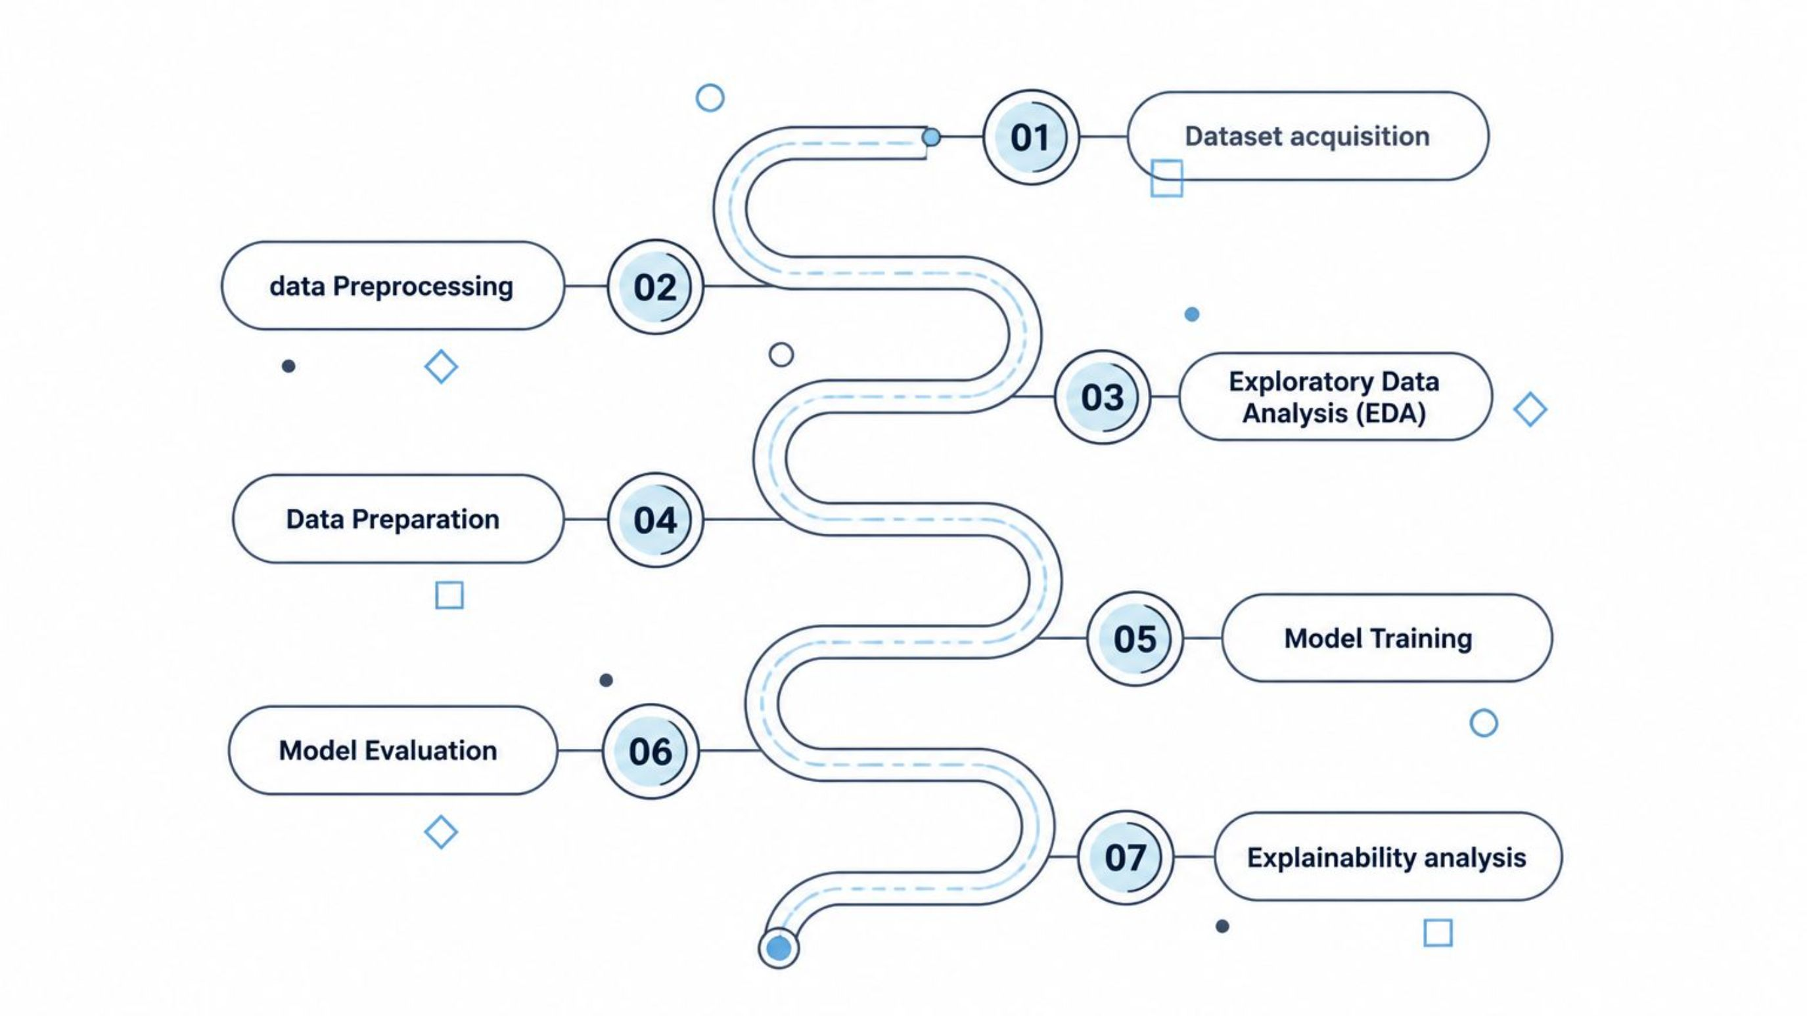
Methodology

Slide 5
The project follows a six-stage machine learning pipeline, beginning with data preprocessing and ending with model explainability. Each stage builds upon the previous one to ensure accurate, reliable, and interpretable intrusion detection.
01
02
Data Preprocessing
Exploratory Data Analysis (EDA)
Merged CICIDS2017 files, removed missing and infinite values, eliminated duplicate records, and prepared a clean dataset.
Explored attack distribution, feature distributions, outliers, and correlations using visualizations.
03
04
Data Preparation
Model Training
Encoded labels, separated features and target, performed a 60:40 train-test split, and applied feature scaling where required.
Trained six machine learning models: Decision Tree, SVM, MLP, Random Forest, XGBoost, and LightGBM.
05
06
Model Evaluation
Explainability
Compared model performance using Accuracy, Precision, Recall, F1-score, Classification Report, and Confusion Matrix.
Used Feature Importance and SHAP to identify influential features and explain individual model predictions.

Slide 6
Models Used
Six machine learning models were implemented and evaluated. Three baseline models were reproduced from the research paper, while three additional ensemble learning models were introduced to improve detection performance.
BASELINE MODELS (FROM PAPER)
EXTENDED MODELS (THIS WORK)
Decision Tree
Random Forest
XGBoost
Tree-based classifier that splits data using the most informative features. Fast, interpretable, and serves as a strong baseline model.
Combines multiple decision trees to improve accuracy and reduce overfitting. Robust ensemble method with strong generalization.
Builds trees sequentially using gradient boosting to improve prediction performance. Achieved the highest accuracy in this study.
SVM
Finds the optimal decision boundary between classes. Effective for high-dimensional data but computationally expensive.
LightGBM
MLP
A fast gradient boosting algorithm designed for efficient training on large datasets. Optimized for speed with competitive accuracy.
Neural network that learns complex, non-linear patterns from network traffic for multi-class classification.

Slide 7
Performance Evaluation
Evaluation Metrics: Accuracy • Precision • Recall • F1-Score
99.80%
Model
Accuracy
Notes
XGBoost
99.80%
Highest performing
XGBoost
Random Forest
99.66%
Strong ensemble model
Highest performing model
Decision Tree
99.41%
Best Baseline model
99.66%
MLP
99.28%
Neural Network classifier
LightGBM
92.81%
Requires further tuning
Random Forest
SVM
96.56%
Computationally intensive
Strong ensemble runner-up
XGBoost achieved the highest accuracy (99.80%), followed closely by Random Forest (99.66%). Decision Tree and MLP also achieved over 99% accuracy, while SVM and LightGBM produced comparatively lower accuracy under the current experimental configuration.
Key Takeaways
Ensemble models outperformed the baseline models.
Decision Tree remained the strongest baseline model.
LightGBM may benefit from additional hyperparameter tuning.

Slide 8
Feature Importance
Feature importance measures how much each feature contributes to the model's predictions. By ranking features according to their contribution, we gain a global view of model behaviour across the entire dataset — identifying which network traffic characteristics are most indicative of malicious activity.
What is Feature Importance?
Security Benefit
Explainability
Measures the contribution of each feature to the model.
Higher importance indicates greater influence on predictions.
Helps identify the most informative network traffic characteristics.
Focus monitoring on the most influential traffic features.
Improve detection efficiency.
Support threat analysis.
Bridges the gap Makes model decisions easier to understand.
Improves trust in intrusion detection systems.
Supports deployment in real-world environments.
Top Features (XGBoost)
Idle Mean
Bwd Packet Length Std
act_data_pkt_fwd
Bwd Packet Length Mean
Total Length of Fwd Packets
Feature Optimization
Low-importance features may be removed.
Reduces model complexity.
Can improve inference speed.
Global Insight
Shows which features consistently influence predictions across the entire dataset rather than explaining a single prediction.

Slide 9
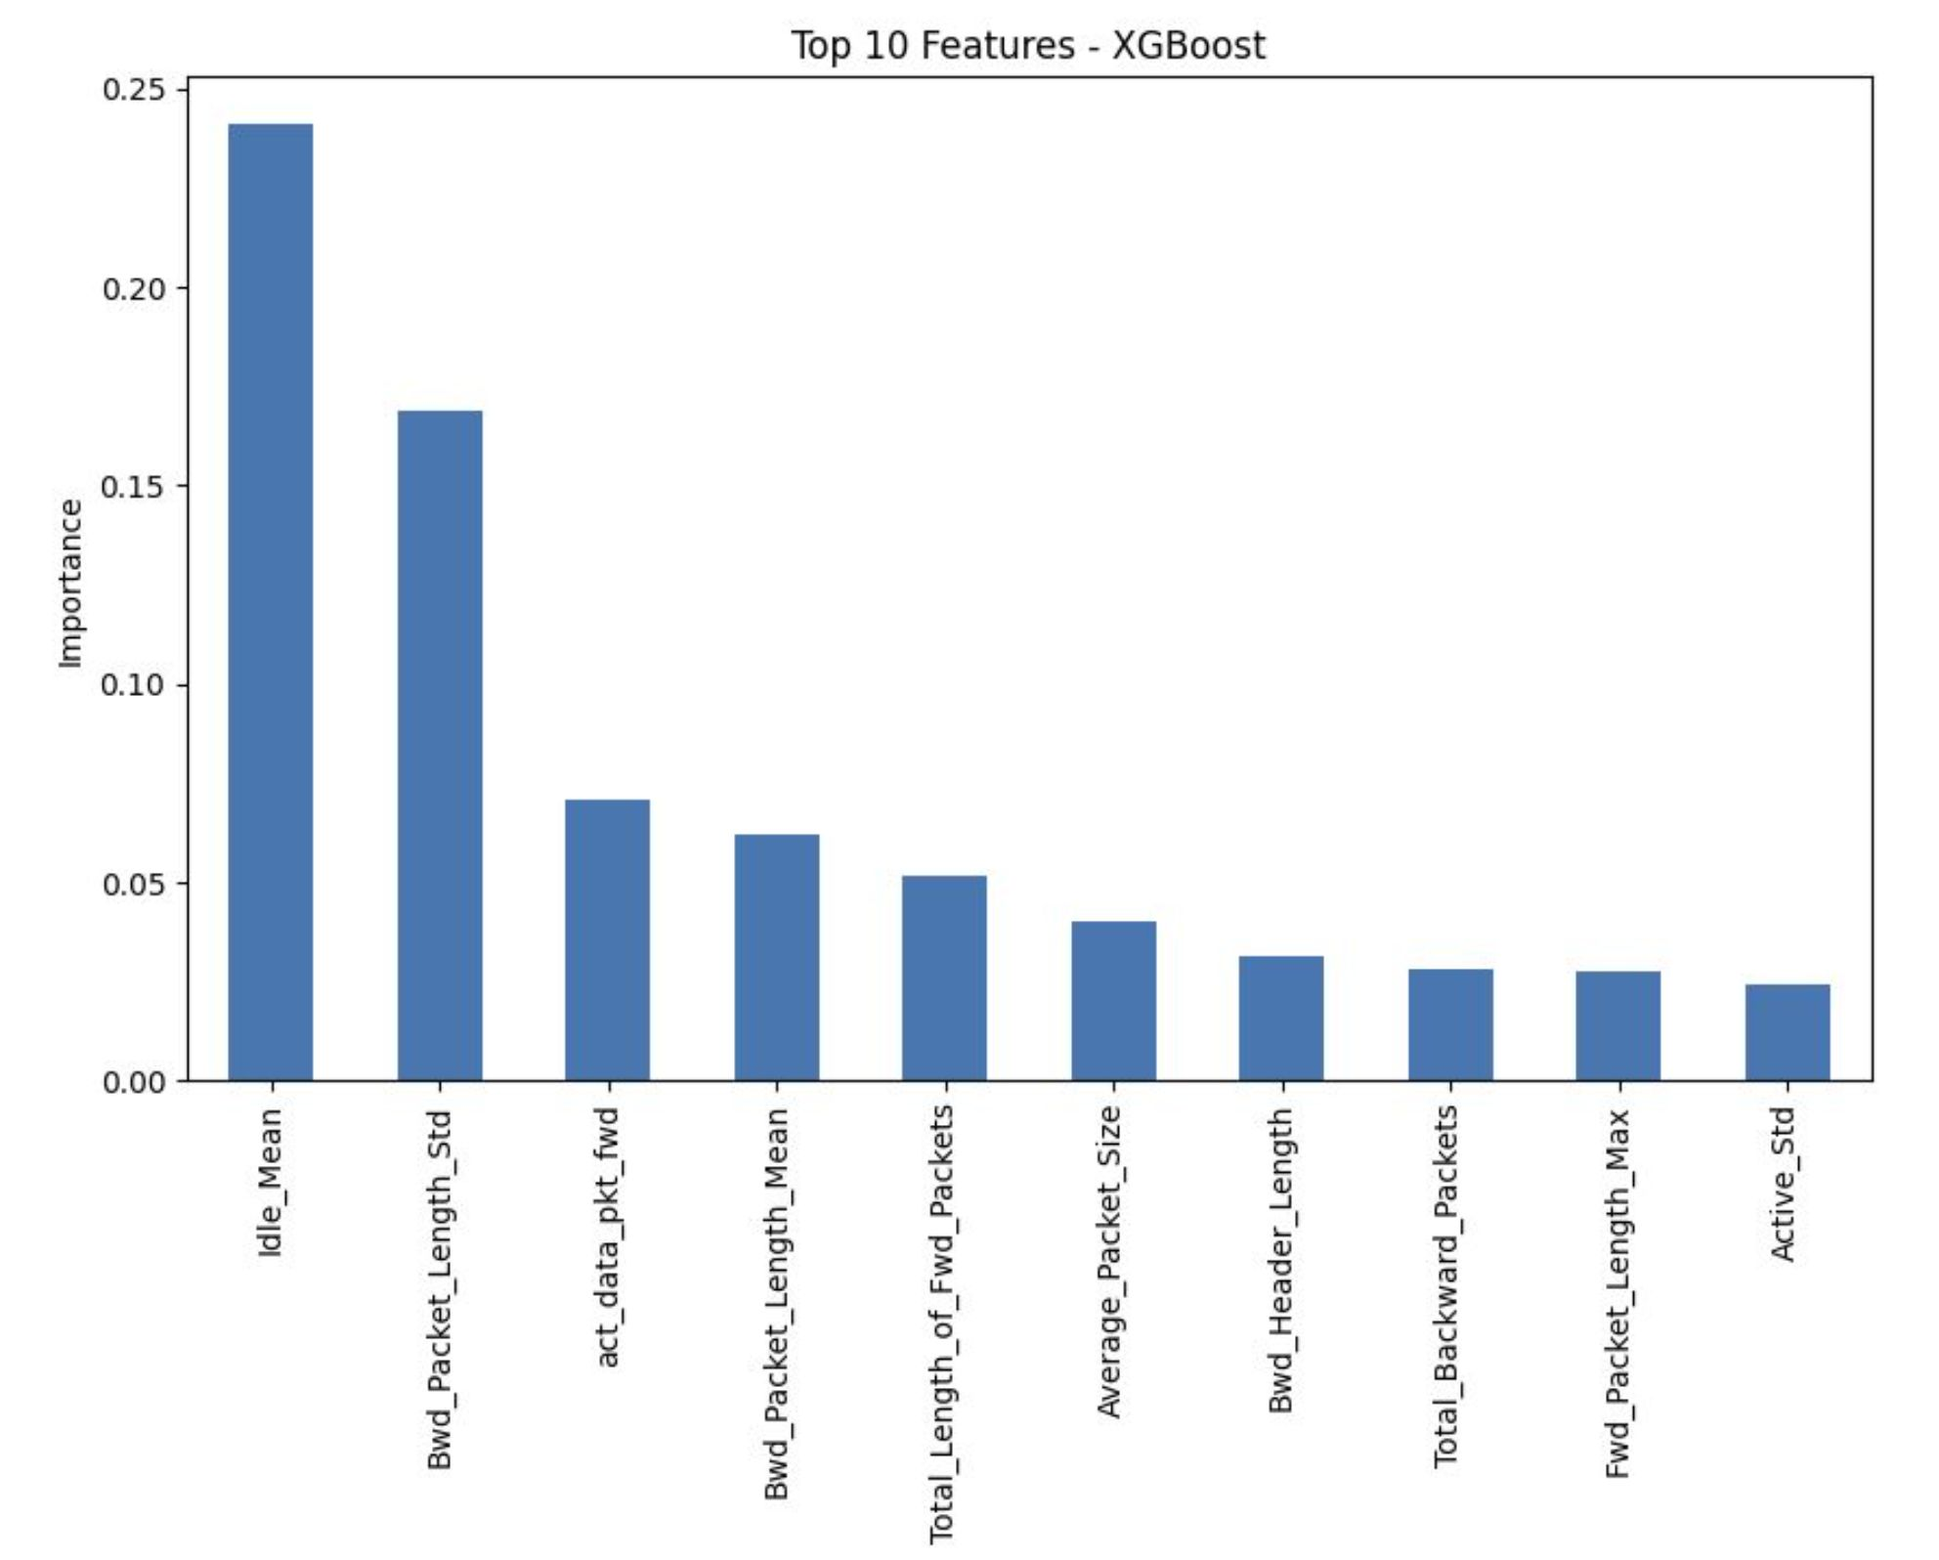
Feature Importance Analysis
Purpose
Ranks features based on their contribution to XGBoost's predictions.
Highlights which network traffic characteristics are most influential.
Key Insights
Idle_Mean is the most influential feature.
Packet length–related features play a major role in distinguishing benign and malicious traffic.
Feature importance improves model interpretability and supports feature selection for future optimization.

Slide 10

SHAP Explainability
SHAP (SHapley Additive exPlanations) improves model interpretability by explaining how each feature contributes to a prediction. It provides both global explanations (overall feature importance) and local explanations (individual predictions).
Summary Plot
Bar Plot
Force Plot
Shows the overall impact of each feature.
Displays how high and low feature values affect predictions.
Provides a global explanation across all samples.
Ranks features by their average Ranks features by their average SHAP value.
Explains one individual prediction.
Shows which features increased or decreased the prediction score.
Provides local model interpretability.
Highlights the most influential features.
Summarizes global feature importance.
Key Benefits
Explains why the model made a prediction.
Improves transparency and trust.
Supports security analysts in understanding attack classifications.

Slide 11
Improvements over the Research Paper
Original Paper
This Implementation
Implemented using MATLAB and KNIME
Evaluated Decision Tree, SVM, MLP
Reported standard evaluation metrics
No explainability analysis
No ensemble learning models
Limited EDA and feature analysis
Reimplemented the complete pipeline in Python
Added Random Forest, XGBoost, and LightGBM
Performed comprehensive exploratory data analysis (EDA)
Implemented Feature Importance analysis
Integrated SHAP explainability
Compared six machine learning models using multiple evaluation metrics

Slide 12

Conclusion
This project successfully reproduced the original Network Intrusion Detection System using the CICIDS2017 dataset and extended it by incorporating ensemble learning models, comprehensive evaluation, and explainable AI techniques.
Reproduction
Performance
Successfully reproduced the original machine learning pipeline in Python using the CICIDS2017 dataset, validating the methodology presented in the research paper.
Evaluated six machine learning models. XGBoost achieved the highest accuracy of 99.80%, followed by Random Forest (99.66%), outperforming the baseline models.
Explainability
Key Finding
Feature Importance and SHAP explainability improved model transparency by identifying influential features and explaining individual predictions, making the intrusion detection system easier to interpret.
The experimental results indicate that ensemble learning models, particularly XGBoost and Random Forest, achieved higher performance than the baseline models on the CICIDS2017 dataset.
The results demonstrate that XGBoost and Random Forest achieved the strongest performance in this implementation, combining high classification accuracy with improved interpretability through Feature Importance and SHAP analysis.

