Slide 1
secure data hiding in images using steganography
CAPSTONE PROJECT
Presented By :
Student Name : JOSHINIKITHA V
College Name & Department : K.Ramakrishnan college of technology,
CSE

Slide 2
OUTLINE
Problem Statement
Technology used
Wow factor
End users
Result
Conclusion
Git-hub Link
Future scope

Slide 3
Problem Statement
This project focuses on secure data hiding in images using steganography.
It embeds a secret message into an image by modifying pixel values without significantly altering the image’s appearance.
The goal is to ensure confidential communication while maintaining image integrity.

Slide 4
Technology used
Programming Language: Python
Libraries: OpenCV (cv2 for image processing), OS (for file handling)
Platform: Any Python-supported OS (eg:Windows)

Slide 5
Wow factors
Invisible Message Encoding: The message is embedded within pixel values without noticeable changes.
Passcode Protection: Ensures only authorized users can decrypt the hidden data.
Lightweight & Fast: Uses simple algorithms for quick encoding and decoding.
Easy Integration: Can be combined with other security systems for enhanced privacy.

Slide 6
End users
Journalists & Whistleblowers: For secure communication in high-risk situations.
Government & Military Personnel: To transfer classified information safely.
Businesses & Organizations: To protect sensitive corporate data.
General Users: Anyone needing secure personal communication.

Slide 7
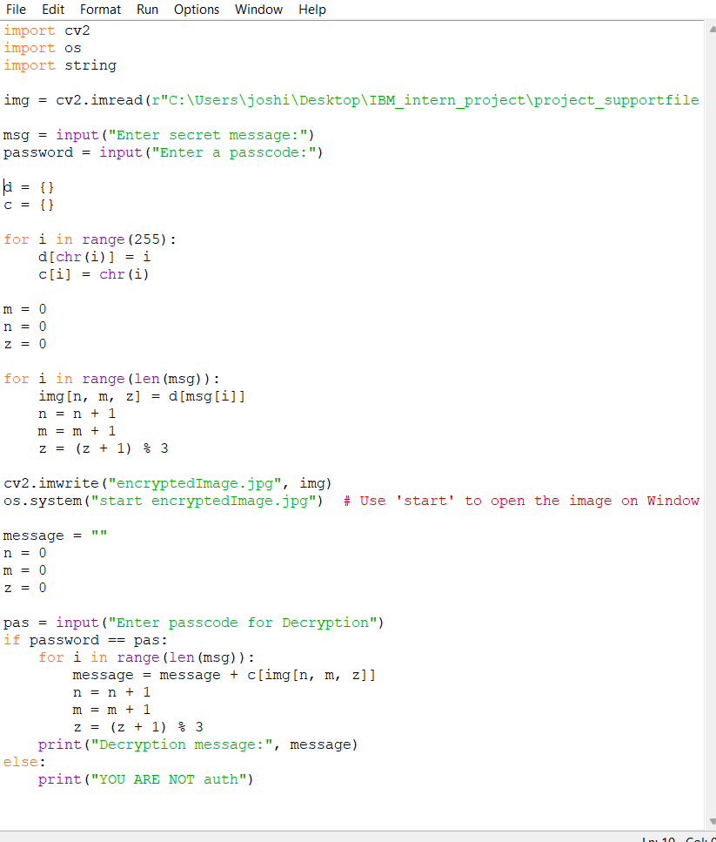
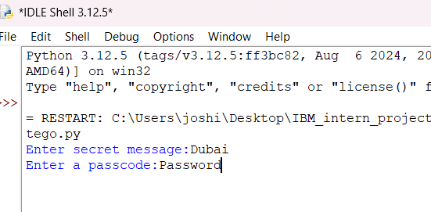
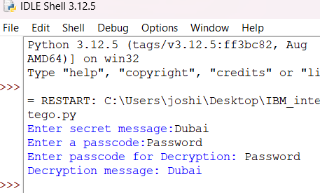
Results

Slide 8

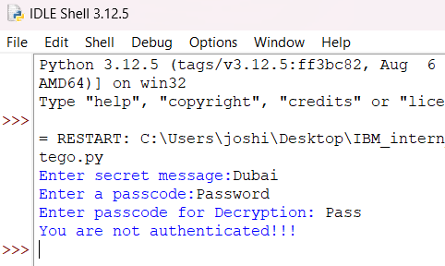
Results

Slide 9
Conclusion
This project provides a simple yet effective steganographic technique to securely embed messages into images. By combining cryptography and image processing, it ensures confidentiality and integrity of the hidden data. This approach can be extended for enhanced security applications in various industries.

Slide 10
GitHub Link
https://github.com/Joshinikitha/IBM_intern_project.git

Slide 11
Future scope
1.Enhanced Security with Cryptography
2. AI-Powered Steganalysis Prevention
3.Blockchain Integration for Tamper-Proof Data
4. Real-Time Steganography for Secure Communication
5.Higher Capacity & Multi-Format Support

Slide 12
THANK YOU

