Slide 1


K.RAMAKRISHNAN COLLEGE OF TECHNOLOGY
(AUTONOMOUS), TRICHY
CURRENCY CONVERTER APPLICATION
SUPERVISOR
Mrs.K.ValliPriyadharshini M.E., (PhD),
AP/CSE.
PRESENTED BY
JOSHINIKITHA V
2303811710422070

Slide 2
PRESENTATION OVERVIEW
Objective
Project Introduction
Problem Statement
Methodologies (Programming concepts relevant to problem statement)
Architecture of the proposed system
List of Modules
7. Merits
8. Results and Discussion
9. Queries

Slide 3
OBJECTIVE
To design and develop a currency converter application that allows users to convert amounts between different currencies in real-time.
To fetch the latest exchange rates from a reliable source and provide accurate conversion results.
To offer users a quick and easy way to convert currency in real-time ,whether for travel ,trading, or everyday transaction.

Slide 4
PROJECT INTRODUTION
The project utilizes the ExchangeRate API to fetch real-time currency conversion rates dynamically. The API provides accurate and updated exchange rate data, ensuring reliable conversions between supported currencies.
Currencies - USD,INR,EUR,GBP,JPY,CAD,AUD.
Through API calls, the application retrieves exchange rate trends over time, enabling the generation of a visually interactive graph that showcases the fluctuation of exchange rates between selected currencies.

Slide 5
PROBLEM STATEMENT
Manual Currency Conversion Complexity:
Manual calculations leads to errors and inefficiencies in financial transactions.
Lack of Visual Insights on Exchange Rate Trends :
Limitied users' ability for graphical visualization to analyze and predict trends.
Limited Accessibility to Real-Time Exchange Rates:
Difficult to access up-to-date exchange rate information.

Slide 6
METHODOLOGIES
API Integration:
Real-time data fetching using HttpURLConnection and parsing with org.json.JSONObject.
Retrieves exchange rates dynamically for accurate calculations and graph generation.
Currency Conversion Logic:
Uses arithmetic operations for conversions based on API rates.
Handles invalid inputs and API errors with try-catch blocks for stability.
GUI Design:
Built with AWT/Swing components (Frame,Button,Choice,etc…)
Organized layout using GridBagLayout for intuitive user interaction.
Error Handling:
Ensures stability using exception handling for network or user input errors

Slide 7





ARCHITECTURE OF THE PROPOSED SYSTEM
LIBRARIES
User interface module
Textfeilds,choice,labels,
button,Graph Panel
Input module
From/to currency
Amount to convert
AWT
BufferReader
HttpURLConnection
Currency conversion module
Fetches data by API call
Realtime rate *amount
Event handling module
Handles button click implements actionlistener
Output module
Graph visualized
Converted Amount
Exchangerate api
Graph visualization module
Plot data in x,y axes
fetches realtime data for past 7 days
Error handling module
Handles non numeric input,
Error during API calls,
ensures proper window closing

Slide 8
LIST OF MODULES
1.User Interface Module:
Handles the graphical interface components of the system, including text fields for user input, drop-down menus (choice), labels, buttons for initiating actions, and a graph panel for visualizing results.
2.Input Module:
Collects input from the user, such as the source and target currencies and the amount to be converted.
3.Event Handling Module:
Manages user interactions, such as button clicks, and implements ActionListener to trigger appropriate responses like initiating conversion or displaying graphs.
My API KEY: 5c9bb566ed62b8722511f24b
My API URL: https://v6.exchangerate-api.com/v6/5c9bb566ed62b8722511f24b/latest/USD

Slide 9
LIST OF MODULES
4.Currency Conversion Module:
Fetches real-time exchange rates using an API (e.g., ExchangeRate API) and calculates the converted amount by multiplying the rate with the input amount.
5.Graph Visualization Module:
Plots real-time exchange rate data on a graph. Displays historical data (e.g., for the past 7 days) on X and Y axes for better visualization and analysis.
6.Output Module:
Displays the converted amount and visualizes the exchange rate trends graphically.
7.Error Handling Module:
Handles invalid inputs (e.g., non-numeric values), manages errors during API calls, and ensures smooth operation like proper window closure in case of issues.

Slide 10
MERITS
Real-Time Accuracy: Retrieves and displays up-to-date exchange rates for accurate conversions.
Graphical Insights: Provides visual trends of currency fluctuations for better decision-making.
User-Friendly Interface: Intuitive design for seamless user interaction and accessibility.
Wide Currency Support: Supports Six multiple global currencies for versatile use cases.
5.Future enhancement: Integrate with financial planning or investment tools within foreign trade apps,
enabling users to make informed decisions based on real-time exchange rate trends.

Slide 11
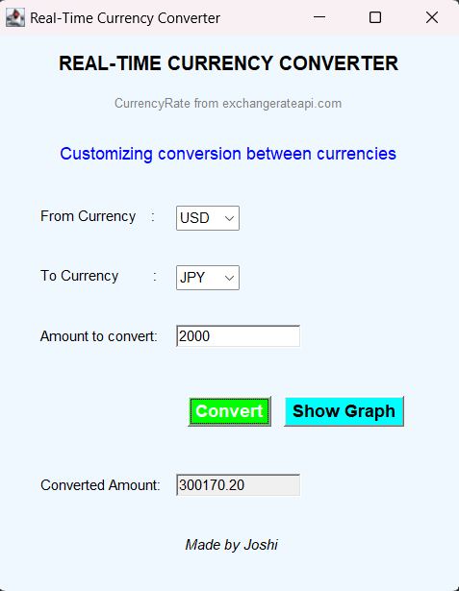
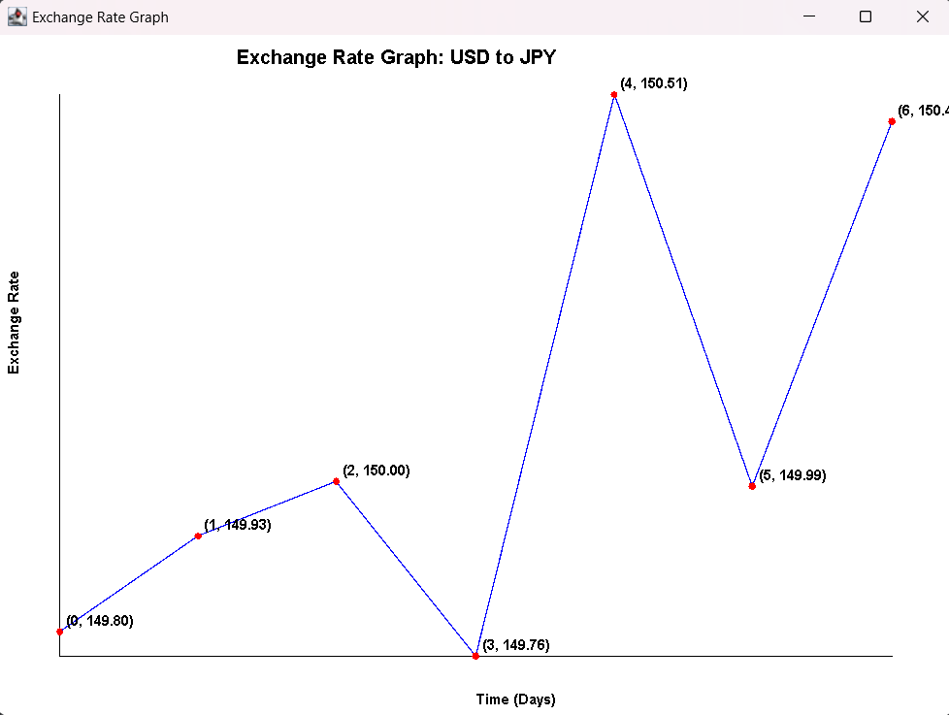
RESULTS AND DISCUSSION

Slide 12
THANK YOU
QUERIES?

