Slide 1

Land-registry using blockchain -
[Student Name ]

Slide 2

PROBLEM STATEMENT
Land ownership records are often prone to fraud, disputes, and inefficiencies due to manual or centralized storage. A blockchain-based Land Registry System ensures secure, transparent, and tamper-proof land registration and ownership transfers. This smart contract automates verification, prevents forgery, and allows only rightful owners to transfer land.

Slide 3
Project Description
The Land Registry System is a blockchain-powered smart contract that enables secure, transparent, and tamper-proof land ownership management. It allows users to register land parcels, verify ownership, and transfer property rights securely without intermediaries.
Built on Ethereum (Solidity), this smart contract: Registers land with a unique ID, location, area, and owner details. Prevents fraud by ensuring only unregistered land can be added. Ensures secure ownership transfer—only the current owner can sell or transfer land. Provides instant verification—anyone can check land details via the blockchain.

Slide 4

WHO ARE THE END USERS?
Government Authorities
Landowners & Property Buyers
Financial Institutions & Banks

Slide 5

Technology Used
Remix ide
solidity

Slide 6
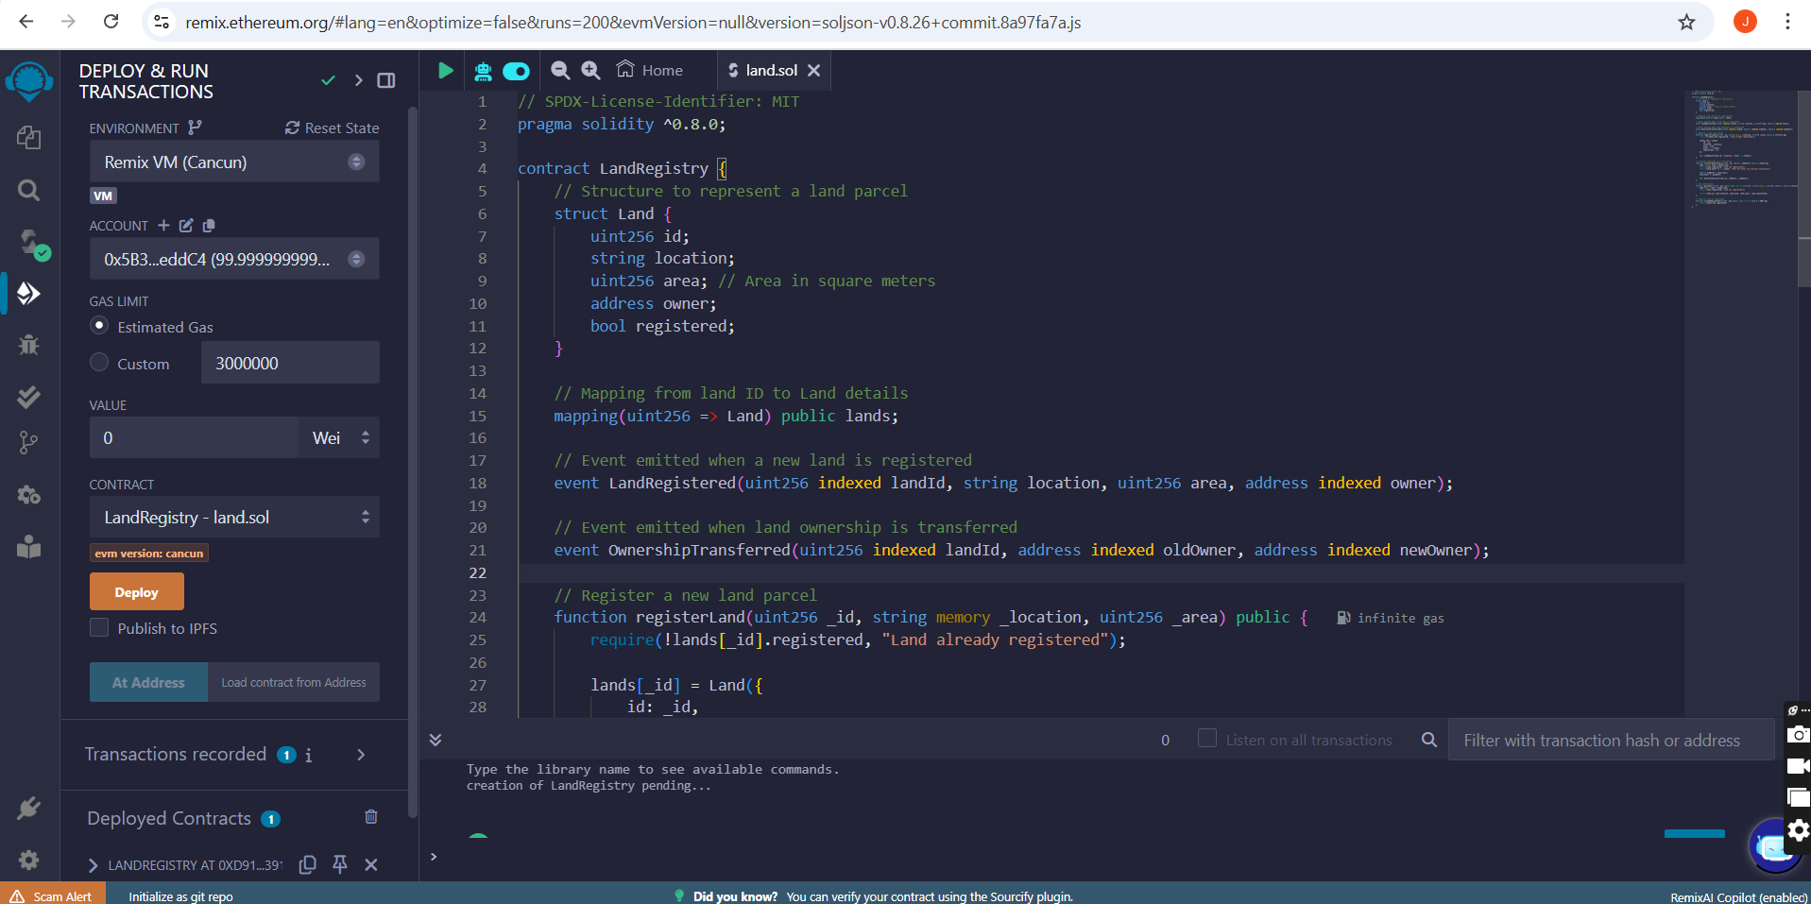
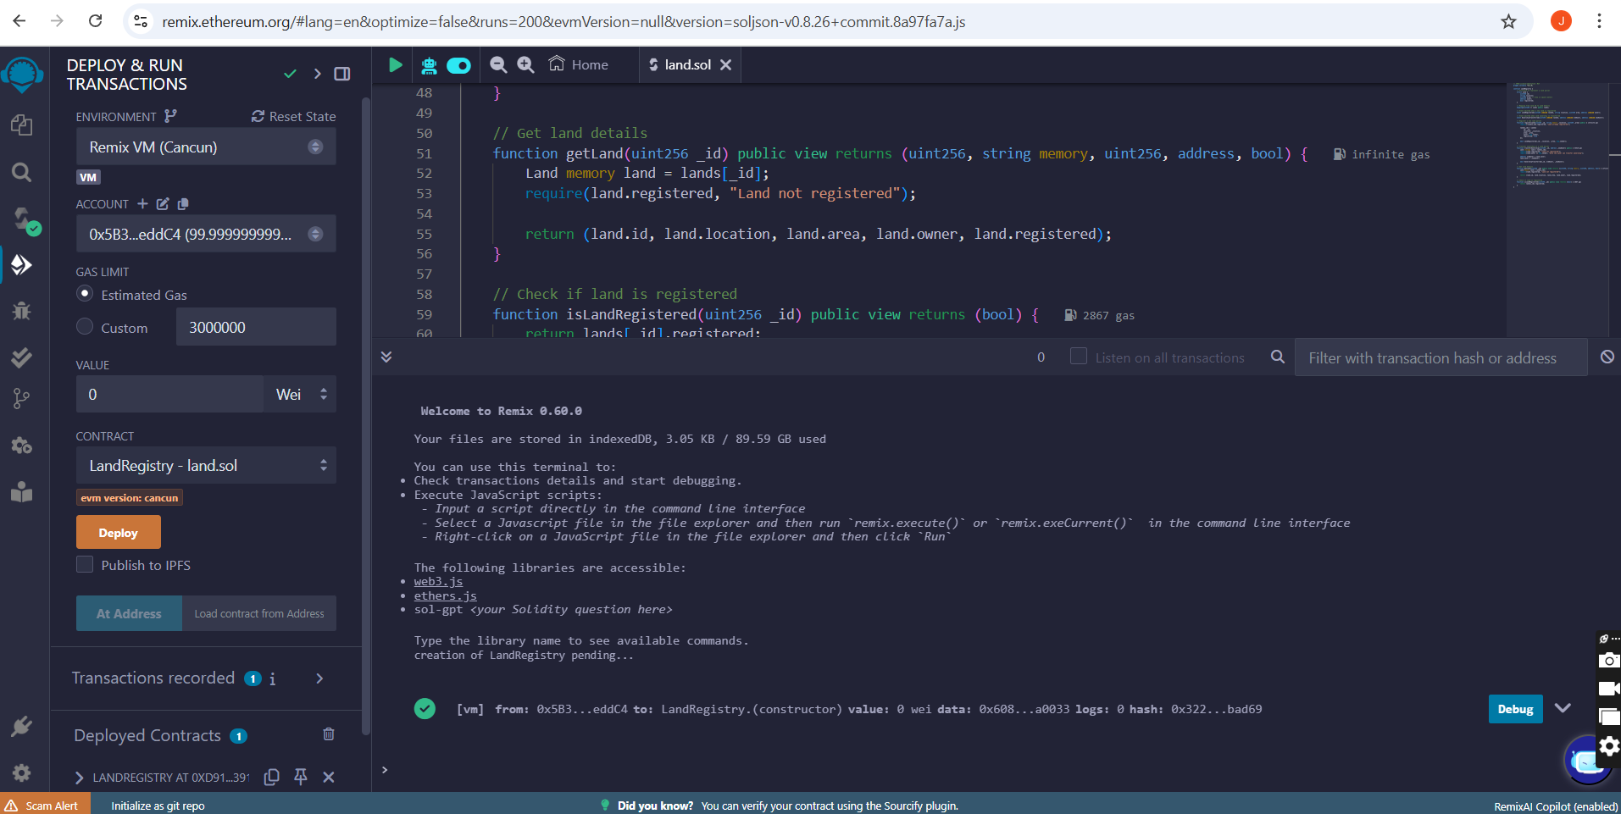
RESULTS
Demo Link:

Slide 7
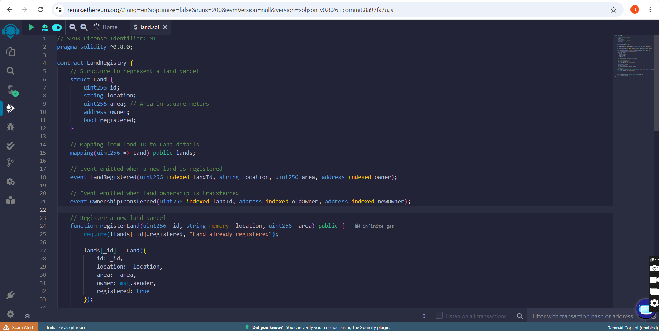
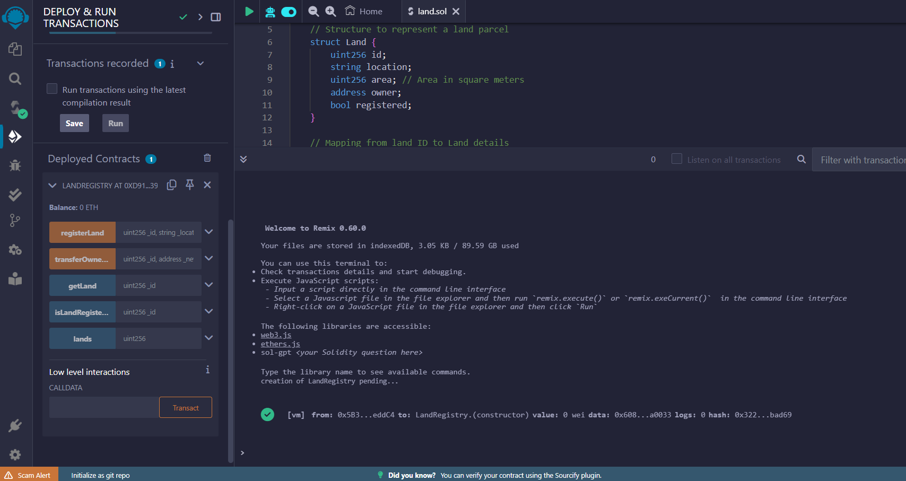
RESULTS
Demo Link

Slide 8
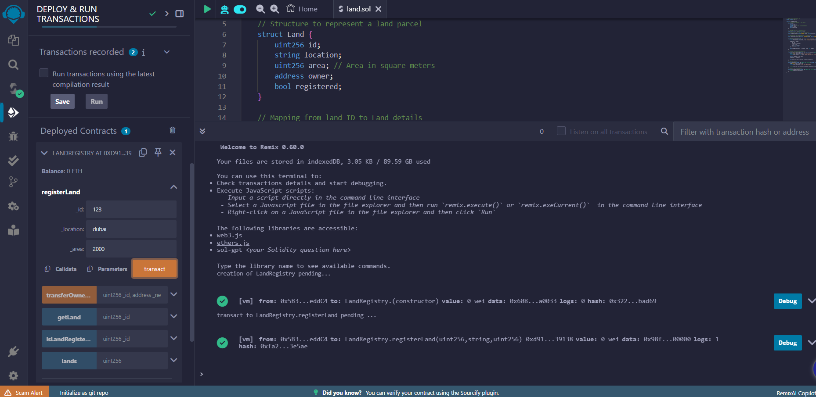
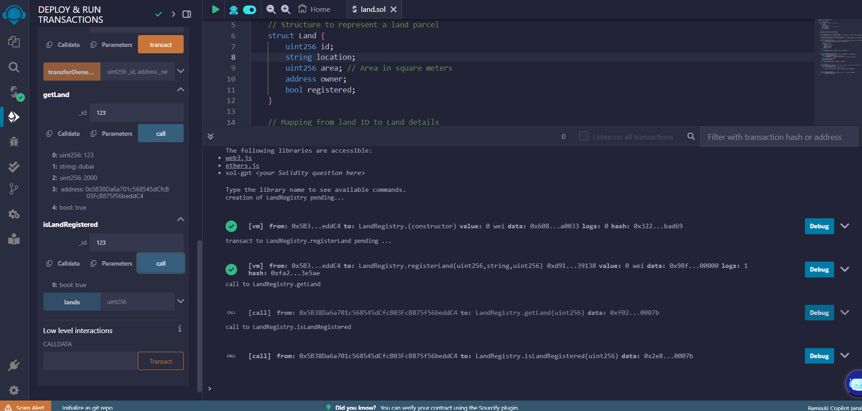
RESULTS
Demo Link

Slide 9
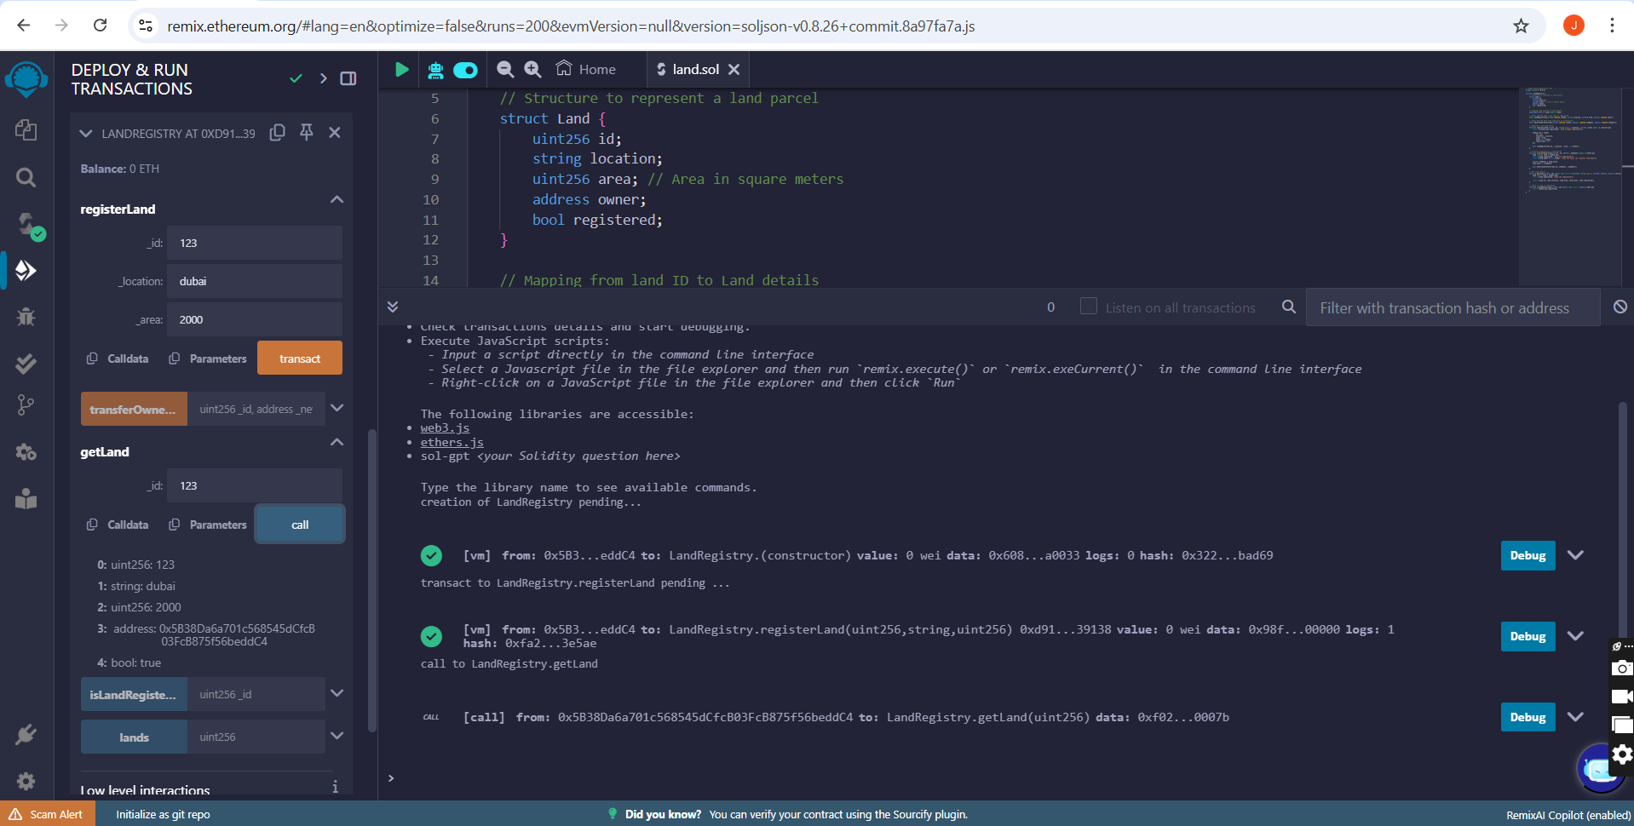
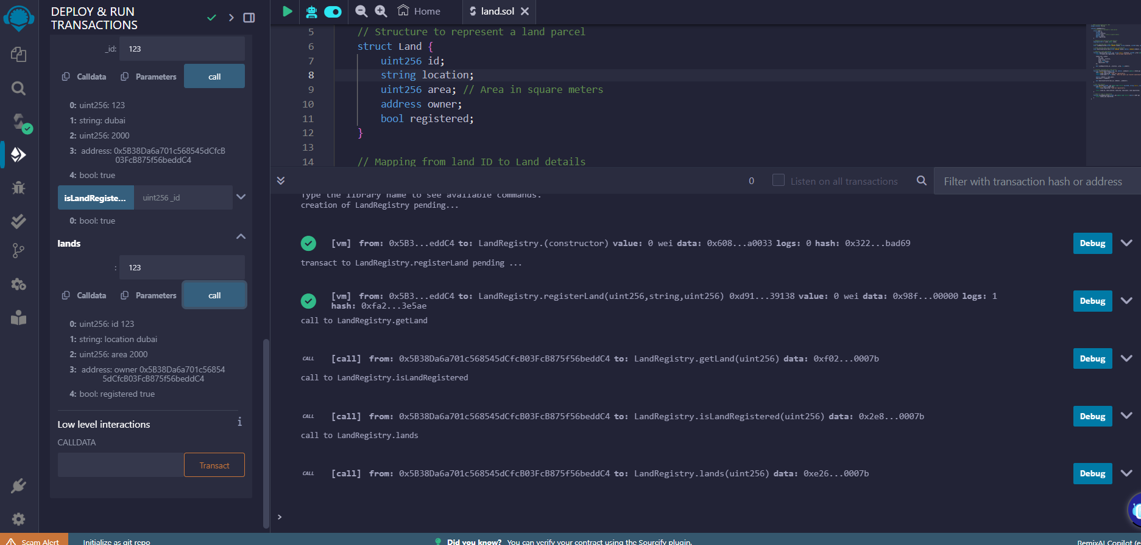
RESULTS
Demo Link

Slide 10
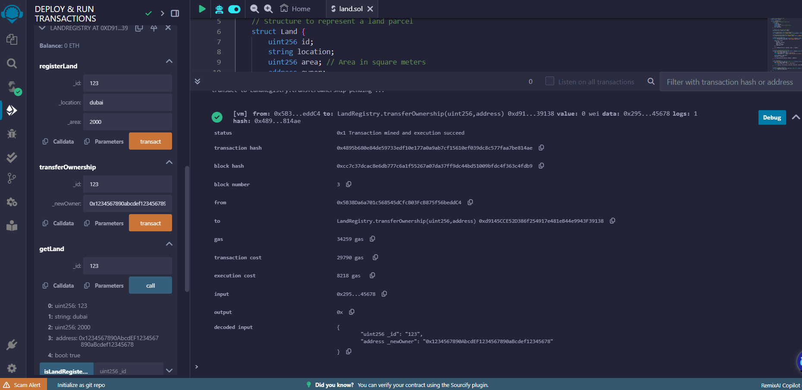
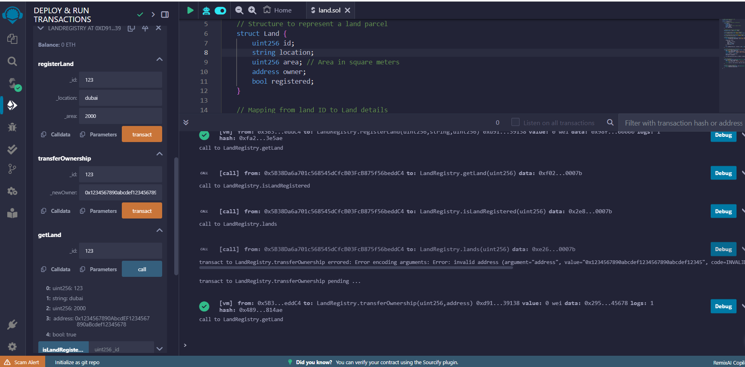
RESULTS
Demo Link

Slide 11
Thank you
.
.

