Slide 1

THE CHURN ANALYSIS
By:
Joshita Sharma

Slide 2

OVERVIEW
The Churn Analysis project is aimed to address the growing concern of customer churn within the telecom industry. By leveraging data analysis and machine learning techniques, we sought to gain a deeper understanding of customer behaviour.
The main objectives of this project were as follows:
Analyse historical customer data to identify churn patterns.
Develop a predictive model to forecast potential churn.
Create an implementation plan for short-term and long-term strategies.

Slide 3
INTRODUCTION
Churn analysis in the telecom industry refers to the process of identifying, understanding, and managing customer churn, which is the rate at which customers cease using the services of a telecommunications company and switch to a competitor or discontinue service altogether.
Importance of Churn Analysis:
Revenue Loss Mitigation: High churn rates can lead to significant revenue loss for telecom companies.
Cost Savings: Acquiring new customers is often more expensive than retaining existing ones.
Customer Insights: Churn analysis provides valuable insights into why customers leave, allowing companies to address underlying issues.

Slide 4
DATASET OVERVIEW
customerID: Unique identifier for each customer.
gender: Gender of the customer (e.g., Female or Male).
SeniorCitizen: Indicates whether the customer is a senior citizen (1 for Yes, 0 for No).
Partner: Indicates whether the customer has a partner (Yes or No).
Dependents: Indicates whether the customer has dependents (Yes or No).
tenure: The number of months the customer has been with the telecom company.
PhoneService: Indicates whether the customer has phone service (Yes or No).
MultipleLines: Indicates whether the customer has multiple phone lines (e.g., No phone service, Yes, or No).
InternetService: Type of internet service subscribed (e.g., DSL, Fiber optic, No).
OnlineSecurity: Indicates whether online security is subscribed (e.g., No, Yes, No internet service).
OnlineBackup: Indicates whether online backup is subscribed (e.g., Yes, No, No internet service).
DeviceProtection: Indicates whether device protection is subscribed

Slide 5
TechSupport: Indicates whether tech support is subscribed (e.g., No, Yes, No internet service).
Contract: Type of customer contract (e.g., Month-to-month, One year, Two year).
PaperlessBilling: Indicates whether the customer has paperless billing (Yes or No).
PaymentMethod: Payment method used by the customer (e.g., Electronic check, Mailed check, Bank transfer).
MonthlyCharges: The amount the customer is charged per month.
TotalCharges: The total amount the customer has been charged over their tenure.
Churn: Indicates whether the customer has churned (Yes or No).
DATASET OVERVIEW

Slide 6

TOOLS USED
Python: Python is the primary programming language for data analysis and machine learning.
Pandas: Pandas is a powerful library for data manipulation and analysis.
NumPy: NumPy is essential for numerical computations.
Scikit-Learn: Scikit-Learn is a machine learning library in Python. It provides a wide range of tools for evaluating machine learning models,
Matplotlib and Seaborn: These libraries are used for data visualization.
Django: Django is a high-level Python web framework that facilitates the development of robust web applications.
HTML (HyperText Markup Language): HTML is the standard markup language used to structure and present content on the web.
CSS (Cascading Style Sheets): CSS is used to style and format the HTML elements, providing a visually appealing and consistent user interface.

Slide 7

Data preprocessing
1. Data Cleaning:
Removal of duplicate records.
Handling missing values.
Outlier detection and treatment.
2. Feature Engineering:
Creation of relevant features.
Encoding categorical variables.
Scaling and normalization of numeric features.
3. Data Transformation:
Log transformations for skewed data.
Handling categorical variables.
4. Data Splitting:
Divide the dataset into training and testing sets:
Typically, 70-80% for training and 20-30% for testing.
Ensures model evaluation on unseen data.

Slide 8
EDA
Data Visualization:
Visualizing data distributions and patterns.
Histograms, box plots, scatter plots, etc.
3. Key EDA Findings:
Highlight significant discoveries during EDA:
Examples include identifying data skewness, outlier detection, and understanding feature relationships.
4. Churn Analysis Insights:
Emphasize insights directly related to churn analysis:
Identify factors that might influence customer churn.
5. Correlation Analysis:
Analyze correlations between features and the target variable (Churn):
Use correlation matrices and visualizations.
6. Data Summary:
Summarize key statistics and characteristics of the dataset:
Mention important statistics like mean, median, and standard deviation.

Slide 9
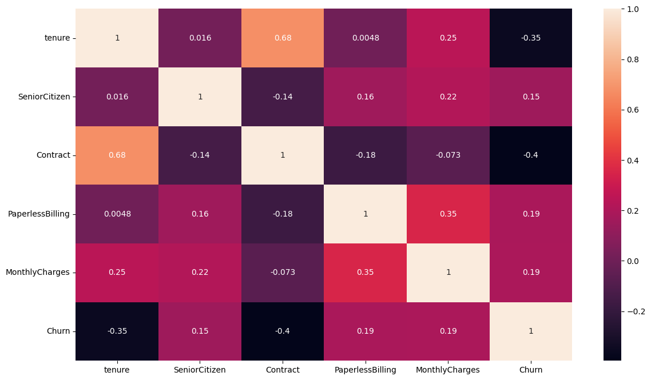
Correlation heatmap of different features with churn

Slide 10
Prediction model
We chose the Random Forest Classifier as our predictive modeling algorithm.
Random Forest is an ensemble learning method known for its:
High predictive accuracy.
Ability to handle both categorical and numerical data.
Robustness against overfitting.
Feature importance assessment.
Model Building:
Feature Selection
Encoding Categorical Variables
Hyperparameter tuning.
Feature Scaling
Feature Importance Analysis
Model Training:
We used telecom dataset from Kaggle and split the data in80:20 ratio.
The number of estimators used in random forest classifier are 18.

Slide 11
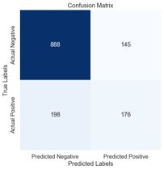
Model Evaluation:
For model evaluation metrics used were:
Accuracy score
Precision score
Recall
F1 Score
Confusion matrix
Feature Importance:
the important of features in predicting churn are:
Tenure, senior citizen, contract, paperlessbiling, monthlycharges

Slide 12

Insights
Churn rates patterns
Contract Length Influence:
Customers with longer-term contracts have lower churn rates.
High Monthly Charges Impact:
Customers with high monthly charges are more likely to churn.
Tenure impact:
Churn rates tends to decrease as tenure increases
Customer age influence:
Churn rates also slight increases if the user is a senior citizen
Payment Method Preferences:
Customers using electronic check as a payment method have higher churn rates.

Slide 13
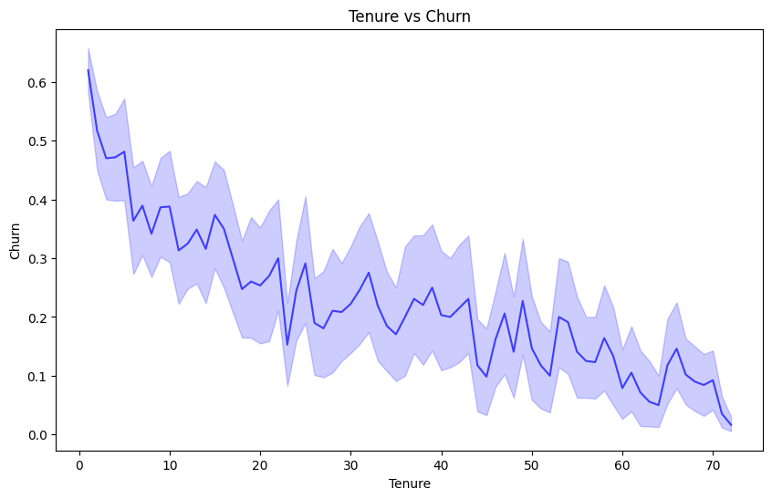
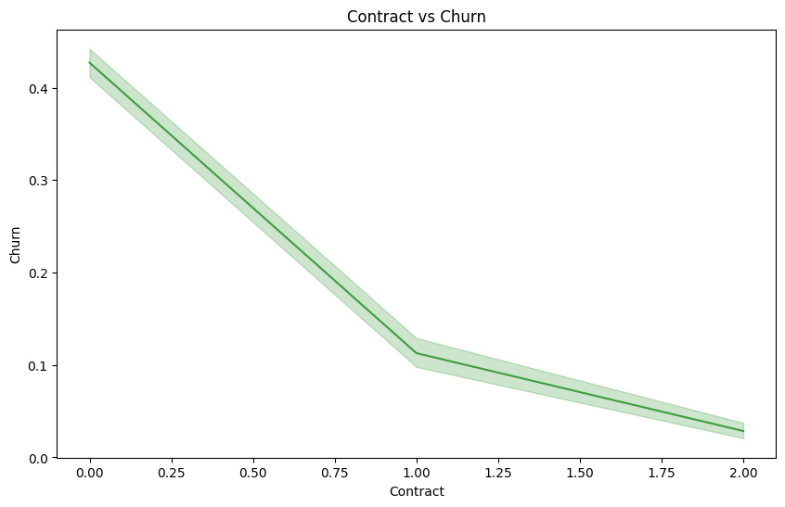
Relationship between Features and Target

Slide 14
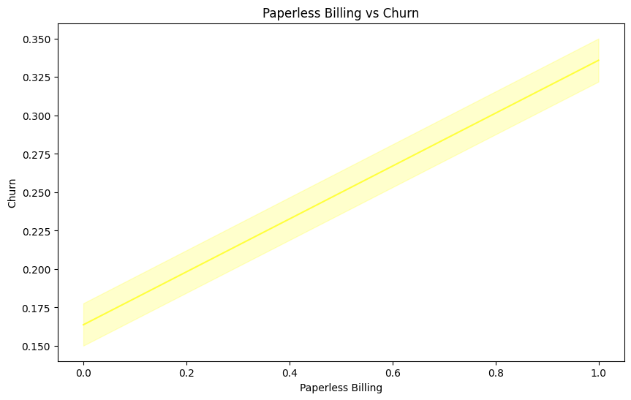
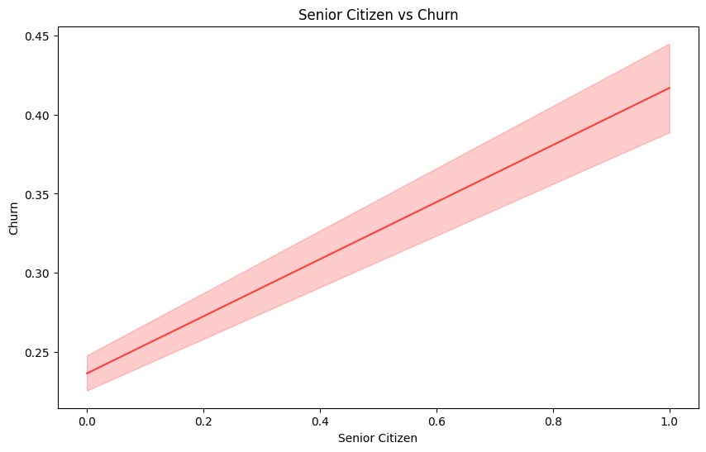
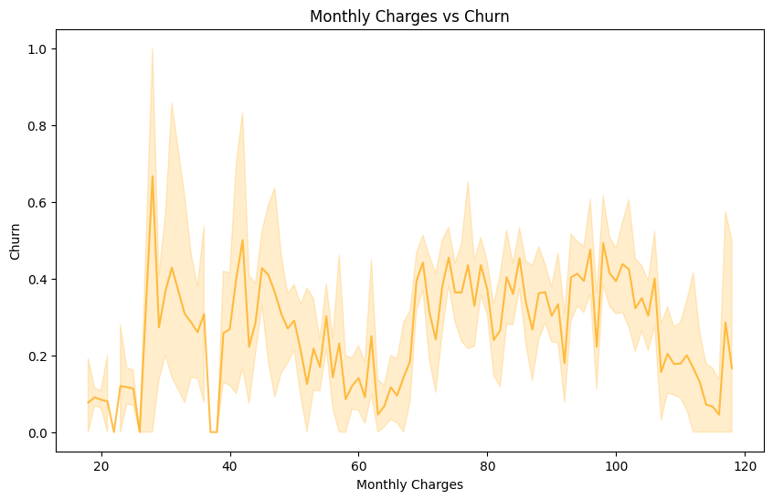

Slide 15

Recommendations
Keeping in mind the insights
Recommendation are:
Promote longer contract options and provide incentives for customers to commit to extended contracts. sights following are the recommendations
Evaluate pricing strategies to remain competitive and consider offering discounts to high-value customers.
Encourage customers to consider longer contracts with benefits like price stability.
Tailor retention strategies for each segment based on their unique needs and preferences.
Invest in improving customer service, training representatives, and addressing customer issues promptly.
Improve customer engagement through personalized communication, proactive support, and loyalty programs.

Slide 16
CONCLUSION
Churn insights: we've identified key behavior patterns and the driving force for customer turnover.
Top Churn Factors: The main factors affecting the number of subscribers are monthly charges, contract types ,use of services and tenure.
Segmentation Impact: Customer segmentation is vital for tailored retention strategies.
Recommended strategies: Prioritize the retention of high value customers, optimize pricing and enhance customer engagement.
Call to Action: It's time to act on these insights and strategies to reduce churn and improve customer retention.
Data Quality: ensure that the data quality is optimal in order to analyse and make decisions.
Continuous monitoring: Every time the rate of churn is assessed, strategies are adjusted according to it.
Impact on businesses: There may be considerable revenue preservation as a result of the implementation of our recommendations.

Slide 17
Future scope
Data Enhancement :
Collect additional data sources, including customer feedback and external indicators, to improve model accuracy.
Advanced Predictive Models : While the project currently uses a Random Forest Classifier, there is room to explore more advanced predictive modeling techniques. Algorithms like gradient boosting, neural networks, or deep learning may yield even better predictive accuracy.
Customer Lifetime Value (CLV) :
Develop CLV models to predict the long-term value of customers. This can guide acquisition and retention efforts by identifying high-value customers.

Slide 18

REFERENCES
Kaggle .com
Google.com
scikit-learn Documentation (sklearn)
Pandas Documentation
Numpy Documentation
Seaborn Documentation

Slide 19
THANKYOU

