Slide 1

Post-Pandemic data-driven health analysis across different categories
(age + gender) survey BOTH PHYSICAL AND PSYCHOLOGICAL
Joshiitha Reddy, B24DS009 : Data Analysis and Visualization project :

Slide 2
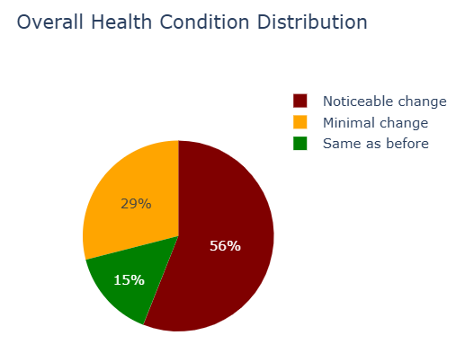
Health changes (PHYSICAL AND PSYCHOLOGICAL)

Slide 3
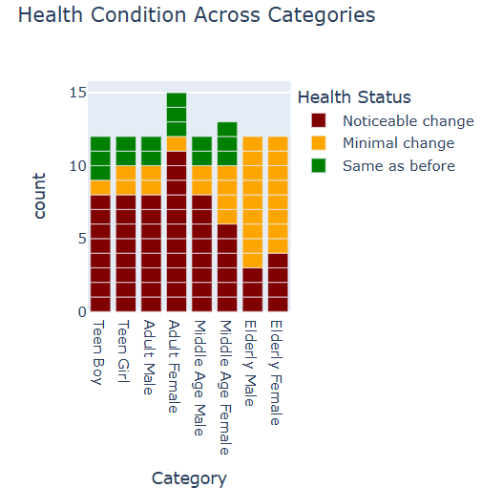
The intensity of Symptoms across different category of people

Slide 4
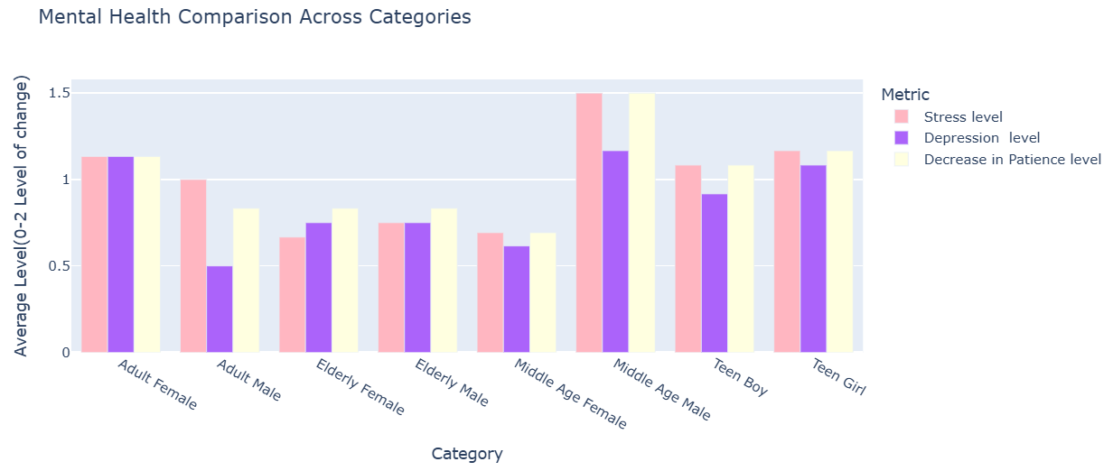
Mental health across categories
Insight:- Middle aged male are facing the highest stress and anxiety

Slide 5
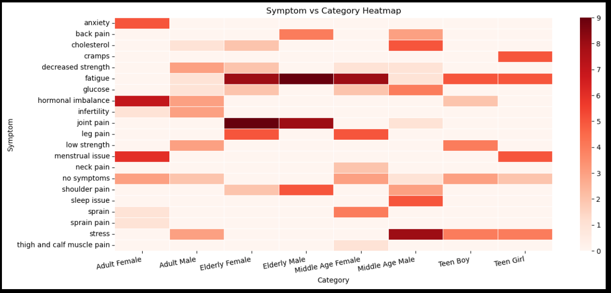
Symptoms patterns across Categories
TRENDS:- Similar age groups have similar kind of problems afer COVID-19

Slide 6
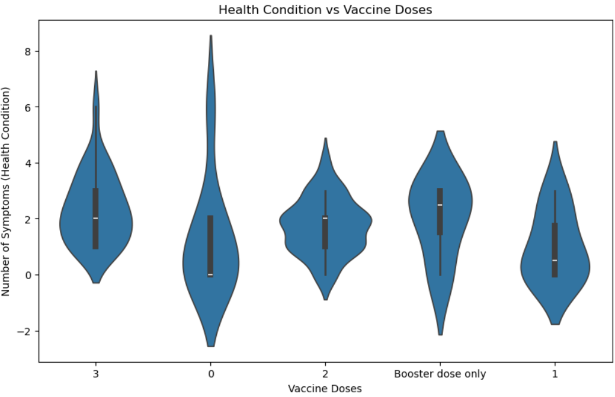
Number of vaccination and Health Issues

Slide 7
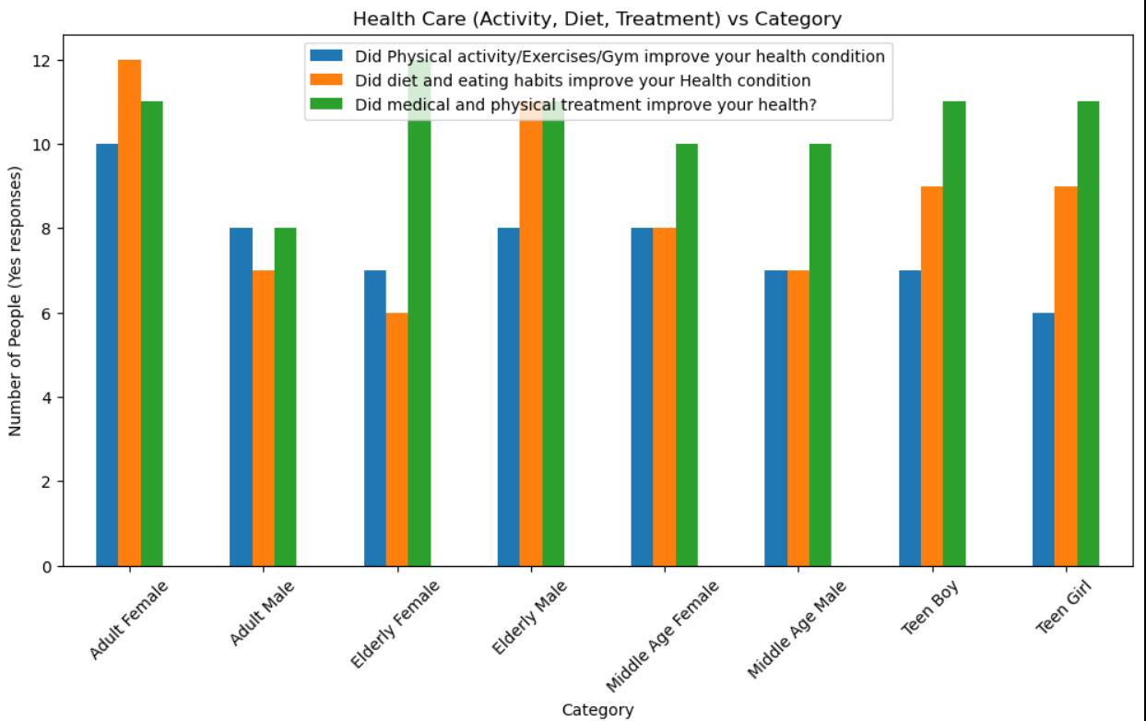
Can we overcome the dynamics of Health issues?
Insights:- Individuals who maintained disciplined lifestyles—including regular physical activity, a balanced diet, and, where necessary, appropriate medical care—demonstrated a significantly higher degree of recovery from these symptoms.

Slide 8

Insights & Implications
1. Health Issues severity varied across individuals (high, medium, low)
2. Similar age groups experienced common change patterns
3. Mental health disturbance was notable in specific groups (middle-aged males, adult females, teen girls)
4. Individuals with disciplined lifestyles showed fewer symptoms and faster recovery
5. Previously infected individuals exhibited a broader range of symptoms beyond common categories

