Slide 1
ARTIFICIAL INTELLIGENCE • PROJECT PRESENTATION
BFS vs UCS
Pathfinding Simulator
TREASURE HUNT
Finding the best route across terrain with different movement costs.
TEAM: ALGORITHMERS
COURSE: AI
FEWEST STEPS vs LOWEST COST
Joshitha Reddy • Lukesh • Vishal • Prem Charan • Sanjana
BFS vs UCS • AI PATHFINDING PROJECT • TEAM ALGORITHMERS
01

Slide 2
01 / BACKGROUND
Two search strategies, two objectives
Both explore a state space, but they define the “best” path differently.
BFS
UCS
Breadth-First Search
Uniform Cost Search
• Uses a FIFO queue (First In, First Out)
• Uses a priority queue (lowest cost first)
• Expands nodes level by level
• Expands the cheapest frontier node
• Finds the path with the fewest steps
• Finds the minimum-total-cost path
• Treats every move as having equal cost
• Accounts for different terrain movement costs
TIME COMPLEXITY: O(V + E)
TIME: O((V + E) log V)
TERRAIN COSTS Grass = 1 | Mud = 3 | Water = 5 | Wall = Blocked
BFS vs UCS • AI PATHFINDING PROJECT • TEAM ALGORITHMERS
02

Slide 3
02 / TEAM WORK DISTRIBUTION
Project Contributions
Five complementary workstreams across problem design, search algorithms, application and evaluation.
MEMBER 1 — PREM CHARAN
MEMBER 2 — LUKESH
MEMBER 3 — VISHAL
Problem Design & Environment
BFS Algorithm & Documentation
UCS Algorithm
• Define problem and objectives
• Implement BFS using FIFO queue
• Implement UCS using priority queue
• Design grid and terrain types
• Track visited nodes and reconstruct path
• Calculate cumulative movement cost
• Create preset maps and custom controls
• Prepare project report and presentation PPT
• Update minimum-cost paths; compare with BFS
MEMBER 4 — JOSHITHA REDDY
MEMBER 5 — SANJANA
Treasure Hunt & Application
Performance Analysis
• Implement treasure collection
• Measure path cost, steps and nodes
• Optimize treasure visiting order
• Measure execution time and net score
• Integrate BFS/UCS and Streamlit interface
• Run map benchmarks and report results
Team Algorithmers • Course: AI • Each member should understand the complete project.
BFS vs UCS • AI PATHFINDING PROJECT • TEAM ALGORITHMERS
03

Slide 4
03 / SYSTEM ARCHITECTURE
Architecture of the Treasure Hunt Simulator
A configurable grid feeds the search algorithms, treasure planner and shared performance audit.
1 ENVIRONMENT
2 SEARCH ENGINES
3 TREASURE MODE
4 PERFORMANCE AUDIT
Preset maps
Custom map builder
Terrain + obstacles
→
BFS: FIFO queue
UCS: Priority queue
Path reconstruction
→
Visit treasures
Choose best order
Return to goal
→
Path cost + steps
Expanded nodes + time
Net score
USER INTERFACE
Streamlit dashboard • Map selection • BFS/UCS execution • Path visualization
TECH STACK
Python • Streamlit • NumPy • Matplotlib • Pandas
The same evaluation metrics are used to compare both algorithms consistently.
BFS vs UCS • AI PATHFINDING PROJECT • TEAM ALGORITHMERS
04

Slide 5
04 / EXPERIMENTAL RESULTS
BFS vs UCS: Results Across Three Maps
Values are taken from the uploaded simulator screenshots; execution times are shown in milliseconds.
Map
BFS
Cost
UCS
Cost
BFS
Steps
UCS
Steps
BFS
Nodes
UCS
Nodes
Net score
BFS / UCS
Easy
Meadow Crossing
14
14
14
14
85
79
21 / 21
Benchmark
Triple Corridor
21
21
15
15
71
50
19 / 19
Hard
Archipelago & Straits
44
38
32
34
297
283
191 / 197
EXECUTION TIME (BFS / UCS)
Easy: 0.37 / 0.45 ms • Benchmark: 0.20 / 0.17 ms • Hard: 1.33 / 2.04 ms
Key observation: UCS reduces cost on the Hard map; both algorithms tie on Easy and Benchmark path cost.
BFS vs UCS • AI PATHFINDING PROJECT • TEAM ALGORITHMERS
05

Slide 6
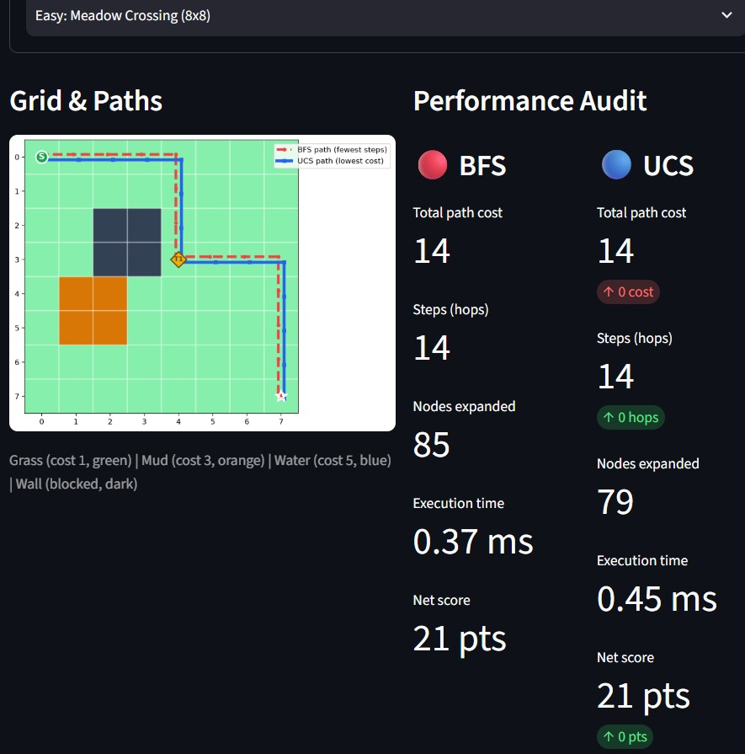
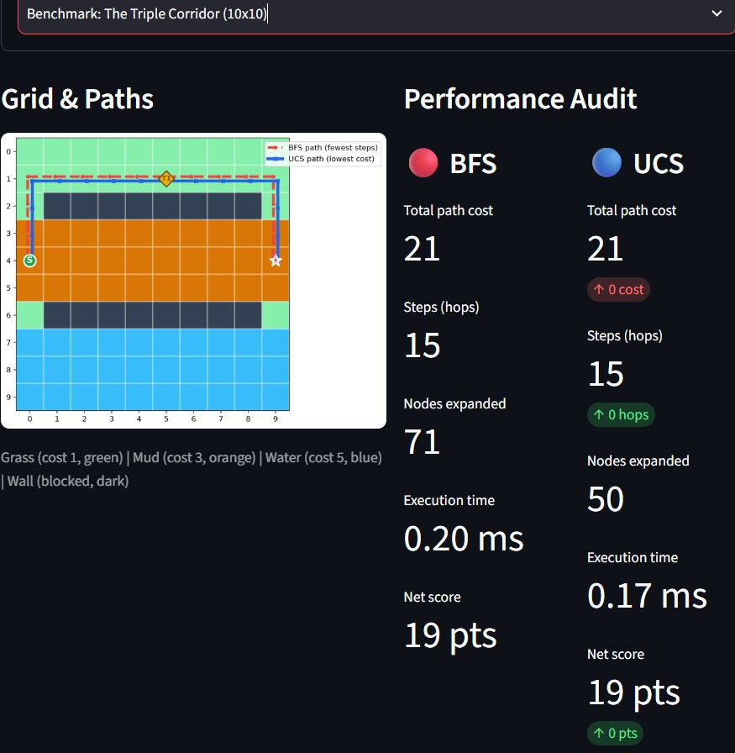
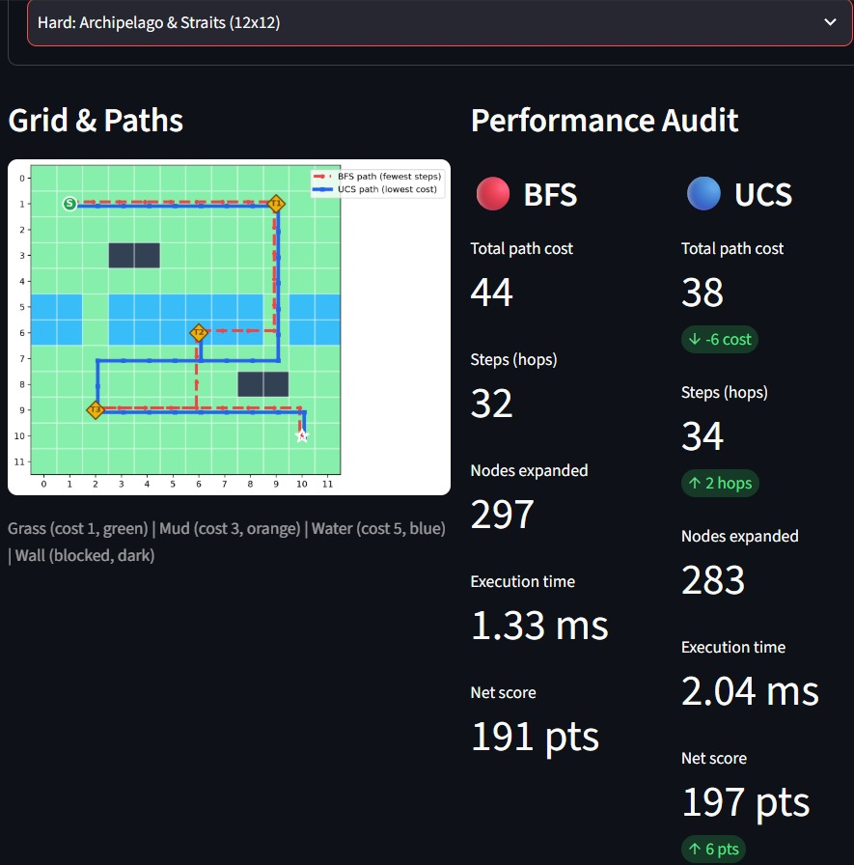
05 / VISUAL RESULTS
Simulator Screenshots
The uploaded screenshots show the path overlays and performance audit for Easy, Benchmark and Hard maps.
EASY — MEADOW CROSSING
BENCHMARK — TRIPLE CORRIDOR
HARD — ARCHIPELAGO & STRAITS
BFS and UCS both cost 14 and use 14 steps.
Both cost 21 and use 15 steps.
UCS cost 38 vs BFS cost 44; two extra steps.
BFS vs UCS • AI PATHFINDING PROJECT • TEAM ALGORITHMERS
06

Slide 7
ARTIFICIAL INTELLIGENCE • PROJECT PRESENTATION
THANK YOU
Team Algorithmers | Course: Artificial Intelligence
BFS vs UCS Pathfinding Simulator — Treasure Hunt
FEWEST STEPS vs LOWEST COST
BFS vs UCS • AI PATHFINDING PROJECT • TEAM ALGORITHMERS
07

