Slide 1

EduBot – A Smart Academic Companion

Slide 2

Batch-14 :
Team Name: Nexus minds
Member 1: D. Sri Hari Krishna(231FA04956), CSE, VFSTR
Member 2: A.Shiva Anjali (231FA04515), CSE ,VFSTR
Member 3: Joshma Joy.Kalimela (231FA04525), CSE, VFSTR
Member 4: Saloni(231FA04550), CSE, VFSTR

Slide 3

Abstract
EduBot is an AI-powered multi-modal intelligent learning assistant designed to enhance student learning by enabling interaction with academic content through images, text, and voice. It leverages Optical Character Recognition (OCR) to extract textual content, uses transformer models for summarization and question answering, supports multilingual translation, and provides voice interaction. Integrated with a chatbot interface, EduBot facilitates personalized and accessible learning, promoting faster comprehension especially useful for self-study, remote education, and multilingual learners.

Slide 4

Introduction
With the increasing reliance on digital education platforms, students face challenges in processing large volumes of academic material efficiently. EduBot addresses this by providing an intelligent assistant capable of extracting, summarizing, and interpreting educational content from various sources, including handwritten notes, scanned pages, and voice queries. By incorporating text-to-speech and multilingual translation features, EduBot aims to make learning more inclusive and interactive. This project integrates cutting-edge AI models with user-friendly interaction interfaces to foster effective autonomous learning.

Slide 5

Literature Review The development of AI educational assistants has gained momentum with advances in natural language processing (NLP) and computer vision. Optical Character Recognition (OCR) technologies such as Tesseract and EasyOCR have enabled text extraction from diverse document formats. Transformer-based models like T5, BART, and Pegasus have proven effective for summarization tasks, providing concise representations of large texts. Question answering systems built on BERT and RoBERTa architectures allow precise information retrieval from context. Speech recognition models, including OpenAI Whisper and Google’s speech-to-text APIs, have enhanced voice interaction, complemented by text-to-speech tools like gTTS and pyttsx3. Prior works demonstrate the potential of chatbots in education to deliver personalized assistance (Wang et al., 2021; Kumar et al., 2022), but a unified multi-modal assistant remains an open research and development area.

Slide 6
Methodology:
EduBot development involved modular integration of multiple AI technologies:
OCR Module: Input images such as textbook pages or handwritten notes are processed using Tesseract/EasyOCR to extract raw text.
Summarization Module: Extracted or directly input text is summarized using transformer models (T5/BART/Pegasus) to produce concise chapter overviews.
Question Answering Module: Users can query the content. Using fine-tuned transformer QA models, EduBot locates and returns precise answers.
Voice Interaction Module: Speech queries are converted to text using Whisper or speech_recognition libraries. Responses are read aloud using gTTS/pyttsx3.
Translation Module: Summaries and answers are translated into regional languages (e.g., Tamil, Hindi) via Google Translate API or similar services.
Chatbot Integration: The entire system is wrapped within a chatbot interface (Dialogflow or Gemini API), enabling conversational academic assistance.

Slide 7

Technologies and Tools
Task | Tools/Packages
OCR | pytesseract, EasyOCR
Summarization | transformers (T5, BART, Pegasus)
Question Answering | transformers (bert-base-uncased, roberta-base-squad2)
Speech Recognition | speech_recognition, Whisper
Text-to-Speech | gTTS, pyttsx3
Translation | googletrans, deep_translator
Chatbot Interface | Dialogflow, Gemini API, rule-based chatbots

Slide 8

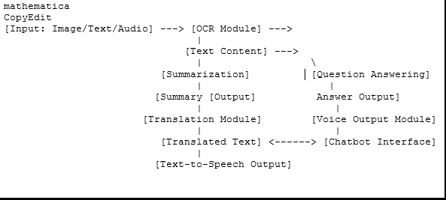
Block Diagram:

Slide 9
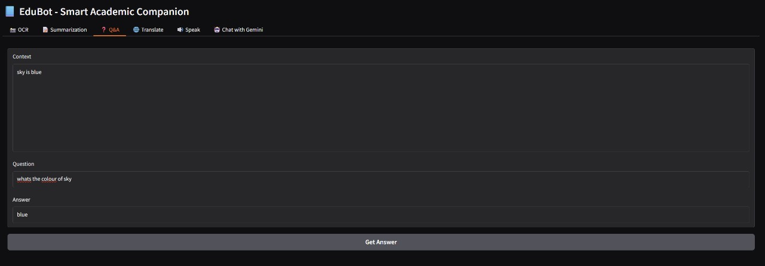

Slide 10
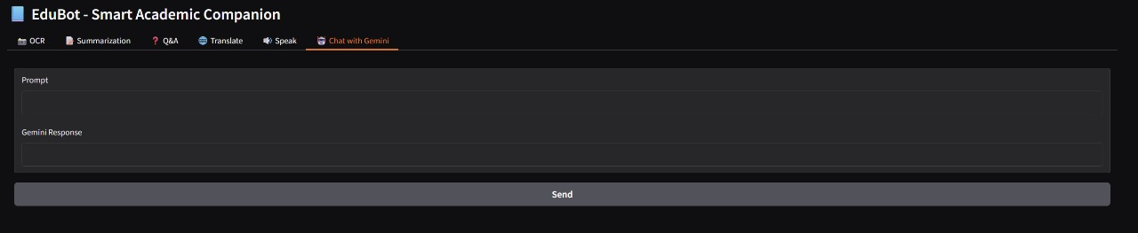

Slide 11
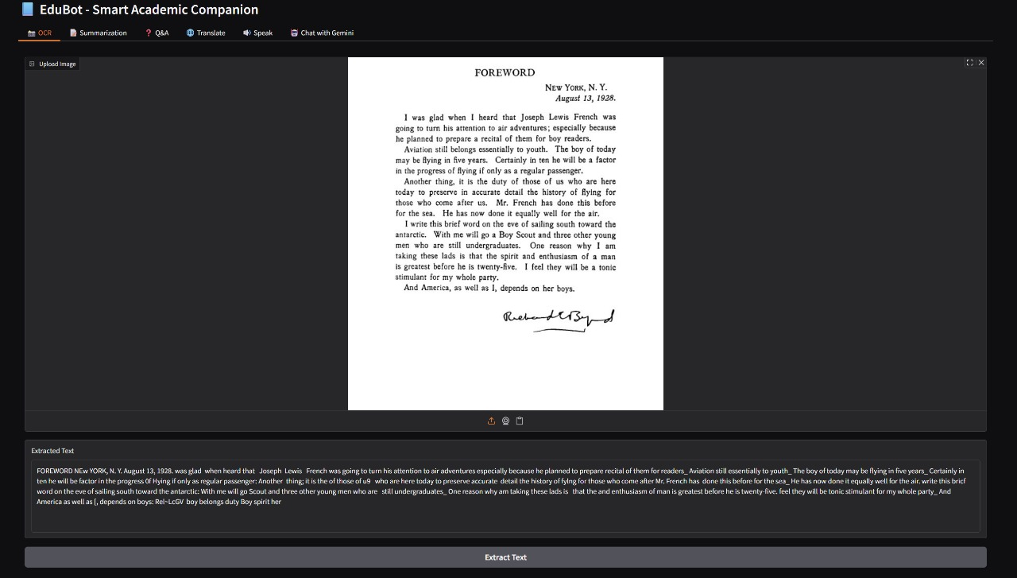

Slide 12
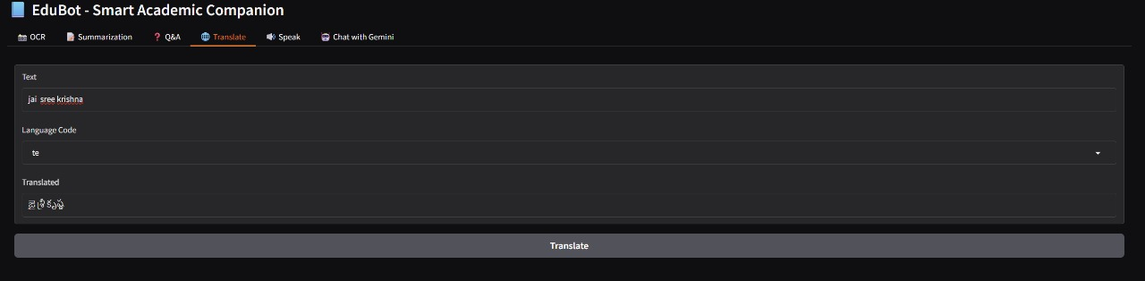

Slide 13
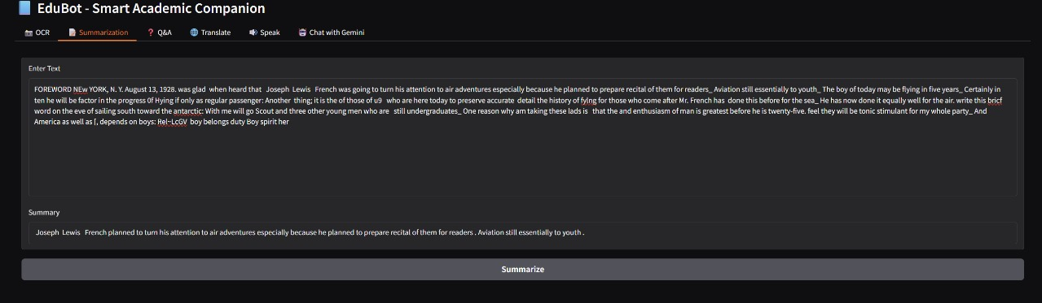

Slide 15

Results and Discussion
EduBot successfully demonstrated the ability to process diverse academic inputs including images and voice queries. The OCR module efficiently extracted text from scanned notes, which transformer-based summarization condensed to key points, facilitating quick review. Question answering yielded accurate, contextually relevant responses, and voice interaction modules provided hands-free accessibility. Translation into Hindi and Tamil enhanced usability for regional language speakers, promoting inclusivity. Integration into a chatbot interface created a seamless, interactive learning experience.
Challenges encountered included OCR inaccuracies with poor-quality handwriting, requiring preprocessing improvements. Summarization occasionally omitted nuanced information, highlighting the need for model fine-tuning on educational datasets. Speech recognition performance varied with ambient noise levels, suggesting future work on noise robustness. Overall, EduBot exemplifies how AI can bridge gaps in educational accessibility and engagement.

Slide 16
Conclusion
EduBot as a multi-modal intelligent academic companion successfully integrates OCR, NLP, speech, and translation technologies to aid students in understanding and interacting with academic content. Its capacity to summarize, answer questions, translate, and vocalize information fosters accelerated and inclusive learning, especially benefiting self-learners, remote students, and multilingual users

Slide 17
Future Scope
Enhance OCR accuracy with handwriting-specific models and image preprocessing.
Incorporate domain-specific fine-tuned transformers for specialized subjects.
Expand multilingual support and dialect recognition in voice modules.
Implement predictive analytics to track learning progress and recommend personalized study plans.
Integrate clustering to identify frequently asked topics and adapt content delivery.
Deploy EduBot on mobile platforms for ubiquitous accessibility.

Slide 18

References
Vaswani, A., et al. (2017). Attention is All You Need. NeurIPS.
Raffel, C., et al. (2019). Exploring the Limits of Transfer Learning with a Unified Text-to-Text Transformer. JMLR.
Devlin, J., et al. (2019). BERT: Pre-training of Deep Bidirectional Transformers for Language Understanding. NAACL.
Brown, T., et al. (2020). Language Models are Few-Shot Learners. NeurIPS.
Wang, X., et al. (2021). AI-Powered Chatbots in Education: Enhancing Student Engagement. Educational Technology Review.
Kumar, P., et al. (2022). Multi-modal Intelligent Tutoring Systems: A Survey. IEEE Access.

Slide 19
Bibliography
Hugging Face Transformers Documentation: https://huggingface.co/transformers/
Tesseract OCR Documentation: https://github.com/tesseract-ocr/tesseract
Google Translate API Documentation: https://cloud.google.com/translate/docs
SpeechRecognition Library: https://pypi.org/project/SpeechRecognition/
gTTS Library: https://pypi.org/project/gTTS/

Slide 20
THANK YOU

