Slide 1


FALAYN
Gulf Job Application Tracker
Organise your applications. Stay on top of your Gulf job search.
Notes:
1

Slide 2
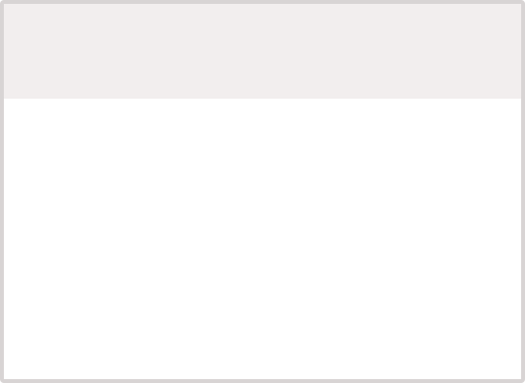

Track Your Job Search in 3 Simple Steps
1
2
3
Find a Job
Track It
Follow Up
Save the opportunities that match your skills and career goals.
Record the company, role, location, application date, and status.
Add a follow-up date so important applications do not get forgotten.
Notes:
2

Slide 3

My Gulf Job Application Tracker
Example entries to get you started:
Company
Job Title
Location
Applied
Status
Follow-Up
Notes
Emaar Properties
Project Manager
Dubai, UAE
Jan 15
Applied
Jan 29
Follow up via email
ADNOC
Operations Analyst
Abu Dhabi, UAE
Jan 10
Interview
Jan 25
Interview scheduled Feb 5
Majid Al Futtaim
HR Specialist
Dubai, UAE
Jan 8
Saved
Jan 22
Customise CV for role
Status options: Saved • Applied • Interview • Offer • Rejected
Copy this format to your own spreadsheet — Excel, Google Sheets, or print this page.
Notes:
3

Slide 4


Know Where Every Application Stands
Saved
Applied
Jobs you plan to apply for.
Applications you have submitted.
Interview
Offer
An interview has been scheduled.
You have received an offer.
Rejected
The application was unsuccessful.
Notes:
4

Slide 5
My Weekly Job Search Check-In
Weekly Checklist
Applications Sent
Follow-Ups Completed
Updated my tracker
_______________
Followed up on pending applications
_______________
Applied to relevant opportunities
Prepared for upcoming interviews
Interviews Scheduled
New Opportunities Found
_______________
_______________
Notes:
5

Slide 6

Don't Just Apply.
Track Your Progress.
Keeping your job applications organised helps you remember important deadlines, follow up on pending applications, prepare for interviews, and track your progress. A simple tracker transforms your job search from overwhelming to manageable — giving you clarity on where each opportunity stands and confidence in your next steps.
FALAYN
Free Career Resources for Gulf Job Seekers
Notes:
6

