Slide 1



The Gulf Job Seeker’s Career Starter Guide
This premium guide helps early-career professionals and job seekers across the Gulf region find opportunities, connect with recruiters and prepare for their next career move. Practical, scannable, and designed for quick action — includes checklists, message templates, a 7‑day plan and interview prep.
FALAYN
GULF CAREERS
DOWNLOADABLE PDF
Page 1 • Cover
Notes:
1

Slide 2


Welcome to Your Gulf Job Search
Finding a job in the Gulf combines local market awareness with proactive networking. This guide focuses on practical steps: clarifying what you want, building a recruiter-friendly profile, targeted search tactics and concise communications that get replies.
Who this guide is for
What you’ll get
Early-career professionals and recent graduates targeting roles across GCC countries.
Actionable checklists, recruiter message templates, interview preparation and a 7‑day action plan.
Page 2 • Introduction
Notes:
2

Slide 3
Know What You’re Looking For
Before applying, define your target role, industry and location preferences. Narrowing your search saves time and improves application quality. Use role level, sector and location as primary filters and list must-have vs nice-to-have criteria.
Role
Industry
Location
Compensation & Benefits
Title, seniority, core responsibilities
Finance, tech, healthcare, construction, hospitality, etc.
Prefer city, country, remote options and visa considerations
Salary band, housing, transport, healthcare expectations
Write a short target statement: one or two sentences that describe your ideal next role. Keep it visible while you apply — it helps tailor each application quickly.
Page 3 • Self‑clarity
Notes:
3

Slide 4

Gulf Job Search Preparation Checklist
Prepare the essentials so you can apply quickly and professionally. This checklist covers profile assets, documents and account setup.
01
02
CV & Resume
LinkedIn Profile
One-page concise resume, tailored for the role, with clear achievements and quantified results where possible.
Professional photo, headline with role target, concise summary and up-to-date experience.
03
04
Recruiter Profile
Documents
Create or update a Falayn profile with key skills, location and preferred contact method.
Organise scanned degrees, certificates and references in one folder for quick sharing.
Tip: Save CV versions named with role and company for easy tracking (e.g., CV-Marketing-CompanyX.pdf).
Page 4 • Checklist
Notes:
4

Slide 5
How to Search for Opportunities
Combine direct applications with network and recruiter outreach. Use targeted filters on job boards, follow company careers pages and set alerts for keywords matching your target statement.
Use role + location keywords (e.g., "Junior Accountant Dubai")
Set daily alerts and prioritise freshly posted roles
Follow industry recruiters and hiring managers on LinkedIn
Apply early — the Gulf market moves quickly for in‑demand roles
Quick Tools
Falayn profile & alerts
LinkedIn saved searches
Company career pages
Page 5 • Search tactics
Notes:
5

Slide 6



How to Approach Recruiters
Recruiters value clarity and responsiveness. Lead with your target role, key skills and availability. Keep messages short, professional and tailored — make it obvious why you’re a match.
Be Concise
Include Essentials
Attach CV
Two–three lines summarising your fit and availability.
Role target, top 2 skills, current location and notice period.
Attach a role-tailored CV and mention it briefly in the message.
Use a polite close with a clear CTA: ask if they’d like your CV or a quick call. Respond quickly when recruiters reply — speed matters.
Page 6 • Recruiter outreach
Notes:
6

Slide 7




25 Ready-to-Send Recruiter Messages
This collection is the premium value of the guide. Each message is short, customisable and designed to fit common recruiter scenarios. Copy, paste and adapt to your context.
1. Interest after seeing role
2. Short follow-up
3. Available immediately
Hi [Name], I saw your posting for [Role]. I’m a [Title] with experience in [Skill]. I’ve attached my CV and am available to speak this week.
Hi [Name], checking in on my application for [Role]. I remain very interested and can be available for interview at short notice.
Hi [Name], I’m currently available to start immediately. My CV is attached — happy to discuss next steps.
Note: The full set contains 25 templates covering cold outreach, referral requests, role clarifications, salary conversations and polite rejections. Keep templates nearby and personalise quickly before sending.
Falayn users can store and send templates directly from their profile for faster outreach.
Page 7 • Templates
Notes:
7

Slide 8

How to Follow Up After Applying
Follow-up shows interest without pestering. Wait 5–7 business days after applying, then send a concise, polite message referencing the role and reiterating your fit. If you’ve already spoken, follow up within 48–72 hours with a thank-you and next steps question.
Wait 5–7 days
Send concise inquiry
Thank you 48–72h
Ask about timeline
Keep a simple tracker (company, role, date applied, recruiter, follow-up dates) to avoid duplicate or missed messages.
Page 8 • Follow up
Notes:
8

Slide 9

Interview Preparation Checklist
Preparation increases confidence. Use this checklist to cover logistics, company research and practice.
Prepare STAR Stories
Research the Company
Three concise examples for common competencies: teamwork, problem-solving, initiative.
Understand core products, values and the role’s place within the team.
Questions for Interviewer
Practical Checks
Prepare 3 thoughtful questions about role expectations, team and next steps.
Test tech (camera/mic), plan route for in-person, prepare documents to share.
Print or save a one-page interview brief with your STAR stories and role-specific notes.
Page 9 • Interview prep
Notes:
9

Slide 10
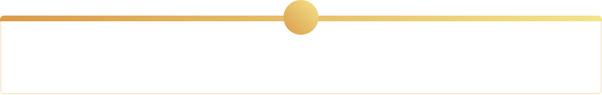
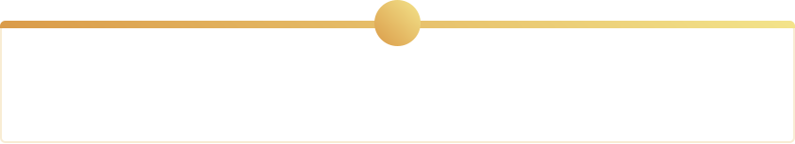
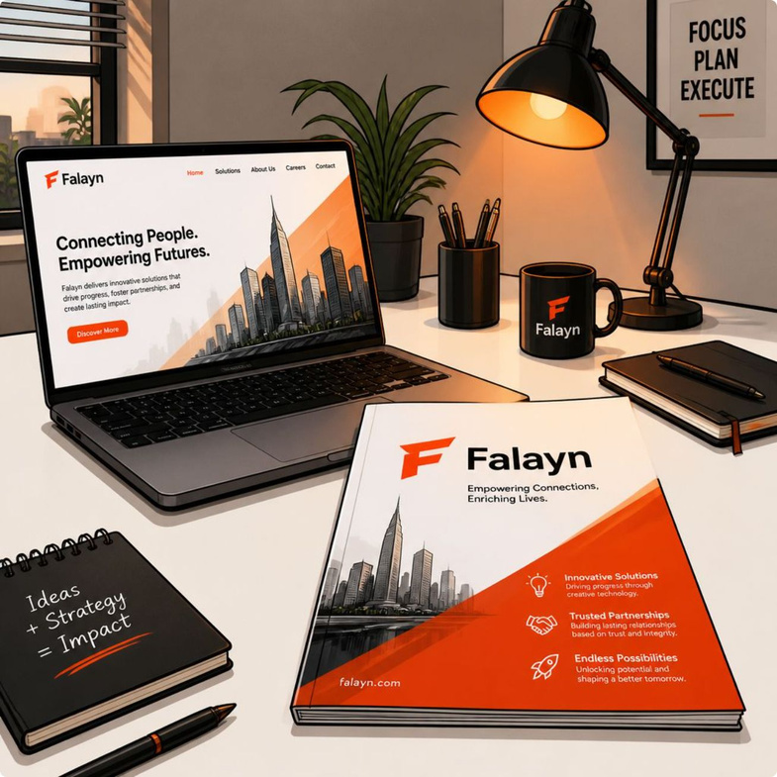


Final Checks, Mistakes to Avoid & Next Steps
Before submitting any application or message, run a final checklist: tailored CV, customised message, correct contact and attachments. Avoid common mistakes: generic messages, unclear role target, missing contact info and late replies.
1
2
Common Mistakes
7-Day Action Plan
Using one CV for all roles; ignoring recruiter instructions; long messages without clarity.
Day-by-day tasks to network, apply to targeted roles and follow up (see inside guide for details).
3
4
Final Application Checklist
About Falayn
Role match, tailored CV, concise message, attachments and follow-up schedule.
Falayn is an AI-powered recruitment platform connecting Gulf job seekers with recruiters. Explore Falayn to create a profile, save templates and receive tailored job alerts.
Next step: upload your CV to Falayn, set job alerts for your target statement and try sending three tailored recruiter messages this week using the templates.
Page 10 • Final • Falayn
Notes:
10

