Slide 1
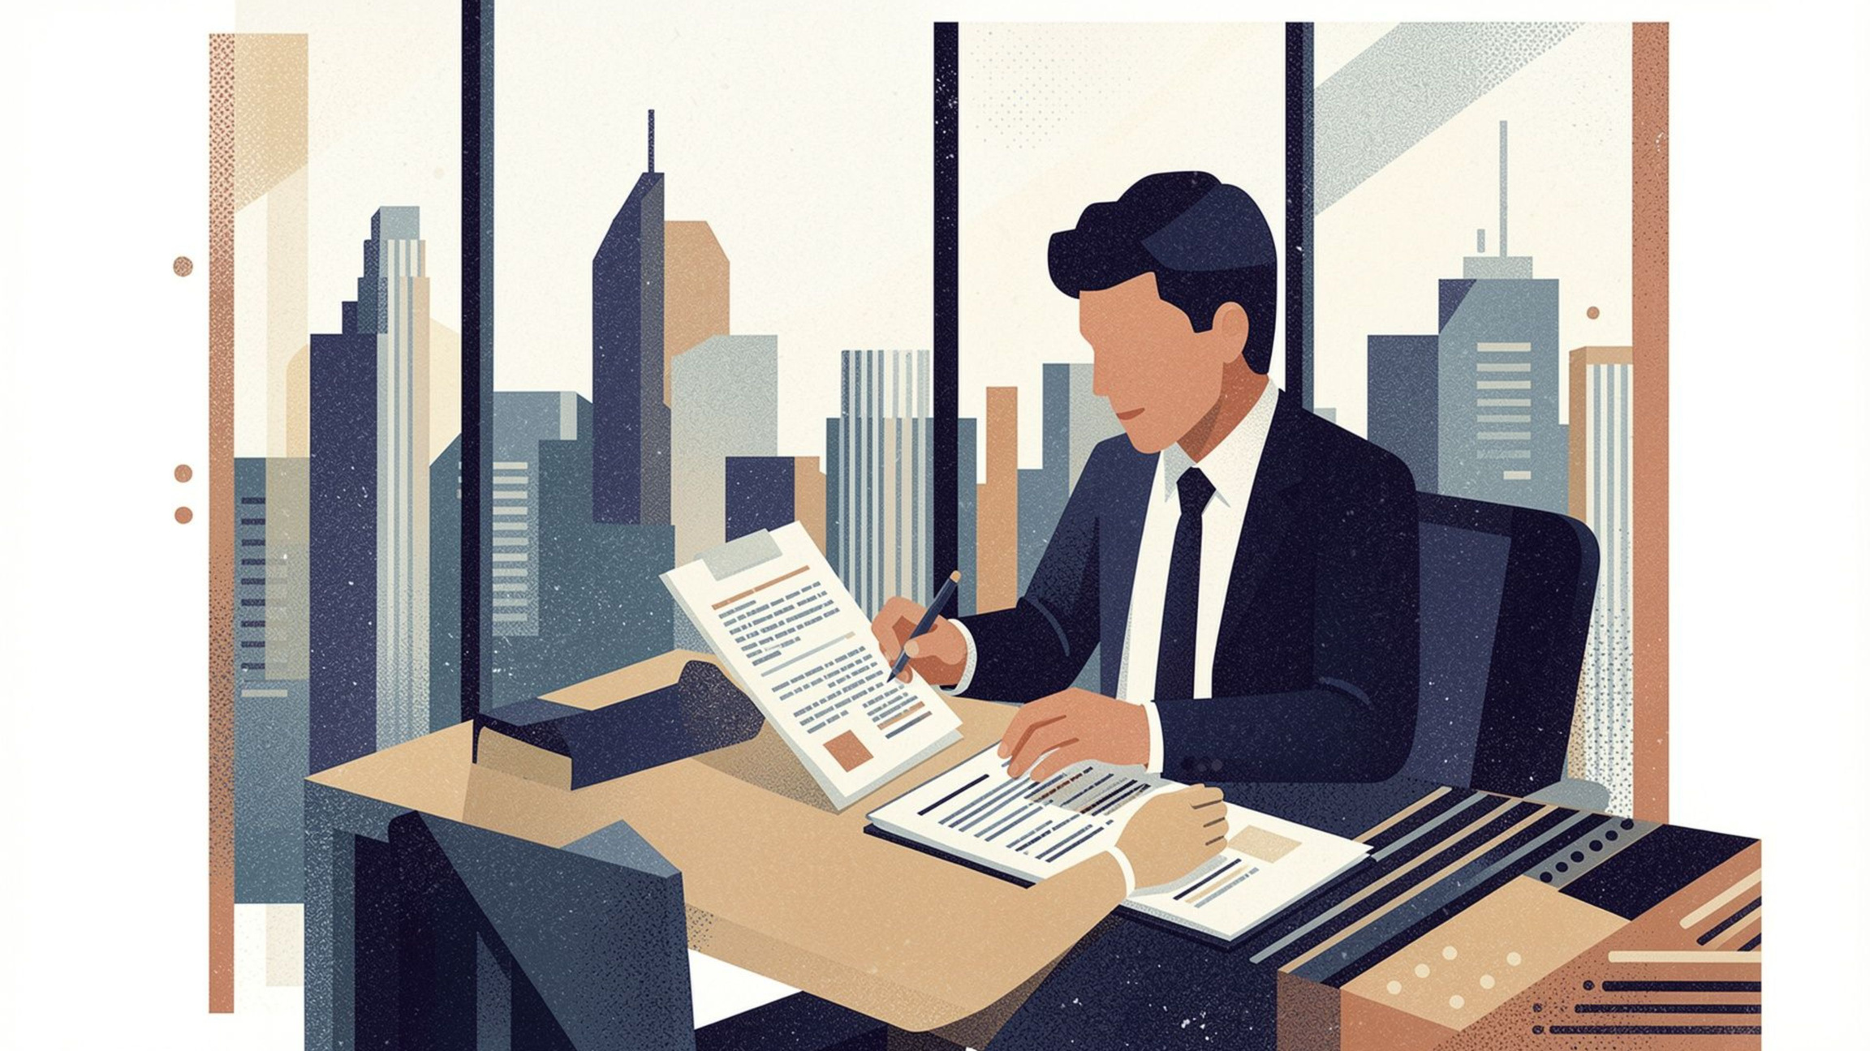



Recruiter Message Pack
Ready-to-use messages to connect with recruiters, follow up on applications, and build professional relationships across the Gulf job market.
GULF CAREER RESOURCE
COPY-READY TEMPLATES
Notes:
1

Slide 2

How to Use This Pack
1
Choose the right message
Match the template to your exact situation — connection request, follow-up, CV submission, or recruiter response.
2
Replace the placeholders
Every template uses clear markers like [Recruiter Name], [Your Role], and [Location] — swap them with your real details.
3
Personalise the opening
Add one specific detail — a post they shared, a role they listed, or a mutual connection — to stand out immediately.
4
Keep it short and professional
Recruiters receive dozens of messages daily. Concise, focused messages get read. Long ones get skipped.
5
Never copy-paste to everyone
Avoid sending the exact same message to every recruiter. Tailored messages get significantly more attention.
Quick Tip: Personalised messages get more attention than generic copy-paste messages. One extra sentence of context can make all the difference.
Notes:
2

Slide 3

Before You Message a Recruiter
Use this checklist before reaching out — every box matters:
Research & Targeting
Your Profile & Materials
Check the recruiter's role and company
Update your LinkedIn profile — photo, headline, summary
Make sure the recruiter hires for your field
Review the job description (if applying for a specific role)
Keep your CV ready and tailored
Prepare a one-line summary of who you are and what you want
Know your target location and role
Know your notice period and salary expectations
Recruiters form an impression within seconds. A complete LinkedIn profile and a ready CV signal that you're serious — and make it easy for them to act on your message.
Notes:
3

Slide 4
LinkedIn Connection Messages
Five ready-to-use connection requests for every scenario — from cold outreach to targeted Gulf opportunities.
General Connection Request
Connection Request for a Specific Job
Connection Request to a Recruiter in Your Industry
When to use: Reaching out to a recruiter you don't know
Hi [Recruiter Name], I'm [Your Name], a [Your Role/Field] professional based in [Your Location]. I'm actively exploring opportunities in the Gulf region and would love to connect. Looking forward to building our professional network.
When to use: You've seen a job posting and want to connect with the recruiter
Hi [Recruiter Name], I came across the [Job Title] role at [Company Name] and it aligns perfectly with my background in [Key Skill/Experience]. I'd like to connect and learn more about this opportunity. Thanks!
When to use: You want to build a relationship with a recruiter who specialises in your field
Hi [Recruiter Name], I've followed your work in [Industry/Field] and am impressed by your insights. I'm a [Your Role] with [Years of Experience] years of experience, and I'd like to connect as I explore opportunities in the Gulf market.
Connection Request After Seeing a Recruiter's Post
Connection Request for Gulf Opportunities
When to use: You've engaged with their content and want to deepen the connection
Hi [Recruiter Name], I really appreciated your recent post on [Topic]. As a [Your Role] professional, I found your perspective valuable. I'd love to connect and stay updated on relevant opportunities in [Location/Industry].
When to use: You're specifically targeting the Gulf job market
Hi [Recruiter Name], I'm [Your Name], a [Your Role] professional with [Years of Experience] years of experience. I'm actively seeking opportunities in [Specific Country/Region] and would value connecting with a recruiter who understands the Gulf market. Let's connect!
Notes:
4

Slide 5

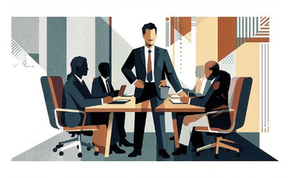

Introducing Yourself to a Recruiter
Your introduction sets the tone for the entire relationship. Use the template that matches your career stage.
Fresh Graduate
Experienced Professional
Professional Relocating to the Gulf
Hi [Recruiter Name], I'm [Your Name], a recent graduate in [Field of Study] from [University Name]. I'm eager to launch my career in [Your Target Role/Industry] and am particularly interested in opportunities in [Location]. I'd appreciate any guidance or relevant openings you might have. Thank you!
Hi [Recruiter Name], I'm [Your Name], a [Your Role] with [Years of Experience] years of experience in [Industry/Field]. My expertise includes [Key Skill 1], [Key Skill 2], and [Key Skill 3]. I'm exploring new opportunities in the Gulf region and would welcome a conversation about relevant roles. Best regards.
Hi [Recruiter Name], I'm [Your Name], currently based in [Current Location] with [Years of Experience] years of experience as a [Your Role]. I'm planning to relocate to [Target Country] and am actively seeking opportunities in [Industry/Field]. I'd love to discuss how my background aligns with roles in your pipeline.
Notes:
5

Slide 6
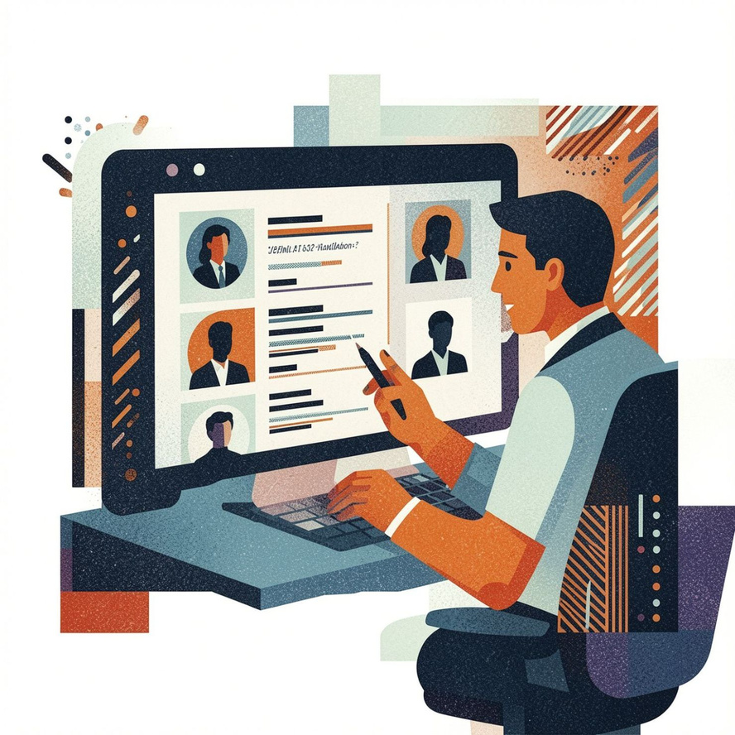
Asking About Job Opportunities
Asking About Current Openings
Asking About a Specific Vacancy
Hi [Recruiter Name], I hope this message finds you well. I'm [Your Name], a [Your Role] professional with expertise in [Key Skill]. I'm currently exploring opportunities in [Location/Industry] and would like to know if you have any relevant openings in your pipeline. I'd be happy to share my CV. Thanks!
Hi [Recruiter Name], I noticed the [Job Title] position at [Company Name]. My background in [Relevant Experience] aligns well with the role requirements. Could you share more details about the position and the next steps in the application process?
Asking About Future Opportunities
Asking Whether Your Profile Matches a Role
Hi [Recruiter Name], I'm [Your Name], a [Your Role] with [Years of Experience] years of experience in [Field]. While I'm not actively job hunting right now, I'd like to stay on your radar for future opportunities that match my profile. Would you be open to a brief conversation?
Hi [Recruiter Name], I came across the [Job Title] role and believe my experience in [Relevant Skill/Experience] could be a strong fit. Before I apply formally, I'd appreciate your feedback on whether my profile aligns with what you're looking for. Happy to discuss further!
Always mention your key skill or field in the first sentence — it helps recruiters instantly assess whether they can help you.
Notes:
6

Slide 7




Sending Your CV
When to attach your CV: Only send your CV when a recruiter has asked for it, when you're applying for a specific role, or when you're proactively reaching out with a personalised message that explains why you're a fit.
After Recruiter Request
For a Specific Vacancy
Proactive Outreach
Hi [Recruiter Name], Thank you for your interest. I've attached my CV as requested. I'm happy to discuss my background and how I can contribute to [Company Name]. Looking forward to hearing from you.
Hi [Recruiter Name], I'm very interested in the [Job Title] position at [Company Name]. I've attached my CV, which highlights my [Years of Experience] years of experience in [Relevant Field]. I'm confident my skills in [Key Skill] would be valuable to your team. I'd welcome the opportunity to discuss this further.
Hi [Recruiter Name], I'm [Your Name], a [Your Role] with [Years of Experience] years of experience in [Industry]. I'm actively exploring opportunities in [Location] and believe my expertise in [Key Skill] could be valuable to your clients. I've attached my CV and would welcome a conversation. Thanks!
Notes:
7

Slide 8
Following Up After Applying
Timing matters. Use the right follow-up at the right moment — and know when to stop.
3–5 Days After Applying
Status Unclear
Hi [Recruiter Name], I applied for the [Job Title] position at [Company Name] a few days ago. I remain very interested in this opportunity and would appreciate any initial feedback on my application. Thank you!
Hi [Recruiter Name], I submitted my application for [Job Title] but haven't received confirmation of receipt. Could you please confirm that my application was received and let me know the expected timeline for feedback? Thank you!
1
2
3
One Week Later
Hi [Recruiter Name], I wanted to follow up on my application for the [Job Title] role submitted on [Date]. I'm very enthusiastic about this position and would love to know the next steps or timeline. Please let me know if you need any additional information from me.
Don't over-follow-up: Limit follow-ups to 2–3 messages maximum. After that, move on to other opportunities. Repeated messages can become counterproductive and may harm your professional reputation.
Notes:
8

Slide 9




Following Up After an Interview
Thank-You Message — Within 24 Hours
Hi [Recruiter Name], Thank you for taking the time to interview me for the [Job Title] position. I enjoyed our conversation about [specific topic discussed] and remain very interested in this opportunity. I look forward to hearing from you.
Asking for an Update — After 1 Week
Hi [Recruiter Name], I hope you're well. I wanted to follow up on the [Job Title] interview we had on [Date]. I remain very interested in the role and would appreciate an update on the timeline or next steps. Thank you!
Final Polite Follow-Up — After 2 Weeks
Hi [Recruiter Name], I wanted to check in one more time regarding the [Job Title] position. I'm still very interested and would welcome any update on the decision timeline. Please let me know if there's any additional information I can provide. Thanks for your time.
Notes:
9

Slide 10
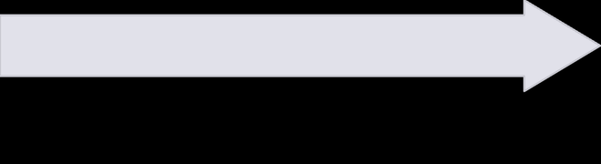

No Response? What to Send
Silence doesn't always mean rejection. Here's how to follow up gracefully — and when to let go.
Final Follow-Up — Graceful Exit
Second Follow-Up — More Direct
First Polite Follow-Up
Hi [Recruiter Name], I appreciate your time and understand if this opportunity isn't moving forward. I'd still value staying connected for future roles that match my profile. Best of luck with your search!
Hi [Recruiter Name], I wanted to follow up on my previous message regarding [Job Title/Opportunity]. I remain very interested and would appreciate any feedback or update. Thank you!
Hi [Recruiter Name], I understand you may be busy, but I wanted to check in once more about the [Job Title] opportunity. If this role is no longer a fit, I'd appreciate knowing so I can explore other options. Thanks for your time.
When to stop following up: If you've sent 2–3 follow-up messages with no response over 3–4 weeks, it's time to move on. Focus your energy on other opportunities and recruiters who are actively engaging with you.
Notes:
10

Slide 11
Recruiter Responded — What Next?
When a recruiter replies, be ready. Here are copy-ready responses to the most common recruiter questions.
"Please send your CV."
Thank you for your interest! I've attached my CV. I'm happy to discuss my background and experience in more detail. Looking forward to hearing from you.
"Tell me about yourself."
I'm [Your Name], a [Your Role] with [Years of Experience] years of experience in [Industry/Field]. My key strengths include [Key Skill 1], [Key Skill 2], and [Key Skill 3]. I've successfully [mention a key achievement]. I'm particularly interested in [specific role/industry] and am excited about the opportunity to contribute to [Company Name].
"What salary are you expecting?"
Based on my experience and the market rate for this role in [Location], I'm looking for a salary in the range of [Range]. However, I'm open to discussing this based on the full package and role responsibilities. What range did you have in mind?
"Are you available for an interview?"
Absolutely! I'm very interested in this opportunity. I'm available at your convenience — please let me know your preferred time and format (phone, video, or in-person), and I'll make myself available.
"Are you willing to relocate?" / "Are you currently in the Gulf?"
Yes, I'm open to relocating to [Target Location]. I'm committed to making this transition and am prepared to handle the logistics. I'm currently based in [Current Location] but actively planning my move and flexible with timing.
"What is your notice period?" / "Can you provide your contact number?"
My current notice period is [X weeks/months]. I'm prepared to provide formal notice as soon as we move forward. My contact number is [Your Phone Number] — feel free to reach out directly at your convenience.
This resource is brought to you by Falayn — your Gulf career partner.
Notes:
11

