Slide 1
Teknologi Open Source Python Web & GUI Lecture 08 (04 May 2015)
Henry Novianus Palit
hnpalit@petra.ac.id

Slide 2
Python web

Slide 3
Python Web Servers
cgi
Django, Pylons, Flask, Pyramid
Turbogears, Cherrypy
Web.py
Werkzeug
Google App Engine

Slide 4
WSGI
Web Server Gateway Interface
It is a specification that describes how a web server communicates with web applications, and how web applications can be chained together to process one request
It is a Python standard described in detail in PEP 3333
Deploying WSGI:
mod_wsgi
FastCGI
SCGI
IIS
uwsgi
tornado

Slide 5
Cherrypy
www.cherrypy.org
apt-get install python-cherrypy3
import cherrypy
cherrypy.server.socket_host = '0.0.0.0'
cherrypy.config.update({'server.socket_port': 8080})
Change 8080 to something else, for example: your NRP’s last 5 digits: 13011
Access from browser: http://opensource.petra.ac.id:13011
Possible user ports: 1025 to 65535
http://docs.cherrypy.org/en/latest/config.html

Slide 6
Cherrypy Example
import cherrypy
cherrypy.server.socket_host = '0.0.0.0'
cherrypy.config.update({'server.socket_port': 8080})
class HelloWorld(object):
@cherrypy.expose
def index(self):
return "Hello world!"
if __name__ == '__main__':
cherrypy.quickstart(HelloWorld())

Slide 7
URL to Function
import random
import string
import cherrypy
class StringGenerator(object):
@cherrypy.expose
def index(self):
return "Hello world!"
@cherrypy.expose
def generate(self):
return ''.join(random.sample(string.hexdigits, 8))
if __name__ == '__main__':
cherrypy.quickstart(StringGenerator())
Go to http://your.server:<port>/generate

Slide 8
URL with Parameter
import random
import string
import cherrypy
class StringGenerator(object):
@cherrypy.expose
def index(self):
return "Hello world!"
@cherrypy.expose
def generate(self, length=8):
return ''.join(random.sample(string.hexdigits, \
int(length)))
if __name__ == '__main__':
cherrypy.quickstart(StringGenerator())
Go to http://your.server:<port>/generate?length=5

Slide 9
Form Submit
class StringGenerator(object):
@cherrypy.expose
def index(self):
return """<html>
<head></head>
<body>
<form method="get" action="generate">
<input type="text" value="8" name="length"/>
<button type="submit">Give it now!</button>
</form>
</body>
</html>"""
@cherrypy.expose
def generate(self, length=8):
return ''.join(random.sample(string.hexdigits, \
int(length)))

Slide 10
Session
@cherrypy.expose
def generate(self, length=8):
some_string = ''.join(random.sample \
(string.hexdigits, int(length)))
cherrypy.session['mystring'] = some_string
return some_string
@cherrypy.expose
def display(self):
return cherrypy.session['mystring']
if __name__ == '__main__':
conf = {
'/': {
'tools.sessions.on': True
}
}
cherrypy.quickstart(StringGenerator(), '/', conf)
Go to http://your.server:<port>/display

Slide 11
Static Files: css & images
@cherrypy.expose
def index(self):
return """<html>
<head>
<link
href="/static/css/style.css"
rel="stylesheet">
</head>
<body>
<form method="get"
action="generate">
<input type="text" value="8"
name="length"/>
<button type="submit">
Give it now!
</button>
</form>
</body>
</html>"""
if __name__ == '__main__':
conf = {
'/': {
'tools.sessions.on': True,
'tools.staticdir.root': \
os.path.abspath(os.getcwd())
},
'/static': {
'tools.staticdir.on': True,
'tools.staticdir.dir': \
'./public‘
}
}
cherrypy.quickstart( \
StringGenerator(), '/', conf)

Slide 12
Cherrypy
http://docs.cherrypy.org/en/latest/tutorials.html
http://docs.cherrypy.org/en/latest/basics.html
http://docs.cherrypy.org/en/latest/advanced.html

Slide 13
Python gui

Slide 14
Python for Windows
Download:
http://portablepython.com/wiki/PortablePython2.7.6.1

Slide 15
GUI Programming in Python
Tkinter
PyGTK
PyQT
wxPython
https://wiki.python.org/moin/GuiProgramming

Slide 16
Tkinter
References:
http://www.tutorialspoint.com/python/python_gui_programming.htm
http://effbot.org/tkinterbook/tkinter-index.htm
http://zetcode.com/gui/tkinter/

Slide 17
Tkinter Widgets (1)
Button → implement various kinds of buttons, containing text or images
Canvas → provide structured graphics facilities to display and edit graphs & other drawings
Checkbutton → implement on-off selections (text or images)
Entry → enter or display a single line of text
Frame → a rectangular region used as a geometric master for other widgets, or to provide padding between other widgets
Label → display a text (may span more than one line) or image on screen
LabelFrame → a variant of Frame, to draw a border around its child widgets or display a title
Listbox → display a list of alternatives (more alternatives can be chosen)
Menu → implement toplevel, pulldown, and popup menu
Menubutton → display popup or pulldown menu when activated

Slide 18
Tkinter Widgets (2)
Message → a variant of Label, designed to display multiline message
OptionMenu → a helper class that creates a popup menu and a button to display it (i.e., combobox)
PanedWindow → a geometry manager widget, which can contain one or more child widgets
Radiobutton → implement one-of-many selections (text or images)
Scale → select a numerical value by moving a “slider” knob along a scale
Scrollbar → implement scrolled listboxes, canvases, and text fields
Spinbox → a variant of Entry, which can be used to select from a fixed number of values
Text → provide formatted text display or a text editor with various styles and attributes
Toplevel → like Frame, but it is used to display extra application windows, dialogs, and other “pop-up” windows

Slide 19
Geometry Management in Tkinter
Pack → organizes widgets in blocks before placing them in the parent widget
Grid → organizes widgets in a table-like structure in the parent widget
Place → organizes widgets by placing them in a specific position in the parent widget

Slide 20
Pack
The packer is the quickest way to design user interfaces using Tkinter
It allows the user to place the widgets relative to their contained widget
It is the most commonly used geometry manager since it allows a fair amount of flexibility
The packer positions the slave widgets on the master widget (container) from the edges to the center, each time using the space left in the master widget by previous packing operations

Slide 21
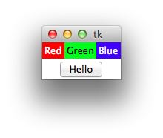
Pack Example
import Tkinter
from Tkinter import *
root = Tk()
frame1 = Frame(root)
frame1.pack()
frame2 = Frame(root)
frame2.pack(side=BOTTOM)
w = Label(frame1, text="Red", bg="red", fg="white")
w.pack(side=LEFT)
w = Label(frame1, text="Green", bg="green", fg="black")
w.pack(side=LEFT)
w = Label(frame1, text="Blue", bg="blue", fg="white")
w.pack(side=LEFT)
w = Button(frame2, text="Hello")
w.pack()
mainloop()

Slide 22
Get Values from Entry (1)
from Tkinter import *
import tkMessageBox
def hello1Back():
hasil = int(E2.get()) + int(E1.get())
tkMessageBox.showinfo("Hello Python", str(hasil))
def hello2Back():
hasil = int(E2.get()) - int(E1.get())
tkMessageBox.showinfo("Hello Python", str(hasil))
def hello3Back():
hasil = int(E2.get()) * int(E1.get())
tkMessageBox.showinfo("Hello Python", str(hasil))
def hello4Back():
hasil = float(E2.get()) / float(E1.get())
tkMessageBox.showinfo("Hello Python", str(hasil))

Slide 23
Get Values from Entry (2)
top = Tk()
E2 = Entry(top, bd=50)
E2.pack(side=LEFT)
E1 = Entry(top, bd=50)
E1.pack(side=RIGHT)
A = Button(top, text="+", command=hello1Back)
B = Button(top, text="-", command=hello2Back)
C = Button(top, text="*", command=hello3Back)
D = Button(top, text="/", command=hello4Back)
A.pack()
B.pack()
C.pack()
D.pack()
top.mainloop()

Slide 24
Grid
The Grid geometry manager puts the widgets in a 2-D table
The master widget is split into a number of rows and columns
Each “cell” in the resulting table can hold a widget
The Grid geometry manager is used for more complex layouts
It allows the user to virtually divide the master widget into several rows and columns, which can then be used to place slave widgets more precisely
The packer geometry manager would require the use of multiple nested frames to obtain the same effect
The Grid geometry manager allows the user to build a widget grid using an approach that is very similar to building tables using HTML
The user building the table specifies not only the row and column at which to place the widget, but also the row span and column span values to use for the widget

Slide 25


Grid Example 1
from Tkinter import *
root = Tk()
# label / entry pair
l1 = Label(root, text="First Name:")
e1 = Entry(root)
# put in first row
l1.grid(row=0, column=0)
e1.grid(row=0, column=1)
# label / entry pair
l2 = Label(root, text="Last Name:")
e2 = Entry(root)
# put in second row
l2.grid(row=1, column=0)
e2.grid(row=1, column=1)
# label / entry pair
l3 = Label(root, text="Age:")
e3 = Entry(root)
# put in third row
l3.grid(row=2, column=0)
e3.grid(row=2, column=1)
root.mainloop()

Slide 26


Grid Example 2
from Tkinter import *
root = Tk()
# label / entry pair in first row
l1 = Label(root, text="First Name:")
e1 = Entry(root)
l1.grid(row=0, column=0, sticky="e")
e1.grid(row=0, column=1)
# label / entry pair in second row
l2 = Label(root, text="Last Name:")
e2 = Entry(root)
l2.grid(row=1, column=0, sticky="e")
e2.grid(row=1, column=1)
# label / entry pair in thir row
l3 = Label(root, text="Age:")
e3 = Entry(root)
l3.grid(row=2, column=0, sticky="e")
e3.grid(row=2, column=1)
# column 0 - do not expand
root.columnconfigure(0, weight=0)
# column 1 – expand
root.columnconfigure(1, weight=1)
root.mainloop()

Slide 27

Grid Example 3
from Tkinter import *
root = Tk()
# label / entry pair in first row
l1 = Label(root, text="First Name:")
e1 = Entry(root)
l1.grid(row=0, column=0, sticky="e")
e1.grid(row=0, column=1, sticky="news")
# label / entry pair in second row
l2 = Label(root, text="Last Name:")
e2 = Entry(root)
l2.grid(row=1, column=0, sticky="e")
e2.grid(row=1, column=1, sticky="news")
# label / entry pair in third row
l3 = Label(root, text="Age:")
e3 = Entry(root)
l3.grid(row=2, column=0, sticky="e")
e3.grid(row=2, column=1, sticky="news")
# column 0 - do not expand
root.columnconfigure(0, weight=0)
# column 1 – expand
root.columnconfigure(1, weight=1)
root.mainloop()

Slide 28
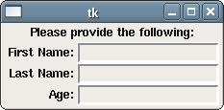
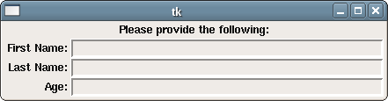
Grid Example 4
from Tkinter import *
root = Tk()
l = Label(root, text="Please provide the following:")
l.grid(row=0, column=0, columnspan=2)
# dynamically fill in grid
items = ("First Name:", "Last Name:", "Age:")
for i in range(len(items)):
l = Label(root, text=items[i])
e = Entry(root)
l.grid(row=i+1, column=0, sticky="e")
e.grid(row=i+1, column=1, sticky="news")
# column 0 - do not expand
root.columnconfigure(0, weight=0)
# column 1 – expand
root.columnconfigure(1, weight=1)
root.mainloop()

Slide 29
Place
The Place geometry manager is the more powerful manager of all
It allows exact placement of the widgets inside a master widget (container)
However, it is more difficult to use and usually represent a great amount of overhead that is generally not needed
The Place geometry manager allows placement of widgets using either
exact coordinates (with the x and y options), or
a percentage relative to the size of the master window (expressed as a float in the range [0.0, 1.0]) with the relx and rely options
The same principle holds for the widget size (using width/height and/or relwidth/relheight)

Slide 30
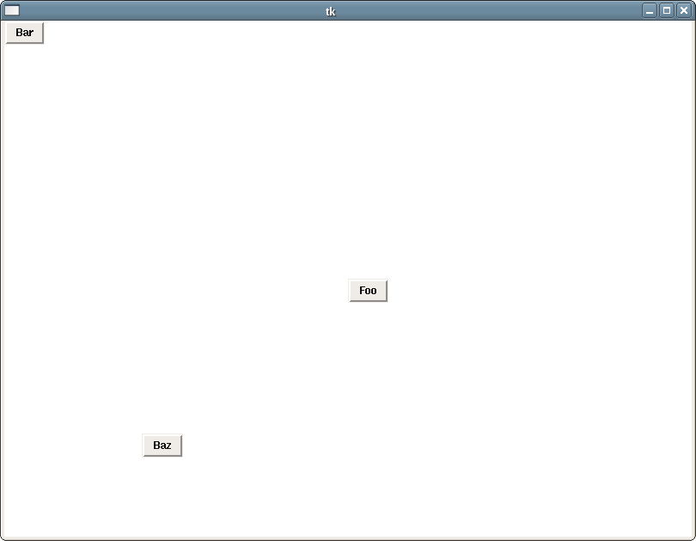
Place Example
from Tkinter import *
root = Tk()
b1 = Button(root, text="Foo")
b2 = Button(root, text="Bar")
b3 = Button(root, text="Baz")
# place b1 at the middle
b1.place(relx=.5, rely=.5)
# place b2 at the top left
b2.place(x=0, y=0)
# somewhere near the bottom left
b3.place(relx=.2, rely=.8)
root.config(width=800, height=600, background="#ffffff")
root.mainloop()

Slide 31
Mixing Geometry: Separate Frames
from Tkinter import *
root = Tk()
# create and pack containers
top = Frame(root, background="red")
bottom = Frame(root, background="blue")
top.pack(fill="x")
bottom.pack(expand="yes", fill="both")
# just use pack on buttons on top
b1 = Button(top, text="Foo")
b2 = Button(top, text="Bar")
b3 = Button(top, text="Baz")
b1.pack(side="left", expand="yes", fill="x", padx=5, pady=5)
b2.pack(side="left", expand="yes", fill="x", padx=5, pady=5)
b3.pack(side="left", expand="yes", fill="x", padx=5, pady=5)
# use grid on the bottom
for x in range(4):
for y in range(4):
b = Button(bottom, text="x = " + str(x) + ", y = " + str(y))
b.grid(row=x, column=y, sticky="news", padx=5, pady=5)
for i in range(4):
bottom.columnconfigure(i, weight=1)
bottom.rowconfigure(i, weight=1)
root.mainloop()

