Slide 1
Distance/ Similarity measures
Eli Marchevsky
Rachely Shiran

Slide 2
Introduction
We implemented 3 different tests to check similarity between sequences.
In each test, we scored each pair of sequences by the test’s similarity. If we succeed running all sequences, we looked for the upper decile of similarity of the test.
All tests presented in the file similarity.py

Slide 3
Test no. 1- common elements
In this test we look for common elements in a pair of sequences.
The score of the sequences for this test is log2(p-val) .
The test is looking for very rare numbers, finds the sequences with these members, and compute for a pair of such sequences the score mentioned above.
In this case, we managed to run the test on all the sequences.

Slide 4
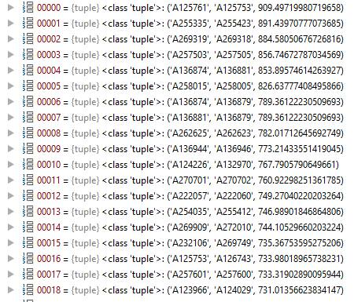
List top pairs which show high similarity

Slide 5
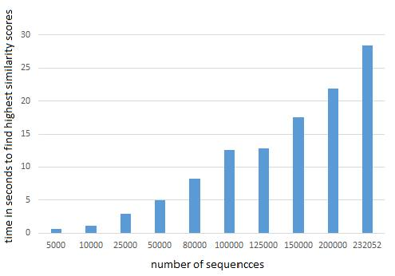
Running time vs. number of sequences

Slide 6
Test no.2- measures based on least bits
In this test we looking at a pair of sequences modulo 2.

Slide 7
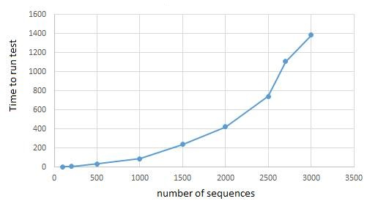
P-val given Pairs test

Slide 8
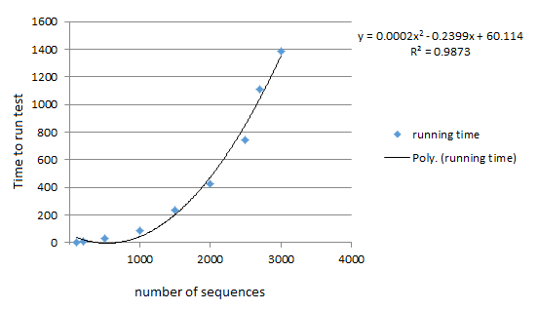
In this case, we couldn’t run the test on all the sequences. But as we can see, there is a polynomial relationship between number of sequences and running time. Therefore we can try to predict the running time for large number of sequences.

Slide 9
Test no.3- Difference Based Measures
The score of the sequences for this test is the Kolmogorov-Smirnoff test statistic.
The test tries all shifts between sequences, takes maximal score and corrects it based on the number of shifts.

Slide 10
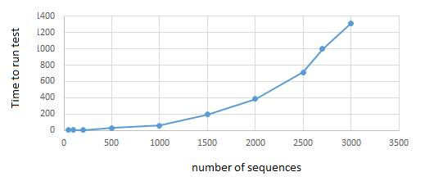
Kolmogorov-Smirnov test on difference between sequences against difference of all permutations of sequences

Slide 11
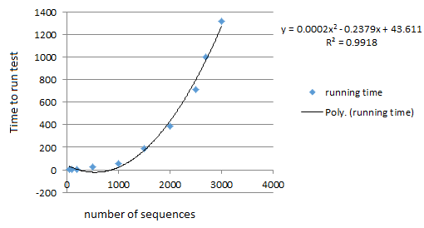
Once again we couldn’t run the test on all sequences. In the same manner, we see that we can try to predict the running time for large number of sequences by the approximation of the results to the polynomial function.

