Slide 1
Superstore
Shop in Style

Slide 2
About Superstore
Superstore is a retail outlet with branches all over the states and cities in the world with its headquarter in the United State of America.
Superstore (US) delivers goods to any location in any part of the world.

Slide 3
Our Focus
Our focus on this project is to use the available dataset (2014 -2017) to conduct a sales, profit and product analysis of Superstore for that same period.
To analyze our sales record, at what quantity sold is profit being maximized.
To identify the product category and sub-category of product giving us our best sales and profit.
To identify regions, states, and segment on best sales and worst sales.

Slide 4
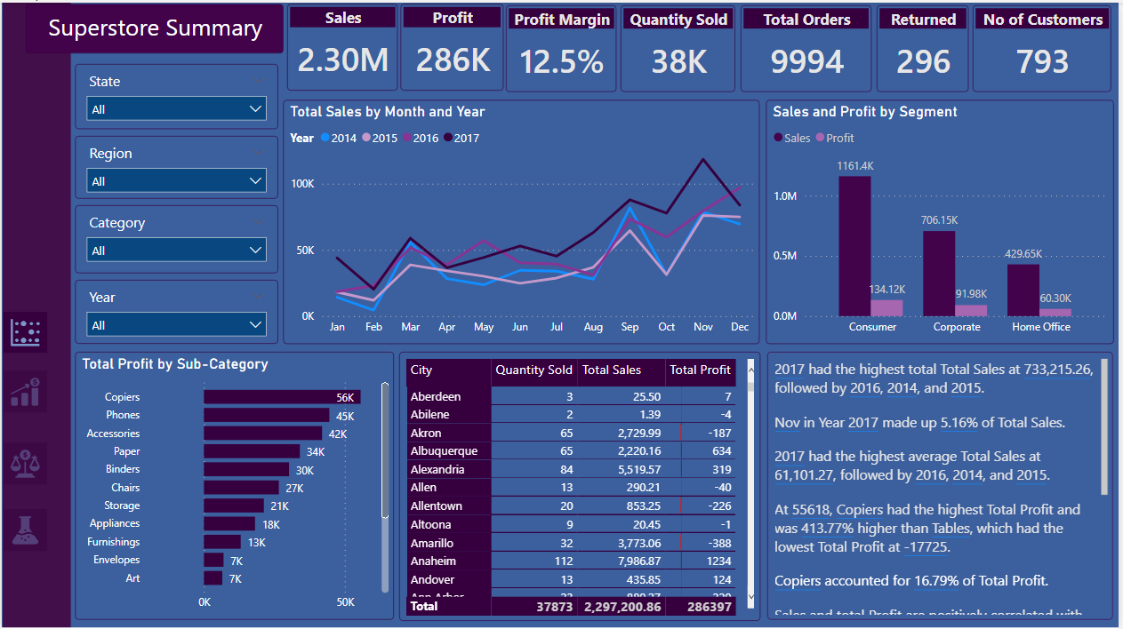
A summarized snapshot of our analysis

Slide 5
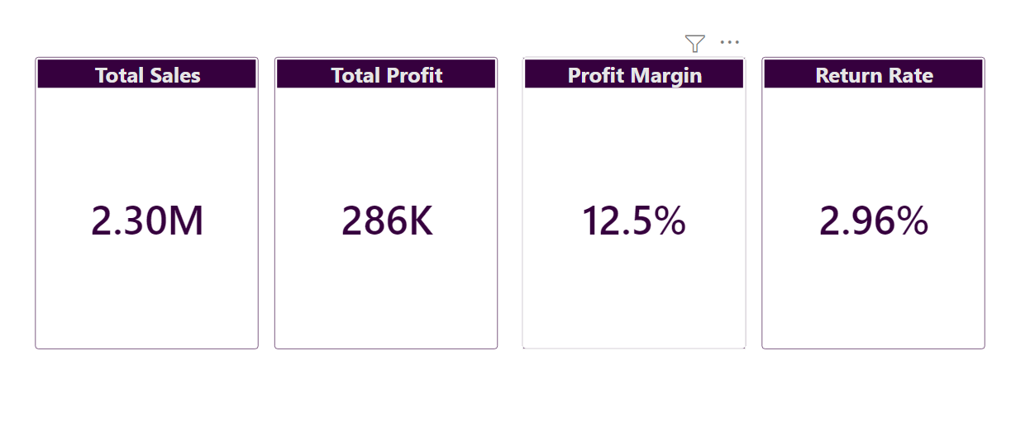
The following shows our total sales, total profit, profit margin and the rate of orders returned against total orders

Slide 6
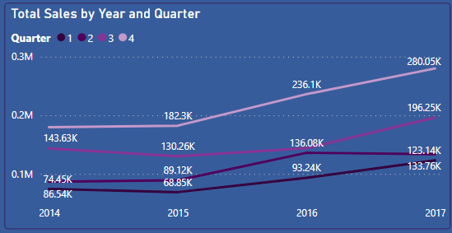
Sales Pattern
Overall sales trend across all quarters within in each year, with all years (2014-2017) in the dataset fully represented.
The trend shows that 75% of the time we have more sales in Q4 (fourth quarter).

Slide 7
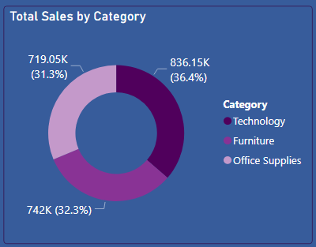
The technology category in this case brings in 36.4 percent of our overall sales in terms of category, a little above the furniture category which comes second with 32.3 percent, which is just a little over office supplies which comes in third with 31.3 percent.

Slide 8
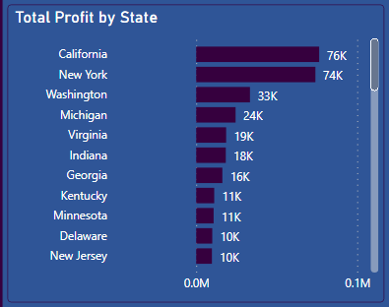
Profit View
California and New York are our biggest market and they give us $76k and $74k respectively, which together is over 52% of our total US profit.

Slide 9
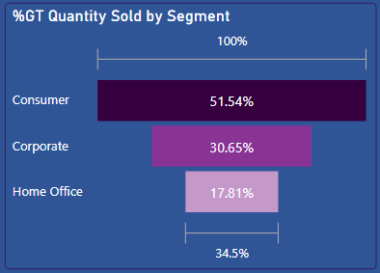
Profit View
The Consumer segment has shown to be the most active in terms of the percentage of quantity sold, as over 50% of the quantity sold id coming from that segment.

Slide 10
Recommendations
In as much as some states have proven to make the highest in sales or some segment selling the highest numbers of quantity, it is not synonymous with profit margin, as highest sales doesn’t guarantee highest profit margin so there is need to focus on maximizing profit margin (not just nominal figures but real values and rate).
There is a need to focus more on increasing sales of goods with higher profit margin and also to encourage increase sales from the home office segment.

