Slide 1
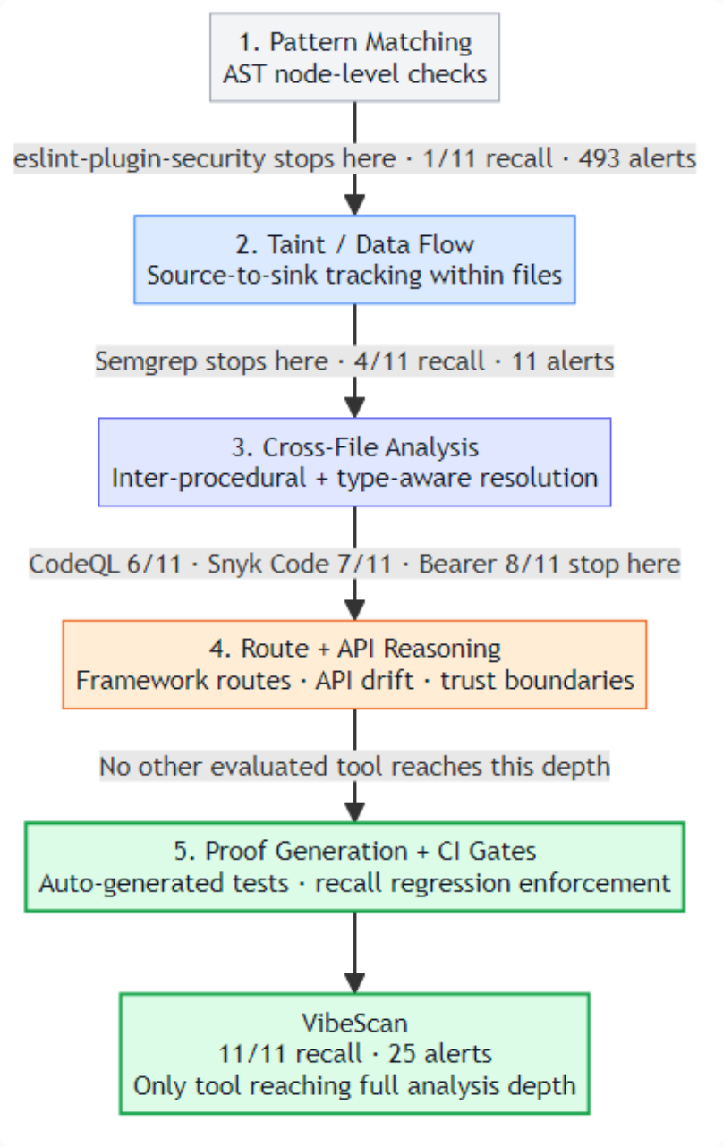
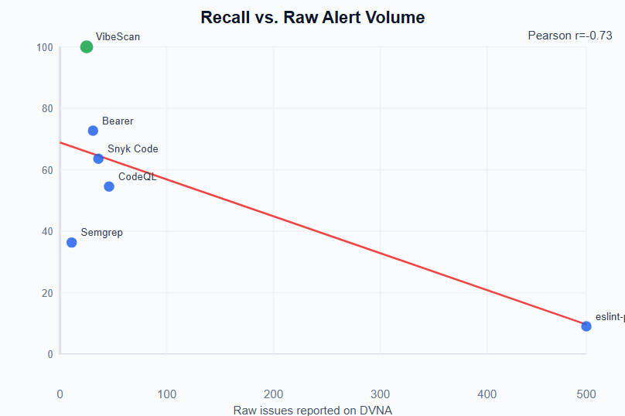
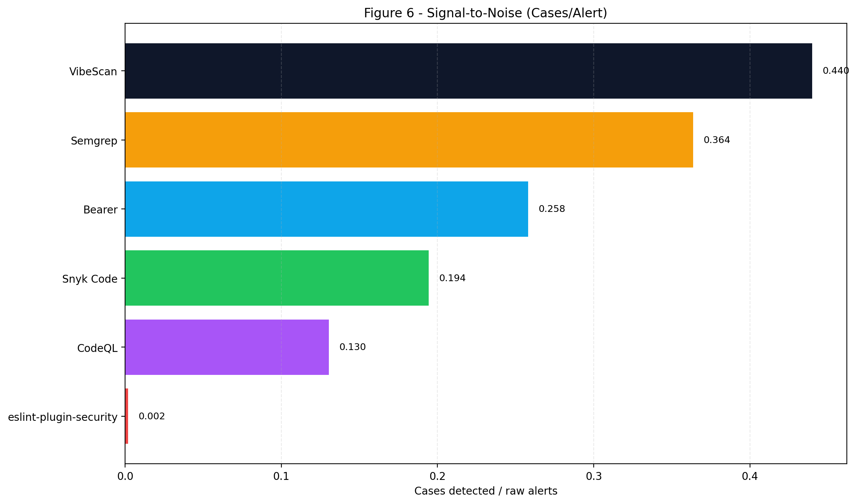
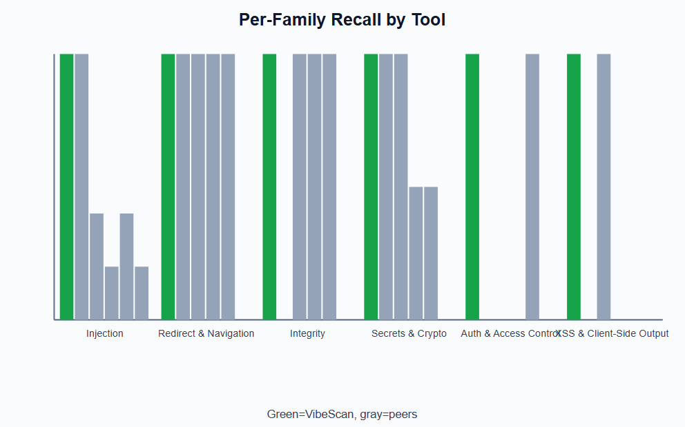
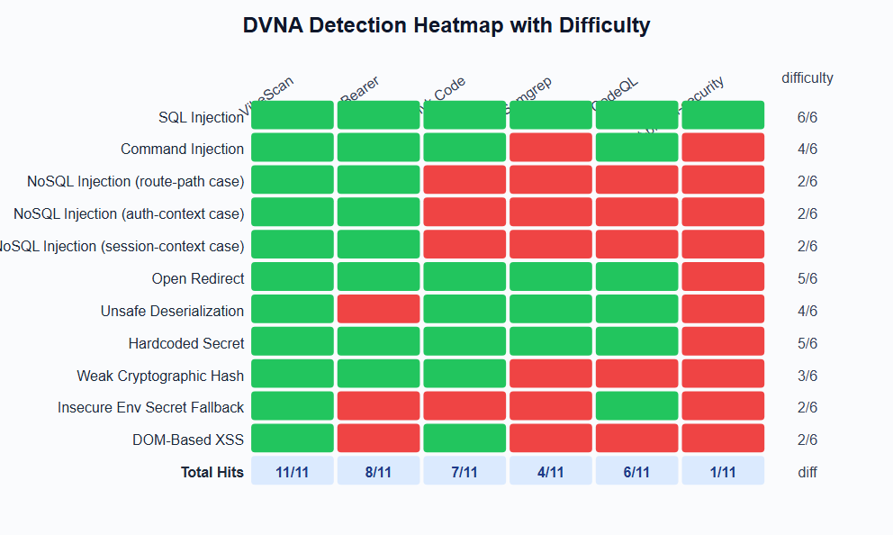
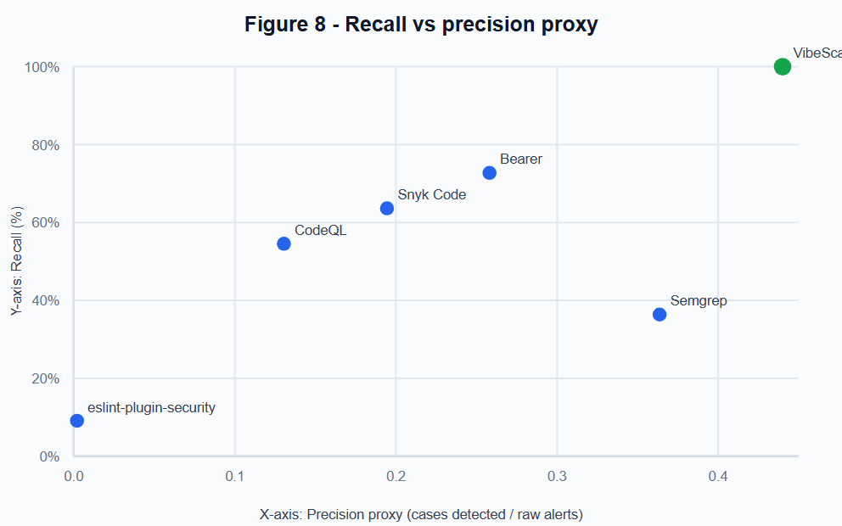
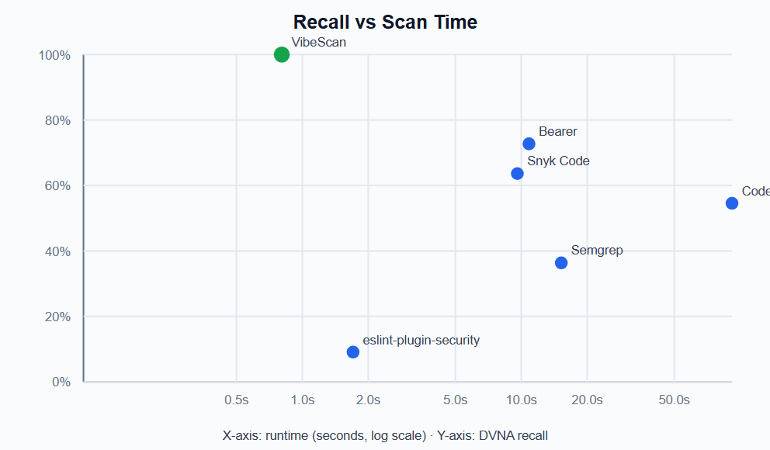
VibeScan Data Science Poster
Combined from benchmark chart slides: recall, precision proxy, runtime, and case-level evidence
Figure 1: Analysis Depth Comparison
Figure 2: Recall vs Raw Alert Volume
Figure 6: Signal-to-Noise
Figure 7: Per-Family Recall
Figure 4: Heatmap with Totals
Figure 8: Recall vs Precision Proxy
Figure 9: Recall vs Scan Time
Source figures: docs/vibescan/ppt-diagrams/*.png | Generated into a new combined poster deck

