Slide 1
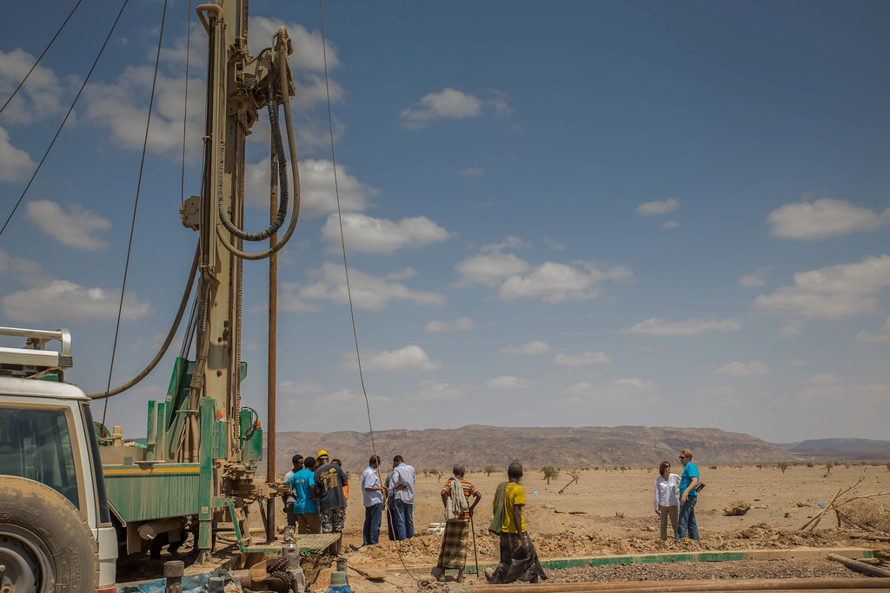
PUMP IT UP – MINING THE WATER TABLE
JOSHUA KARANJA

Slide 2
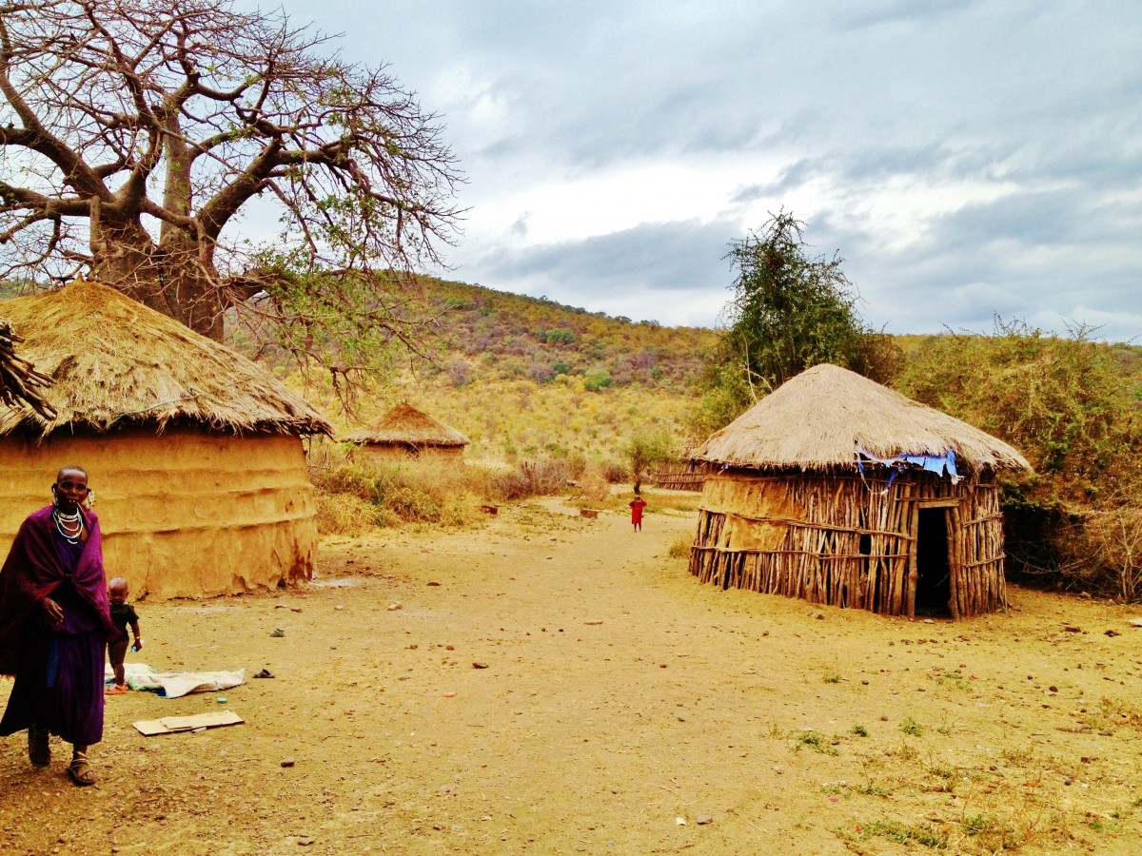

Slide 3
Project overview
Using data from Taarifa and the Tanzanian Ministry of Water, we would like to predict which pumps are functional, which need some repairs, and which don't work at all. We will predict one of these three classes based on a number of variables about what kind of pump is operating, when it was installed, and how it is managed.
We shall therefore breakdown the data into several chunks in order to create a proper understanding of the problem statement and how to do deal with the matter.

Slide 4
Explanatory Data Analysis Overview
This briefly explains the dataset that is being analysed.
We shall breakdown the data into the various variables being analysed in order to conclude with the model used to predict the functional and non- functional water wells.

Slide 5
Basins
It should be noted that the basin with the most boreholes was the Lake Victoria Basin
However it should also be noted that the most efficient basin was Lake Nyasa as 65% of the wells were functional.

Slide 6
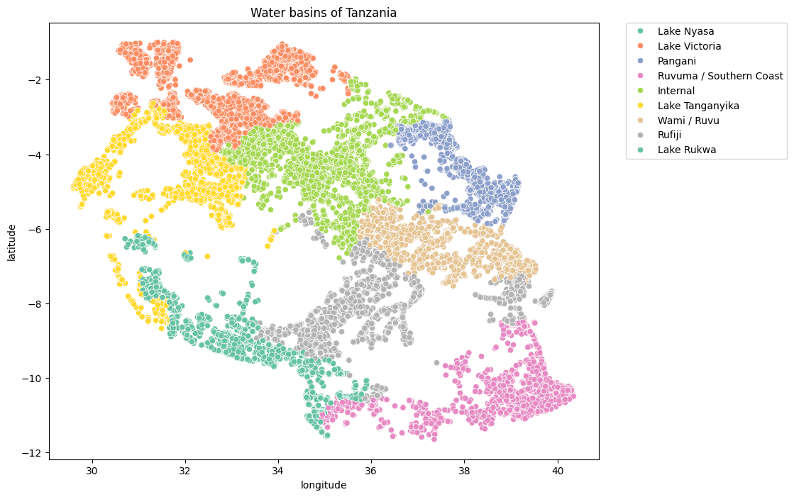
The Water Basins of Tanzania

Slide 7
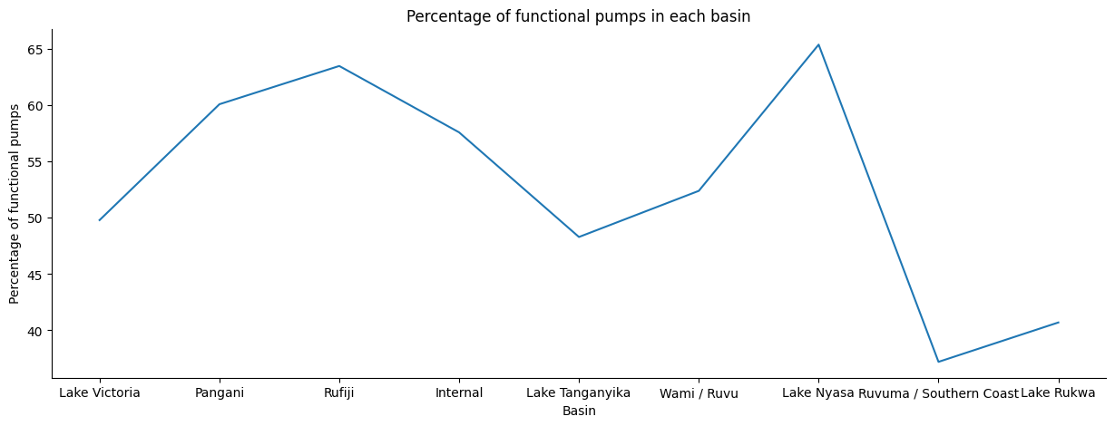
Percentage of functional Pumps in each basin

