Slide 1
Cybersecurity Presentation
The importance of cybersecurity
Family
Friends
Staying connected

Slide 2
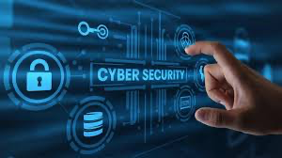
What Is Cybersecurity?
Cybersecurity is the practice of protecting computers, networks, and data.
It keeps information safe from attacks, damage, or unauthorized access.
Similar to locking your doors, cybersecurity protects your digital life.
Helps prevent identity theft, hacking, and data loss.

Slide 3
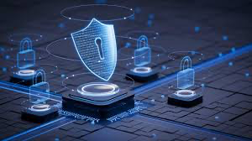
Why Cybersecurity Matters
We rely on technology for school, work, banking, and communication.
Cyberattacks can steal personal information or money.
Hackers target companies, hospitals, and everyday people.
Strong cybersecurity keeps our data safe and systems working.

Slide 4
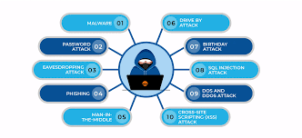
Types of Cyber Attacks
Malware
Phishing
Social engineering
Password attacks
Denial-of-service (DoS) attacks
Each attack targets different weaknesses in systems or people.

Slide 5
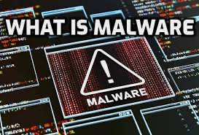
Malware & Ransomware
Malware is harmful software that damages or steals data.
Includes viruses, worms, spyware, and ransomware.
Ransomware locks your files and demands payment.
Many businesses, hospitals, and cities have been victims.

Slide 6
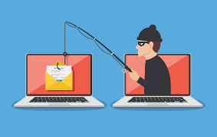
Phishing & Social Engineering
Phishing uses fake emails or messages to steal information.
Messages often look real (banks, schools, companies).
Social engineering tricks people instead of computers.
Hackers pretend to be someone trusted to get passwords.

Slide 7
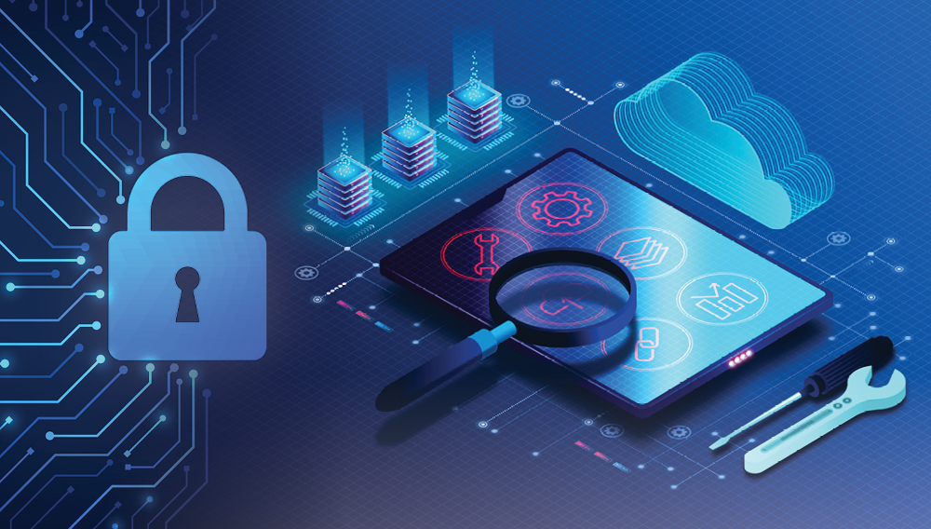
Protection Methods
Use firewalls and antivirus software.
Create strong, unique passwords.
Avoid clicking suspicious links or emails.
Keep software and devices updated.
Small habits make a big difference in safety.

Slide 8
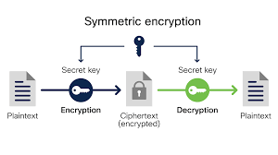
Encryption & Authentication
Encryption turns data into unreadable code for protection.
Only someone with the correct key can access it.
Authentication adds extra security layers.
Examples: passwords, verification codes, and 2-step login.

Slide 9
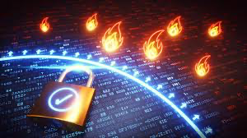
Firewalls & Network Security
Firewalls act like security guards for your computer.
They block harmful traffic and allow safe connections.
VPNs protect your online activity with encrypted tunnels.
IDS/IPS systems detect and stop suspicious behavior.

Slide 10

Cybersecurity Careers
One of the fastest-growing job fields today.
Roles include security analyst, penetration tester, and forensic analyst.
Careers focus on protecting systems and responding to threats.
Many jobs offer strong pay and high job security.

Slide 11
Certifications & Skills
Helpful certifications: Security+, CEH, CISSP.
Builds knowledge in networks and security.
Important skills: problem-solving, communication, and attention to detail.
Certifications help beginners enter the field.

Slide 12
Conclusion
Cybersecurity protects our information and digital lives.
Understanding threats helps us stay safe online.
Simple habits and strong security tools prevent most attacks.
Cybersecurity is an important field with many career opportunities.

