Slide 1
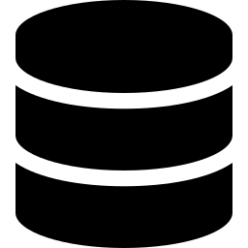
Integration of MQTT and Python
for Big Data Storage
Across SQL, Document and Graph Database Platforms
Project track DB-B1 — Environmental Monitoring
Abebe, Eyasu Belete · Student ID: 571914 · Eyasu_abebe@studenti.unime.it
github.com/Joshua-Abebe/environment-monitoring-system

Slide 2



Introduction
Why one database is not enough for IoT telemetry
Heterogeneous data, one environment
Numeric sensor readings, free-form event records, and a web of relationships between devices, locations and metrics — no single database model handles all three well at once.
A real-time, multi-database pipeline
Simulated IoT sensors across several rooms publish over MQTT; every event is routed into a relational store, a document store and a graph store — each used for what it does best.
Built like a small production system
Defensive validation and normalization, per-database failure isolation, per-stage performance instrumentation, and an automated test suite that runs in CI on every change.
2

Slide 3







System Architecture & the MQTT Layer
End-to-end event flow — one event in, three stores updated
MySQL
valid readings
Subscriber
validate → normalize
alert check → write
MongoDB
raw events
Sensors
(simulator)
Mosquitto
MQTT broker
Dashboard
Streamlit
Neo4j
sensor graph
TOPIC STRUCTURE
Each topic encodes both location and measurement type, so the subscriber — or any future consumer — can filter by either dimension using standard MQTT wildcards, without first parsing every payload.
building/lab_a/temperature
building/# (wildcard)
3

Slide 4


Publisher — Realistic Sensor Simulation
Six simulated sensors, each on its own thread and interval
Plain bounded random walk
Mean-reverting walk + spike
Drifts and lingers near whichever bound it last wandered to
Spends a large fraction of time inside the alert zone
Produces an unrealistic, almost constant stream of alerts
Each step pulls the value back toward a configured “normal” baseline
Small, independent per-reading probability of a sharp anomaly spike
Idles realistically; alerts happen, but are the exception, not the rule
6
3
4
simulated sensors
metric types
rooms covered
4

Slide 5


Subscriber — Validation, Normalization & Alerting
Every message passes through three defensive steps before it is written anywhere
1. Validate
2. Normalize
3. Alert (edge-triggered)
Every message is parsed as JSON and checked against a required-field schema. Malformed or incomplete messages are logged and dropped — never allowed to crash the pipeline.
The sensor-type string is trimmed, lower-cased and space-collapsed before any comparison, so a stray formatting quirk cannot silently disable a threshold check.
A sensor that stays over threshold for many readings produces exactly one alert, the moment it first crosses — and re-arms once the value drops back under.
5

Slide 6
Multi-Database Integration
A deliberate polyglot-persistence design — each store used for what it does best
MySQL
MongoDB
Neo4j
Locations, sensors, readings and alerts
Per-event pipeline performance metrics
Backs relational analytics — averages, joins across sensors and rooms
Archives every raw incoming JSON event exactly as received
No fixed schema
Preserves the original document for flexibility and auditing
Sensors, locations and metrics modelled as a graph
Kept in sync via idempotent MERGE on every event
Backs relationship / network queries
mysql-connector-python
pymongo
neo4j (Bolt driver)
6

Slide 7
Designed to Fail Gracefully, Not Together
Per-database write isolation — informed by a real incident during testing
Each database write is wrapped in its own isolated try/except block, rather than one block around the whole pipeline. This was not a hypothetical concern: during testing, a MongoDB container restart caused writes to that one database to fail silently for a period, while MySQL and Neo4j kept working normally.
3
The original single-try/except design would have swallowed that failure along with the rest of the event's processing. Isolating each write means a single store having an outage degrades gracefully — logged distinctly — instead of taking the whole event down with it.
independent try/except blocks — one per database write
A MongoDB outage no longer silently takes MySQL or Neo4j down with it.
7

Slide 8

Testing & Performance Evaluation
Automated coverage, plus instrumentation that caught a misleading benchmark
48
2
5
automated pytest tests
Python versions in CI (3.11 / 3.12)
pipeline stages timed independently
Per-stage write timing
Validation, MySQL, Neo4j, MongoDB and total latency are timed independently for every event, so a slowdown in one store is never hidden inside a single end-to-end number.
Fair read benchmarking
Each connection is warmed up before the timed query runs — without it, Neo4j's one-time BOLT handshake made it look like consistently the slowest database, when query performance was actually comparable.
Manual end-to-end verification
The full stack was run via Docker Compose; live readings, alerts, analytics and Manage-page edits were all confirmed to take effect immediately, without restarting any container.
8

Slide 9
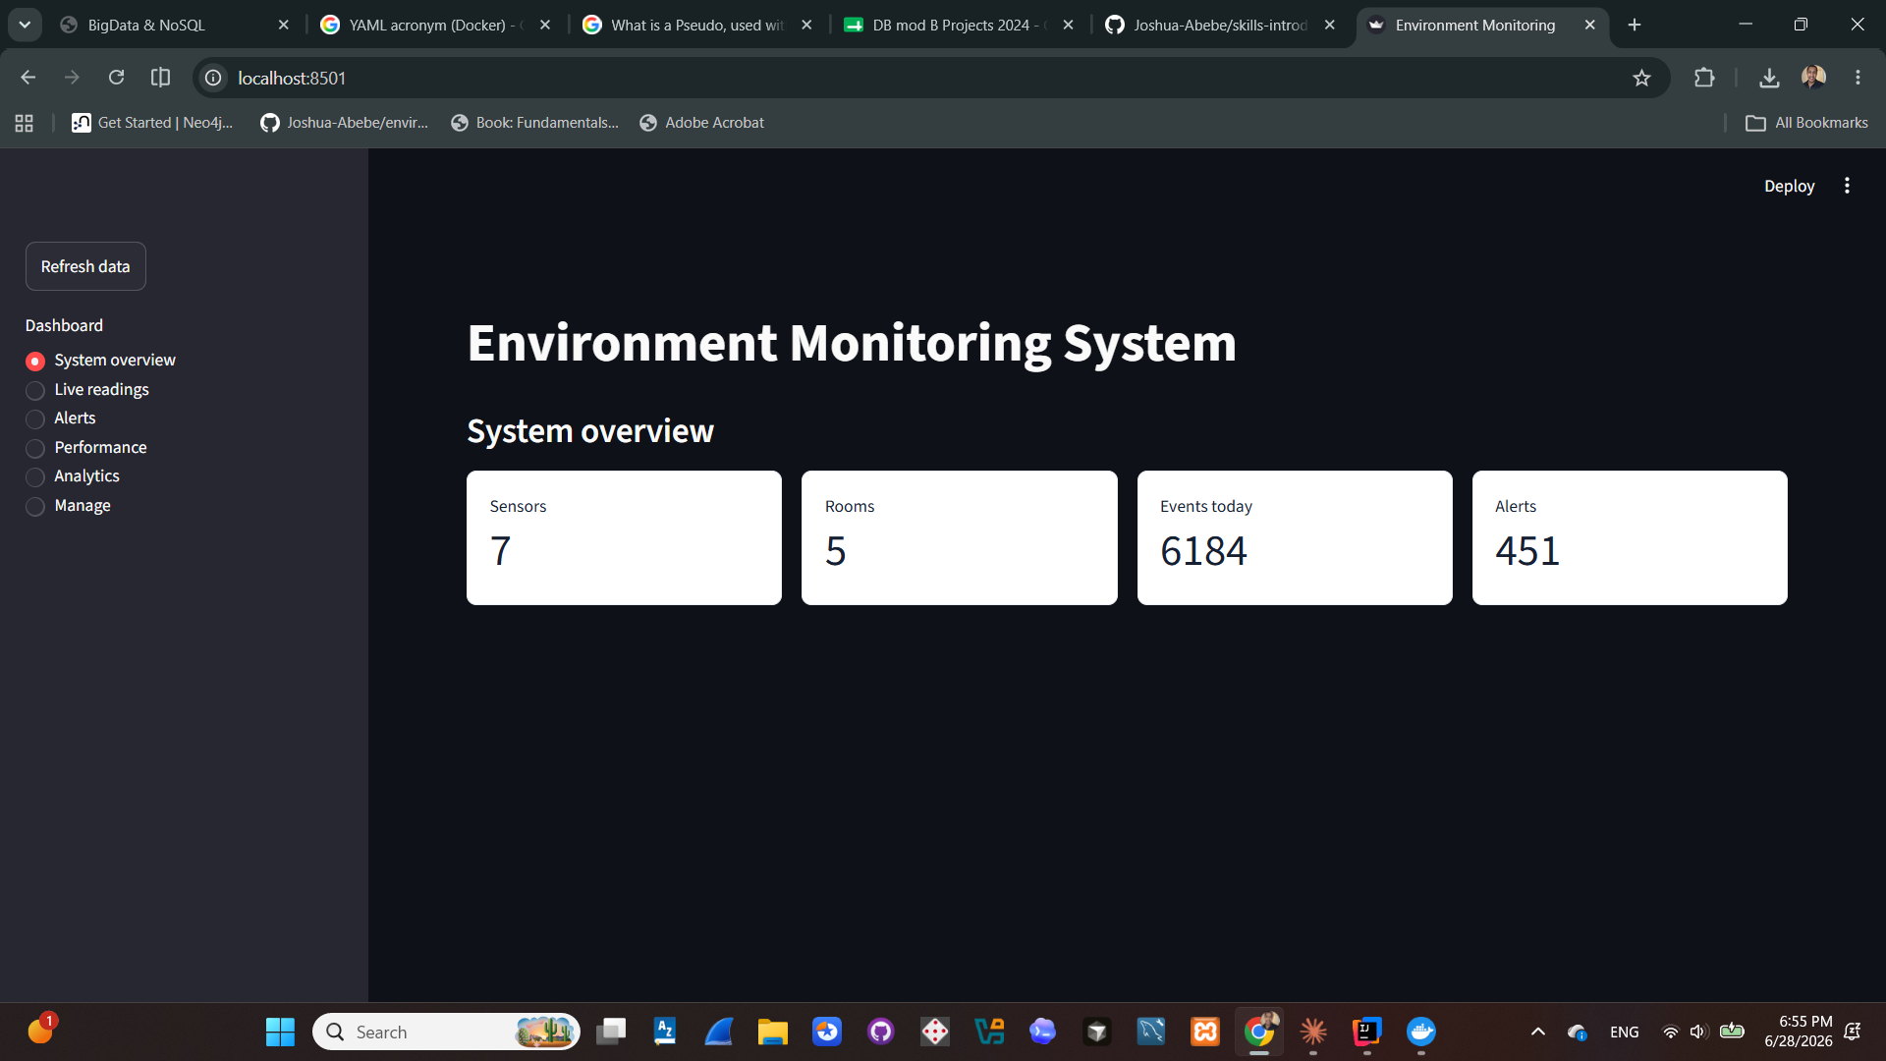
Results — System Overview
Live counts of sensors, rooms, events recorded today and total alerts
Dashboard home page, reading live from all three databases.
9

Slide 10
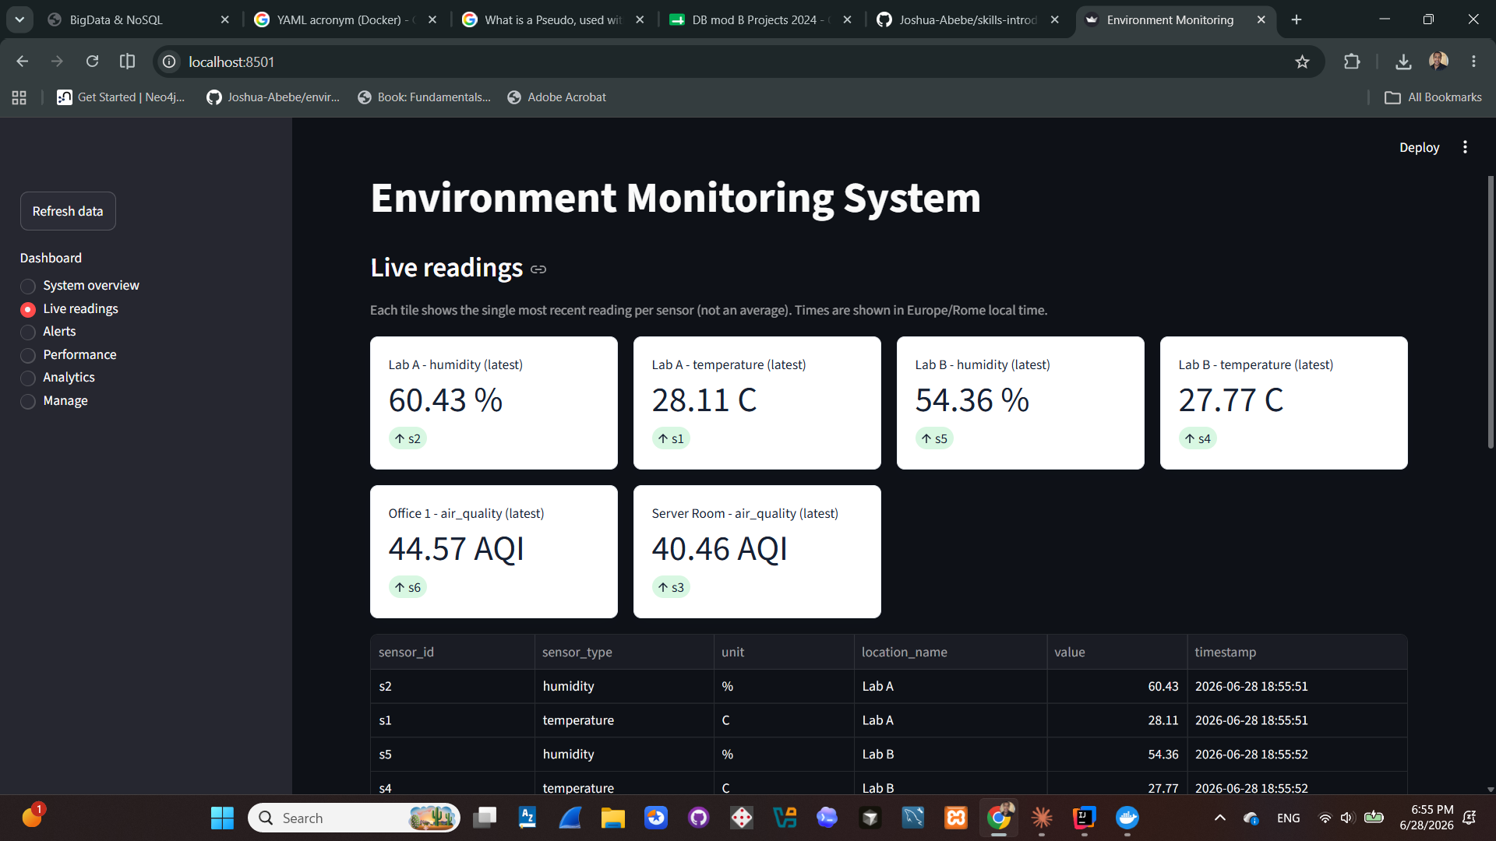
Results — Live Readings
Most recent value per sensor, grouped by room
Current readings plus a recent-history table and trend chart.
10

Slide 11
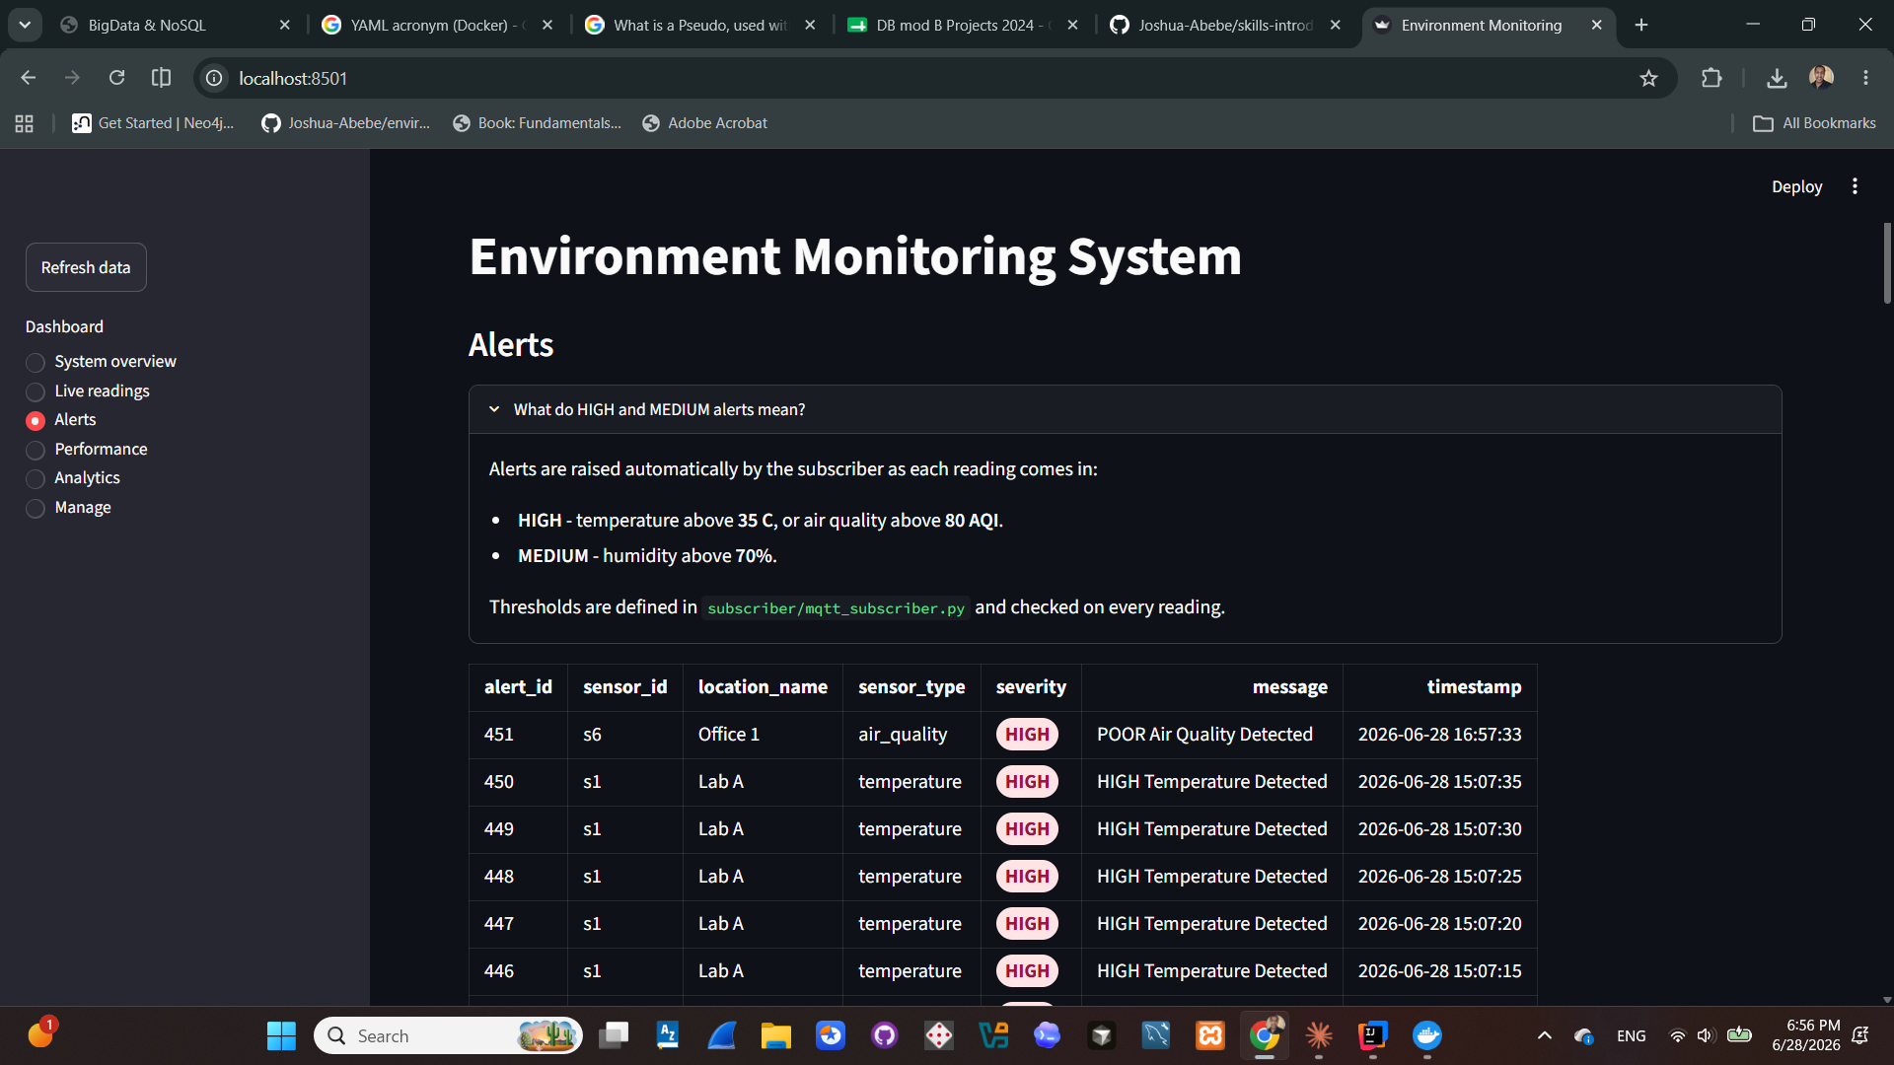
Results — Alerts
Severity-coded threshold excursions raised by the subscriber
Alert log with the threshold rules shown inline for context.
11

Slide 12
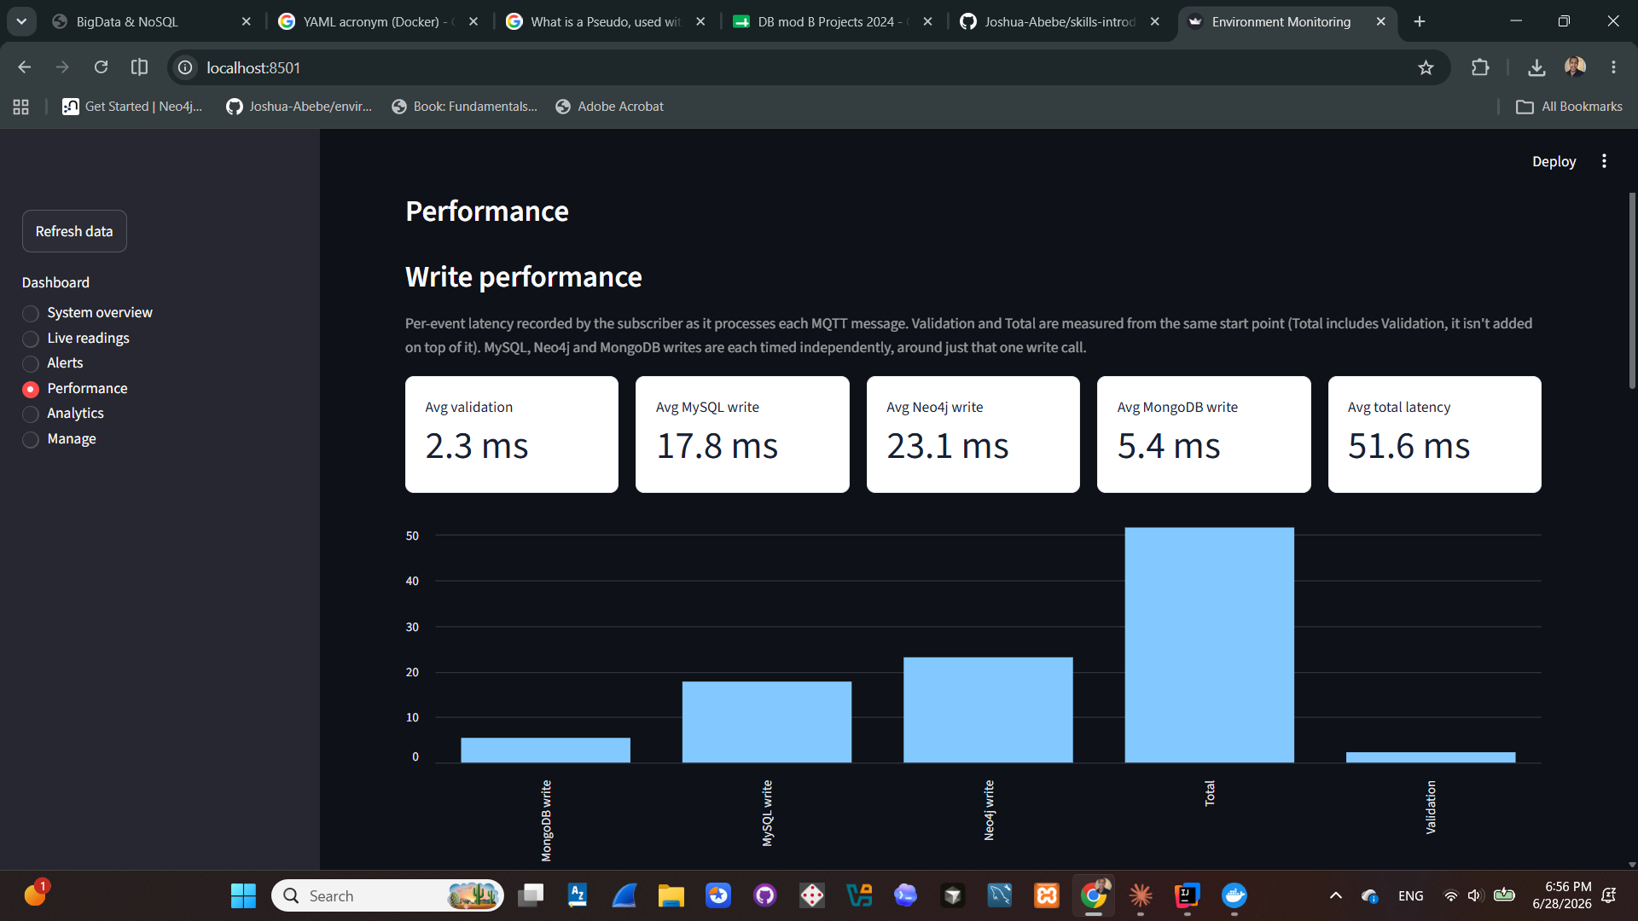
Results — Performance (Write)
Per-stage write latency for every event processed
Validation, MySQL, Neo4j, MongoDB and total latency, timed independently.
12

Slide 13
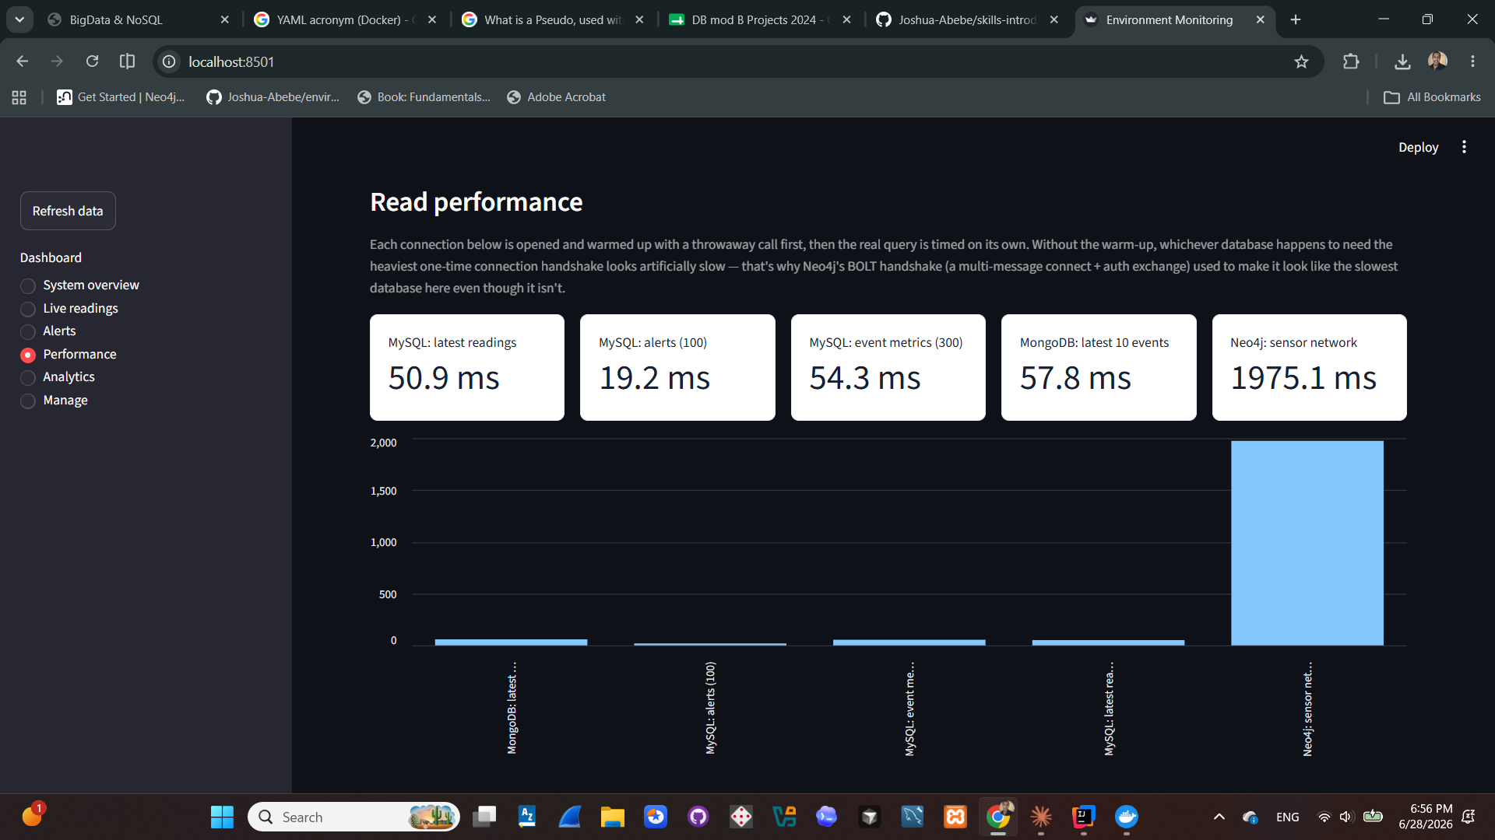
Results — Performance (Read)
Read-latency benchmark across all three databases
Each connection warmed up before timing, to keep the comparison fair.
13

Slide 14
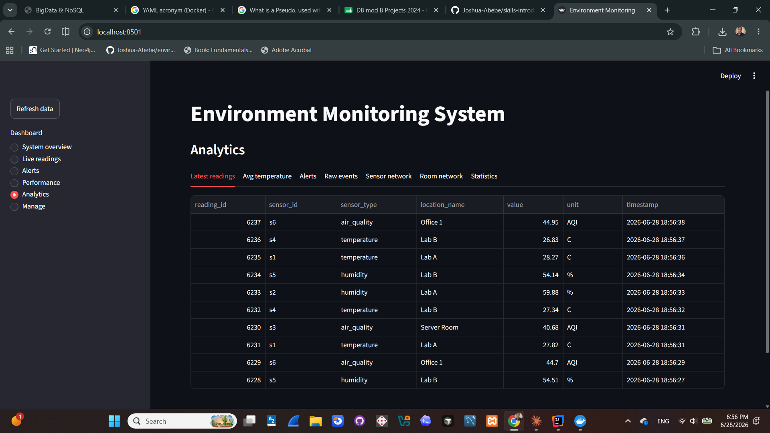
Results — Analytics
Tabbed cross-database views
Latest readings shown; also averages, alerts, raw events, sensor/room network and statistics.
14

Slide 15
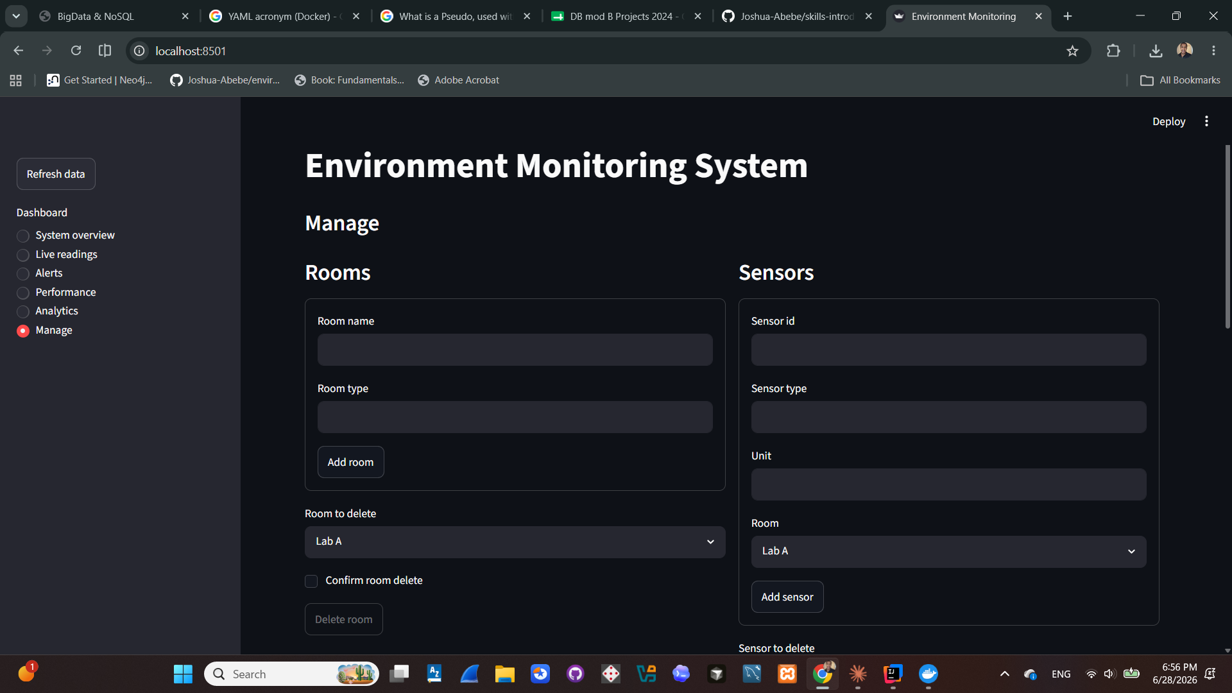
Results — Manage
Adding and removing rooms and sensors
The same page also creates Neo4j relationships between sensors, metrics and rooms.
15

Slide 16
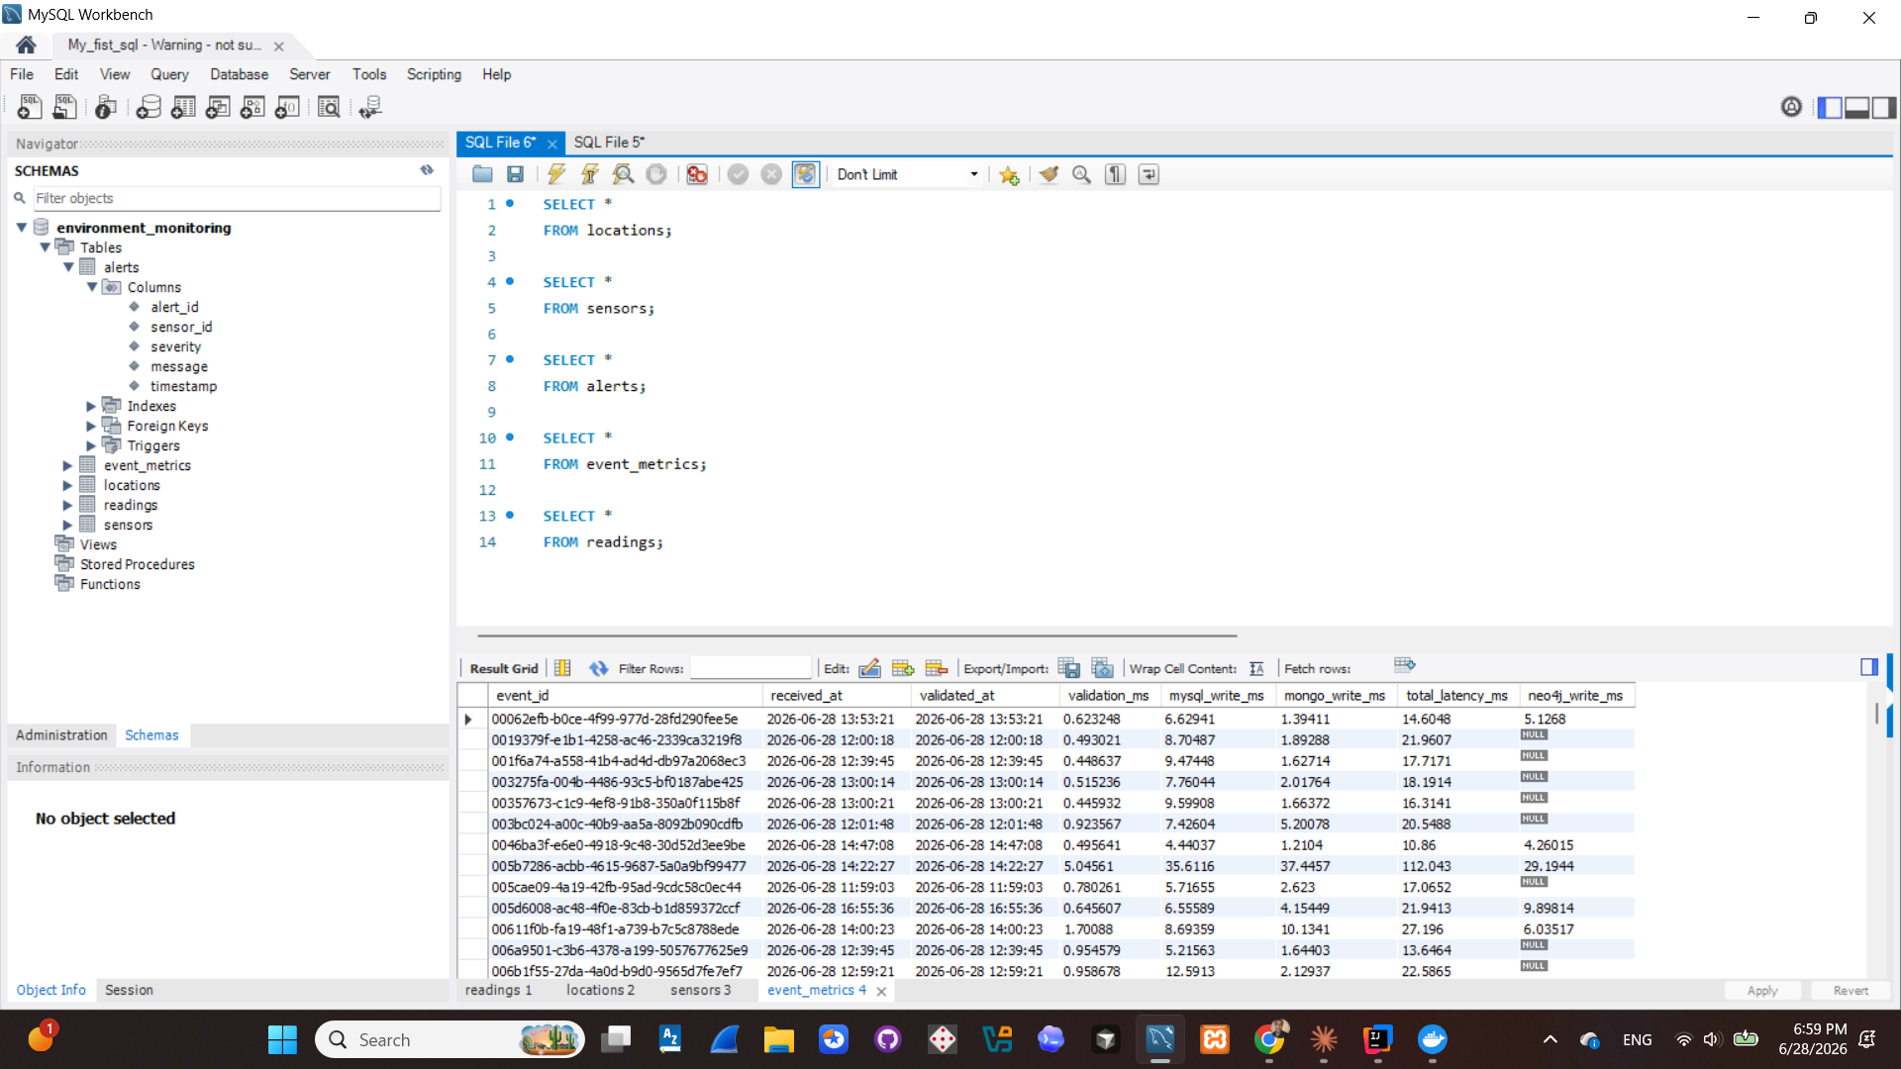
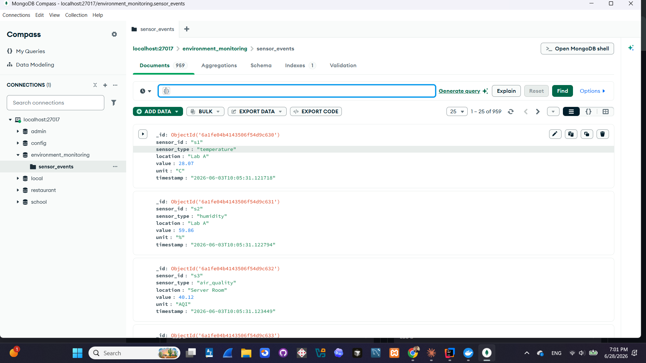
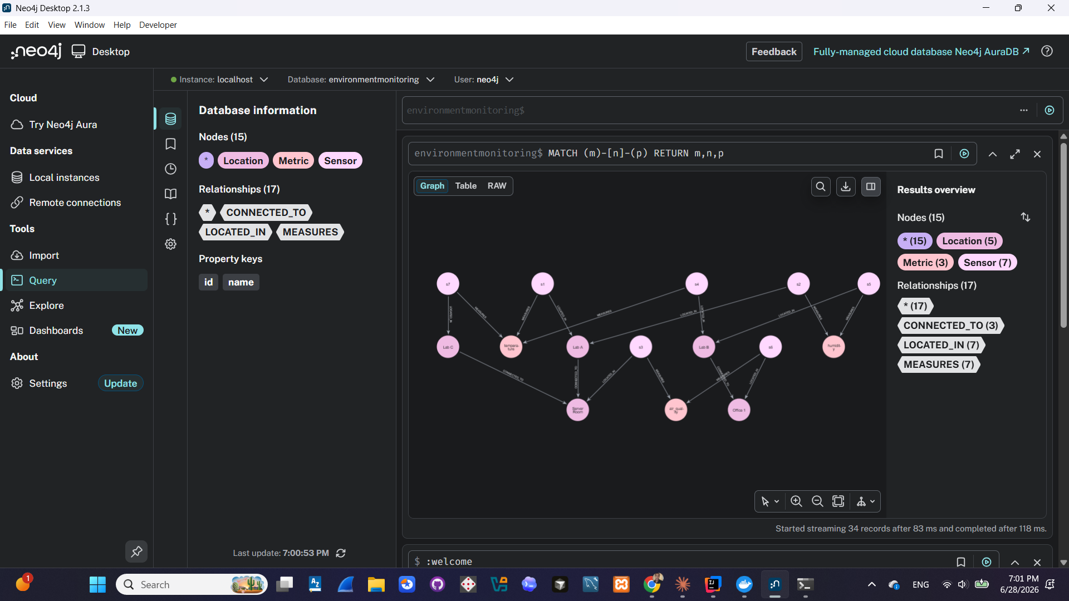
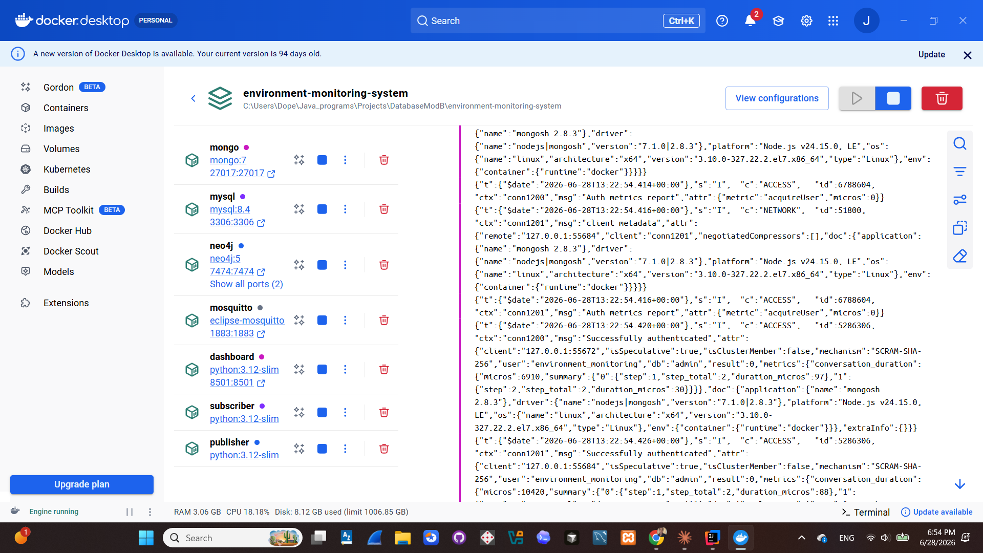
Database Backends, Verified Directly
Confirming each store independently holds real data — not just relayed through the dashboard
MySQL Workbench — event_metrics table
MongoDB Compass — raw sensor_events collection
Neo4j Browser — live sensor / location / metric graph
Docker Desktop — all seven services running
16

Slide 17

Conclusions & Future Work
What Was Delivered
Future Work
A working, fully containerized MQTT → 3-database pipeline
Defensive event validation and edge-triggered alerting
Per-database failure isolation
Per-stage performance instrumentation
An automated test suite (48 tests) that runs in CI on every change
Machine-learning-based anomaly detection in place of fixed thresholds
Deployment to a cloud environment
Integration with real sensor hardware in place of the simulator
Per-service Dockerfiles, so dependencies are not reinstalled on every container start
17

Slide 18

Thank You
Full source, configuration, automated tests and the CI workflow:
github.com/Joshua-Abebe/environment-monitoring-system
Setup and usage instructions are documented in the repository's README.
Abebe, Eyasu Belete · Student ID: 571914 · Eyasu_abebe@studenti.unime.it

