Slide 1


F´ Sphinx Reference Deployment
Kevin F. Ortega, Flight Software Engineer, 9/16/2020

Slide 2
Outline
Background
Software Configuration
Hardware Configuration
Demo
Conclusion

Slide 3
What is F`?
F` Flight Software Framework
A component-based architecture as well as a software framework to support it
Uses the concept of software components
Designed from the ground up to be compact and reusable
Includes framework, code generators, build tools, Command/Telemetry GUI, and unit test environment
Designed to make it easier for developers to concentrate on mission-specific logic rather than common implementation patterns.

Slide 4
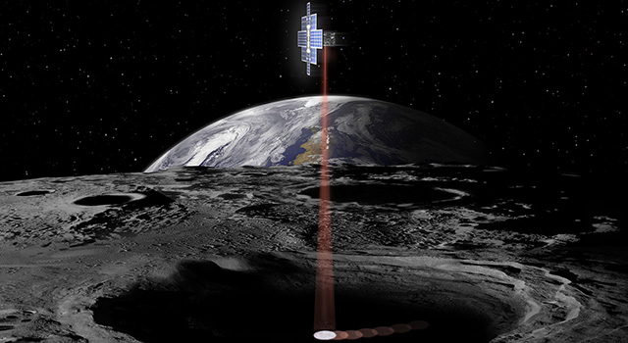
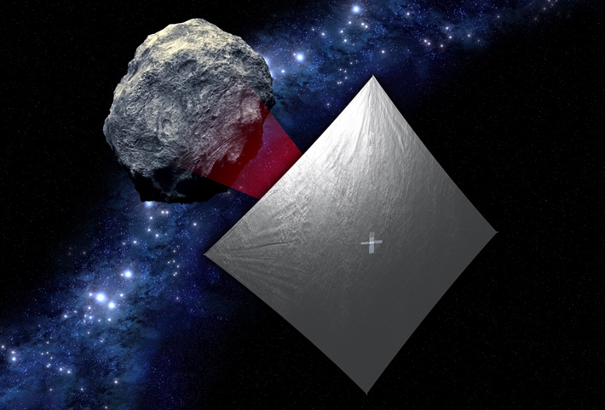
F´
F´ Sphinx Drivers
NOR
ADC
SphinxTime
SpaceWire
SPI
UART
GPIO
Sphinx Hardware

Slide 5
Sphinx Reference Deployment
latestF´
F´ Sphinx Drivers
NOR
ADC
SphinxTime
SpaceWire
SPI
UART
GPIO
Sphinx Hardware
© 2020 California Institute of Technology. Government sponsorship acknowledged.

Slide 6
Software Configuration
Sphinx Drivers
F’ Service Components
Deployment Specific
eventLogger
FSWInfo
SphinxTime
SPIDriver
chanTlm
DriverDemo
GPIODriver
FPGASPIDriver
FPGAGpioDriver
GroundInterface
CmdDispatcher
SphinxUartOnboardDriver
UARTDriver

Slide 7
Hardware Configuration
workstation
Sphinx Hardware
UART
JPL VPN
F’ Sphinx Reference Deployment
SPI
Laptop
GDS
UART
Sphinx GSE Card

Slide 8
Demo
https://github.com/fprime-community/fprime-sphinx
https://github.com/fprime-community/fprime-sphinx-drivers

Slide 9
Conclusion
Thanks to F’ innate feature of modularity
Able to rapidly produce Sphinx Reference Deployment
Sphinx Reference Deployment can be used as a starting point

