Slide 1
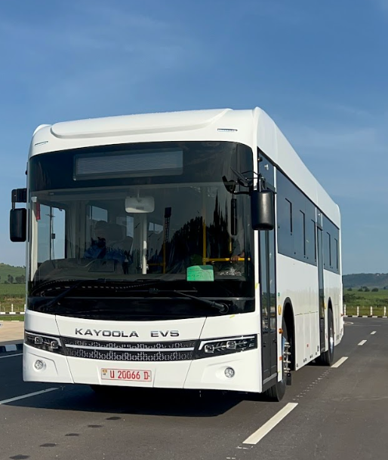


INCIDENT REPORTING SYSTEM (IRS)
PROGRESS REPORT
Joshua Aryampa
Swahiba Nabisere
Notes:
Good morning/afternoon. We are Joshua Aryampa and Swahiba Nabisere, and this is our progress report on the Incident Reporting System (IRS).
In the next few minutes we will walk through why this system was needed, what we built, the main challenges we hit, what is working today, and what we need to do before it can go live plant-wide.

Slide 2
2. Introduction
Web-based Incident Reporting System (IRS) for Kiira Motors Corporation
Digitizes incident reports from submission through verification to approval
Built as a Django application with Keycloak single sign-on for plant employees
Goal: one system usable plant-wide, with a clear audit trail and accountable sign-offs
This presentation summarizes the problem, solution, challenges, progress, and next steps
Notes:
IRS is a web-based incident reporting tool for Kiira Motors — from first report through verification and final approval.
We chose Django for a maintainable backend and Keycloak so every employee signs in with the same company identity they already use. The real goal is not just digitizing a form: it is one plant-wide system with a clear audit trail and accountable sign-offs at each step.
This slide sets the roadmap for the rest of the presentation.

Slide 3
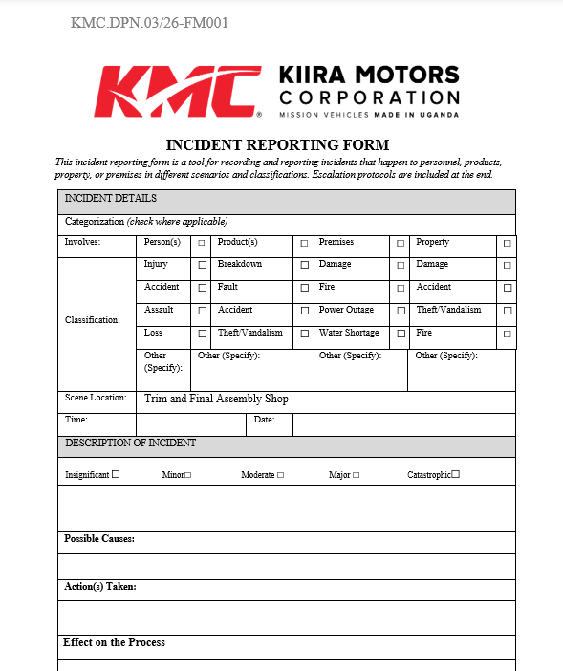
3. The Problem
Incident reporting was manual, slow, and difficult to track across the plant
Limited visibility into open incidents, late submissions, and workflow bottlenecks
Hard to produce consistent closed reports with signatures and audit history
Notes:
Today, manual or fragmented reporting makes incidents hard to track and easy to lose between people and departments.
Supervisors struggle to see what is still open, which submissions came in late, and where the workflow is stuck. When a case closes, there is often no single, consistent record with signatures and history — that weakens follow-up and accountability.
This is the gap IRS is meant to close.

Slide 4
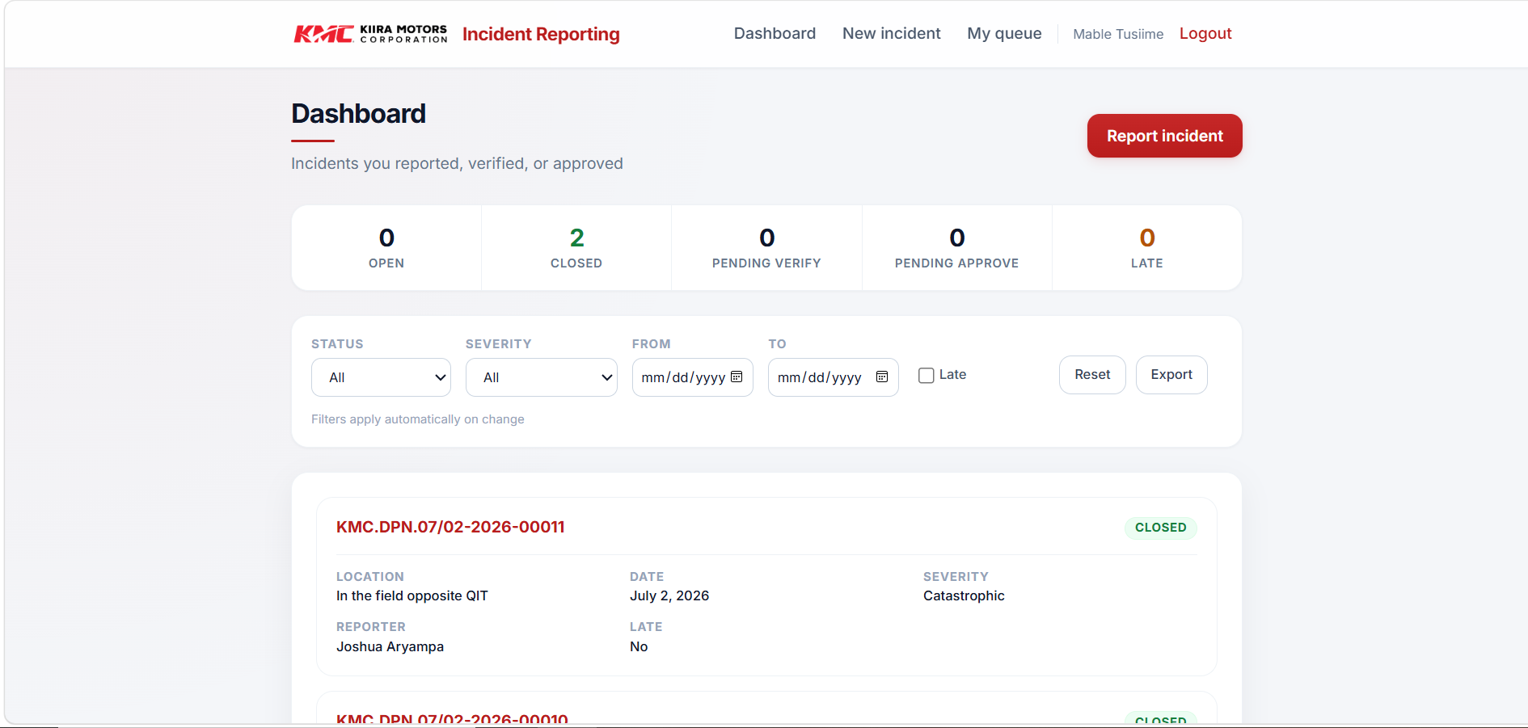
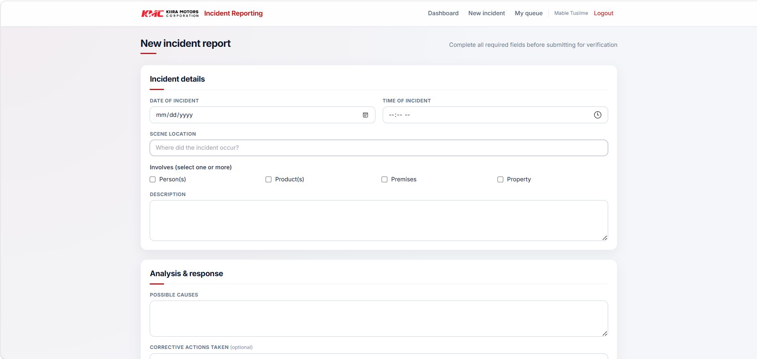
4. The Solution
Django web app — works on desktop and mobile browsers
Keycloak login for all employees; roles synced automatically on sign-in
Reporter types scene location and selects a verifier; verifier selects an approver
Workflow: Draft → Pending verification → Pending approval → Closed
Dashboard with filters, personal queue, email notifications, CSV export, and PDF reports
Signatories captured at submit, verify, and approve (signature image or printed name)
Notes:
Our solution is a browser-based app — usable on desktop or mobile without installing anything.
Employees log in through Keycloak; roles sync on sign-in. The reporter enters the scene location and chooses who verifies; the verifier then chooses the approver. That keeps responsibility explicit instead of hidden in fixed rules.
The workflow is Draft → Pending verification → Pending approval → Closed. The dashboard, queue, notifications, CSV export, and branded PDF give users one place to work and a proper closed report with signatories.

Slide 5
5. The Challenges
Integrating Keycloak (realm, client, redirect URI, service account for search)
Replacing automatic routing with flexible employee search and manual sign-off selection
Server/client clock sync for JWT validation during login
Signature hosting still to be finalised
Notes:
Most of our hardest work was integration, not layout. Keycloak needed the correct realm, client, redirect URI, and a service account so we could search employees when picking verifiers and approvers.
We also moved away from automatic routing to flexible search — a better fit for plant-wide reporting. JWT login failed until server and client clocks were aligned; that is a common SSO lesson, not a one-off bug.
Signature hosting is still being finalized with IT, which affects how signature images appear on closed reports.

Slide 6

6. The Progress
End-to-end workflow implemented and tested locally with Keycloak SSO
Free-text incident location, pagination, and updated signatories section on reports
Employee search for verifier (at submit) and approver (at verify)
Software Requirements Specification and Software Design Document prepared
UI improvements: clearer forms, branded logos, role-based dashboard visibility
Closed incidents export to PDF with official KMC branding
Notes:
We now have a working end-to-end flow tested locally with real Keycloak login — not a mock-up.
Key deliverables include free-text location, pagination, employee search for verifier and approver, an updated signatories section, role-based dashboard visibility, and PDF export with KMC branding. We also prepared the SRS and SDD so the work is documented for handover.
If helpful, we can briefly demo the dashboard or a closed PDF after the slides.

Slide 7

7. The Next Steps
Updating the UI of the System
Configure signature file storage (SIGNATURE_BASE_URL)
Production deployment: PostgreSQL, HTTPS, and application server setup
User acceptance testing with supervisors and representative plant users
Short user guide and handover to Information Systems / support team
Monitor feedback and prioritize analytics enhancements for Admin and CEO roles
Notes:
Near term, we are polishing the UI so the system feels ready for daily use.
Before production we need IT to configure signature storage (SIGNATURE_BASE_URL), deploy on PostgreSQL with HTTPS, and run user acceptance testing with supervisors and representative plant users. We will prepare a short user guide and hand over to Information Systems for support.
After launch, we will gather feedback and prioritize analytics improvements for Admin and CEO roles. We welcome your guidance on priorities and are happy to take questions.

