Slide 1
Medical Costs
Analysis

Slide 2
Business problem
Use patient data to predict the cost of their hospital visits.

Slide 3
Business application
Enable actuaries for health insurance companies to appropriately price insurance plans.

Slide 4
data
1,338 hospital visits in the United States
Response variable: ‘Charge’
individual medical costs allowed by health insurance companies

Slide 5
data
Original Variables
‘Age’
‘Sex’
‘BMI’ Body Mass Index

Slide 6
data
Original Variables
continued…
‘Children’ number of dependents covered on health insurance plan
‘Smoker’ (binary variable, indicating whether patient smokes)
‘Region’ Northwest, Northeast, Southwest, or Southeast USA

Slide 7
Data engineering
Age, BMI, Charge
Because we’re using linear regression,
numeric variables should be approximately normal.
Since these variables have domains [0, ∞),
lognormal transformations are preferable to standardization
To improve symmetry,
Divide each variable by its median before applying the log transformation

Slide 8
Data engineering
Age, BMI, Charge
‘New’ = LOG(‘Original’/MEDIAN(‘Original’))

Slide 9
Data engineering
Sex, Smoker
Converted into binary variables;
1 represents female sex or positive smoker status.

Slide 10

Data engineering
Children
Categories 4 and 5 were lumped into 3
due to limited sample size
To prevent overfitting.
The resulting categories were converted with one-hot encoding
Despite their ordinality
because the relation to charge is non-linear.

Slide 11
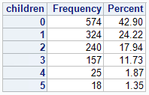

Data engineering
Children

Slide 12
Data engineering
Region
Converted via one-hot encoding

Slide 13
Variable analysis

Slide 14
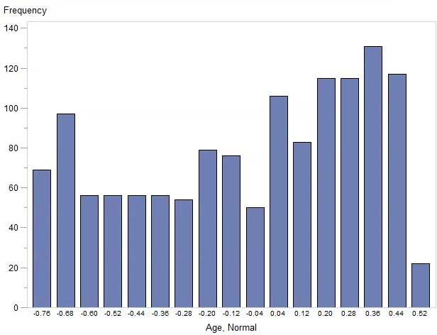

Age
Despite our transformation, the distribution is not normal.
Left skew

Slide 15
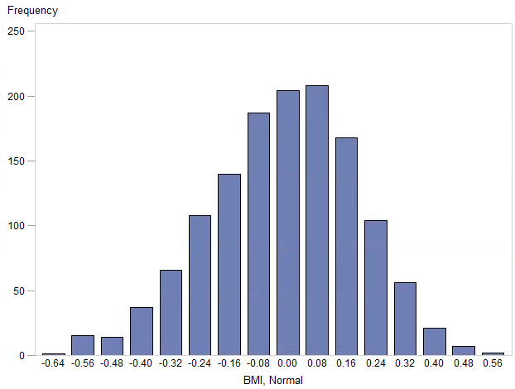

bmi
Despite our transformation, the distribution is not strictly normal.

Slide 16
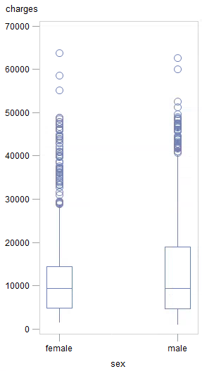
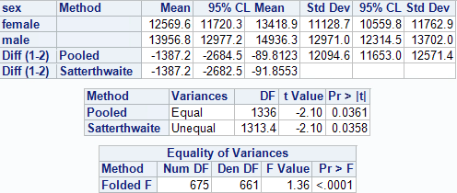
Sex!
For males,
average charge is roughly $1,400 higher;
dispersion is also greater;
these differences are statistically significant.

Slide 17
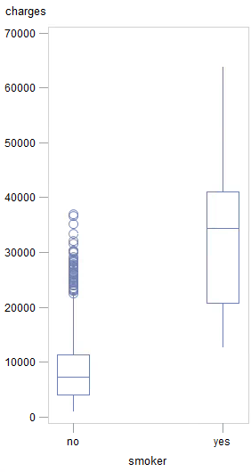
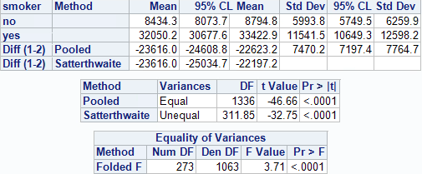
smoker status
For smokers,
average charge is roughly $24,000 higher;
dispersion is also greater.
these differences are statistically significant.

Slide 18
children
Based on T-Tests,
not strong evidence of difference between
children = 0 or 1, …or between
children = 2 or more than 2.
but there is a difference between
children = 1 or 2.
Conclusion: To prevent overfitting,
Cluster variable into children <= 1 and children >= 2.

Slide 19
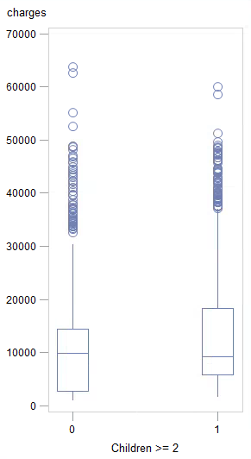
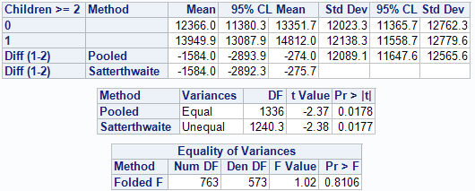
children
For patients with 2 or more children,
average charge is roughly $1,584 higher;
this difference is statistically significant.

Slide 20
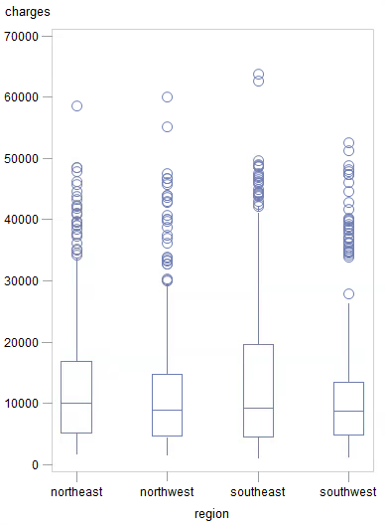
region
Based on T-Tests,
SE charges have greater mean and dispersion (statistically significant);
NW and NE charges have less dispersion (statistically significant).
Conclusion: Use all regions as binary predictors
(treating southwest as the baseline).

Slide 21
model
General linear model
Step-wise selection

Slide 22
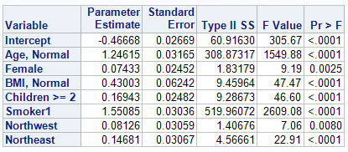
Model, results
All variables made it into the final model,
except SW and SE regions which were merged.
Smoker status and age alone account for 74.57% of the variation in charge.
Adding the other five variables only improved the R-squared to 76.55%.
1.98% increase

Slide 23
conclusion
Age and smoker status are highly predictive of hospital visit charges.
The final model performed competently,
explaining most of the variation in charge.

