Slide 1
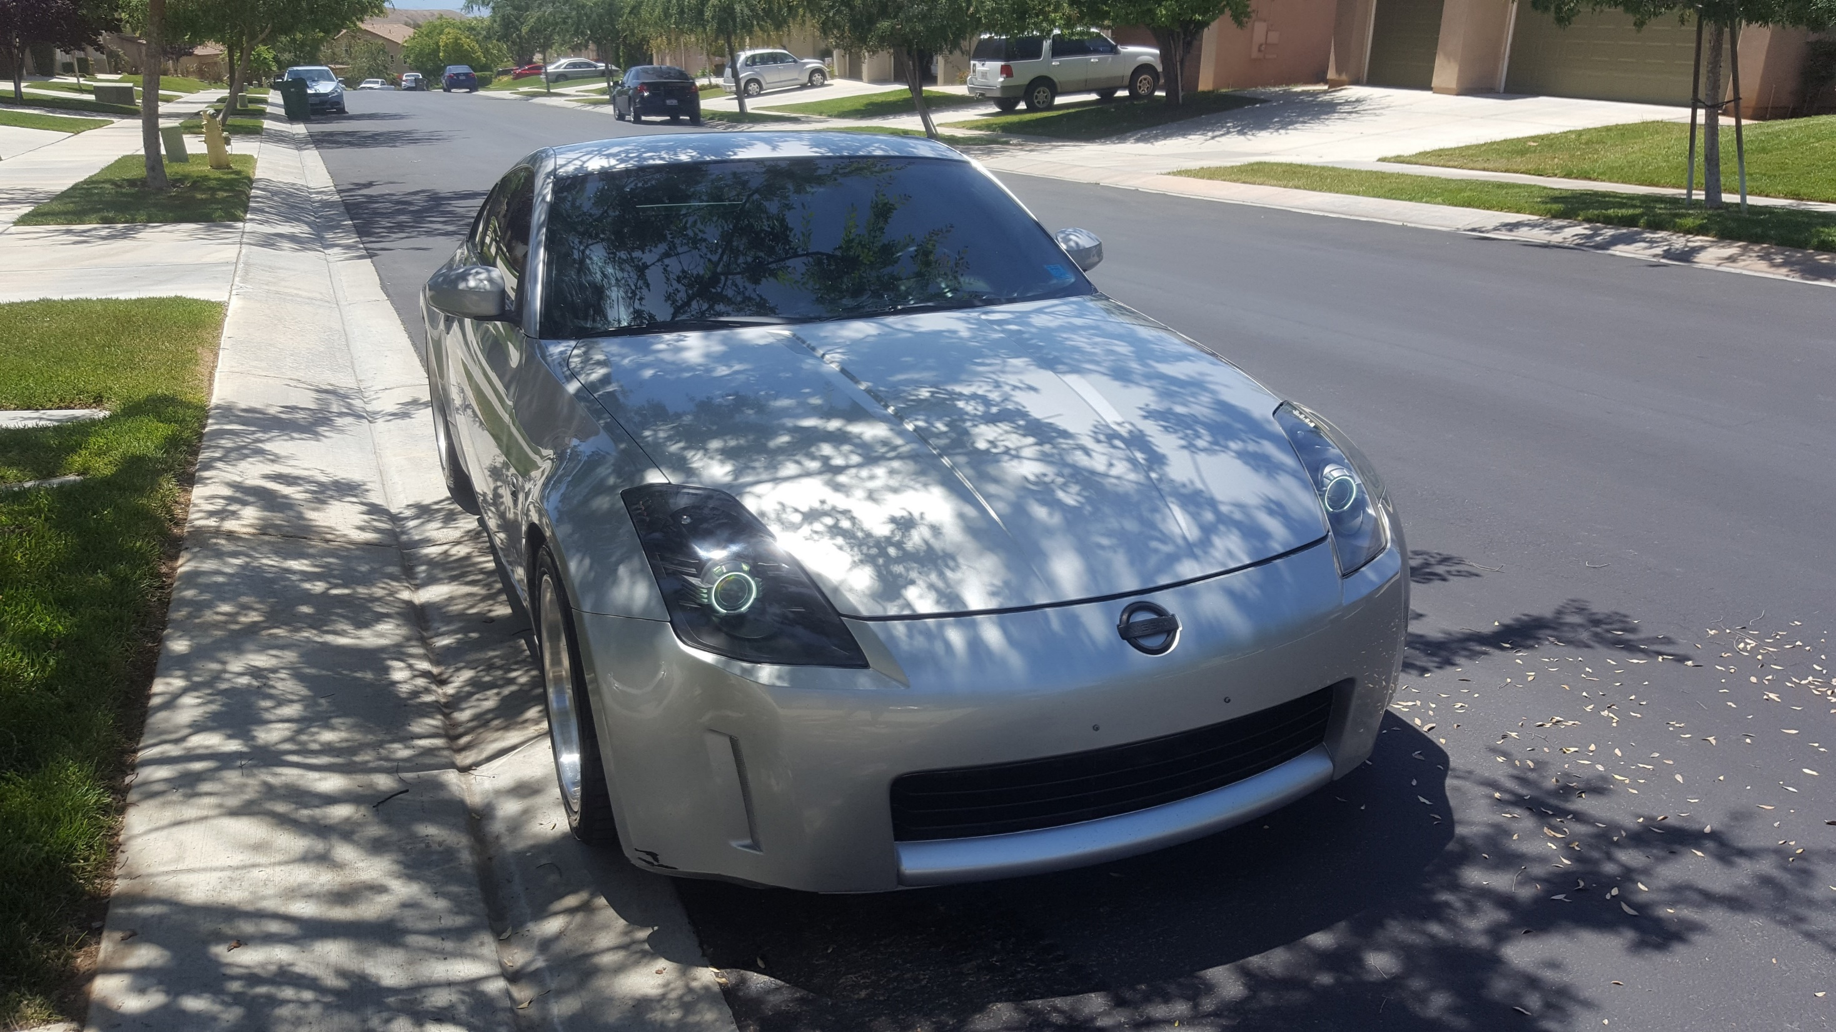
OpenZ
HnB Enterprises
Team Members:
Alyssa Abram
Joshua Bonner
Richard Bowers
Jonathan Edsell
Jacob Gallucci
Ariel Rupp

Slide 2
AGENDA
PURPOSE
LANE DEPARTURE DETECTION
PARKING COLLISION DETECTION
ON BOARD DIAGNOSTICS
MUSIC PLAYER
GPS NAVIGATION
WRAP UP
Q/A

Slide 3
Purpose
In the beginning we sought to challenge ourselves and expand our knowledge within the realms of computer science and engineering. We decided to create a complex project consisting of multiple disciplines not only within the computer science field but that of other engineering fields as well.
Thus we created, from scratch, an infotainment system customized for the Nissan 350z.
With the composition of the team and its many different talents, we divulged our own unique touches on the system to create something that stands out from other projects.
It is our hope that you will be just as impressed as we are with the functionality and all that the system is capable of.

Slide 4
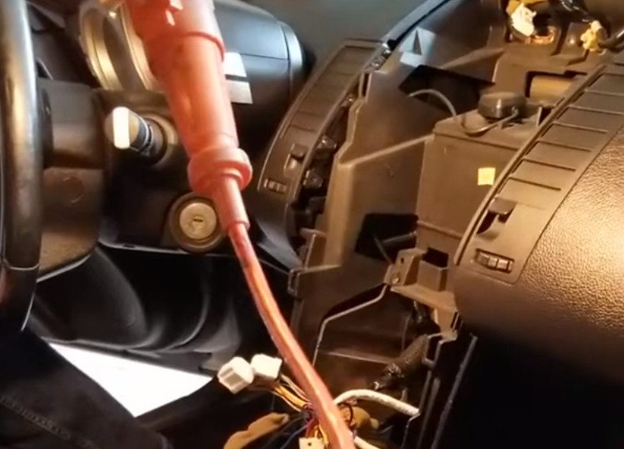
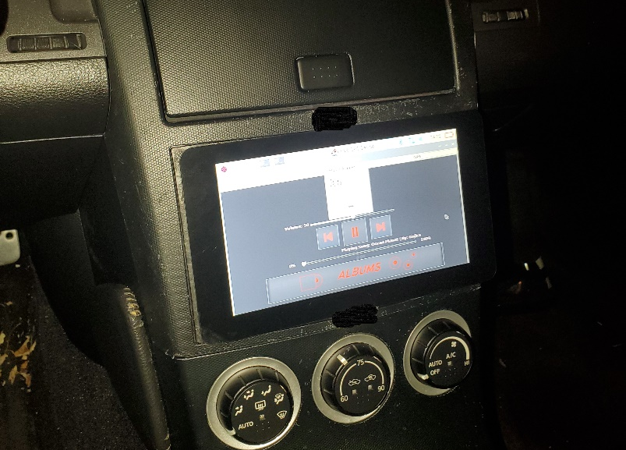
The Infotainment system
As mentioned previously, we created an infotainment system that includes many functions which will be discussed in this presentation.
The system includes, a Raspberry Pi4 micro computer attached to a touch screen LCD which is used in place of a headunit inside a Nissan 350z.
With some research, we connected the appropriate wires from the gutted dash of the vehicle. This required the expertise and knowledge of many disciplines such as electrical engineering and some mechanical know how.
The end result is a fully functional computer embedded into a motor vehicle.

Slide 5
Lane Departure Detection (LDD)
As the title suggests, we have implemented a lane departure system that will warn the user when they are drifting from their lane when the vehicle is in motion.
The system makes use of a camera designed to work with the Raspberry Pi micro computer and uses machine vision, in its traditional sense, to detect the brightly colored lines on a normal road.
Once the system recognizes these lines within a defined area, if the lines move too far from one side of the predefined area, the system alerts the user with a distinct audible beep until the user corrects their trajectory.

Slide 6
Lane Departure Detection (LDD)
Embedded video demonstration

Slide 7
Parking collision detection (PCD)
To create a parking collision detector, we needed to make use of some hardware designed to be used with the Arduino micro controller.
Using 4 SR04 Ultra Sonic Sensors, a passive buzzer, and a few LEDs, we created a system which alerts the user of a potential collision during a parking maneuver.
The sensors will detect objects using ultra sonic waves to determine the distance between the encroaching object and the sensors themselves.
At a predefined distance the sensors will communicate via the Arduino with the passive buzzer and provide distinct beeps alerting the user of the potential collision.
Paired with the passive buzzer are the LEDs which will indicate certain statuses of the PCD system.

Slide 8
Parking collision detection (PCD)
Embedded video demonstration

Slide 9
On board diagnostics (OBD)
Given that this system is for a motor vehicle, we decided that it would be an important function to provide the user with vehicle data generated by the Engine Control Module.
Using the On Board Diagnostic interface, common in most vehicles, we can pull, display, and reset real time data from the engines CPU, including maintenance codes used by mechanics to diagnose engine issues.
A server on the Raspberry Pi is set up to receive incoming data retrieved by the OBDII and then displayed on the user interface
Additional data pertinent to the use of this vehicle includes engine load, intake temperature, and throttle position.

Slide 10
On board diagnostics (OBD)

Slide 11
Music Player
A standard expectation of an infotainment system is to provide the user the ability to listen to music of their choice when traveling. Thus, we created our own music player.
Given the standard libraries available in Java, mp3 files can be read in and played back through the systems speakers, in this case the sound system of the vehicle.
Classes were implemented to hold an album and its associated mp3 files along with the album art.
While integrated into the user interface, the user is able to choose an album and play its contents.

Slide 12
GPS Navigation

