Slide 1
Mersenne Twister Implementation and Cryptographic Insecurity: Project Presentation
Joshua Jurgensmeier (Just Me)
CS 399: Cryptography

Slide 2
Outline
Project Goals
Mersenne Twister Overview
Cryptographic vulnerability
Project Overview
Software Design

Slide 3
Project Goals and Learning Objectives
Goals
Implement Mersenne Twister 19937 (MT19937) pseudo-random number generator (PRNG) algorithm
Demonstrate cryptographic insecurity
Learning Objectives
PRNGs
Cryptographic security
Algorithm implementation
MT

Slide 4
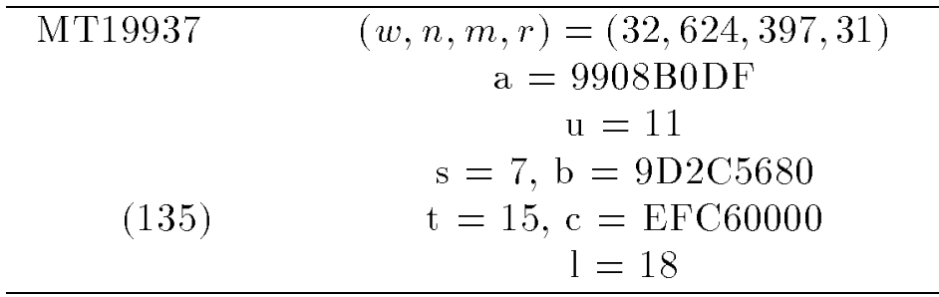
Mersenne Twister (MT) Overview
Mersenne Twister: A 623-dimensionally equidistributed uniform pseudorandom number generator by Makoto Matsumoto and Takuji Nishimura. Published in 1998 in the ACM Transactions on Modeling and Computer Simulation journal. [Mat98]
MT19937

Slide 5
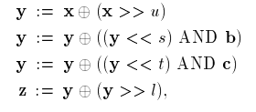

Initialize state
seed
Twist
New state
Temper and output
[Mat98]
[Mat98]
$$xT$$

Slide 6


Initialize state
seed
Twist
New state
Temper and output
$$xT$$
$$xTT^{−1}$$

Slide 7
Scenario
User wants to encrypt a message
Stream cipher uses MT19937 as keystream generator
Attacker injects known-plaintext
Attacker captures state
User encrypts
Attacker decrypts
Pu (secret)
Pa (624 32-bit words, 2496 bytes)
Ca = Pa XOR Temper(Su)
Su = Sa = Untemper(Ca XOR Pa)
Cu = Pu XOR Temper(Su)
Pu = Cu XOR Temper(Sa)

Slide 8
Software Design
Python 3
main() entry point
Three classes
MersenneTwister19937
StreamCipher
MThacker

Slide 9
main()
Instantiate objects
Capture MT state vector
Prompt for plaintext and encrypt
Decrypt ciphertext
Display the results
StreamCipher and MThacker
MThacker.hack_stream()
StreamCipher.encrypt(plaintext)
MThacker.decrypt(ciphertext)
Display the results

Slide 10
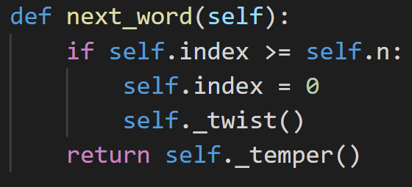
MersenneTwister19937
_initialize_state(seed)
int next_word()

Slide 11
StreamCipher
source_mt = MersenneTwister19937(seed)
String encrypt(String plaintext)
ciphertext = plaintext XOR keystream
Return ciphertext

Slide 12
MThacker
hkd_mt = MersenneTwister19937(1234)
hack_stream(StreamCipher stream_cipher)
Use known plaintext and untempering to duplicate state of stream_cipher's MT
ciphertext = stream_cipher.encrypt(payload)
keystream = payload XOR ciphertext
For i = 0—n:
hkd_mt.state[i] = MThacker._untemper(keystream[i])
String decrypt(String ciphertext)
plaintext = keystream from hkd_mt XOR ciphertext
Return plaintext

