Slide 1
TEMPERATURE INFLUENCE ON RELATIVE HUMIDITY USING PCA APPROACH
BY
ODURO YEBOAH JOSHUA
MENSAH CHARLES
DZAHENE RICHMOND K. ELORM

Slide 2
OUTLINE
Introduction
Objectives
Methodology
Processing
Results
Discussion
Conclusion
Recommendations
References

Slide 3
Introduction
Temperature is a physical quantity that expresses quantitatively the attribute of hotness or coldness(Hetch et al, 2024)
Relative humidity is the ratio of water vapor partial pressure to the saturated at a stated temperature, usually quoted as a percentage.(Dyer 2012).
According to Britannica (Gentilli et al. 2025), “Warmer air holds more moisture than cooler air – so the relative humidity falls if the temperature rises but the amount of moisture in the air stays the same
Principal component analysis (PCA) is a multivariate technique that analyzes a data table in which observations are described by several inter-correlated quantitative dependent variables. (Abdi et al, 2010)

Slide 4
Objective
To apply Principal Component Analysis (PCA) to investigate and quantify the influence of temperature on relative humidity by identifying underlying patterns and variance contributions within the data.

Slide 5
Methodology
Standardize the data
Compute the variance and covariance
Compute the covariance matrix
Find the eigenvectors
Find the eigenvalues
Derive the PCs

Slide 6
Processing
The process involved from standardizing the data through to computing the Pcs and visualizing them can all be found at PCA/PCA.ipynb at main · Joshua-Oduro/PCA

Slide 7
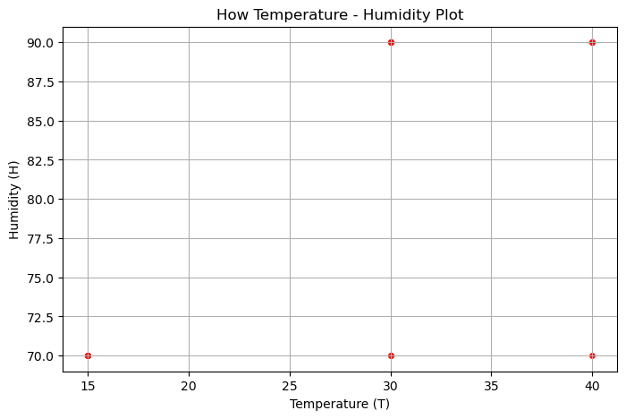
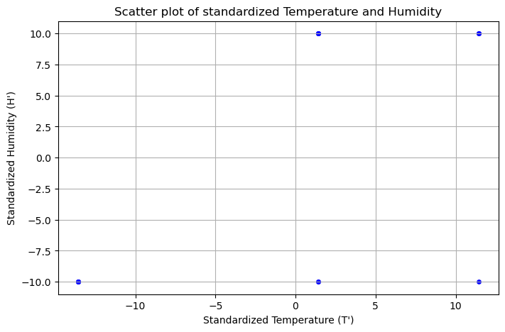
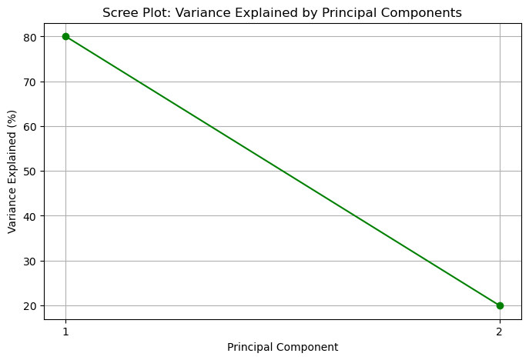
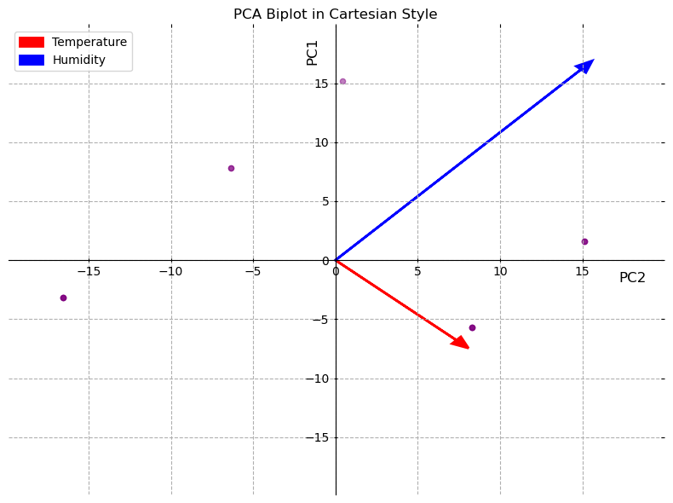
Results

Slide 8
Discussion
Scatter plot of standardized Temperature and Humidity: Shows standardized temperature and humidity values (-10 to 10) with no clear linear relationship.
Scree Plot: Variance Explained by Principal Components: Indicates the first principal component explains 80% of variance, the second 20%, with a sharp decline.
The PCA biplot shows humidity (blue arrow) strongly loading on PC1 (80% variance) and temperature (red arrow) on PC2 (20% variance)

Slide 9
Conclusions
No clear linear relationship exists between standardized temperature and humidity based on the scatter plot.
The first principal component, driven by humidity, explains 80% of the variance, per the scree plot.
The PCA biplot shows humidity loading strongly on PC1 and temperature on PC2, reflecting distinct contributions.

Slide 10
Recommendations
Include data from different seasons, times of day, or more years to capture broader climatic variability and strengthen the PCA results.
Incorporate other meteorological factors (e.g., wind speed, solar radiation, pressure) to see if temperature’s influence on humidity holds when other drivers are present.
Apply regression or correlation analysis alongside PCA to quantify the direct effect of temperature on humidity.
Analyze dry and wet seasons or day vs. night separately to see if the influence of T on H changes under different conditions.

Slide 11
References
Hecht, L., Caprini, L., Löwen, H., & Liebchen, B. (2024). How to define temperature in active systems? Journal of Chemical Physics, 161(22), 224904.
Dyer, I. (2012). Measurement of humidity. Measurement: Journal of the International Measurement Confederation, ?(?), Article S1472‑02991100302X.
Britannica. (2025). Relation between temperature and humidity. In Encyclopaedia Britannica. Retrieved July 20, 2025.
Abdi, H., & Williams, L. J. (2010). Principal component analysis. Wiley Interdisciplinary Reviews: Computational Statistics, 2(4), 433–459.

Slide 12
Group Members (M12)
Charles Mensah – 8676121
Joshua Oduro Yeboah – 8676321
Dzahene Richmond K. Elorm - 8674521

