Slide 1
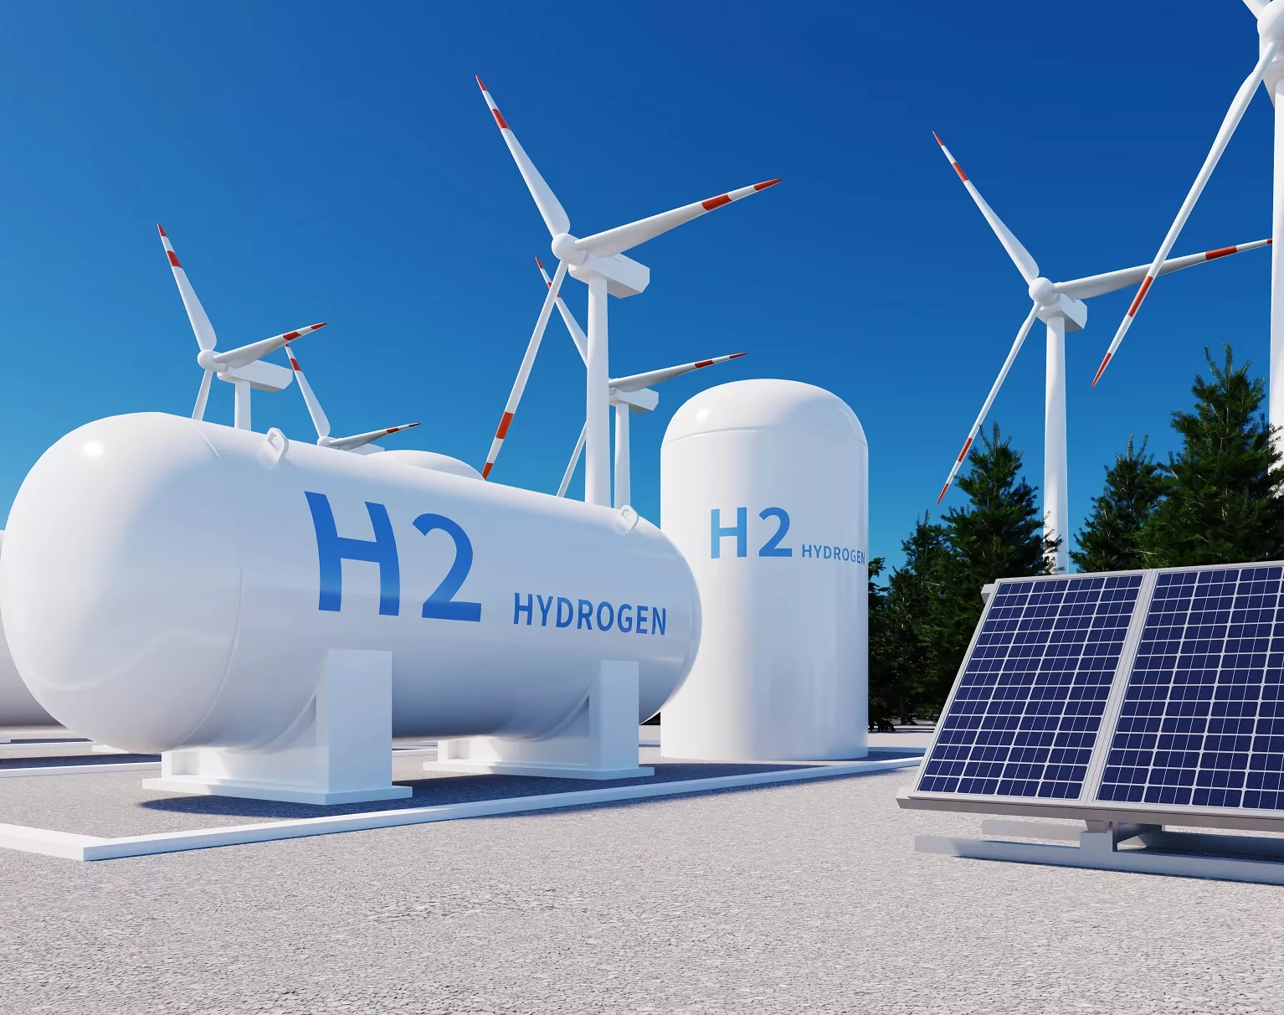

Sustainable Energy Production through Electrolyzed Water Using Solar Powered Hydrogen Generation
Name: Tewaratantrige Joshua Fernando
Student Number: 23022490
Supervised By: Dr. Mosayeb Davoudi Kashkouli

Slide 2
Introduction
Highlights
Aim:
To design and evaluate a system for generating clean hydrogen energy through the electrolysis of water using solar power for the electrolysis process, with energy recovery via hydrogen combustion or fuel cells.
Objectives:
Review current technologies for solar electrolysis and hydrogen fuel systems.
Theoretical framework simulating solar-powered water electrolysis.
Calculate energy balances across the electrolysis and hydrogen usage processes.
Compare energy recovery between combustion and fuel cell systems.
Assess the environmental and economic feasibility of the system.
Ways of increasing hydrogen production efficiency through electrolysis.
Assessing the viability of this system in real life.
Identify optimal method for hydrogen production
Compare AWE, PEM, and gyroid electrode methods
Evaluate hydrogen energy recovery via combustion and fuel cells
• Rising energy demands and fossil fuel limitations
• Hydrogen: High energy density, no harmful emissions
• Goal: Efficient solar-powered hydrogen production

Slide 3
Motivation and research questions
What is the novelty of your project comparing with the lit. rev?
To produce a highly efficient, cost-effective and clean method of continues hydrogen and energy production, and the impact of using Gyroid electrode.
What is the motivation behind this idea?
The inefficiency of solar power in many applications and the limitations for hydrogen powered technologies due to the energy imbalance of its production and the environmental impact that still exists in using a clean energy source due to the methods its produced.
What challenges and gaps you may face with? Main challenges and are with the effect of gas bubble dissipation effect on electrolysis, which requreis futher research.
Research Questions
What's the maximum energy efficiency of green hydrogen?
How much energy is lost through electrolysis hydrogen power ?
Which is the most energy efficient electrolysis and hydrogen energy method?
What is the feasibility of Solar –hydrogen power?

Slide 4

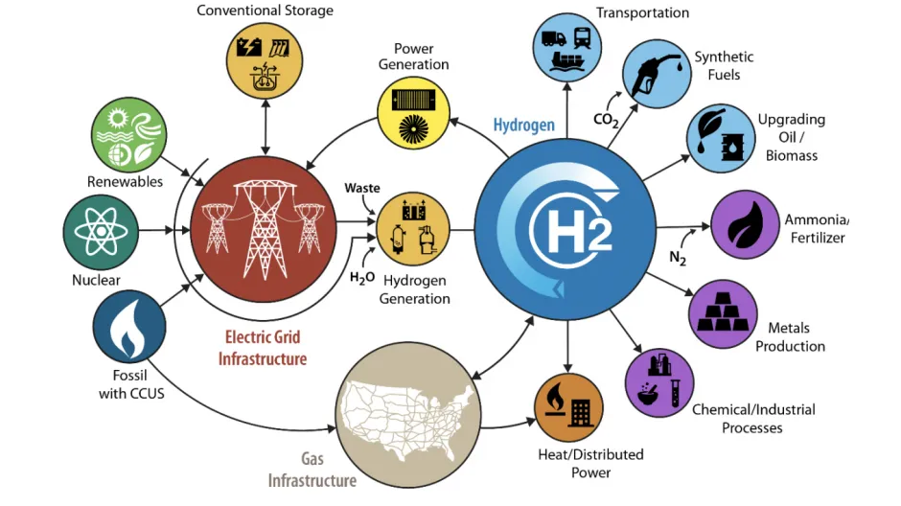
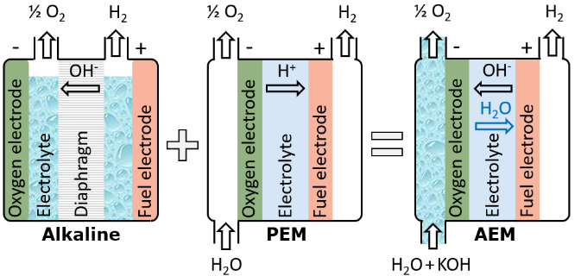
Background and Literature
Extensive research was done on the following topics, and their key data was validated and collected for the study.
Solar Energy Systems
Hydrogen Utilization
Electrolysis Technologies

Slide 5

Solar Energy Systems
Here a comparison between various solar energy source types and variations of Solar energy electrolysis were compared
Akpinar, E., Gül Katircioglu, G. and Das, M. (2025). Effects of solar tracking on different types of solar panels; experimental study for thermal and photovoltaic types. International Journal of Hydrogen Energy.
Key points
Effects of solar tracking system (STS) on thermal and photovoltaic (PV) solar panels.
Investigation of electrical power generation depending on PV panel surface temperature.
Solar thermal panel output temperature increased by 25.6% on average with STS.
An average increase of 22.7% in electrical energy generation values with STS.
Negative effects of STS, such as photovoltaic panel surface temperature increase.
“Solar energy is most abundant form of renewable energy available all over the world, but it tends to vary and dependent on factors such as solar irradiance (Akpinar et al., 2025) shows significant improvement in power output by introducing solar tracking technology which has increased by 22.7% in electricity and 25.6% in heat”.
Miao, L., Zhang, G., Shan, S., Xu, Z., Zhou, Z., Wang, Z. and Cen, K. (2025). Analysis of a three-band spectrum splitting photovoltaic-photothermal driven SOEC hydrogen production system. Solar Energy, [online] 297, p.113611
Key points
Propose a solar three-band spectrum splitting photovoltaic-photothermal driven SOEC hydrogen production system.
Establish a system thermodynamic model to analyze parametrical effect.
Optimize the matching condition between spectrum splitting and SOEC.
Couple S-CO₂ Brayton cycle to adapt to SOEC low-temperature conditions with stable splitting wavelengths.
The system optimal efficiency can reach 47.38%, better than the non-spectrum-splitting system.
• PE-VC systems selected for efficiency (up to 32%)
• Oxford PV panels: 25% conversion, 1087 W/m² output
• Solar tracking increases output by ~22%

Slide 6

Electrolysis Technologies
Here the main types of electrolysis were researched, and 4 main types were identified, and the AWE and PEM were chosen as the best due to their standard operational conditions
“AWE and PEMWE(PEMs) are electrolysers that can be operated via solar power as their operating conditions are close to normal environmental conditions and various operating conditions are highlighted for optimal hydrogen production. As well as by (Emam et al., 2023) which collaborates their research with more experimental data with respect to Alkaline concentration, electrode spacing and surface area”.
Burton, N.A. and Grant, J.C. (2025). The effects of magnetic fields on the electrochemical and molecular dynamics during water electrolysis. International Journal of Hydrogen Energy, [online] 137, pp.710–724
Key points
Increasing efficiency of hydrogen production with linear magnetic fields.
Magnetic fields increase the molecular energy of H₂O during electrolysis.
Magnetic fields enhance load adaptability.
Electrolysis efficiency is enhanced as water’s molecular energy increases.
AWE: Cost-effective, 2 A/cm², Ni electrodes + 30% KOH
PEM: 1 A/cm², Pt electrodes, requires ultrapure water
Alkaline Water Electrolysis (AWE),
Polymer Electrolyte Membrane Water Electrolysis (PEMWE)
Solid Oxide Electrolysis Cells (SOEC)
Microbial Electrolysis Cells (MEC)

Slide 7

Hydrogen Utilization
Here the various methods of energy production through hydrogen was analysed and ways of optimal energy production was investigated.
“H2-ICEs (hydrogen Internal combustion engines) are the best fit as they can make use of the highly combustible properties and convert to mechanical work. (Gao et al. 2025) has studied the efficiency of a H2-ICE both with a methane mixture and pure hydrogen operation. In only hydrogen internal combustion, the ratio of air in the mixture affects the flammability and combustion pressure, where it was found that a ratio of 0.6 gave the highest peak in flame propagation”.
Hwang, J., Krisha Maharjan and Cho, H. (2023). A review of hydrogen utilization in power generation and transportation sectors: Achievements and future challenges. International Journal of Hydrogen Energy, 48(74).
Key points
A comprehensive review on hydrogen production and utilization.
Achievements in hydrogen-powered system are discussed by world-wide projects.
Technical challenges in hydrogen utilization are discussed.
Ideal scenario of hydrogen-powered transportation is suggested
Combustion 286 kJ/mol
H2-ICE 55% mechanical efficiency)
PEMFC: 65% electrical efficiency

Slide 8
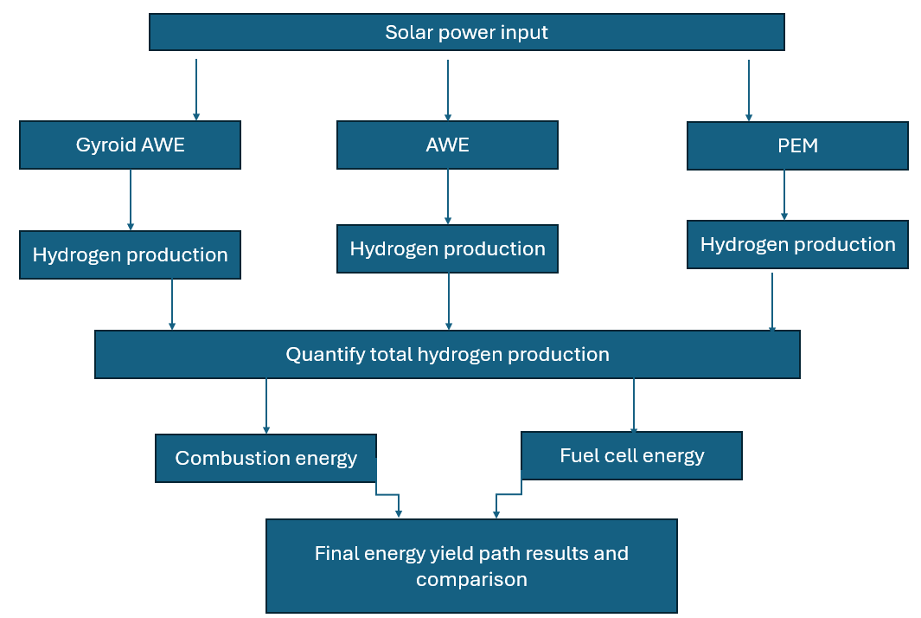
Methodology
Visual methodology
The methodology for this project followed a step-by-step process as illustrated. Looking at a variety of variables involved with electrolysis and improvements made for existing processes to increase the overall energy efficiency of the system. All the equations, energy and hydrogen production values have been validated based on the literature review and the key improvements made in them have been taken into consideration in this project. The two electrolysis methods analyzed are PEM and AWE electrolysis. Their operational conditions are much more energy efficient, the power used will be through solar power panels, the approach will look at traditional solar input and the increase done by solar tracking. Furthermore, the gyroid shape electrode was analyzed in respect to AWE electrolysis, as a key improvement to existing electrodes.

Slide 9

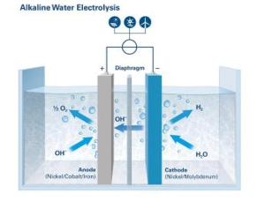
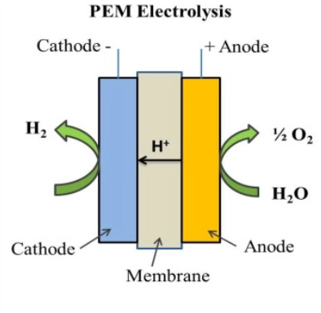
AWE and PEM Electrolysis
The AWE electrolyzes as demonstrated use two metal electrodes which when an electric field is passed through break the hydrogen oxygen bonds and produce hydrogen and oxygen gases.
The anode oxygen gas is produced while the anode releases hydrogen.
Utilizes Nickle (Ni) and Cobalt (Co) electrodes for large scale hydrogen production along with a Potassium hydroxide solution(KOH) used in 30-40% concentration for optimal hydrogen production as a catalyst for the reaction (El-Shafie, M. 2023).
The PEM electrolyzes as demonstrated uses a proton exchange membrane along with electrodes to produce hydrogen gas.
These electrolyzes are standard for safe sustainable use operating at 1.80V and a current density of 1 A/cm2 (Vedrtnam et al., 2025)
The PEM electrolyzes have a few drawbacks compared to regular AWE electrolysis as the proton exchange membrane are susceptible to degradation in case of power overload or prolonged use.

Slide 10
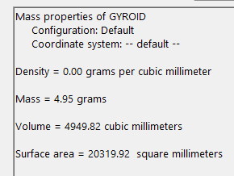
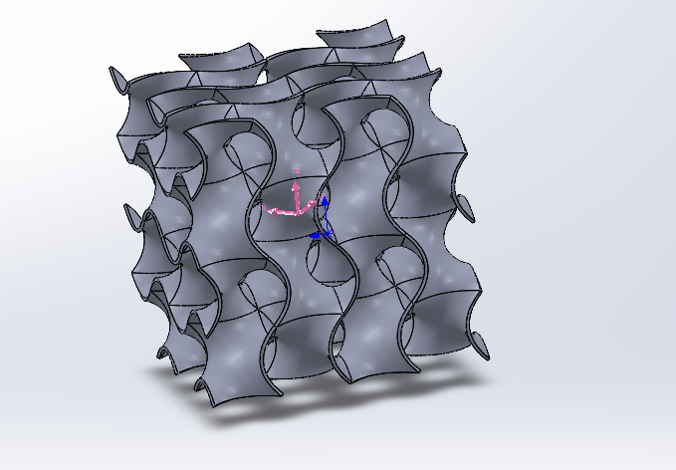
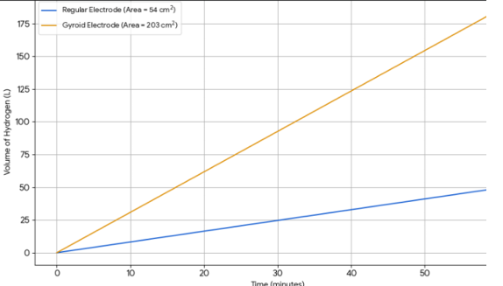
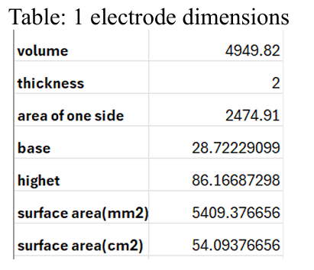
AWE Gyroid electrode
• Gyroid: 203 cm² surface area vs 54 cm² (flat)
• 3D printed Ni gyroid improves rate with same energy
The gyroid is a shape with high surface area and porosity which makes it ideal for the electrolysis process and its performance was investigated as an alternative to traditional flat face electrodes for AWE process. Therefore, a regular electrode with the same amount of material as the gyroid was analyzed.

Slide 11
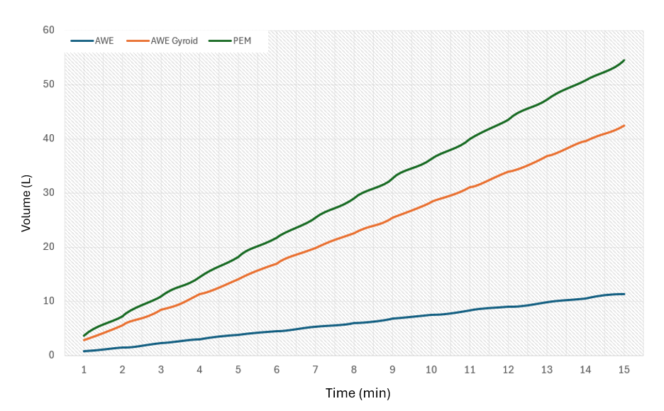
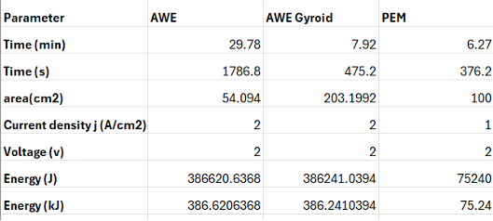
Results & Discussion
The production rate of the three electrolysers was modelled and compared for a run time of 15 minutes to see the amount of hydrogen produced and for energy analysis as provided
Hydrogen has a molar volume of 22.4L/mol at STP which combined with the time and energy input for each electrolyser gives an estimate of the energy required per mole of Hydrogen produced for each electrolyser.

Slide 12
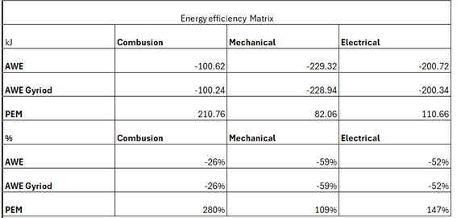
Energy & Efficiency Analysis
An energy matrix for the total energy comparison between each hydrogen production method energy input and hydrogen energy output through discussed utilization methods. Both AWE processes have identical overall energy efficiency loss, between 26% - 59% energy loss. Energy recovery through combustion has maximum efficiency for all three methods, as direct conversion to heat has minimal losses, electrical energy recovery shows an efficiency loss of 52% due to energy loss due to ohmic resistance and heat in fuel cells, and mechanical energy loss being nearly 60% due to heat loss in the H2-ICE cylinders. PEM energy recovery shows an overall net positive in energy recovery between 9% - 180% gain in efficiency, this increase is not a thermodynamically accurate result as there should be loss created; however, this result could be due to the highly optimal conditions considered in theoretical calculations.
Hydrogen Energy matrix
This does give insight to the fact that PEM electrolysers do have a much higher energy efficiency that AWE electrolysers in comparison. The Gyroid shaped electrode did achieve a higher hydrogen production rate equivalent to the PEM in optimal conditions which does make it a viable alternative for improved hydrogen production.

Slide 13
Conclusions and Future Work
The study confirmed the viability of Solar powered electrolysis for green H₂
Gyroid electrodes boost AWE efficiency in H₂ production.
PEM has the best H₂ production rate under optimal lab conditions
More CFD/experimental validation recommended
PEM most energy efficient, but costly (requires pure water)
Gyroid AWE: Promising balance of efficiency & cost
H₂ combustion is the best energy recovery path as there is no energy loss.
H₂ mechanical energy recovery is on 55% efficient, and H₂ fuel cells have an efficiency of 65%.
H₂ production effected by gas bubble dissipation needs further research

Slide 14
References
Akpinar, E., Gül Katircioglu, G. and Das, M. (2025). Effects of solar tracking on different types of solar panels; experimental study for thermal and photovoltaic types. International Journal of Hydrogen Energy. Available from: https://www.sciencedirect.com/science/article/pii/ S0360319925007207#sec3
Burton, N.A. and Grant, J.C. (2025). The effects of magnetic fields on the electrochemical and molecular dynamics during water electrolysis. International Journal of Hydrogen Energy, [online] 137, pp.710–724. Available from: https://www.sciencedirect.com/science/article/pii/ S036031992502350X#sec5#
El-Shafie, M. (2023). Hydrogen production by water electrolysis technologies: A review. Results in Engineering, [online] 20, p.101426.Available from: https://www.sciencedirect.com/science/article/pii/ S2590123023005534?via%3Dihub
Emam, A.S., Hamdan, M.O., Abu-Nabah, B.A. and Elnajjar, E. (2023). Enhancing alkaline water electrolysis through innovative approaches and parametric study. International Journal of Hydrogen Energy. [online] 55, pp. 1161-1173. Available from: https://www.sciencedirect.com/science/article/pii/S0360319923059736?dgcid=rss_sd_all#:~:text=First%2C%20surface%20roughness%20can%20in crease,leading%20to%20higher%20current%20d ensity.
Gao, N., Geng, Z., Zhao, W., Geng, L., Dong, F. and Huang, D. (2025). Review on the combustion and emission characteristics of hydrogen engine. International Journal of Hydrogen Energy, [online] 143, pp.121–146. Available from: https://www.sciencedirect.com/science/article/pii/ S0360319925026254
Hwang, J., Krisha Maharjan and Cho, H. (2023). A review of hydrogen utilization in power generation and transportation sectors: Achievements and future challenges. International Journal of Hydrogen Energy, 48(74). Available from: https://www.sciencedirect.com/science/article/pii/ S0360319923017123#sec1
Miao, L., Zhang, G., Shan, S., Xu, Z., Zhou, Z., Wang, Z. and Cen, K. (2025). Analysis of a three-band spectrum splitting photovoltaic-photothermal driven SOEC hydrogen production system. Solar Energy, [online] 297, p.113611 Available from: https://www.sciencedirect.com/science/article/pii/S0038092X25003743
Vedrtnam, A., Kalauni, K. and Pahwa, R. (2025). A review of water electrolysis technologies with insights into optimization and numerical simulations. International Journal of Hydrogen Energy, [online] 140, pp.694–727.Available from: https://www.sciencedirect.com/science/article/pii/ S0360319925025984#sec2

Slide 15

Q & A session

