Slide 1




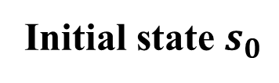















$${𝓦 }_{j}^{1}$$
$${𝓦 }_{j}^{2}$$
$${𝓦 }_{j}^{i}$$
$$𝓕^{1}\left({𝓦 }_{j}^{1}\right)={𝓦 }_{j − 1}^{1}$$
$$𝓕^{2}\left({𝓦 }_{j}^{2}\right)={𝓦 }_{j − 1}^{2}$$
$$𝓕^{i}\left({𝓦 }_{j}^{i}\right)={𝓦 }_{j − 1}^{i}$$
$${𝓦 }_{j − 1}^{1}$$
$${𝓦 }_{j − 1}^{2}$$
$${𝓦 }_{j − 1}^{i}$$
$$𝓕^{1}\left({𝓦 }_{j−1}^{1}\right)={𝓦 }_{j−2}^{1}$$
$$𝓕^{2}\left({𝓦 }_{j−1}^{2}\right)={𝓦 }_{j−2}^{2}$$
$$𝓕^{i}\left({𝓦 }_{j−1}^{i}\right)={𝓦 }_{j−2}^{i}$$
Initial state $s_{0}$
…
…
…
$$𝓕^{1}\left({𝓦 }_{1}^{1}\right)={𝓦 }_{0}^{1}$$
$$𝓕^{2}\left({𝓦 }_{1}^{2}\right)={𝓦 }_{0}^{2}$$
$$𝓕^{i}\left({𝓦 }_{1}^{i}\right)={𝓦 }_{0}^{i}$$
$${𝓦 }_{0}^{1}$$
$${𝓦 }_{0}^{2}$$
$${𝓦 }_{0}^{i}$$
Progress Specification 1 Fulfilled
Progress Specification 2 Fulfilled
Progress Specification $i$ Fulfilled
…

Slide 2



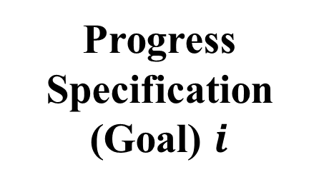






Progress Specification (Goal) 1
Progress Specification (Goal) 2
Progress Specification (Goal) $i$
$${𝓦 }_{j}^{1}$$
$${𝓦 }_{j}^{2}$$
$${𝓦 }_{j}^{i}$$
$${𝓦 }_{j − 1}^{1}$$
$${𝓦 }_{j − 1}^{2}$$
$${𝓦 }_{j − 1}^{i}$$
…
…
…
$${𝓦 }_{0}^{1}$$
$${𝓦 }_{0}^{2}$$
$${𝓦 }_{0}^{i}$$
…

