Slide 1

ProudSmart
Learning Platform
Team JABB

Slide 2





Table of Contents
Client
Problem
Project
Goals
Design
Considerations
Project
Work Flow
SECTION ONE
SECTION TWO
SECTION THREE
SECTION FOUR
Live
Walkthrough
Challenges & Ethical Issues
Favorite
Parts
Question Time
SECTION FIVE
SECTVION SIX
SECTION SEVEN
SECTION EIGHT

Slide 3
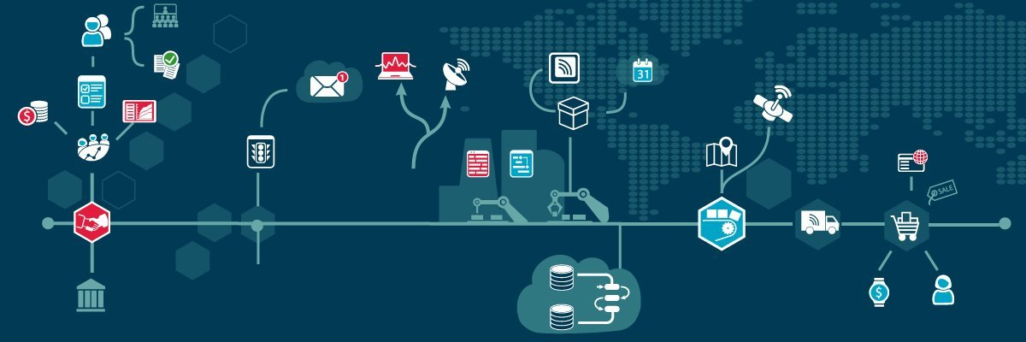
The Client Problem
Why Care?
ProudSmart is a business which sells complex technology solutions
A online learning platform will enable ProudSmart to drive more value out propriety technologies through educating:
Internal staff
Customers
Partners
Students

Slide 4
1
Permission based access
4
Different user types have different access to course content
Project Goals
2
Live streaming of course content
Leveraging third party services to host and stream content
Our MVP focused on 4 critical features…..
LEARN MORE
3
Payments
Ability to accept payments from users
4
Content creation
Ability for educators to upload course content

Slide 5
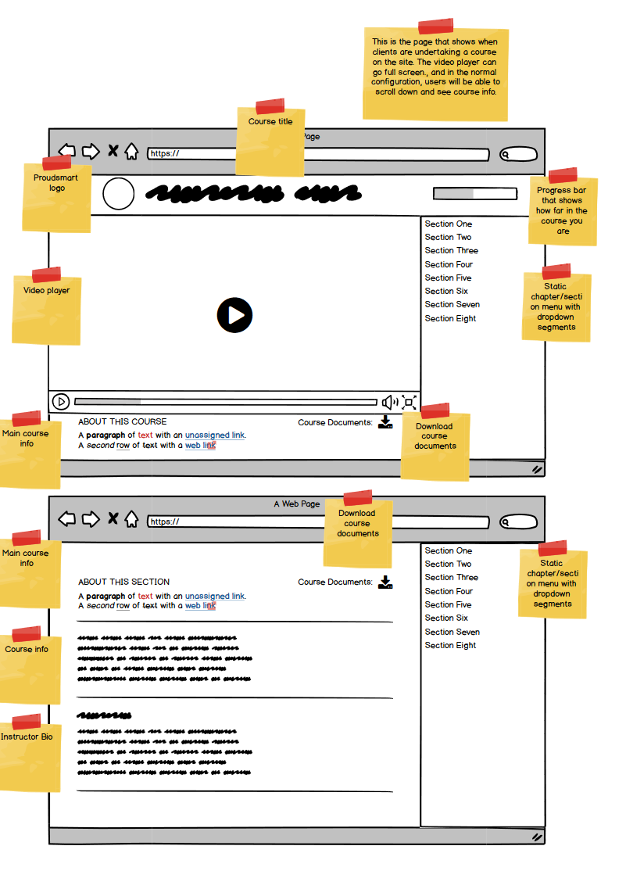
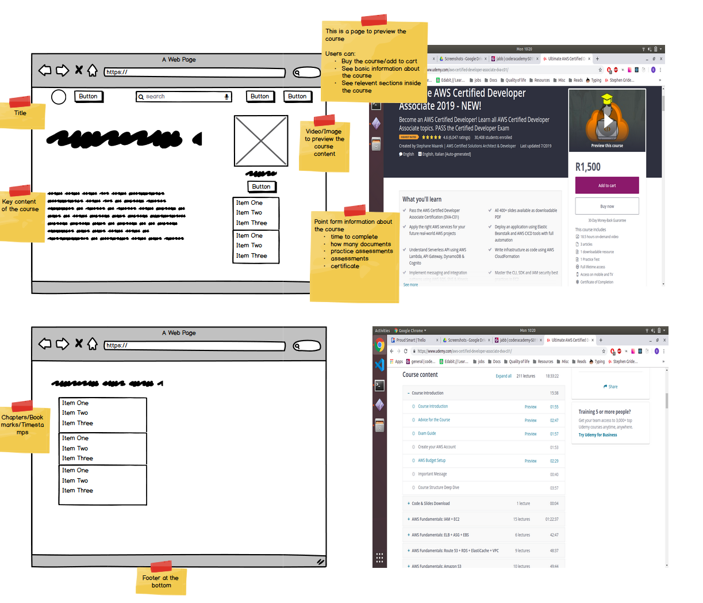
Design Considerations
Our design focus was to provide a simple and intuitive front-end user experience similar to other popular online learning portals (e.g. Udemy, Coursera, Edx etc…)

Slide 6



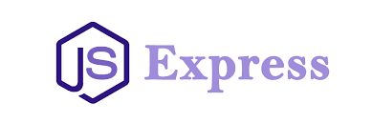

Project Workflow
We separated front and back end responsibilities to simplify project delivery and reduce overall rework
Josh
Ari
Bruce
Billy
Third Party Services
Front End Experience
API
Service

Slide 7
Key Challenges
Ethical Issues
Implementing live streaming
Handling state
Addressing roadblocks
Managing client expectations
Accessibility considerations
Piracy risk
Content censorship
Disguised sales medium

Slide 8
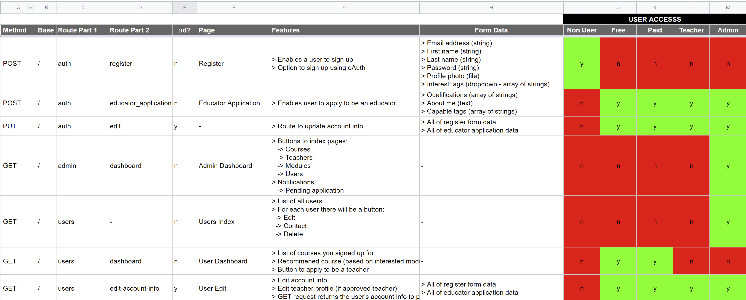
Favorite Parts
Investing lot’s of time into planning early on in the project ensured strong teamwork and communication throughout the project

Slide 9
Live Walkthrough

Slide 10
Question Time

