Slide 1

ggplot2
Session 20

Slide 2
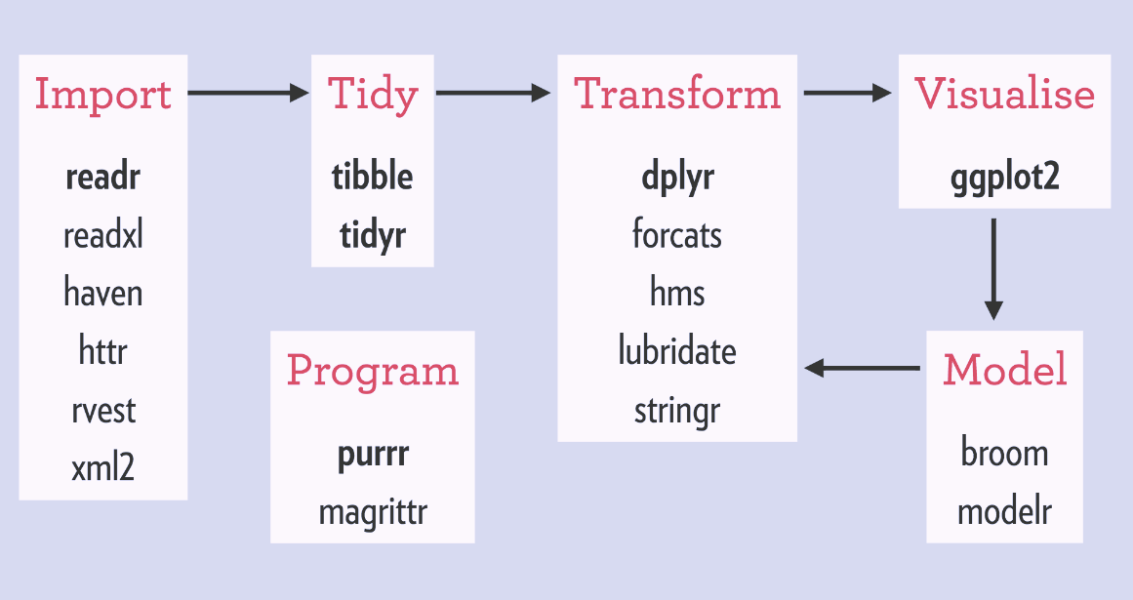
Tidyverse
ggplot2 is the main visualization package that is associated with the tidyverse
There are a number of extensions (plotly, ggmap) that add functionality but we’ll focus on ggplot2 here (A little ggmap)

Slide 3
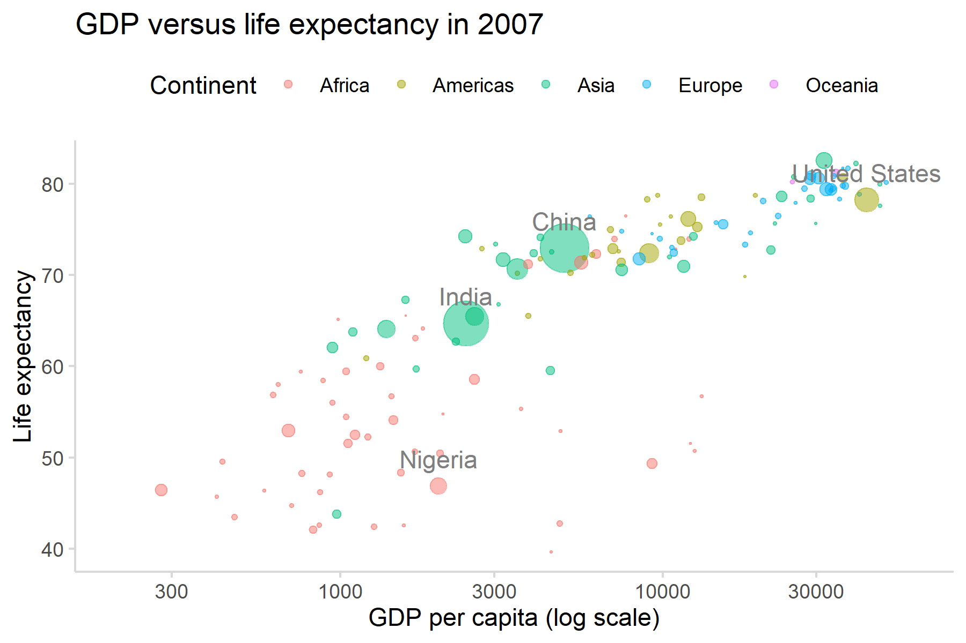
ggplot2
Layered grammar of graphics https://vita.had.co.nz/papers/layered-grammar.pdf
Data and Mapping
Statistical Transformation
Geometric Object
Position Adjustment
SCALES
COORDINATE SYSTEM
FACETING
R package for implementation of visualization and plotting
Uses an approach that is stylistically related to tidyverse (dplyr)

Slide 4
ggplot2
Theory of graphics.
R package for implementation of visualization and plotting
Uses an approach that is stylistically related to tidyverse (dplyr)

Slide 5
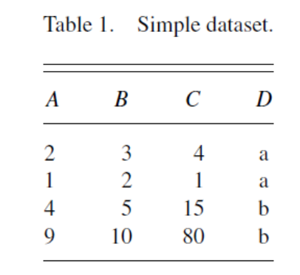
ggplot2
R package for implementation of visualization and plotting
Uses an approach that is stylistically related to tidyverse (dplyr)

Slide 6
ggplot2
Theory of graphics.
R package for implementation of visualization and plotting
Uses an approach that is stylistically related to tidyverse (dplyr)

Slide 7
ggplot2
Theory of graphics.
R package for implementation of visualization and plotting
Uses an approach that is stylistically related to tidyverse (dplyr)

Slide 8
ggplot2
Theory of graphics.
R package for implementation of visualization and plotting
Uses an approach that is stylistically related to tidyverse (dplyr)

Slide 9
ggplot2
Theory of graphics.
R package for implementation of visualization and plotting
Uses an approach that is stylistically related to tidyverse (dplyr)

Slide 10
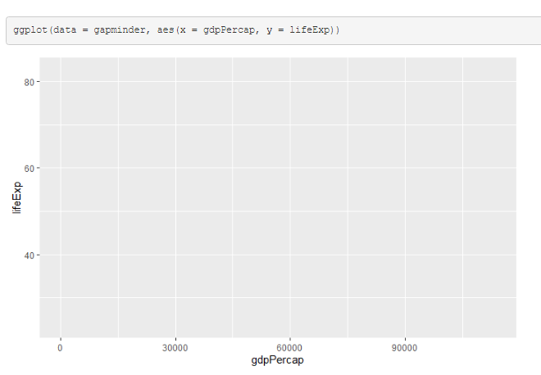
ggplot2
Data and Mapping
Data and mapping
Usually given to ggplot() and ‘inherited’ by subsequent layers.
Data – first argument
aes() – contains aesthetic mappings

Slide 11
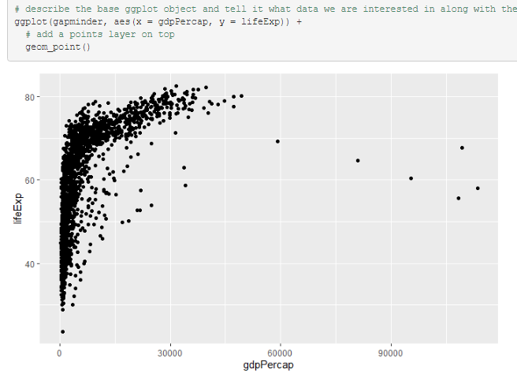
ggplot2
Data and Mapping
Geometric Object
Data and mapping
Usually given to ggplot() and ‘inherited’ by subsequent layers.
Data – first argument
aes() – contains aesthetic mappings e.g. map variable to specific attribute of chart. Think of this almost like renaming/setting the variable equal to correspond to specific chart elements.

Slide 12
ggplot2
Data and Mapping
Statistical Transformation
Position Adjustment
Data and mapping
Statstical transformations can be procued directly through stat_smooth() etc…
Or often by default through specific geometries geom_smooth() or geom_boxplot()

Slide 13
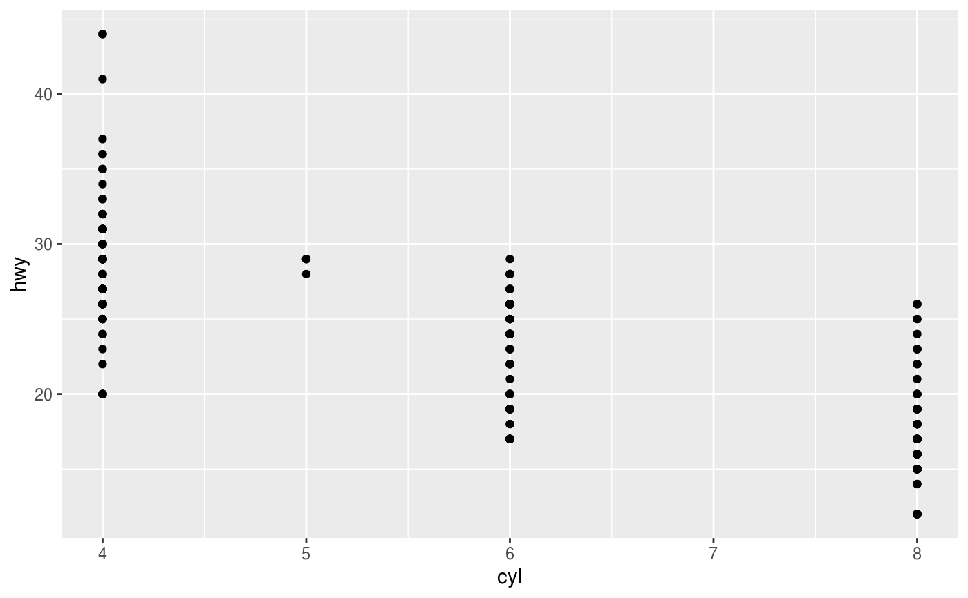
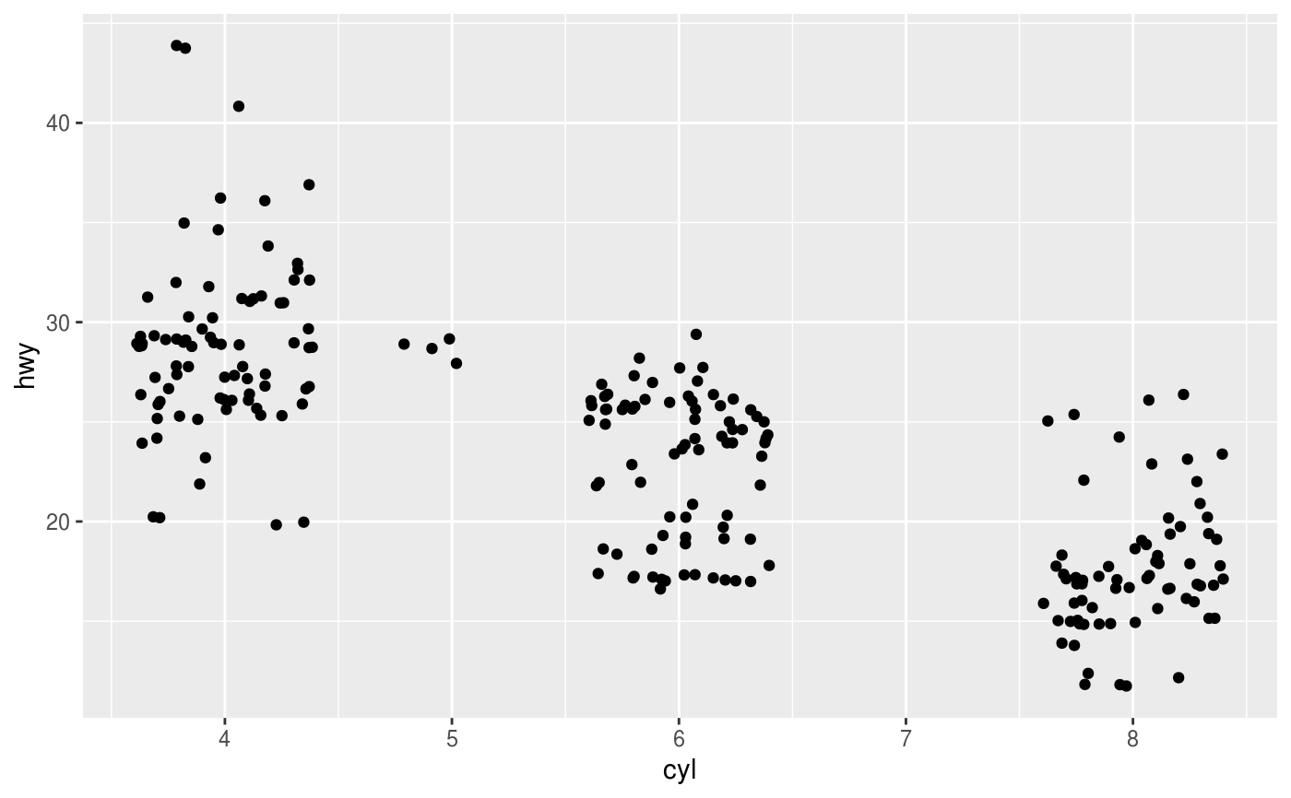
ggplot2
Data and Mapping
Statistical Transformation
Position Adjustment
Jitter points
Stack, dodge
p <- ggplot(mpg, aes(cyl, hwy))
p + geom_point()
P + geom_jitter()
Data and mapping
Usually given to ggplot() and ‘inherited’ by subsequent layers.
Data – first argument
aes() – contains aesthetic mappings

Slide 14
ggplot2
SCALES
Scales control how data are mapped to aesthetic attributes like color, shape, size
They are functions and inverse functions with parameters

Slide 15
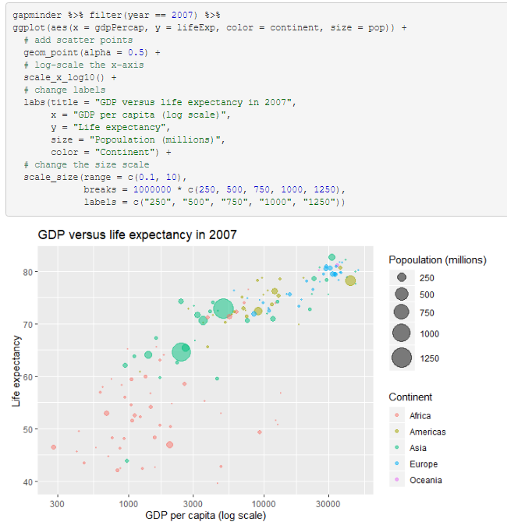
ggplot2
SCALES
Scales control how data are mapped to aesthetic attributes like color, shape, size
They are functions and inverse functions with parameters
See for example the scale size in example at right which controls the rage of point sizes, as well as how they are displayed in the legend

Slide 16
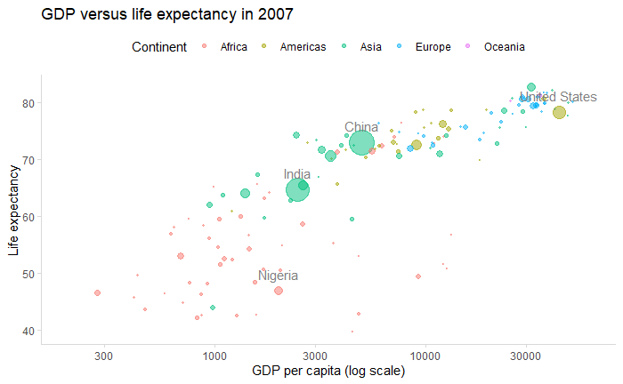
ggplot2
COORDINATE SYSTEM
Coordinate system:
Coords() can be used to specify cords (pie charts for example are bar charts in polar coordinates).
Semi log plots are common.

Slide 17
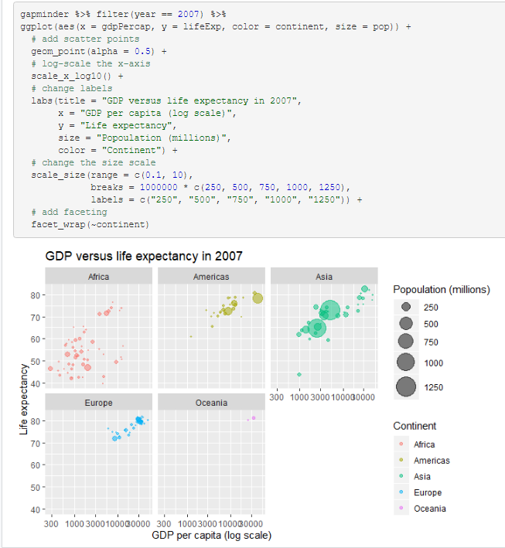
ggplot2
FACETING
Facetting…
Facet_wrap() or facet_grid()
Take formulas or vars(variable names) as arguments and allow multiple plots conditioned on a specific variable (or more than one as per facet_grid()

Slide 18
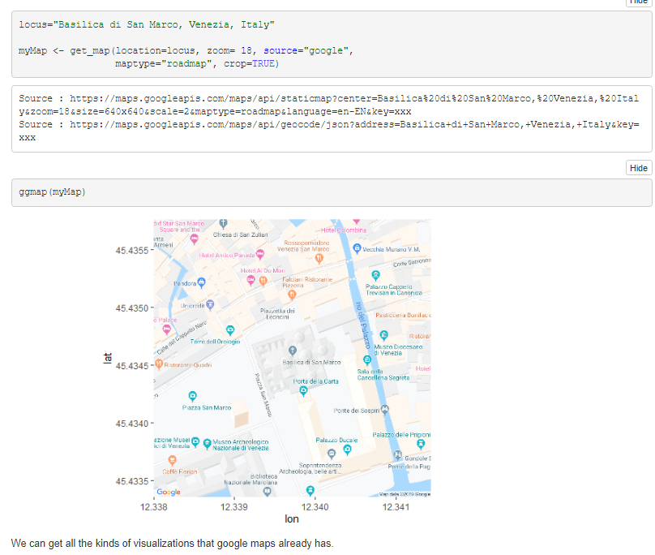
ggmap
Package for overlaying ggplot2 like graphics on static maps derived from web mapping services like google.
Nowadays you need a google cloud account with billing set up
Mostly this can still be free (as long as you don’t use a huge amount of queries)

Slide 19
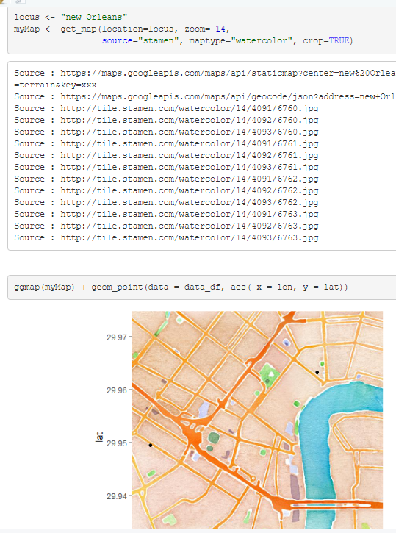
ggmap
I’ve included some information on how to get setup with ggmap and a google map API key
Also there are other map sources. Stamen maps
http://maps.stamen.com/#watercolor/12/37.7706/-122.3782

