Slide 1
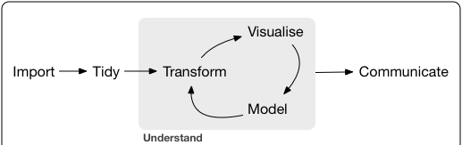
INTRO TO COURSE / Data Science and Statistical Computing
session 1
Notes:
Image credit Wickham and Grolemund

Slide 2
RESEARCH
Google Define Results
Noun: “the systematic investigation into and study of materials and sources in order to establish facts and reach new conclusions.”
Verb: “investigate systematically.”
https://tinyurl.com/y5tw8zaj
In computation and statistics:
“The full software environment, code, and data that produced the results”
DEFINITIONS

Slide 3
REPRODUCIBILITY
What do you think this means?
THEORY

Slide 4
REPRODUCIBILITY
Reproducibility is a scientific ideal –
Theoretical reproducibility
Experimental reproducibility
Measurement reproducibility
Analytic reproducibility
Interpretation reproducibility
“Replication crisis”
THEORY

Slide 5
Reproducibility
Scripts should be written such that, with no changes to data
1) Starting from a clean session they can be run and get the same results every time
II) They can be run by someone other than you and produce the same results
III) They can be run on a machine which is not yours and produce the same results with NO changes.
MonteCarlo Simulation / processes that involve generation of random/pseudo-random numbers provide an extra challenge here.
The broader perspective is that others should be able to read, understand and recreate your results exactly using the materials and documentation that you leave behind.
Practice as relates to statistical computing

Slide 6

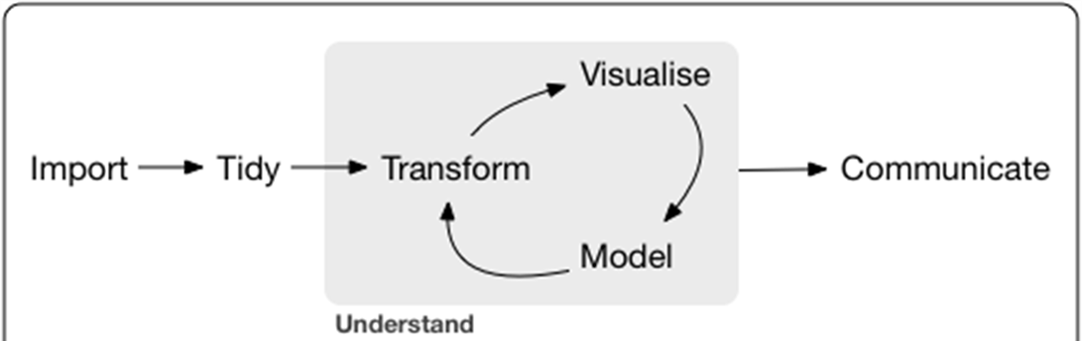
WORKFLOW
Sync Backup
Version control: git
Standardized Workflow and Software Stack
Facilitates Reproducibility
Instills Best Practices for coding
Builds good habits of documentation
Enhances your ability to communicate and share results to others
SQL, Python, Java, R etc..
Python, R, STATA, SAS
Markdown, LaTeX, Jupyter notebooks, html, shiny, etc…

Slide 7
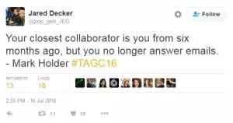
Workflow
Document!
Everything is a text file
All files are human readable (gets complicated with Images and sounds)
Explicitly tie files together
Plan to organize, store and disseminate
We work with scripts.
This are readable text files, that will give instructions to various pieces of software on how to import, clean/tidy, transform, analyze, visualize, model and communicate our results.
We use formal version control software and conventions to maintain current versions of all code, documentation and communications as well as history of previous iterations and documentation of changes and facilitate collaboration
This is done (often) using the git language/software
We never change the real original data.
Everything is auditable.
Practically

Slide 8
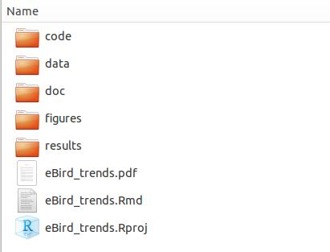
Reproducible Research addenda
Other advice:
https://guides.lib.berkeley.edu/c.php?g=652220&p=4575532
Project/directory structure is critical

