Slide 1

R markdown
Session 17

Slide 2
R Markdown (notebooks and Dynamic Documents)
Markdown language used to format a document (rmarkdown and knitr packages) (included in Rstudio) allow inclusion of code chunks of R (and other languages) to produce analyses, tables, charts and other outputs which are dynamically updated
Notebooks contain output inline and are output as filename.nb.html files
Standard output from R markdown document is a dynamically created but static .html file
If you have a TeX (LaTeX) install or Microsoft Word or similar you can also ‘knit or sweave’ output to TeX -> PDF or Word (.docx) formats
These documents are handy ways to prepare and package reproducible research and present results of your work.
When coupled with repositories/git tracking of versions they form excellent vehicles for collaboration/code and analysis sharing.

Slide 3
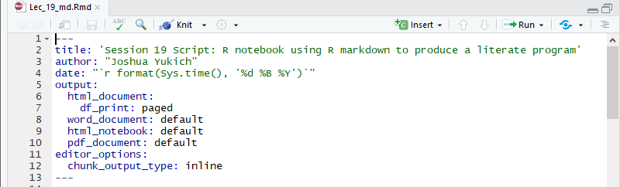
YAML Header
YAML Ain’t Markup Language
It’s a very simple language used for data ‘serialization’, a part of the XML, JSON, BSON family of languages.
Used to specify features of the Notebook or R markdown document.
Must include title, author, date and output statement
Starts with ‘---’ and ends with ‘---’ on its own line
Indenting used for indicating levels of data (i.e. output: statement above (do not use tabs).
Note above the use of ‘backticks’ to include an R inline statement to print date (more on this later)
Notes:
Dec 15 exam 3 due and Dec 5 is exam review day
Takehome 4 due Nov 21

Slide 4
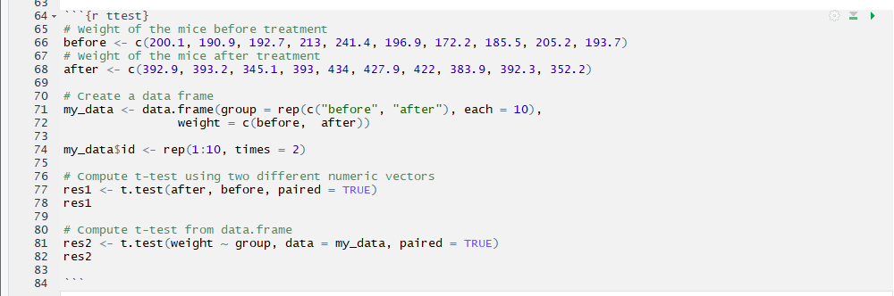
Code Chunks
Code chunks contain potentially multiple lines of R code
Printed console and other output results (options can be specified to control the output as seen in final document).
Code chunks can be executed within the global environment (Notebooks) or a local document specific environment (knit/sweave).
Code chunk basics
Start with three backticks followed by curly braces ```{}
End with three backticks ```
Inside curly braces are three elements.
{language chunk_label, options}
In the example above {r ttest} is a code chunk to be executed in R which is labeled ttest and has no options specified.
In between the start and end is working executable R code.

Slide 5
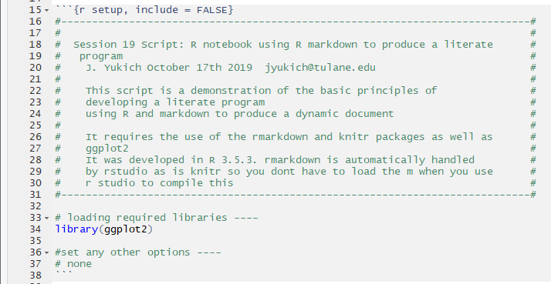
Code Chunks
Code chunks contain potentially multiple lines of R code
Printed console and other output results (options can be specified to control the output as seen in final document).
Code chunks can be executed within the global environment (Notebooks) or a local document specific environment (knit/sweave).
Preamble code chunk (I like to include in addition to header)
Use option (following a comma) include = FALSE
This suppresses printing of the echo of commands and the results and everything else in the final document (the code still runs).
Useful when you have a lot of code that doesn’t need to be shown and are making a formal report

Slide 6
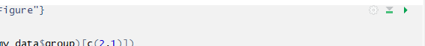
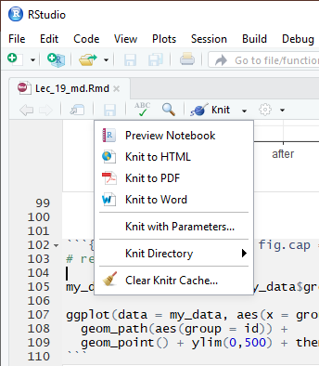
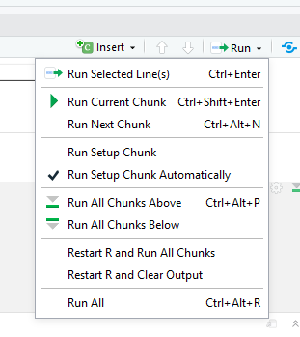
Code Chunks Execution
Executing Code chunks
Chunk options
Run all chunks above
Run this chunk
Knit
Run options

Slide 7
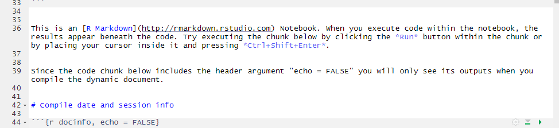
MarkDOWN SECTIONS
You can more or less write plain text as markdown language
chunk above shows how to include a link to website
[link text](URL)
How to make a header - # or ## or ### etc…
How to make bold text - _text_ or italic *text*
Other techniques are in lecture on markdown under STATA
Surround code chunks
Form the text of your report
Can actually include R code too we’ll cover how to do this in a little bit

Slide 8
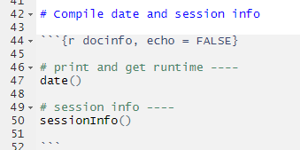
Showing the DATE and Session INFO
Compilation date and session info can be important in finding issues as well as maintain reproducibility of work.
I’d suggest generally including the following in notebooks shortly after the main preamble
Note that first line here is still pure markdown (text)
Then a code chunk named docinfo with option ‘echo = FALSE’
This means that we don’t have echos of the commands but the output is still shown in our final document
Command date() returns the date and sessionInfo() prints info about the R session

Slide 9
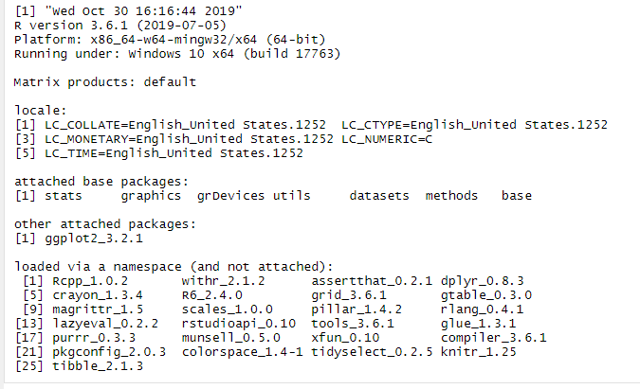
Results
My session info an compile date code chunk results in :
Note the absence of the actual R commands

Slide 10
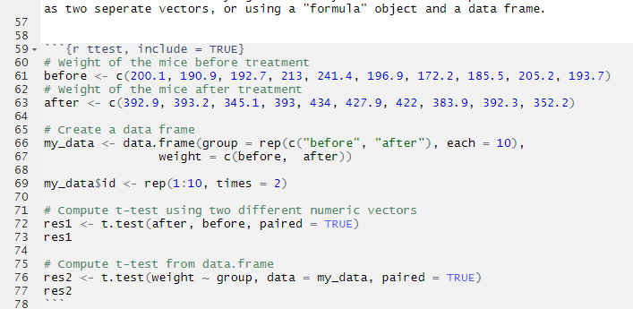
A real functional R code chunk
In this example we have data actually directly entered in the Rmd file (notebook/dynamic doc base code).
Data is entered as vectors, combined into a data.frame
Additional data is added to the data.frame and then a paired t-test is conducted in two different ways and the results stored to two objects which are then printed
Directly keeping the data in the R notebook makes the analysis very very reproducible but is probably best done only with very small datasets as above.
Note option ‘include = TRUE’ means that the code will be printed as well as results (not strictly necessary as this is the default)
Notes:
$ to get a specific data variable back from a dataframe
Or create a new variable if you put it before the assignment of a new variable
Factor variable is a categorical variable in R

Slide 11
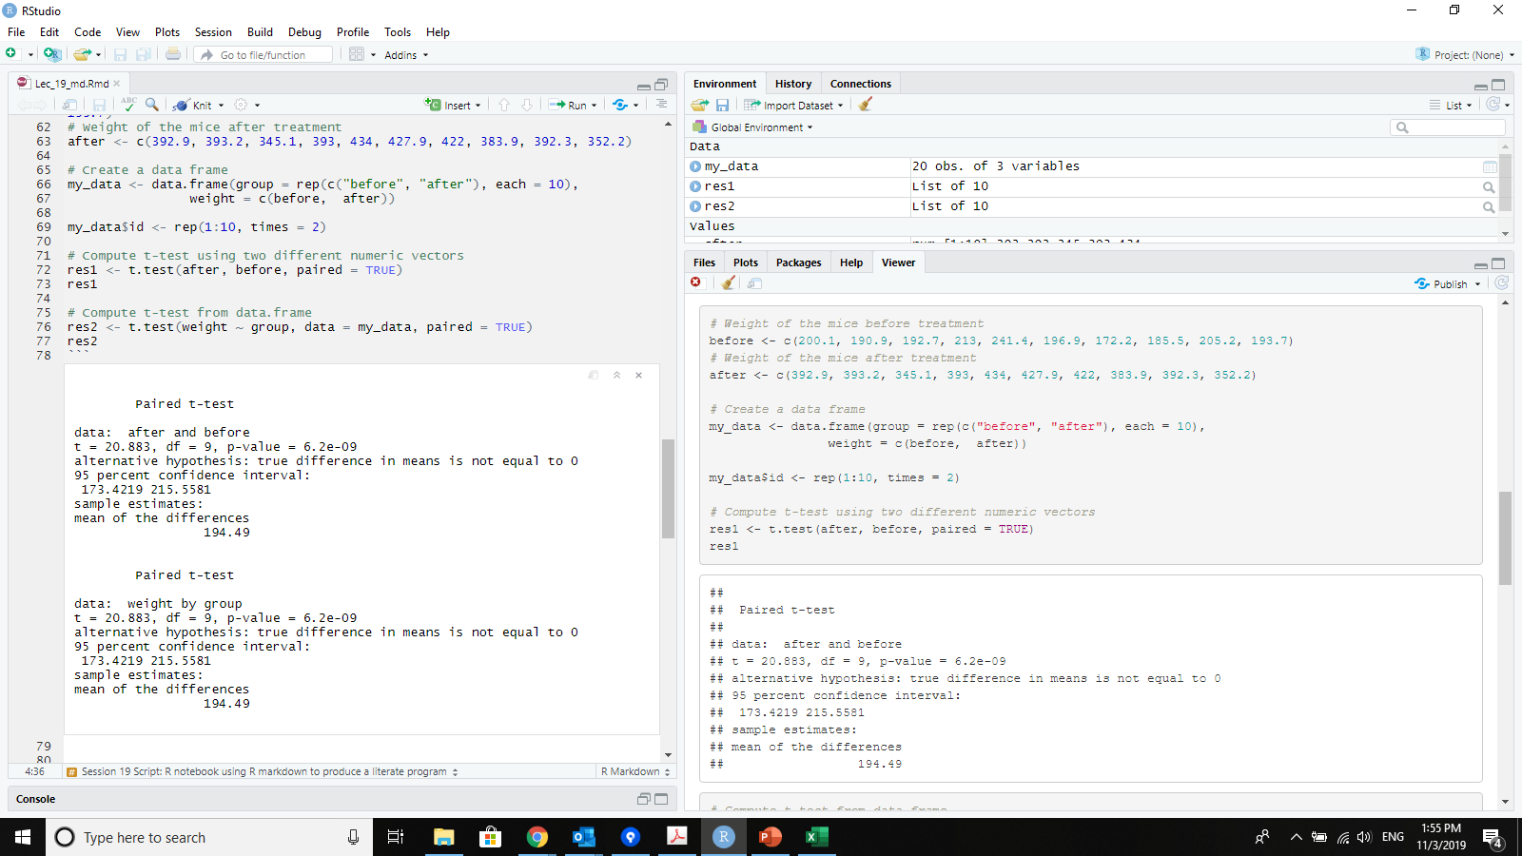
What does this look like
In viewer on left
Inline in script file on right

Slide 12
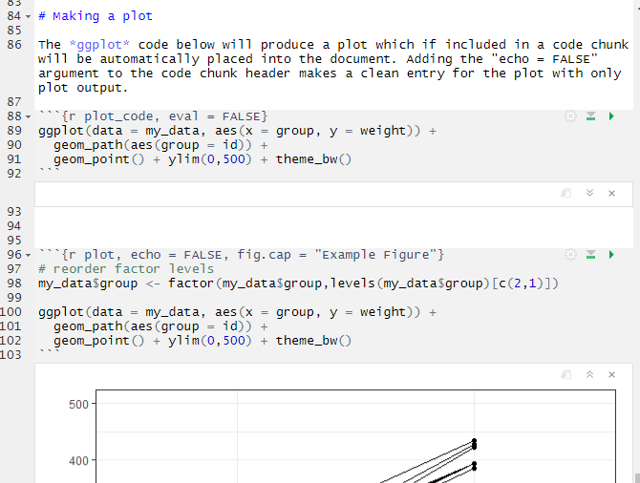
Including plots
Bottom code chunk here actually does the work
Top includes option ‘eval = FALSE’ – meaning not evaluated: but it is printed. Its there so that the code is shown in the text.
Second chunk includes ‘echo =FALSE’ because I only want the plot!
It also includes ‘fig.cap = text’ because I want a figure caption
Notes:
#eval means eval but saying it will print but not run it, echo makes sure the commands doesn't print
ggplot code: mapping, aesthetics and geometry; aes = aesthetics (usually two dimensional like example above; don’t have to be continuous or numeric you can also have groups, factor variables ,categorical variables)
In the + sign afterwards you see geom_line, geom_path, other geom arguments
And can add aesthetics
Ggplot you tell what dataset you want to use and your x and y along with geometry
Reorder factor levels

Slide 13
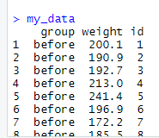
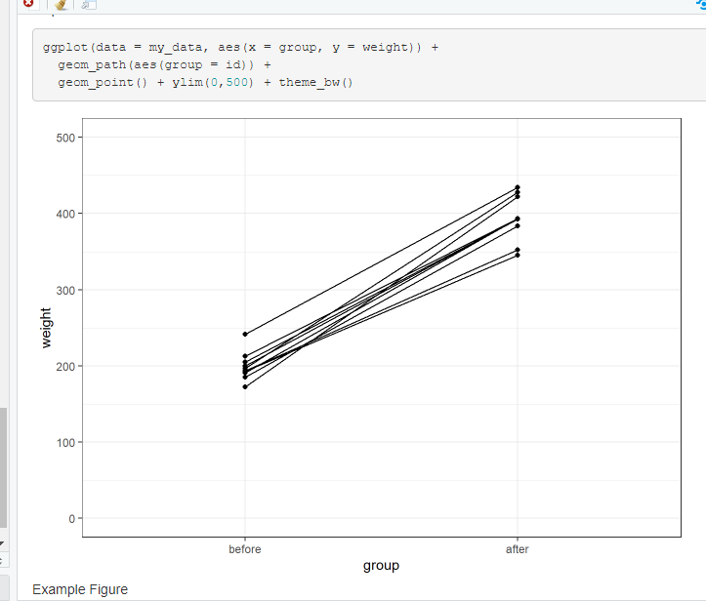
Interlude for ggplot
ggplot2
Library for grammar of graphics
Basics
Data
Aesthetics
Geometries

Slide 14
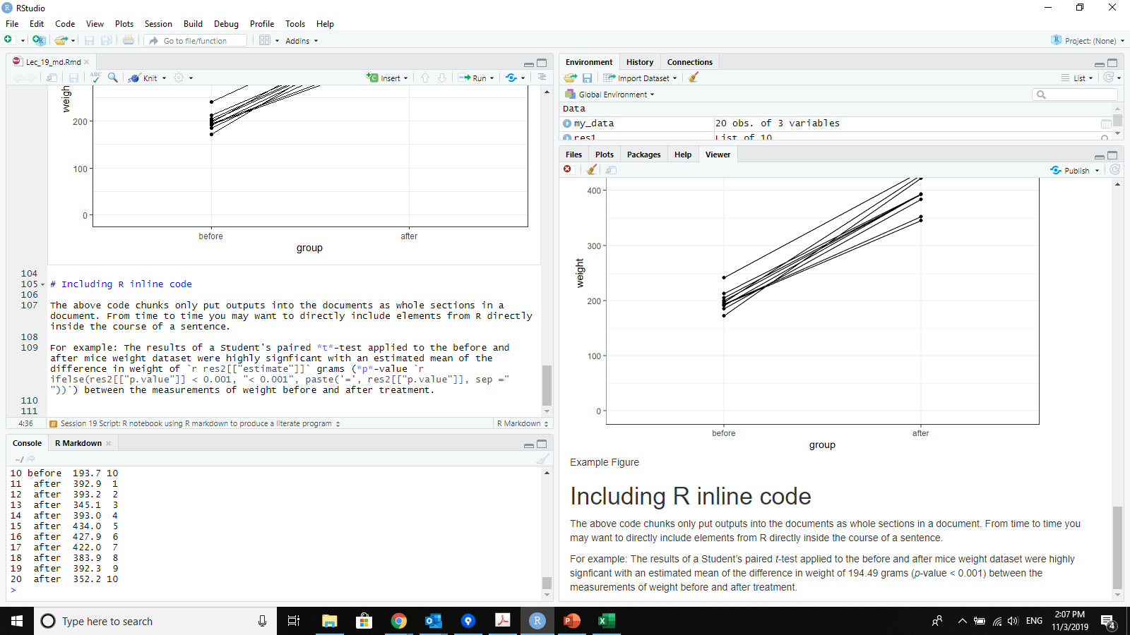
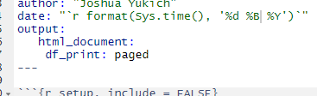
R INLINE Code
Sometimes we want to include results directly in the text.
This can be done with R code placed directly in markdown instead of in a code chunk
Useage is `r rcode`
Generally most useful for executing and printing simple statements
Cannot use options
Never echos code always prints results
Can actually be put in YAML header
Notes:
Have R code directly into a sentence
Asking for value of res 2 (and we saved them because we wanted to use them later)
Review the use of the curly brackets [ ]

Slide 15
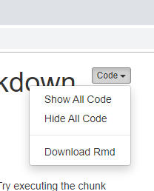
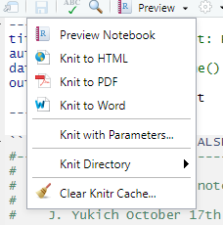
Compiling to different File TYPes
HTML – static html (.html extension – readable by web browser)
nb.html – html notebook (.html extension – readable by web browser) but contains full Rmd file too
HTML
nb.ntml
PDF
WORD/DOCX
Pdf – requires a TeX installation (you can also of course print a PDF from a html or word doc)
Word/DOCX – requires word or similar to be installed
Output field in YAML header specifies output type (or options)

Slide 16
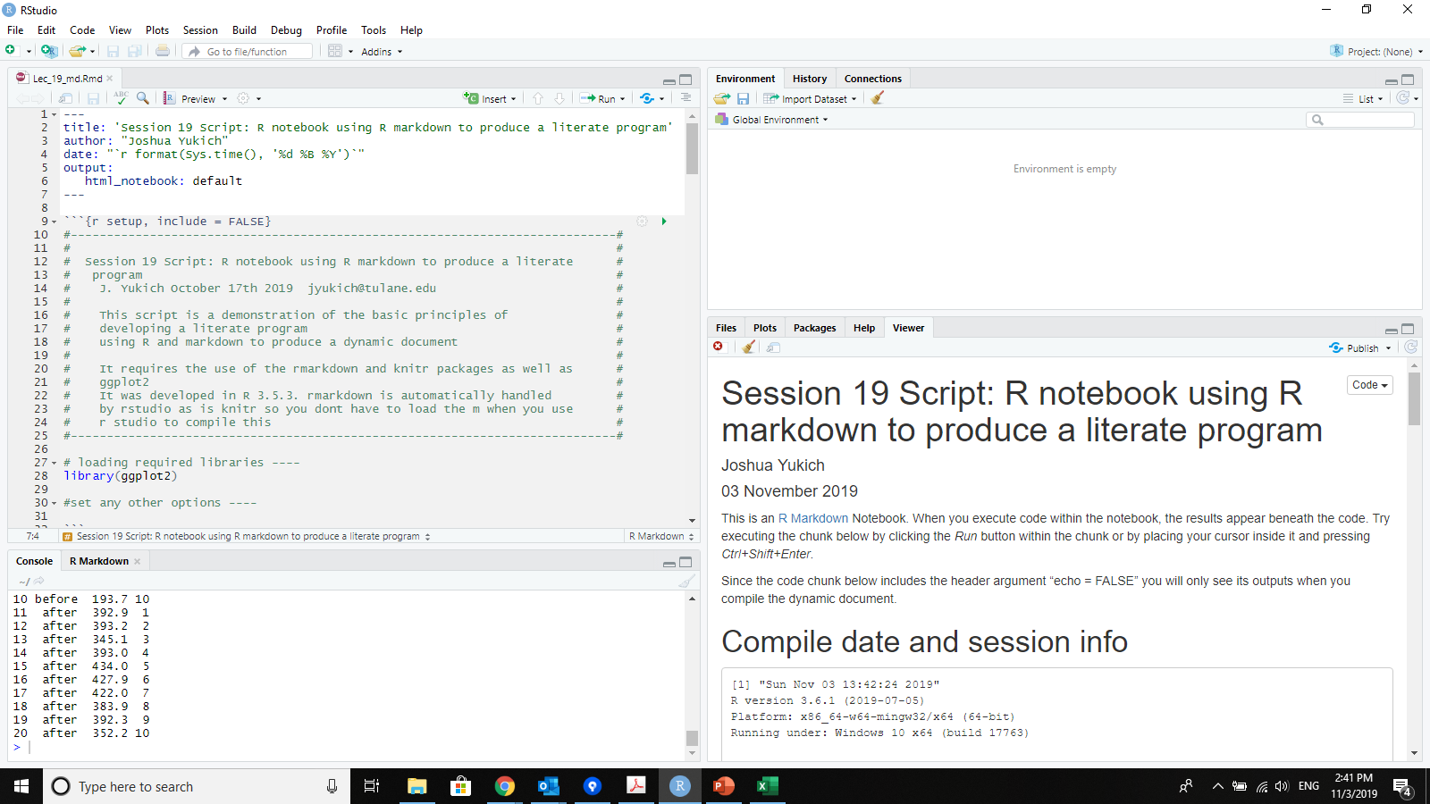
Compilation Environment
Rendering can be done through global environment (to see results inline)
By executing code chunks one at a time or all at once or even line by line
Or knit which opens a separate R instance to execute (so nothing from global environment is used)
Notes:
Download Rmd puts your script and everything compiled in it
**start with an empty/clean environment when you run chunks of code bc you want to make sure you don’t have any that interferes when you run your chunks**

