Slide 1
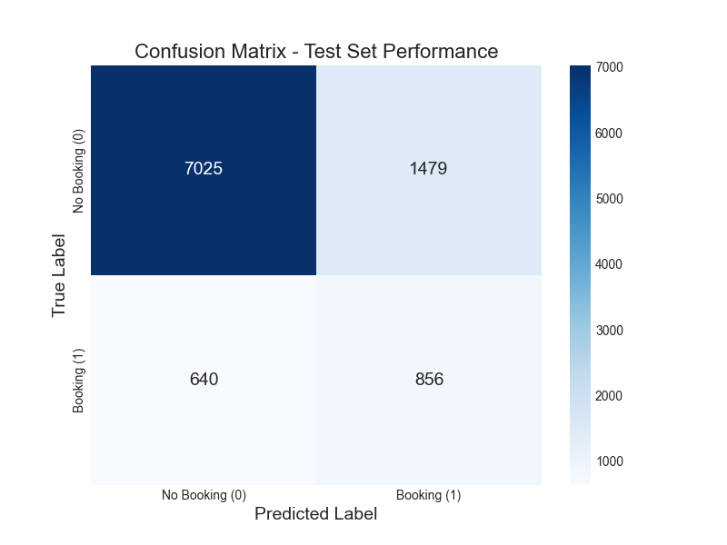
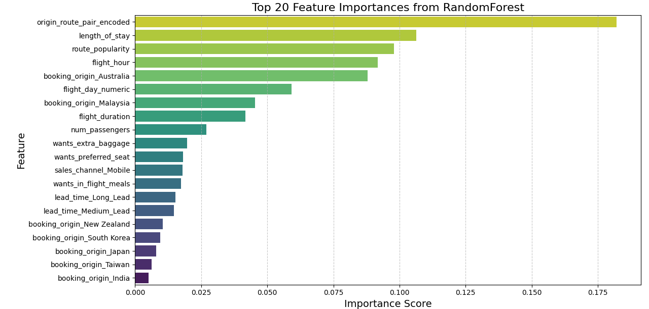
Predictive Modeling of Customer Bookings: Key Insights for Enhanced Conversion
🔍 Project Overview
📊 Model Performance (Test Set)
• Objective: Predict booking completion, identify key factors • Data: 50,000 records (14 original, 916 engineered features) • Model: RandomForestClassifier + RandomizedSearchCV • Training ROC-AUC: **0.7882** (5-fold CV)
• ROC-AUC: **0.793** → strong discriminatory power • F1-Score (Booking): **0.45** | Recall: **0.57** • Confusion Matrix: → TP: 856 | FP: 1479 → FN: 640 | TN: 7025
🔎 Key Drivers & Actionable Insights
🔍 **Origin-Route Pairs**: Encoded values 500–2200 → higher bookings 🛏️ **Length of Stay**: < 20 days → more conversions 🕒 **Flight Timing**: 5–8 AM, 1–4 PM peaks 📈 **Route Popularity**: U-shaped effect
Figure 2: Top Feature Importances
🎯 Strategic Recommendations
🎯 Target marketing to high-propensity segments 🕒 Optimize scheduling around peak hours 🎁 Tailor offers based on revealed preferences
by Oluwadarasimi Bamisaye

