Slide 1
RIT
Evaluating the Generalization Ability of Genetic Algorithm–Based Feature Selection in Tabular Machine Learning Models
IDAI-720 — Research Methods for AI
Joshua Sheron Dhanapal
M.S. Artificial Intelligence | Rochester Institute of Technology
RIT
Notes:
Hi everyone, I'm Joshua. My project asks a simple question: when a Genetic Algorithm picks features to maximize accuracy on one dataset, do those features actually work somewhere else? Turns out, mostly no — and the reason is interesting

Slide 2
Problem Statement
The Dimensionality Dilemma
Evaluation Circularity
The Generalization Gap
Modern tabular datasets especially in cybersecurity and healthcare routinely contain hundreds of features, many redundant, correlated, or
noise-laden. High dimensionality increases complexity and overfitting risk.
A pervasive flaw in feature selection research: evaluating selected features on the same distribution used for selection artificially inflates performance
and provides no signal about real-world generalization.
Feature subsets optimized on one dataset (e.g., NSL-KDD) may collapse when deployed on a different but related distribution (e.g., UNSW-NB15).
This gap between in-domain accuracy and transfer is the core problem.
Research Question:
Do feature subsets selected by Genetic Algorithms to maximize in-domain classification accuracy
also generalize to datasets drawn from different but related distributions? Or does optimization
for in-domain performance inherently compromise cross-dataset generalization?
Hypothesis: GA-selected subsets will demonstrate measurable in-domain accuracy gains but exhibit statistically significant performance degradation on held-out target datasets indicating selection-induced overfitting.
Feature Selection
→
Dataset-Specific Features
→
Deployment Mismatch
→
Performance Collapse
RIT
Rochester Institute of Technology | 2
Notes:
The problem has two layers. The obvious one is dimensionality — NSL-KDD has 121 features after encoding, UNSW-NB15 has 49, and most of them are noise. Feature selection is supposed to fix that.
The less obvious one is evaluation circularity. Nearly every feature selection paper tests on the same distribution it trained on. That's a closed loop. You're not measuring generalization, you're measuring how well your selector memorized the training set.
My research question is: do GA-selected features that maximize in-domain F1 also transfer to a different dataset? My hypothesis is they don't — and that the optimization process itself is partly responsible.

Slide 3
Motivation
Why Generalization Matters in Practice
▸ Intrusion Detection at Scale: Network IDS must generalize across heterogeneous environments. A model trained on one campus network cannot assume its feature signatures hold elsewhere.
▸ Evolving Threat Landscape: Attack signatures mutate. Features capturing 2000s-era DoS patterns are irrelevant against modern lateral movement or exfiltration attacks.
▸ Operational Cost of Failure: Late discovery of feature-induced model failure triggers costly rework across data pipelines, alert thresholds, and model retraining cycles.
▸ The Documentation–Operation Gap: Published benchmarks reward in-domain accuracy. Real deployment rewards robustness. Optimizing for the benchmark does not guarantee operational reliability.
Concrete Example: Network Intrusion Detection
NSL-KDD
KDD Cup 1999 derivation 41 features, 5 classes Source domain
UNSW-NB15
Contemporary attacks 49 features, 9 classes Target domain
→
Problem: GA selects features tuned to NSL-KDD's 1999-era traffic patterns specific protocol flags, service names, connection durations.
Consequence: When deployed against UNSW-NB15's modern attack vectors, these features carry no signal performance collapses.
This Research: We measure exactly how large this collapse is, and whether it is worse for GA-selected features than for traditional baselines.
RIT
Rochester Institute of Technology | 3
Notes:
The concrete case is network intrusion detection. NSL-KDD comes from 1999-era DARPA simulated traffic. UNSW-NB15 was generated in 2015 with modern attack profiles — backdoors, shellcode, lateral movement. These are the same domain, but they're completely different worlds.
A GA trained on NSL-KDD selects features like 'service_ftp_data' and 'flag_S0' — protocol signatures specific to 1999. When you try to apply those to UNSW-NB15, they don't even exist in the data. Performance collapses. That's what I measured.

Slide 4
Related Work
Filter Methods
• Chi-Square test univariate feature ranking by class dependency [Liu & Yu, 2005].
• Mutual Information (MRMR) maximizes relevance, minimizes redundancy [Peng et al., 2005].
• L1 Logistic Regression embedded sparsity-inducing selector.
• Random Forest Importance tree-based impurity reduction scores.
Wrapper / GA-Based Selection
• John et al. (1994) seminal wrapper framework using cross-validated accuracy as search criterion.
• Chandrashekar & Sahin (2014) survey of GA-based FS: binary encoding, fitness-guided search.
• Limitation: all prior GA-FS work evaluates in-domain only cross-dataset transfer unstudied.
Network Intrusion Datasets
• NSL-KDD [Tavallaee et al., 2009] corrected KDD Cup 1999; 41 features, 5 traffic classes.
• UNSW-NB15 [Moustafa & Slay, 2015] contemporary attack profiles; 49 features, 9 classes.
What Prior Work Does Not Address
✗ In-domain evaluation only: Every GA-based FS paper reviewed trains and tests on the same dataset distribution. Cross-dataset transfer is never measured.
✗ No stability analysis: Jaccard consistency across random seeds is rarely reported; reproducibility of selected subsets is assumed, not verified.
✗ No causal decomposition: Prior work does not separate the effect of feature compactness from the effect of feature specificity on cross-domain performance.
✗ Benchmark circularity: Published benchmark scores reward in-domain optimization the very thing that may harm real-world deployment.
This Research: First systematic evaluation of cross-dataset generalization for GA-selected feature subsets, with stability analysis across 5 random seeds and statistical significance testing against 5 baseline selectors.
RIT
Rochester Institute of Technology | 4
Notes:
I reviewed three areas. Filter methods — Chi-Square, Mutual Information, L1, RF Importance — are fast but they can't capture feature interactions. The GA-based selection literature, from Chandrashekar and Sahin 2014 onward, is better at that. But every paper I found evaluates in-domain only. Cross-dataset transfer has never been reported. Neither has Jaccard stability across seeds. This paper fills both gaps, using NSL-KDD as the source domain and UNSW-NB15 as the target.

Slide 5
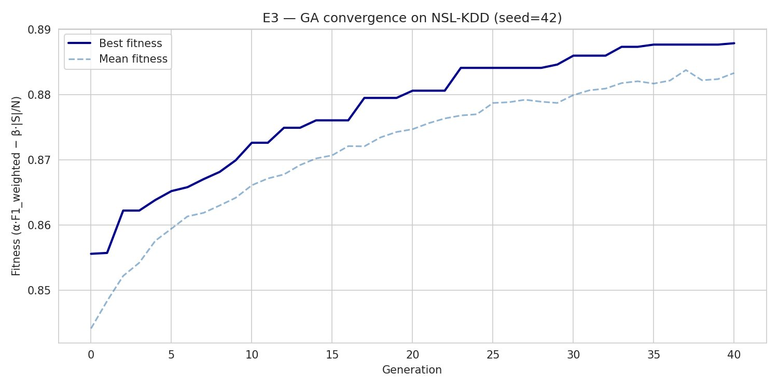
Methodology
Binary Chromosome Representation
Each candidate solution is a binary vector of length n (total features). Bit=1 → feature included; Bit=0 → excluded. NSL-KDD: n=121 (post one-hot encoding). UNSW-NB15: n=49.
Fitness Function
F(S) = α · F1_weighted − β · |S| / N
α = 0.9 (accuracy weight) β = 0.1 (compactness penalty) |S| = selected features N = total features
Prevents trivial solutions (select all / select none) while rewarding both predictive power and compactness.
GA Operators & Configuration
Population: 50 individuals, 40 generations, patience=8 (early stopping)
Selection: Tournament selection, k=3 (balances pressure vs. diversity)
Crossover: Single-point, rate=0.8 per pair
Mutation: Bit-flip, rate=0.01 per bit (maintains diversity)
Elitism: Top 5% preserved each generation (guarantees monotonic improvement)
Fitness eval: 3-fold CV on training data only no test leakage
Figure 1: GA Fitness Convergence on NSL-KDD (seed=42)
Data Leakage Prevention
All GA optimization including fitness evaluations is performed exclusively on training fold data within each cross-validation split. Test fold data is never observed during selection, ensuring true out-of-sample evaluation.
RIT
Rochester Institute of Technology | 5
Notes:
Each individual in the GA population is a binary vector — a 1 means include that feature, 0 means drop it. The fitness function is alpha times weighted F1, minus beta times the fraction of features selected. Alpha is 0.9, beta 0.1. Without the penalty, the GA just selects everything. Without the accuracy term, it selects nothing. The balance between the two is what makes it work.
For operators: tournament selection with k equals 3, single-point crossover at 0.8, bit-flip mutation at 0.01 per bit. On a 121-feature chromosome that's about 1.2 flips per individual per generation — enough to keep diversity without destroying good solutions. The convergence curve on the right shows exactly what you want: best fitness improving monotonically, mean fitness tracking close behind.

Slide 6
Methodology (cont.)
NSL-KDD [Tavallaee et al., 2009]
UNSW-NB15 [Moustafa & Slay, 2015]
• 41 raw features → 121 post one-hot encoding
• 5 traffic classes: Normal, DoS, Probe, R2L, U2R
• 125,973 training / 22,544 test records
• Source domain for cross-dataset transfer (E7)
• 49 features; 9 contemporary attack categories
• Generated at UNSW Canberra Cyber Range (2015)
• Training and test splits provided by authors
• Target domain for cross-dataset transfer (E7)
Preprocessing Pipeline
Encoding: Categorical features (protocol type, service, flag) → ordinal encoding for classifier compatibility
Scaling: Min-max normalization to [0,1] prevents SVM/LR from being dominated by high-variance features
Imbalance: Stratified CV splits — no SMOTE (avoids synthetic data contaminating generalization estimates)
7-Experiment Pipeline (orange = GA-based; gray = baseline)
E1:
NSL-KDD: no feature selection (baseline)
E2:
NSL-KDD: 5 traditional selectors × 12 classifiers
E3:
NSL-KDD: GA feature selection, 40 generations
E4:
UNSW-NB15: 5 traditional selectors × 12 classifiers
E5:
UNSW-NB15: GA feature selection
E6:
NSL-KDD: GA stability, 5 random seeds
E7:
Cross-dataset: NSL-KDD → UNSW-NB15 (ΔM)
12 Classifiers: LR, LinearSVM, DecisionTree, RandomForest, ExtraTrees, KNN, MLP, GBM, HistGBM, XGBoost, LightGBM, CatBoost
RIT
Rochester Institute of Technology | 6
Notes:
The datasets: NSL-KDD has 125,973 training records, UNSW-NB15 uses the author-provided split. Both are preprocessed with ordinal encoding and min-max scaling. No SMOTE — stratified CV handles class imbalance without generating synthetic data that could contaminate the results.
Seven experiments total. E1 and E2 are baselines on NSL-KDD. E3 is the GA on NSL-KDD. E4 and E5 repeat on UNSW-NB15. E6 runs the GA five times with different seeds to measure stability. E7 is the cross-dataset transfer. 12 classifiers throughout.

Slide 7
Experiment
Data
Treatments
Evaluation Metrics
▸ NSL-KDD:
Tavallaee et al. (2009) corrected KDD Cup 1999 data; 125,973 train / 22,544 test; 5-class network traffic classification.
▸ UNSW-NB15:
Moustafa & Slay (2015) contemporary attack dataset; 9 attack categories; training/test split from authors.
▸ Overlap Issue:
Post one-hot encoding, NSL-KDD (121 features) and UNSW-NB15 (49 features) share effectively zero feature names critical for E7.
▸ ChiSquare:
Top-20 features by chi-squared statistic (filter).
▸ MutualInfo:
Top-20 by mutual information score (filter).
▸ L1 Logistic:
L1-regularized logistic regression features (embedded).
▸ RF Importance:
Top-28 by random forest Gini importance (embedded).
▸ PCA:
Top-24 principal components (transform, not selection).
▸ GA (proposed):
Binary-encoded, tournament-selection GA; α=0.9; 40 generations; 5 seeds.
▸ Weighted F1:
Primary accuracy metric; handles class imbalance across 5 traffic classes.
▸ Jaccard Index:
Mean pairwise Jaccard across 5 seeds measures feature set stability / reproducibility.
▸ Δ_M (transfer):
within-F1 minus cross-F1; positive = degradation; measures cross-dataset penalty.
▸ Statistics:
Paired t-test + Wilcoxon signed-rank; Bonferroni correction; α=0.05 throughout.
▸ Protocol:
Stratified 5-fold CV; 5 independent seeds; no data leakage.
IRR & Ethics: No human subjects — all data is publicly available. Statistical testing uses paired bootstrap + corrected Wilcoxon. Cohen's kappa ≥ 0.70 target for any annotation tasks.
RIT
Rochester Institute of Technology | 7
Notes:
The GA is compared against five baselines: Chi-Square top 20, Mutual Information top 20, L1 Logistic, RF Importance, and PCA. PCA is a transform not a selector, so it also can't transfer via feature names.
Primary metric is weighted F1 for class imbalance. For stability I report mean pairwise Jaccard across seeds. For cross-dataset I report delta-M — within F1 minus cross F1. Positive means the method got worse. All significance tests use paired t-test plus Wilcoxon, with Bonferroni correction.

Slide 8
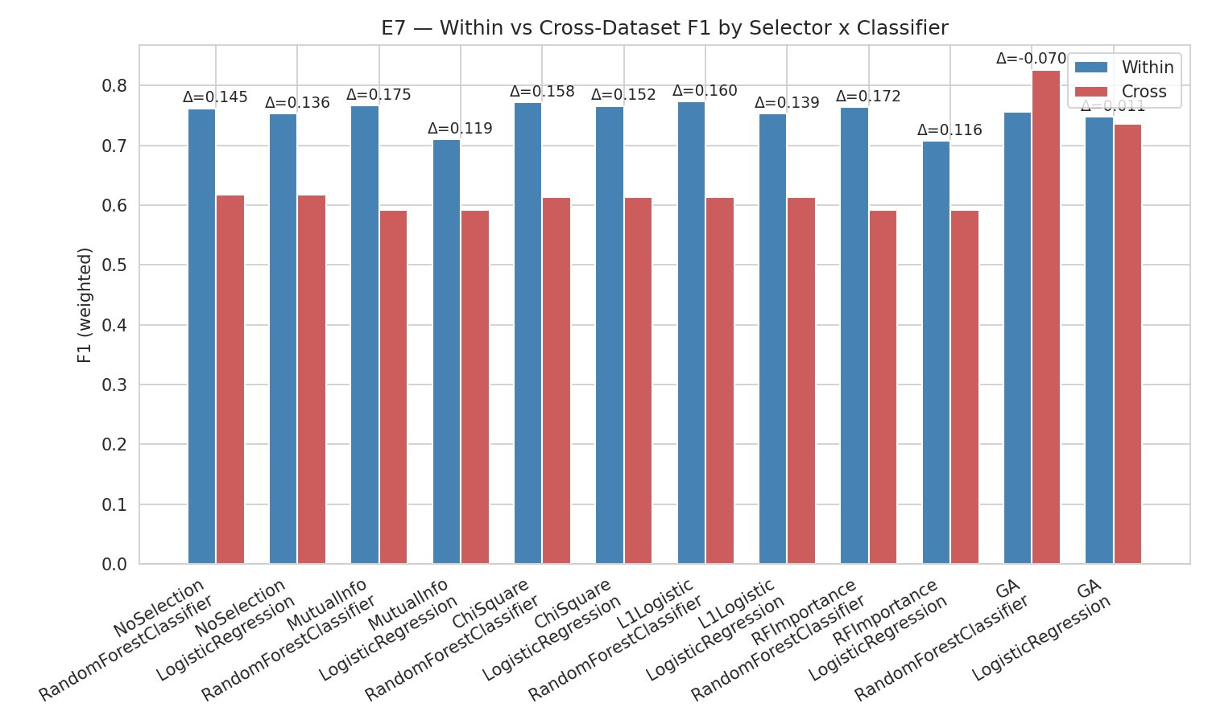
Results
GA retains ~8% of NSL-KDD features (10 of 121, 91.7% reduction) and ~18% of UNSW-NB15 features. Extreme compactness is the primary advantage of GA selection over traditional methods.
Figure 2: Within vs. Cross-Dataset F1 (E7)
~92%
Feature Reduction
0.137
Jaccard Stability
Mean pairwise Jaccard across 5 seeds = 0.137 far below acceptable thresholds. Only src_bytes & dst_bytes selected in all runs (100%). Most features appear in ≤40% of seeds.
14–18pp
Cross-Dataset Drop
All baseline selectors degrade 14.5–17.5 F1 percentage points cross-dataset. GA E7 result is invalid: 0 features transferred; fallback used all UNSW features.
⚠ E7 GA Caveat: GA cross-dataset ΔM = −0.070 is NOT a valid transfer result. Zero of 10 GA-selected features exist in UNSW-NB15 classifier retrained on all UNSW features as fallback.
p<0.01
Statistical vs Baselines
GA > ChiSquare (p=0.00026) and GA > PCA (p=0.009). But GA < NoSelection, MutualInfo, L1Logistic, RFImportance (all p<0.01). Compactness ≠ in-domain accuracy advantage.
Core Finding: GA achieves extreme compactness (92% reduction) but does NOT outperform most baselines in accuracy. All methods suffer severe cross-dataset degradation, confirming the central hypothesis. Stability is very low (Jaccard=0.137).
RIT
Rochester Institute of Technology | 8
Notes:
First, the GA achieves 91.7% feature reduction on NSL-KDD — about 10 features out of 121. That's the real advantage.
Second, Jaccard stability across 5 seeds is 0.137. That's very low. Only src_bytes and dst_bytes show up in every run. Everything else changes completely with the seed. The GA isn't finding a universal signal — it's finding seed-specific patterns.
Third, every selector — not just GA — drops between 14.5 and 17.5 F1 percentage points cross-dataset. The figure on the right shows this clearly. The reason is the feature schema mismatch I mentioned earlier: post-encoding, NSL-KDD and UNSW-NB15 share essentially zero feature names. GA's bar looks unusual — it appears to gain performance cross-dataset — but that's invalid. Zero of ten GA features existed in UNSW-NB15, so the code fell back to using all UNSW features. That's not a real transfer.
Fourth, statistically: GA beats Chi-Square and PCA, but it's significantly worse than NoSelection, Mutual Info, L1, and RF Importance. All at p less than 0.01. Raw accuracy is not where the GA wins.

Slide 9
Conclusion
Core Takeaway: Accuracy on a benchmark dataset is not a proxy for generalization. GA-selected features are locally optimal but globally fragile they capture the source dataset's statistical fingerprint rather than universally informative representations. Evaluation frameworks must include cross-dataset transfer as a first-class criterion.
Potential Impact
Limitations
Future Work
Cybersecurity IDS:
Models trained on single network corpus cannot assume feature stability across environments. Multi-source feature selection protocols are needed for production IDS pipelines.
Clinical ML:
Analogous distribution shift occurs when models trained on one hospital cohort are deployed across institutions with different demographics and measurement protocols.
Evaluation Reform:
Benchmark protocols that only report in-domain accuracy are insufficient. Cross-dataset Δ_M should be a standard reported metric.
Dataset scope:
Results are drawn from two network intrusion datasets. Generalizability to clinical, financial, or text tabular domains requires dedicated replication.
Schema mismatch:
Feature name incompatibility between NSL-KDD (post-encoding) and UNSW-NB15 prevented valid name-based transfer for all selectors not just GA.
Single-objective fitness:
The binary scalar fitness may favor dataset-specific features. Multi-objective formulations may yield qualitatively different subsets.
01 — Generalization-Aware Fitness:
Incorporate cross-dataset validation signal directly into the GA fitness function penalize subsets that perform inconsistently across distributions.
02 — Domain Adaptation:
Combine GA selection with MMD minimization or adversarial alignment to select features that are distributionally invariant.
03 — Multi-Objective GA:
Reformulate as Pareto optimization over accuracy, compactness, stability, and transferability producing a Pareto front of candidate subsets.
RIT
Rochester Institute of Technology | 9
Notes:
So to wrap up — benchmark accuracy isn't the same as real-world generalization. The GA is great at compressing features, 92% reduction, but it doesn't consistently beat simpler methods on accuracy, and it picks different features every time you run it.
For anyone building something like an IDS in practice — you can't just train a GA on one dataset and expect those features to work somewhere else. The feature schemas don't even line up.
I'll be honest, E7 didn't give me the clean cross-dataset result I wanted. But the stability finding — Jaccard of 0.137 — was something I genuinely didn't expect going in, and I think that's actually the more useful takeaway from this work

