Slide 1
Teach Me X: Java GUI
Using JavaFX to create a GUI

Slide 2
How do we create a GUI in Java?
Two main ways:
  Swing
  JavaFX

Slide 3

What is Swing?
The successor to the Abstract Window Toolkit (AWT)
Old – designed in 1996/7
Distinct look and feel
The method we will
learn in semester 2

Slide 4
What is JavaFX?
The newest method to create GUIs in Java
Relatively modern – Initially released in 2008
Very powerful and dynamic

Slide 5
What will we use?
JavaFX because
  Modern
  Nice
  Powerful
Eclipse because
  It is the best IDE :)

Slide 6
Let’s make a JavaFX project
Download eclipse:
http://www.eclipse.org/downloads/
Follow the instructions on this link:
thtp://www.eclipse.org/efxclipse/install.html#for-the-lazy

Slide 7
How do JavaFX applications work?
Program the components manually
Or designing the layout using FXML and CSS
Programming is easier
FXML and CSS can look nicer but is overkill for this session

Slide 8
How do JavaFX applications work?
            Structure

Slide 9
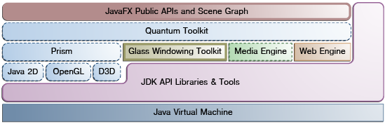
Structure of JavaFX

Slide 10
The Scene Graph
A hierarchical tree of nodes
Every node is a visual or structural element
Each node in a scene graph has a parent
They can have:
  Effects, such as blurs and shadows
  Opacity
  Transforms
  Event handlers (such as mouse, key and input method)

Slide 11
Layout
Flexible and dynamic arrangements of UI controls
Layouts:
  BorderPane
  HBox
  Vbox
  GridPane
  TilePane
  AnchorPane
To achieve a desired layout structure, different containers can be nested

Slide 12
Layout
BorderPane - Lays out its content nodes in the top, bottom, right, left, or centre region
HBox - Arranges its content nodes horizontally in a single row
VBox - Arranges its content nodes vertically in a single column
StackPane - Places its content nodes in a back-to-front single stack
GridPane - Enables the developer to create a flexible grid of rows and columns in which to lay out content nodes

Slide 13
Layout
GridPane - Enables the developer to create a flexible grid of rows and columns in which to lay out content nodes
FlowPane - Arranges its content nodes in either a horizontal or vertical ”flow,” wrapping at the specified width (for horizontal) or height (for vertical) boundaries
TilePane - Places its content nodes in uniformly sized layout cells or tiles
AnchorPane - Enables developers to create anchor nodes to the top, bottom, left side, or center of the layout

Slide 14
So how do we use this information?
Lets get into the code...

Slide 15
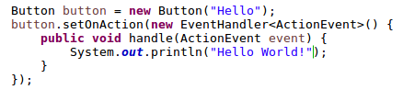
What’s that?
Uses some more advanced topics we haven’t learnt yet
  Generics
  Anonymous class
Lets break this down

Slide 16
Generics
Generics are the bit in the diamond (the angled brackets)

Slide 17
Generics
Some classes might not know what type they need
You might want to generalise an algorithm or class
e.g. ArrayList
Only can hold one type of data
Don’t want multiple classes for each data type
e.g. IntegerArrayList, StringArrayList, etc

Slide 18
Generics
ArrayList<E> where E is the generic element
Can be any letter or word but there are conventions
We create an ArrayList like so:
  ArrayList<Integer> integers = new ArrayList<Integer>();
Only works for Integer data types
:D
Lets get back to the example...

Slide 19
Generics
EventHandler generically handles any event type
e.g. ActionEvent, MouseEvent etc
So it uses generics

Slide 20
Anonymous Class
Allows you to implement methods on instantiation of the Object
Useful when this is the only use of the class
Saves creating a complete extra class for each use

Slide 21
Errr… okay
Don’t worry if that theory goes over your head
Just stick to the code and you should be fine!
Lets get back to it...

Slide 22
That was cool but what else
Lets make a game!
Bare bones here: http://tinyurl.com/TeachXJavaGUI

Slide 23
Extra Resources
http://docs.oracle.com/javase/8/javafx/get-started-tutorial/jfx-overview.htm
http://docs.oracle.com/javase/8/javase-clienttechnologies.htm
http://docs.oracle.com/javase/8/javafx/get-started-tutorial/get_start_apps.htm
http://docs.oracle.com/javase/tutorial/java/generics/why.html
http://docs.oracle.com/javase/tutorial/java/javaOO/anonymousclasses.html

