Slide 1
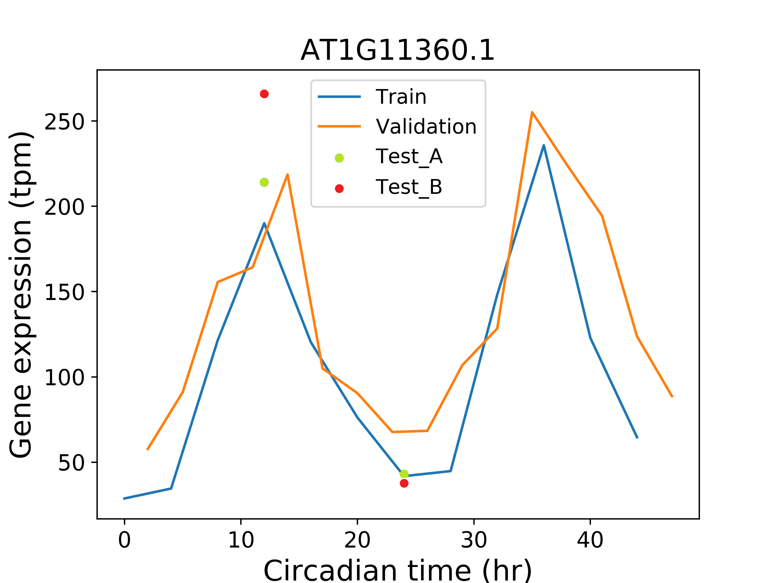
Rhythmic gene ranking
Diverse gene selection
Circadian time prediction

