Slide 1


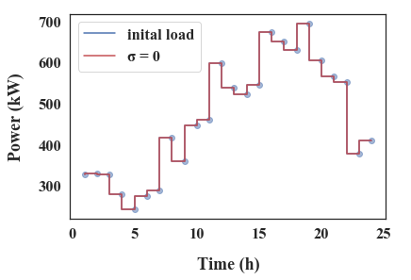
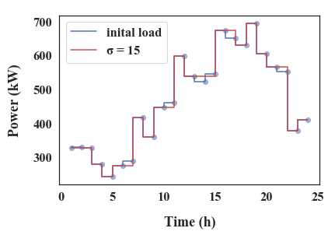
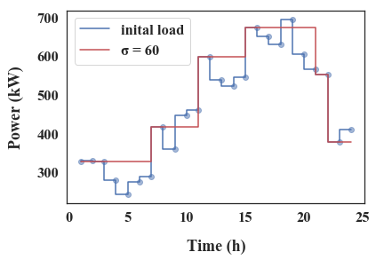
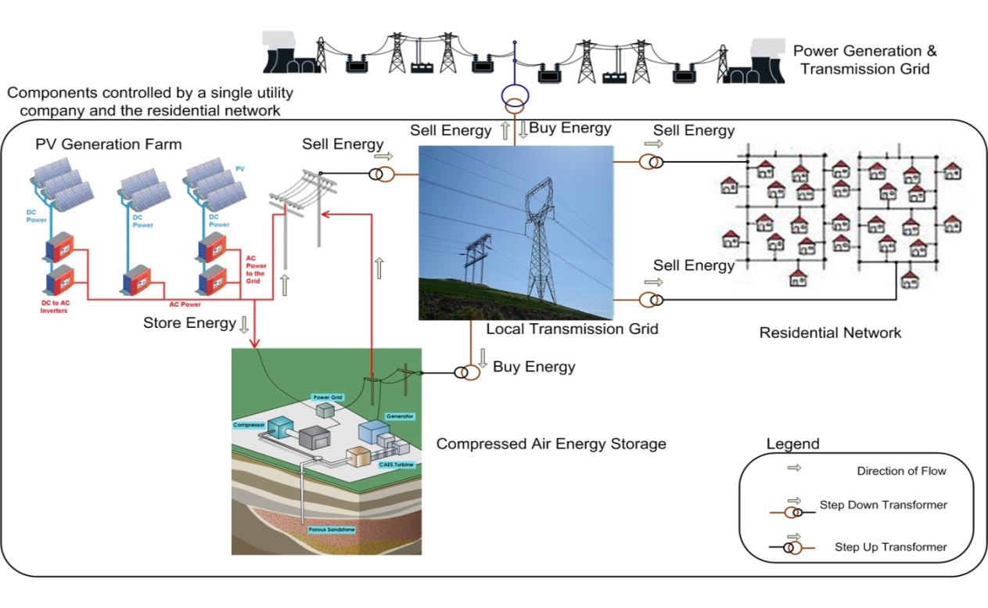
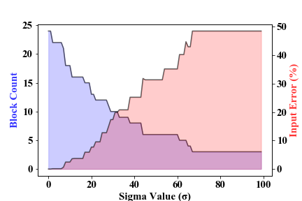
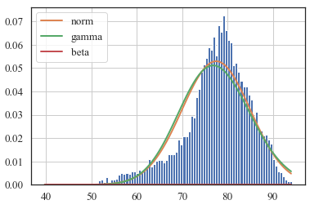
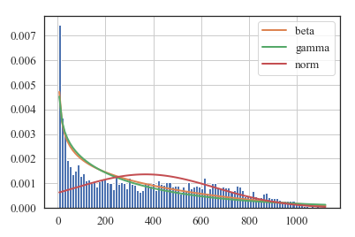
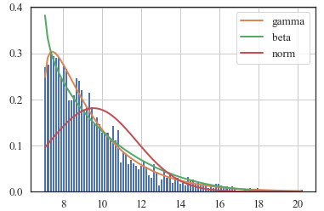




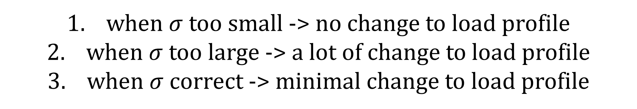
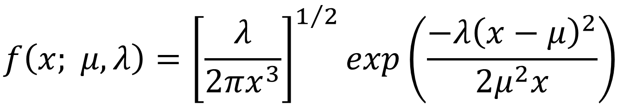
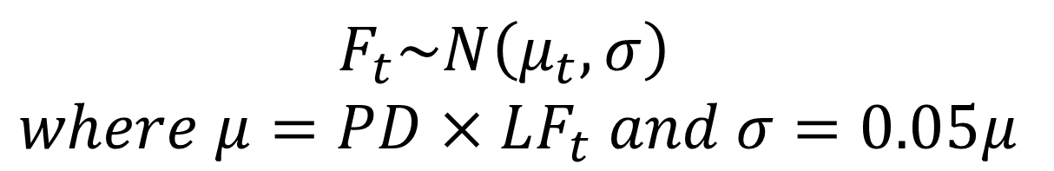

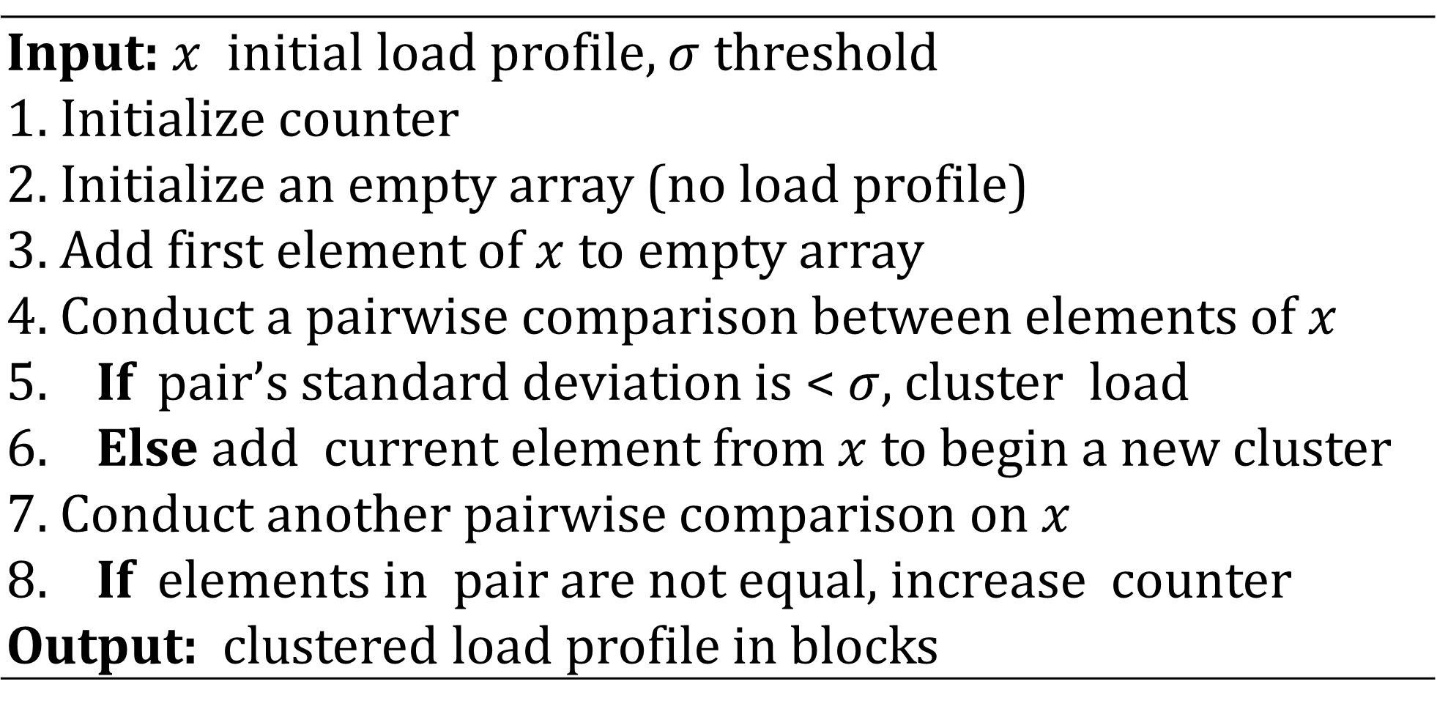
Microgrid Operational Planning using Deviation Clustering within a DDDAS Framework
Department of Industrial Engineering | University of Miami
Joshua Darville – Advisor: Dr. Nurcin Celik
Email: jmd437@miami.edu Celik@miami.edu | Website: https://simlab.coe.miami.edu/
(1) Motivation
(3) Proposed Solution & Methodology
(5) Deviation Clustering (DC)
Modern power systems continue to increase in complexity due to climate change and stochastic weather conditions. Considering both these factors simultaneously generates enumerable operating scenarios and complicates microgrid (MG) decision-making. Hence, dimension reduction techniques are needed to reduce an MG model’s complexity. In this work, we present a deviation clustering (DC) algorithm within a dynamic data-driven application systems (DDDAS) framework to reduce the length of the an MG dispatch model’s planning horizon while retaining the temporal characteristics of the initial load profile. The DDDAS framework allows for the adjustment of the current dispatch decisions
in near real-time.
Key Finding: Studies throughout literature note a significant relationship between scale of a MG model (complexity) & the length of its planning horizon (decision-making period).
Proposition: Since decisions occur chronologically, the planning horizon is temporal. However, an MG system does not respond to time itself; an MG responds to the amount of consumer energy demand at a given time. Thus, we re-define the planning horizon based on the amount of demand at a given time (block). Since blocks < time units, we expect a short planning horizon.
Input: $x$ initial load profile, $σ$ threshold Initialize counter Initialize an empty array (no load profile) Add first element of $x$ to empty array Conduct a pairwise comparison between elements of $x$ If pair’s standard deviation is < $σ$, cluster load Else add current element from $x$ to begin a new cluster Conduct another pairwise comparison on $x$ If elements in pair are not equal, increase counter Output: clustered load profile in blocks
DDDAS Framework
Modify Sensing Strategy
Rule-based Policy
Courses of Action
Transmission Sytem Officer
Alternative Manual Decision
1
Input Error
3
MG Simulation
Load
Climate Sensor
Market Price
Grid Topology
Clustered Profile
Dispatch Decisions
MG System
Diesel Units
Renewables
Storage Units
Radial Layout
→
→
(2) Problem & Challenges
Deviation Clustering
MG Dispatch Model
when $σ$ too small -> no change to load profile
when $σ$ too large -> a lot of change to load profile
when $σ$ correct -> minimal change to load profile
R. Question: How should I compress information from a power system for accurate decision-making?
2
Real-Time Sensory Data
Point of
Intersection
(4) Models & Data Collection
Load / Demand
Market Price
$$F_{t}\sim N\left(μ_{t},σ\right)$$
$$where μ=PD×LF_{t} and σ=0.05μ$$
$$f\left(x; μ, λ\right)={\left[\frac{λ}{2πx^{3}}\right]}^{1/2}exp\left(\frac{−λ{\left(x−μ\right)}^{2}}{2μ^{2}x}\right)$$
Solar Power
Wind Power
$${PV}_{t}=FF∙V_{t}∙I_{t}$$
$$V_{t}=V_{oc}−k_{v}\left[T_{t}^{cell}−25\right]$$
$$I_{t}={SI}_{t}∙\left(I_{sc}+k_{i}\left[T_{t}^{cell}−25\right]\right)$$
$$T_{t}^{cell}=T_{t}^{amb}+\frac{\left(T^{nom}−20\right)}{0.8}∙SI$$
$$W_{out}=\left\{\begin{matrix} & if v_{w}<v_{ci} \\ P_{w}×\frac{v_{w}−v_{ci}}{v_{r}−v_{ci}} & if v_{ci}≤v_{w}≤v_{r} \\ P_{w} & if v_{r}≤v_{w}<v_{co} \\ 0 & if v_{w}≥v_{co}\end{matrix}\right.$$
Result Summary
Decision Timescale
Load Profile | Block Count | Input Error | Speed Ratio | Output Error
Sigma = 0 | 24 | - | - | -
Sigma = 15 | 16 | 3.7 | 2 | 2.8
Sigma = 25 | 13 | 7.744 | 2.4 | 3.6
Sigma = 30 | 10 | 17.4 | 3 | 7.23
Sigma = 45 | 8 | 25.22 | 5 | 8.2
Sigma = 60 | 6 | 35.2 | 7 | 9.6
Years: nuclear power plant location
Months: avoiding capacity expansion
Weeks: demand-side management (DSM)
Days: unit commitment (UC)
Hours: battery arbitrage
Seconds: frequency regulation
$T_{t}^{amb}$: Ambient Temperature
${SI}_{t}$: Solar Irradiance
$v_{w}$: Wind Speed
Publication Citation: J. Darville and N. Celik, “Microgrid Operational Planning Using Deviation Clustering Within a DDDAS Framework,” in International Conference on Dynamic Data Driven Application Systems, 2020, pp. 77–84.

