Slide 1
Parcellations
Scinet Summer School: Biomedical Stream
June 26th, 2019

Slide 2
Definition: Parcellation
Webster’s: A division into parcels
Neuroimaging: A division of the cortical and/or sub-cortical structures into smaller regions based on characteristics of that brain area
Can be structural or functional in origin (or both)
Can be based on histological data
Have varying amount of parcells

Slide 3
Why Parcellation?
Allows you to compress the data into a smaller size for easier analysis
Parcellations have meaningful interpretations (aka M1, S1, etc)
Parcellations can be generated from any kind of data
allows for comparison to anatomy or histology
Parcellations increases signal as you average results over multiple voxels/vertices

Slide 4
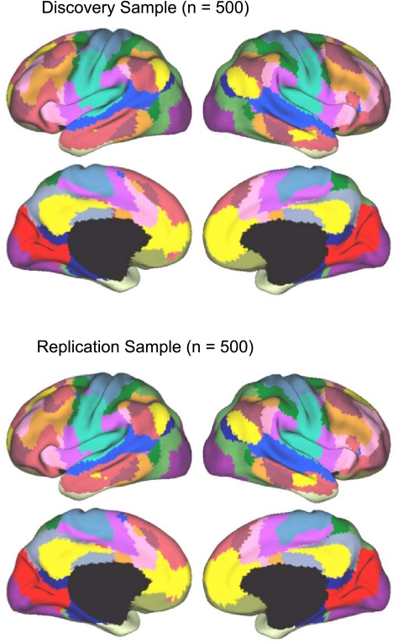
Example 1: Yeo et al. 2011, J Neurophysiology
Based on 1000 young healthy volunteers resting state scans.
Normalization across individuals was completed in surface space.
Available in Freesurfer package
Two versions: 7 or 17 parcells

Slide 5
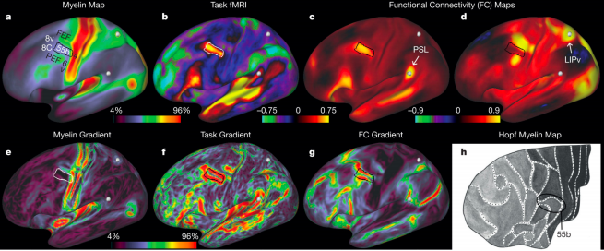
Example 2: Glasser et al. 2016, Nature
210 healthy young adults (part of the HCP Data)
Normalization across individuals was completed in surface space
Multimodality, used functional tasks, resting state and structural data
180 parcels per hemisphere

Slide 6
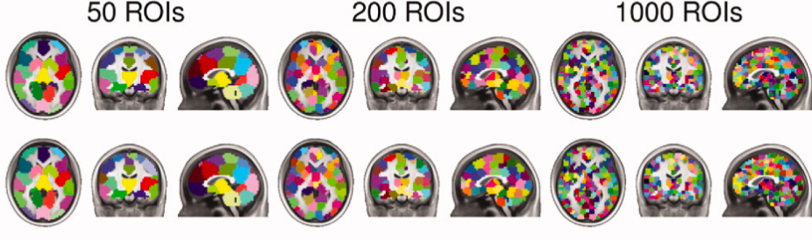
Example 3: Craddock et al. 2010, Hum Brain Map.
Based on 41 young healthy volunteers resting state scans.
Normalization across individuals was to MNI152 space
Completed volumetric clustering
Many versions with 50-1000 ROIs
Used both anatomical and random initializations

