Slide 1


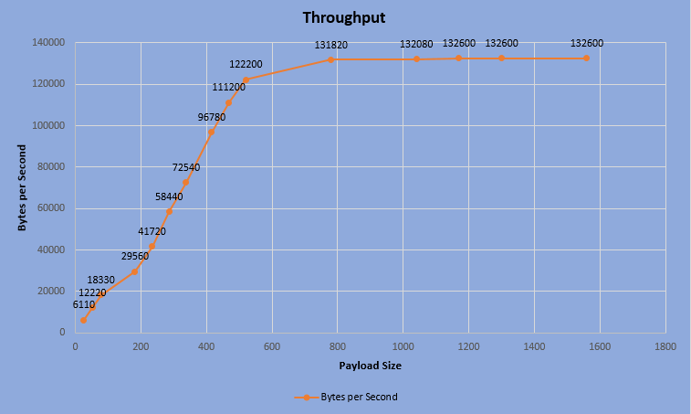
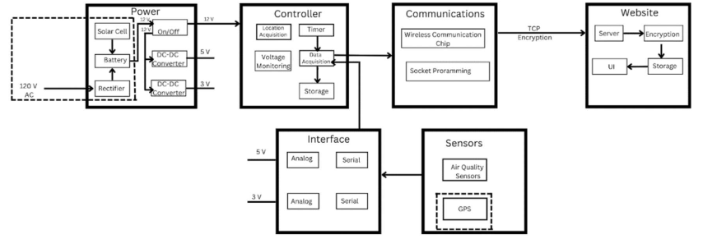
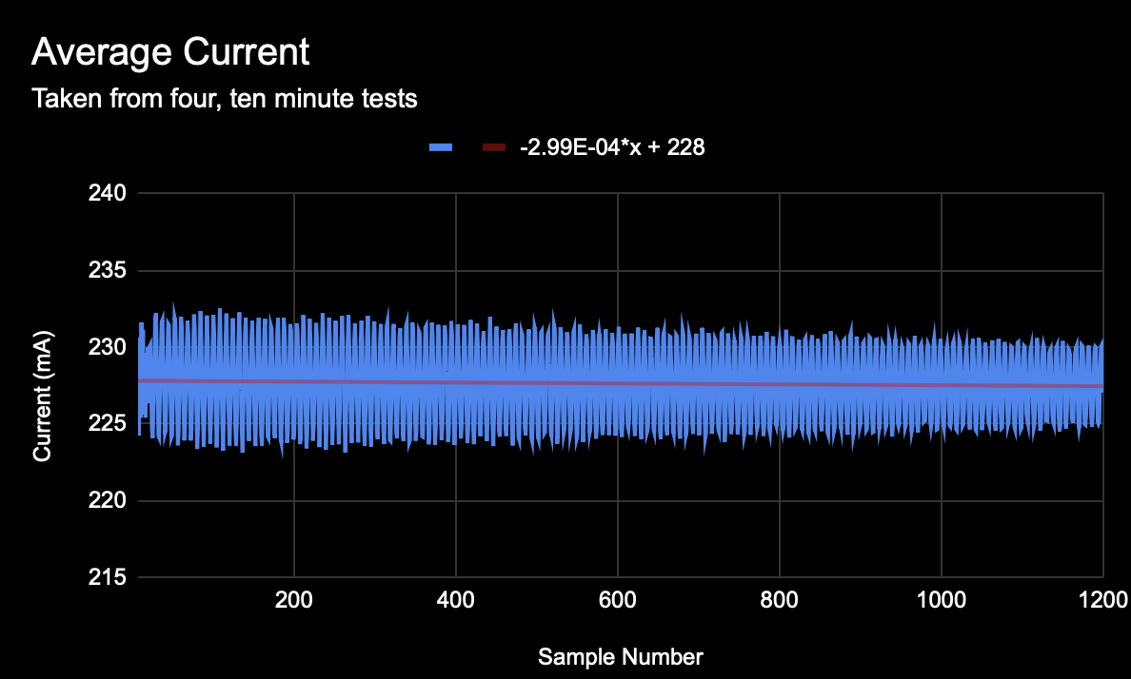
Spring 2023
Citizen Air Quality Sensor
Cameron Smith, Kaleb Irwin, Marvo Odds, Alejandro Moore, Joshua Egwuatu
Introduction
In the modern age, humans have pushed levels of pollution in the world to unprecedented levels. Pollution affects the air that all living things rely on to survive. The project goal was a modular device that accepts & operates multiple air quality sensors independently for local data collection. The negative repercussions of air pollution led to the proposal of a device allowing citizens to monitor pollutants in their communities.
Core Features
Be able to measure six common qualities: carbon monoxide, lead, nitrogen oxides, ozone, particulate matter & sulfur dioxide.
Easily replicated with little engineering experience or knowledge.
Be relatively inexpensive at $300 maximum.
Utilize multiple sensors simultaneously.
Allow for easily accessible data via the website or directly by using a USB flash drive.
Ambition
There were numerous planned features for the final version. Time constraints & workload volume resulted in various features being omitted from the final product. Electrically, the proposed device was simple. In terms of software, it required far more non-trivial coding than anticipated.
Proposed Solution
Development of Solution
Product development suffered from three main issues: Ordering holdups, parts delivery delays, and workload, especially for the Communications subsystem & sensors. The original Communications design had to be discarded due to its reliance on the decommissioned 3G cell network. With components being a major issue, numerous compromises had to be made to simulate the device’s I/O. Other kinds of sensors were used for testing purposes & proof of concept. With our stand-in sensors and microcontroller, we coded a polling solution before moving to an interrupt solution. Next, we adapted a method of logging sampled data onto a USB Fat32 flash drive. Next, we moved to wireless logging to a website. The server solution was discarded in favor of a Google script that logged the data to a Google Sheet linked to a Google Site.
Results/Experimentation
The device can reach sample rates of 8924 Hz, a throughput of 132600 Bytes, and a lifetime of 524 hours with tested solar conditions. All data can be logged onto to local flash drive and website. The limiting factor is logging into the website due to POST cooldowns. This can be circumvented by sending accumulated data using the ESP8266’s ability to send bigger payloads with sufficient throughput. Analog and Digital signals are supported. The battery lasts for up to 81.14 hours. The solar option can increase this value to 418 hours assuming optimal solar conditions. Battery and solar can be forfeited for operating off mains power. Practical sample rates for application are 2 Hz nominal and 10 Hz at high wind speeds. A sampling at 8924 Hz is possible but is an unnecessary waste of resources.
Future Work
Air quality sensors are needed to measure air quality.
Finish development on a sleep mode for saving power.
Implement a configuration header file for optional modes.
An error handling functionality is a must for long-term operation.
Global positioning system and encryption for security.
Battery capacity measuring and notification when low.

