Slide 1
Citizen Air Quality Sensor
Presentors:
Joshua Egwuatu, Kaleb, Irwin, Alejandro Moore, Marvo Odds, Cameron Smith

Slide 2
Introduction
A replicable device that uses multiple air quality sensors for local data collection.
Emphasis on community atmospheric science
Easily replicable
Thorough documentation
Relatively cost-effective
Modular
Solar cell rechargeable on-board battery pack, or direct AC power
Use Wi-Fi or 4G
Wireless data collection
On-board and server storage
Data encryption

Slide 3
Defining the Problem
Poor air quality can cause:
Inhospitable environments
Health risks such as heart disease and lung cancer.
Phones and PC’s can give generalized data
Not very accurate, averaged over regions
There needs to be a way for local air quality data to be tested cheaply and easily.

Slide 4
Solution to the Problem
The Air Quality Device will use modular sensors to measure the specific pollutants in its’ surrounding area
Gives user options for what pollutant they would like to detect
Remote/manual access
Specified Pollutants:
Carbon Dioxide
Sulfur Dioxide
Nitrogen Dioxide
Ozone
Methane
Particulate Matter

Slide 5
Standards & Regulations
Environmental Considerations:
National Electrical Code benchmark for electrical design to avoid harming people, property, and the environment [1]
ANSI/ASHRAE Standard 62.1-2016: Ventilation for Acceptable Indoor Air Quality for sensor detection in ppm (Parts Per Million) concentration indoors. [2]
IP34 (Resistance to small objects and resistance to rain on all sides) [3]
NFPA 70E (Health risk assessment protocols) [4]
TCP/IP & associated Web standards [5]
IEEE 802.11 (Wireless connections) [6]

Slide 6
Design
Power
Function:
Provide modular power options with battery, mains, and or solar
Constraints:
Ability to provide 1.686 W to account for maximum current usage
Battery capacity of at least 39.89 Wh to allow device to run for the 48 hour minimum
Analysis
Chosen battery has a capacity of 92.5 Wh and can output 15 W
Microcontroller
Function:
Sample sensor data, log onto local storage, and send to Communication subsystem.
Constraints:
Sufficient memory for operating code. Estimated 165 kB (+-5%)
Support USB flash drives.
Analysis:
Arduino Mega will come with 265 kB flash and ample pins.
Arduino Host Shield provides USB capabilities.
Communication
Function:
Transfer data wirelessly to Google Sheets for logging.
Constraints:
Grant ability to send/receive data on the Internet.
Utilize either Wi-Fi or 4G
Analysis:
ESP8266 can provide Internet access and has good reviews.
Widely used and field tested for Wi-Fi abilities.

Slide 7
Design
Sensors
Function:
Observes outside data and transfers through Interface within sampling interrupts.
Constraints:
Sensor must detect at least 1 pollutant within the selected list.
Max sampling rate of 10Hz.
Analysis:
The MIKROE-2767 is analog voltage O3 sensor that can sample in range.
The SEN0377 is digital NO2 sensor that can take 3.3-5V.
Interface
Function:
Conditions a chosen set of analog voltage and analog current output ranges before entering the ADC
Constraints:
Scale signals to 0 - 5 volts
Convert a current signal 0 to 5 V
Analysis:
Interface uses a combination of op amps, 2 and 3 resistor circuits to scale or convert signal ranges
Web & Wireless
Function:
Provide easy access to logged data via a website or spreadsheet.
Constraints:
Must be able to log at least 1 month of data. 50 MB.
Provide public or private data access
Analysis:
A Google Script connected to a Google Sheets.
Google services are easy to use and available

Slide 8
Implementation
Sensors
Air quality sensors were substituted with other types to simulate the input/output of sensors.
Current sensors include: distance, temperature, gyroscopic, acceleration
Web and Wireless
A Google Script has been written to automatically update a Google Sheet when given a set of data. This Google Script updates data dynamically and may optionally be linked to a Google Site.
Interface
The interface was implemented as planned with 4 different circuits soldered onto different areas of a perfboard.
Communication
4G dropped out of scope. Internet access and data exchange was implemented with Wi-Fi.
Power
Solar powered battery was implemented and has an operation time of 21.8 days. This far exceeds our expectations and needs.

Slide 9
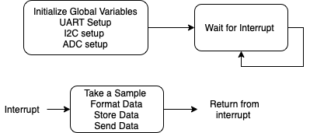
Software

Slide 10
Software cont.
Achieved | Not Achieved
Dynamic usage of USB flash drive. | Current error handling.
Master-Slave communication from Arduino to ESP. | Battery monitoring capabilities.
Wi-Fi accessed and utilizing HTTPS for data transfer. | Power saving options and emergency deep sleep mode.
Interrupt driven sampling. | Hot swapping digital sensors.
Local logging of data onto USB flash drive. | Temporary data buffers for larger payload transmissions during logging.
Wireless logging of data onto Google Sheets. | Wireless connection timeout and connection self-diagnosis.
Successfully read from at least 3 Digital and/or Analog sensors. | Security measures such as encryption, GPS, or psychical trauma.

Slide 11
What Went Wrong…
Pitfalls:
Due to ordering delays and disruption, the team did not receive air quality sensors and the use of other sensor types to simulate data was required.
The original plan was for a deployable server to encompass the Web & Wireless subsystem. Difficulties in making the code run and easy to use resulted in the idea being discarded.
Time management was poor with features taking much longer to implement than anticipated.
Faulty components were received and required repurchasing.
Authorization to use an Internet Access Point on campus took six weeks longer than expected.

Slide 12
Experimentation
Microcontroller
Data is able to be written at 64 KB/s and read at 169 KB/s
Flash storage storage needs at most 4 ms to access.
Communications
Max throughput is 132,600 KB/s at 1000 KB payload size
Reliable connection distance from Internet access point is 70 ft.
Interface
The Sharp 2Y0A21 distance sensor was connected to the interface and the voltage was read from the ADC at varying distances between 10 - 80 cm.
Power
Measured an average current draw for the system of 228 mA
Using solar panel extends operational time to 524 hours

Slide 13
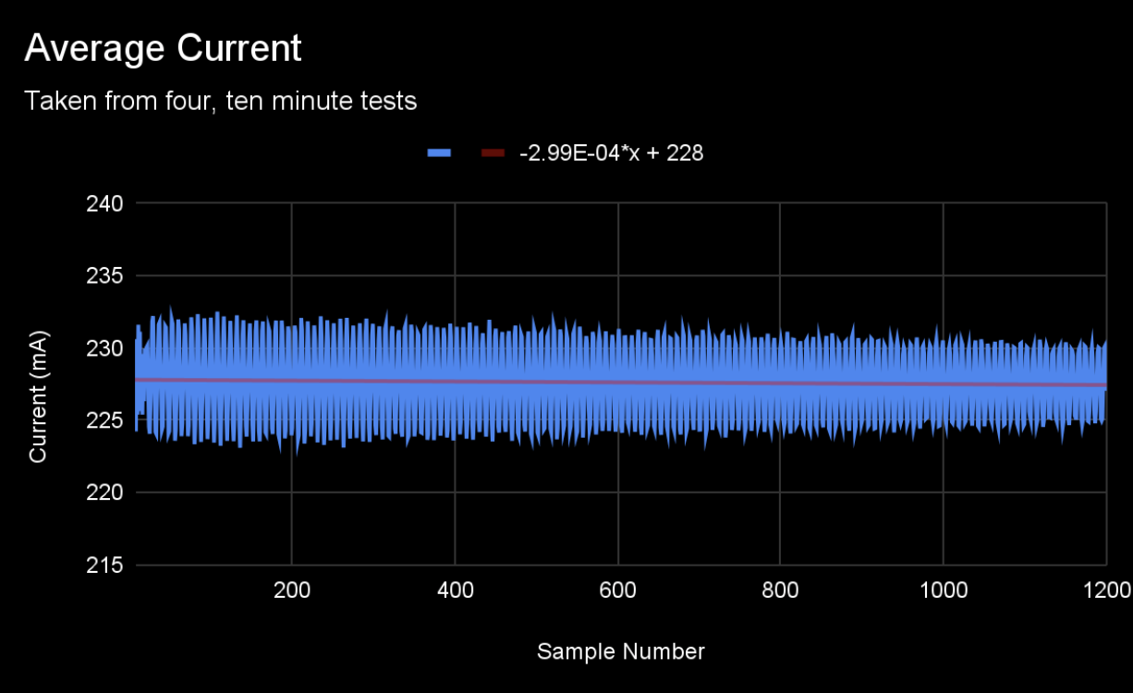
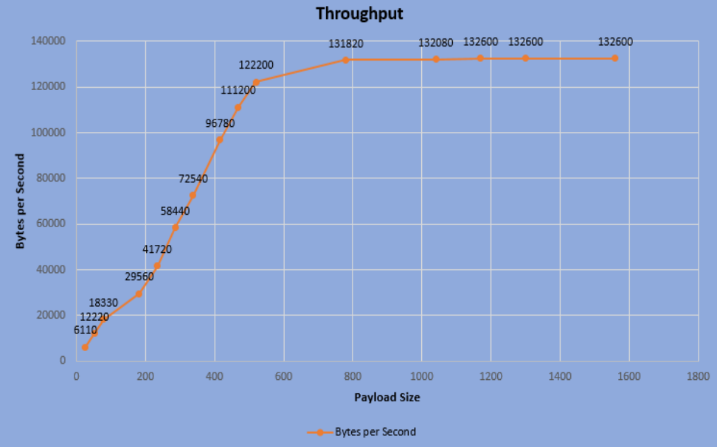
Experimentation cont.

Slide 14
Budget
Options | Major components | Total
1 | Solar, Battery, Wi-Fi, USB | $77.38
2 | Solar, Battery, 4G, USB | $181.18
3 | Mains, Wi-Fi, USB | $89.37
4 | Mains, 4G, USB | $146.18
5 | Mains, USB | $73.39
Note: All options not enumerated

Slide 15
Lessons Learned
Take deadlines more seriously
Fully explore and research all available options before you make final decisions
Better communication between team members
Better communication between supervisors and customers.
More accountability between team members
Scheduled group work times

Slide 16
References
National Fire Protection Association, International Fire Safety Protocol Institute, “National Electrical Code,” https://www.nfpa.org/codes-and-standards/all-codes-and-standards/list-of-codes-and-standards/detail?code=70
The National Institute for Occupational Safety and Health (NIOSH) “Indoor Environmental Quality” https://www.cdc.gov/niosh/topics/indoorenv/hvac.html
Rainford Solutions “Ingress Protection Rating” https://rainfordsolutions.com/products/ingress-protection-ip-rated-enclosures/ip-enclosure-ratings-standards-explained/#:~:text=IP34,water%20spray%20from%20any%20direction
National Fire Protection Association “Standard for Electrical Safety in the Workplace” https://www.nfpa.org/codes-and-standards/all-codes-and-standards/list-of-codes-and-standards/detail?code=70E
International Business Machine Corporation (IBM), “Socket Programming,” https://www.ibm.com/docs/en/i/7.1?topic=communications-socket-programming
IEEE 802 “IEEE 802.11TM WIRELESS LOCAL AREA NETWORKS” https://www.ieee802.org/11/

