Slide 1
VIDSCAPE
Unleashing AI for personalized video discoveries and interaction.

Slide 2

CONTENT
1.Introduction
2.Interface of Vidscape
3.Video Transcription and Interaction
4.Using AI to help with Video interaction
5.Personalization
5.Business model
6.Conclusion

Slide 3
The Team :
Aryan chopra
Joshua Daniel
Nikunj
Chirag
Sujeeth Kompela

Slide 4
Introduction
1
In modern day and age, with rise in Audiovisual content, information overload is rampant
Especially with regard to study videos, too much information is given to users, without proper interaction to understand discussed concepts and problems

Slide 5
VIDSCAPE
your interactive viewing service
1
Uses multiple streaming and video sites to deliver an diverse repository of information for our users
Uses AI to create an interactive atmosphere in video viewing with our users.
Further improvements in the interface which can lead to cross-website video collection
Creates a unique and novel way to help improve both online audiovisual learning and research

Slide 6
Interface
Vidscrape is present in both application and web form
Application :
Includes sign-in and user based features, such as bookmarked and playlists
Has direct video website interface, with chat console present
Multiple video websites present (YouTube,Twitch,Udemy,etc.)
Figma link: https://www.figma.com/file/J8CEKLYQr4rRf4L0VAzegO/Untitled?type=design&node-id=0%3A1&t=w7K6d2rGT3dXEDp1-1
Website :
Includes sign-in and user based features, such as bookmarked and playlists
Has URL reader, with subsequent video and chat console
Multiple video websites readable (YouTube,Twitch,Udemy,etc.)
Figma link : https://www.figma.com/file/J8CEKLYQr4rRf4L0VAzegO/Untitled?type=design&node-id=0%3A1&t=w7K6d2rGT3dXEDp1-1
Further improvements in the interface which can lead to cross-website video collection
2

Slide 7
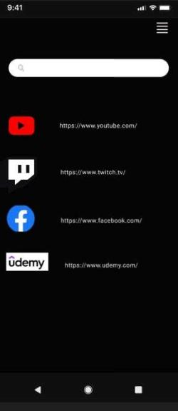
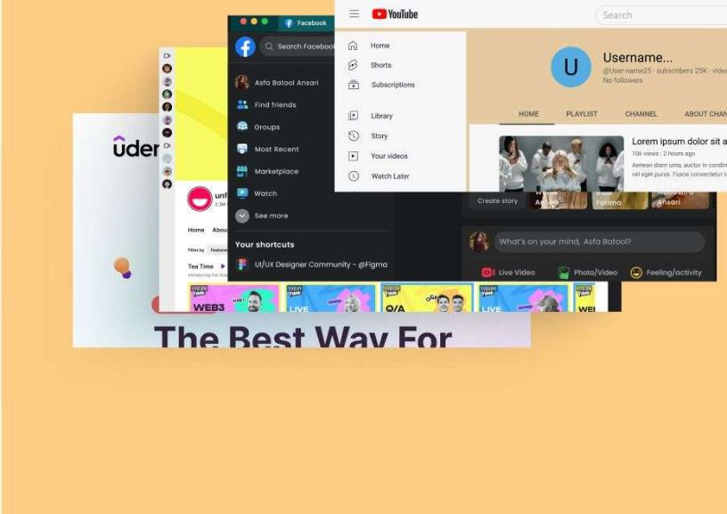
Application
Website
Vidscape Application showing multiple gateway into websites, with url reader
Website showing multiple links to video websites, as well as url reader and user profile

Slide 8
Video Transcription and Interaction
3
The method we use to collect video data is simple, and unique :
Audio Transcription
Using python, we can do transcription extraction on youtube
We then implement extracted transcript onto GPT

Slide 9
Using AI to help with Video interaction
4
Automation in information
The method we use to collect video data is simple, and unique :
Audio Transcription
Using python, we can do transcription extraction on youtube
We then implement extracted transcript onto GPT
Github repo : https://github.com/JoshuaF4/vidscape1

Slide 10
How it works
01
Video input
User inputs given video, either through viewing through application,
Or pasting the video url into the website
02
Transcript Scraping
Using the given link , by either app or web, the website scrapes off the transcript found within the video and redirects it to a GPT as data.
03
AI interaction
Now, from the given data , we can ask any question regarding the video, and the GPT answers, creating an interactive session based around the video

Slide 11
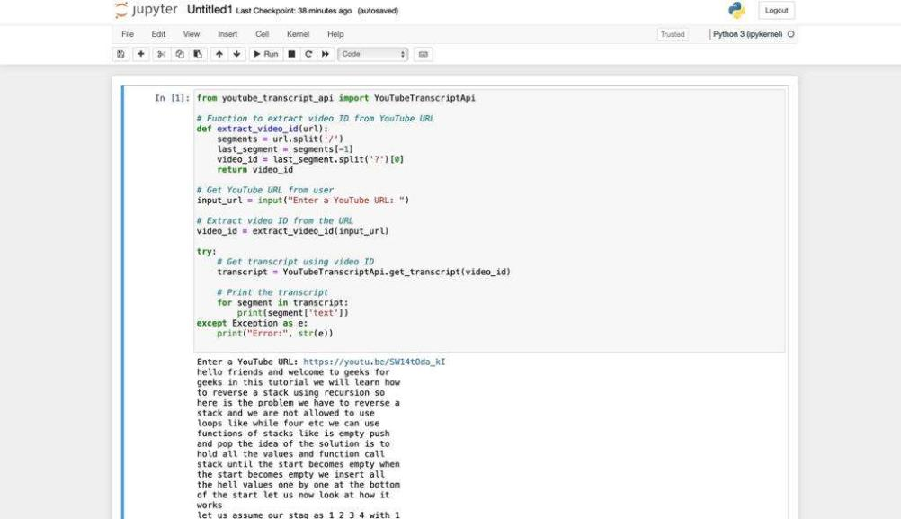
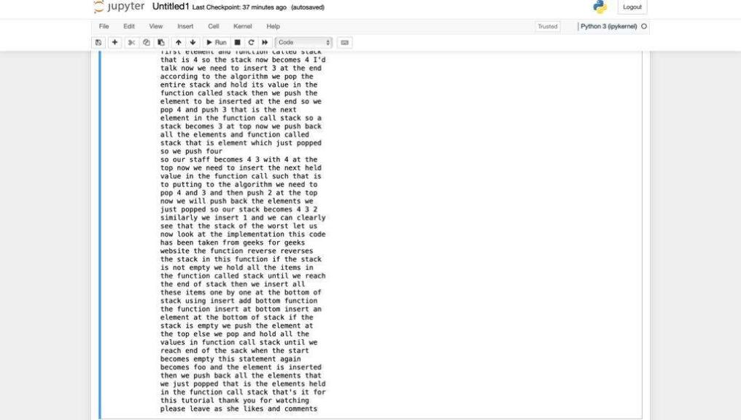
Transcription extraction
AI interaction
Vidscape code for extracting transcript in youtube video
Using ChatGPT fot interaction with user with respect to video on basis of transcript
(given question : how to use pop in stack recursion

Slide 12
Business Model
5
Subscriptions
Here, select features present within the premium subscription plan will be available for a limited amount use for a certain sum,
Eg : 10 bookmarked questions for 300$
Microtransactions
Using blog
Here, select features present within the premium subscription plan will be available for a limited amount use for a certain sum,
Eg : 10 bookmarked questions for 300$

Slide 13
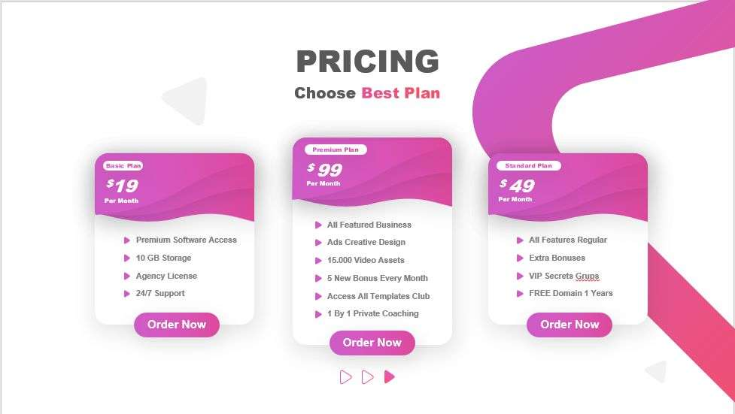
Template for pricing display
This method works for both subscription as well as microtransaction viewing

Slide 14
Conclusion
6
In modern day and age, with rise in Audiovisual content, information overload is rampant
With Vidscape , we hope to make easy information access which is muddled in videos, making it easier for all to be able to both learn and research

Slide 15
THANK YOU

