Slide 1
CSCI 1302
Programming Principles II
Mr. Joshua Farara
Notes:
If this PowerPoint presentation contains mathematical equations, you may need to check that your computer has the following installed:
1) MathType Plugin
2) Math Player (free versions available)
3) NVDA Reader (free versions available)
Slides in this presentation contain hyperlinks. JAWS users should be able to get a list of links by using INSERT+F7

Slide 2
Attendance Verification
Take attendance quiz in Folio
Students who do not complete will be
dropped from course
CLOSES Friday August 25th
Notes:
If this PowerPoint presentation contains mathematical equations, you may need to check that your computer has the following installed:
1) MathType Plugin
2) Math Player (free versions available)
3) NVDA Reader (free versions available)
Slides in this presentation contain hyperlinks. JAWS users should be able to get a list of links by using INSERT+F7

Slide 3
Agenda
Folio
Syllabus
Tentative schedule
Pearson Revel
Gradescope
  Labs
  Programming Assignments
  Exams
Eclipse

Slide 4
Pearson
Link from Folio through the link.
14 Day Trial Available
E-Book, Revel Assignments
Notes:
If this PowerPoint presentation contains mathematical equations, you may need to check that your computer has the following installed:
1) MathType Plugin
2) Math Player (free versions available)
3) NVDA Reader (free versions available)
Slides in this presentation contain hyperlinks. JAWS users should be able to get a list of links by using INSERT+F7

Slide 5
Gradescope
Link to Gradescope with Folio
View Assignments list
Labs and Programming Assignments
Notes:
If this PowerPoint presentation contains mathematical equations, you may need to check that your computer has the following installed:
1) MathType Plugin
2) Math Player (free versions available)
3) NVDA Reader (free versions available)
Slides in this presentation contain hyperlinks. JAWS users should be able to get a list of links by using INSERT+F7

Slide 6
Announcements
Lab1 - Friday, August 21st @2:30pm
Revel Exercises Ch. 9 due Sunday, Aug. 30th @ 11:59PM
Notes:
If this PowerPoint presentation contains mathematical equations, you may need to check that your computer has the following installed:
1) MathType Plugin
2) Math Player (free versions available)
3) NVDA Reader (free versions available)
Slides in this presentation contain hyperlinks. JAWS users should be able to get a list of links by using INSERT+F7

Slide 7
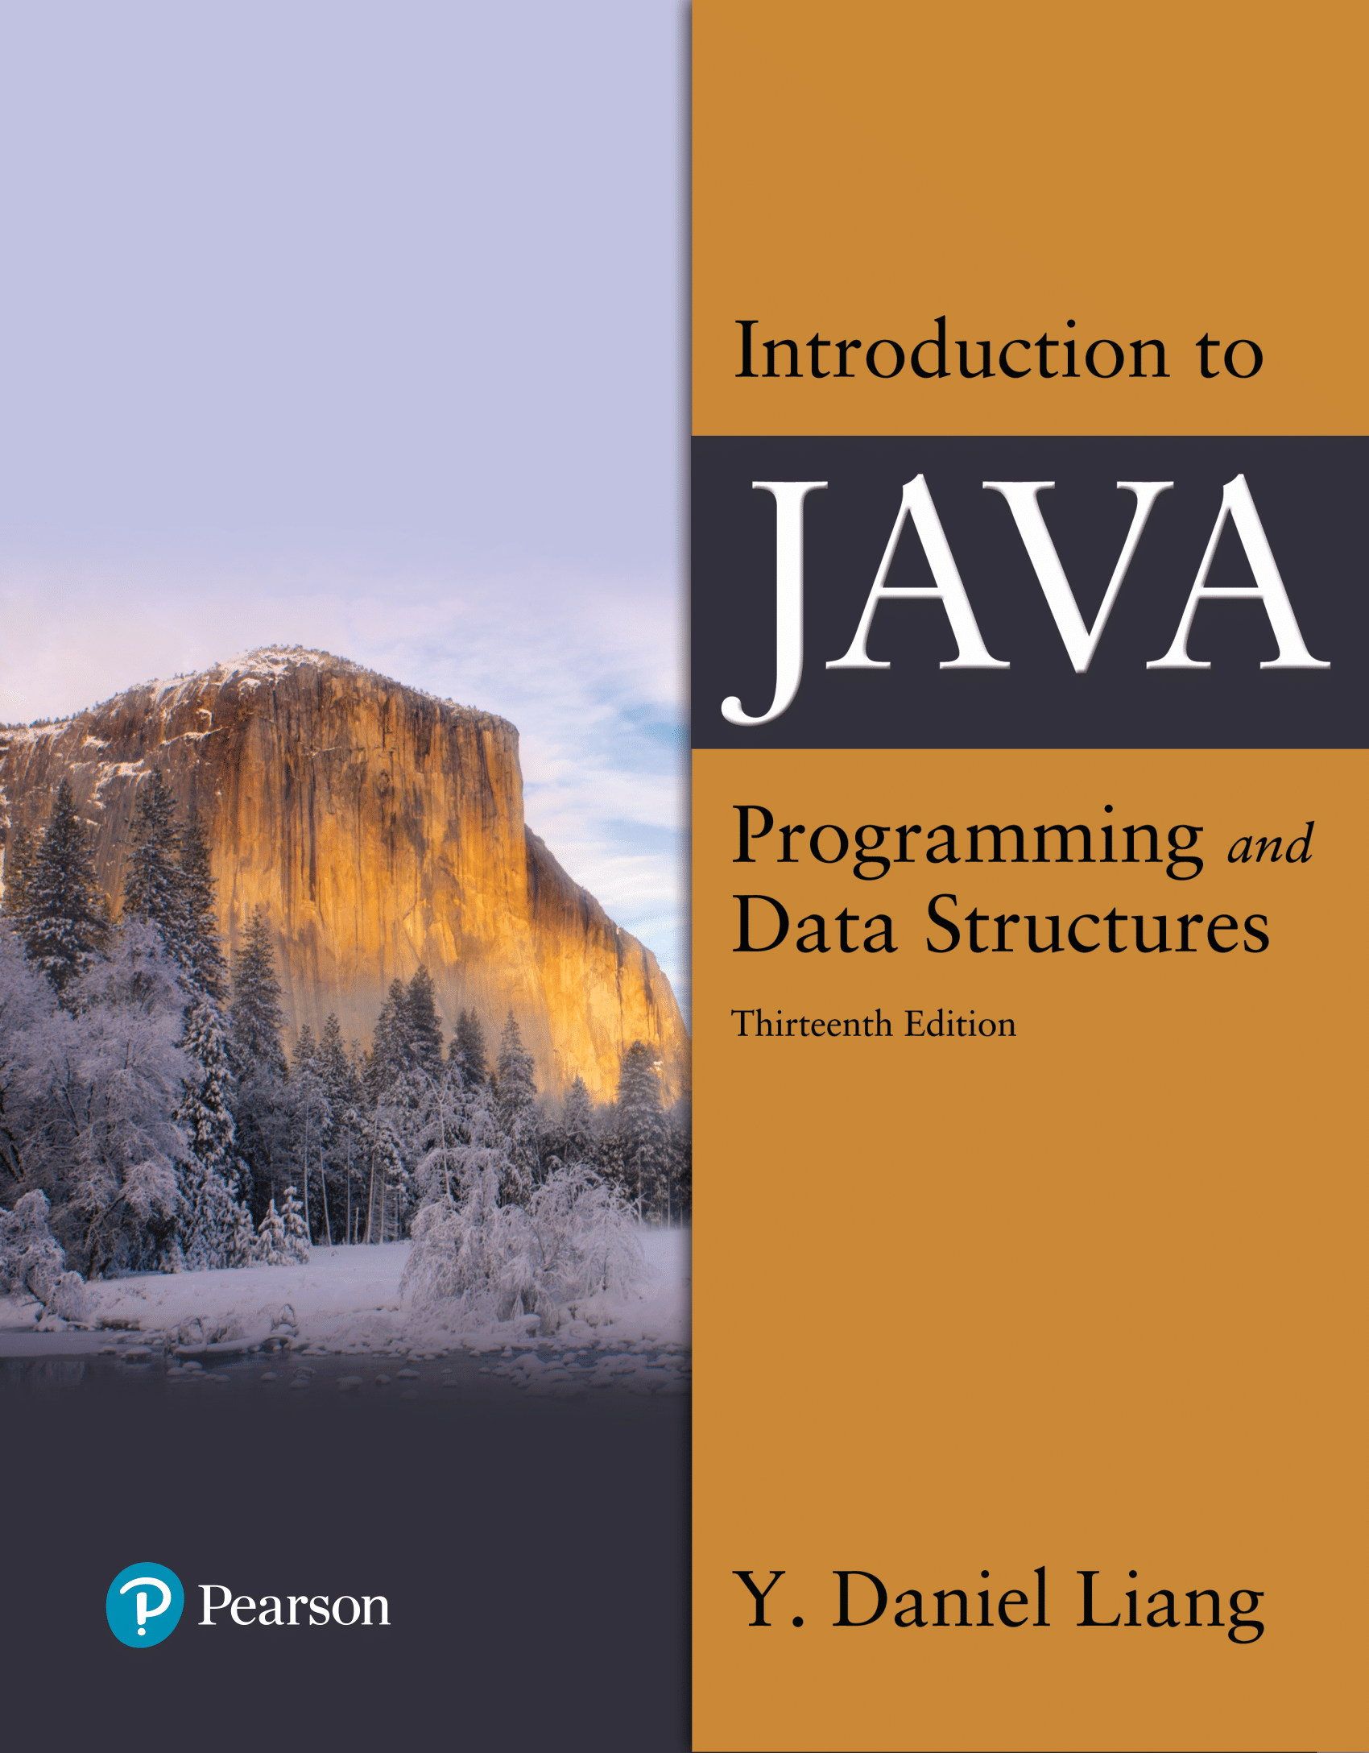

Introduction to Java Programming and Data Structures
Thirteenth Edition
Chapter 9
Objects and Classes
Copyright © 2024 Pearson Education, Inc. All Rights Reserved
Notes:
If this PowerPoint presentation contains mathematical equations, you may need to check that your computer has the following installed:
1) MathType Plugin
2) Math Player (free versions available)
3) NVDA Reader (free versions available)
Slides in this presentation contain hyperlinks. JAWS users should be able to get a list of links by using INSERT+F7

Slide 8
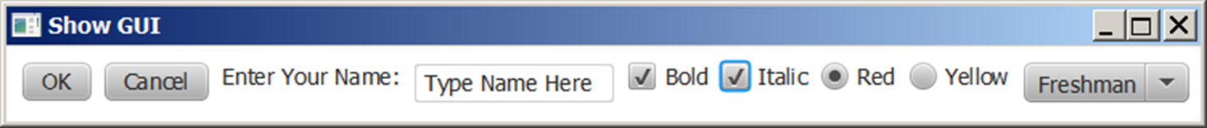
Motivations
After learning the preceding chapters, you are capable of solving many programming problems using selections, loops, methods, and arrays. However, these Java features are not sufficient for developing graphical user interfaces and large scale software systems. Suppose you want to develop a graphical user interface as shown below. How do you program it?

Slide 9
Objectives (1 of 2)
9.1 To describe objects and classes, and use classes to model objects (§9.2).
9.2 To use U M L graphical notation to describe classes and objects (§9.2).
9.3 To demonstrate how to define classes and create objects (§9.3).
9.4 To create objects using constructors (§9.4).
9.5 To define a reference variable using a reference type and access objects via object reference variables (§9.5).
9.6 To access an object’s data and methods using the object member access operator (.) (§9.5.1).
9.7 To define data fields of reference types and assign default values for an object’s data fields (§9.5.2).
9.8 To distinguish between object reference variables and primitive data type variables (§9.5.3).

Slide 10
Objectives (2 of 2)
9.9 To use the Java library classes Date, Random, and Point2D (§9.6).
9.10 To distinguish between instance and static variables and methods (§9.7).
9.11 To define private data fields with appropriate get and set methods (§9.8).
9.12 To encapsulate data fields to make classes easy to maintain (§9.9).
9.13 To develop methods with object arguments and differentiate between primitive-type arguments and object-type arguments (§9.10).
9.14 To store and process objects in arrays (§9.11).
9.15 To create immutable objects from immutable classes to protect the contents of objects (§9.12).
9.16 To determine the scope of variables in the context of a class (§9.13).
9.17 To use the keyword this to refer to the calling object itself (§9.14).

Slide 11
Objects
What are Objects?

Slide 12
O O Programming Concepts
Object-oriented programming (O O P) involves programming using objects. An object represents an entity in the real world that can be distinctly identified. For example, a student, a desk, a circle, a button, and even a loan can all be viewed as objects. An object has a unique identity, state, and behaviors. The state of an object consists of a set of data fields (also known as properties) with their current values. The behavior of an object is defined by a set of methods.

Slide 13
Objects
What would be the state or the data fields of these objects? The properties that characterize them
Student
Desk
Rectangle
Circle
We will observe the circle as an object
Notes:
Student – name, age, year level, major, credit hours completed
Desk – Height, legs, surface texture, electronic
Rectangle – Length and width, stroke color, fill color
Circle – Radius, Stroke color, fill color

Slide 14
Objects
An object has both a state and behavior. The state defines the object, and the behavior defines what the object does.
Notes:
Class name, Circle.
Data fields. Radius is, blank space. Methods, getArea.
Three objects of the Circle class are as follows.
Circle object 1. Data fields, radius is 10.
Circle object 2. Data fields, radius is 25.
Circle object 3. Data fields, radius is 125.

Slide 15
Circle
Shared Characteristics
All have:
Radius
Notes:
Class name, Circle.
Data fields. Radius is, blank space. Methods, getArea.
Three objects of the Circle class are as follows.
Circle object 1. Data fields, radius is 10.
Circle object 2. Data fields, radius is 25.
Circle object 3. Data fields, radius is 125.

Slide 16
Circle - Coding
class Circle {
/** Default radius of this circle */
double radius = 1.0;
}

Slide 17
Circle
Shared Characteristics
All have:
Radius
Shared Behaviors
Calculate diameter
Calculate circumference
Calculate area

Slide 18
Classes (1 of 2)
Classes are constructs that define objects of the same type. A Java class uses variables to define data fields and methods to define behaviors. Additionally, a class provides a special type of methods, known as constructors, which are invoked to construct objects from the class.

Slide 19
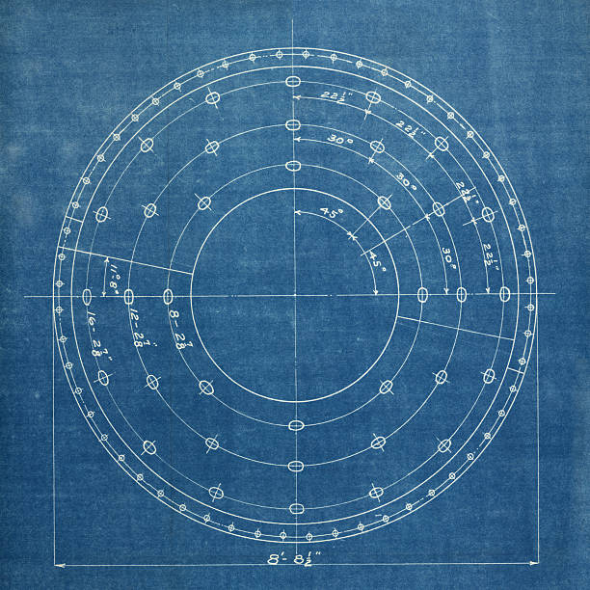
Classes (2 of 3)
A class is a blueprint or template that defines data fields and methods.

Slide 20
Classes (3 of 3)
Notes:
Line 1, indicates class Circle open braces. Line 2, slash forward address address The radius of this circle address slash forward. Line 3, double radius equal to 1.0 semicolon. The line 3 is Data field. Line 4, Blank. Line 5, slash forward address address Construct a circle object address slash forward. Line 6, Circle open parenthesis close parenthesis open braces. Line 7, close braces. Line 8, Blank. Line 9, slash forward address address Construct a circle object address slash forward. Line 10, Circle open parenthesis double new Radius close parenthesis open braces. Line 11, radius equal to new Radius semicolon. Line 12, close braces. The lines 5, 6, 7, 8, 9, 10, 11 and 12 are Constructors. Line 13, Blank. Line 14, slash forward address address Return the area of this circle address slash forward. Line 15, double get Area open parenthesis close parenthesis open braces. The line 15 is Method. Line 16, return radius address radius address 3 period 14159 semicolon. Line 17, close braces. Line 18, close braces.

Slide 21
Announcements
Lab2 - Friday, August 28th @2:30pm
Revel Exercises Ch. 9 due Sunday, Aug. 30th @ 11:59PM

Slide 22
U M L Class Diagram
Unified Modeling Language (UML)
Allows programmers to succinctly document and describe an object in detail, its data and behavior.
Notes:
Row 1 shows the Class name (circle). Row 2 shows the Data fields (radius: double). Row 3 shows the computer coding of 6 lines for Constructors and methods. Line 1, indicates Circle open parenthesis close parenthesis. Line 2, Circle open parenthesis new Radius colon double close parenthesis. Line 3, g e t Area open parenthesis close parenthesis colon double. Line 4, g e t Perimeter open parenthesis close parenthesis colon double. Line 5, s e t Radius open parenthesis new Radius colon. Line 6, double close parenthesis colon void. A left side text box shows the 2 rows of UML notation for objects. Row 1 shows the Circle 1 colon Circle. Row 2 shows the radius equal to 1.0. A middle text box shows the 2 rows of UML notation for objects. Row 1 shows the Circle 2 colon Circle. Row 2 shows the radius equal to 25. A right side text box shows the 2 rows of UML notation for objects. Row 1 shows the Circle 3 colon Circle. Row 2 shows the radius equal to 125.

Slide 23
Let’s Build an Example (1 of 4)
Let’s Start With UML Diagrams:
Structure:
ClassName
Data Fields
Constructors and Methods

Slide 24
Let’s Build an Example (2 of 4)
Examples:
  Student
  Give Me An Example
  Triangle

Slide 25
Let’s Build an Example (3 of 4)
Examples:
  Student
  Give Me An Example
  Triangle

Slide 26
Let’s Build an Example (4 of 4)
Examples:
  Student
  Give Me An Example
  Triangle

Slide 27
Constructors (1 of 2)
Circle() { // default or no-arg constructor
}
Circle(double newRadius) { // convenience constructor
radius = newRadius;
}
Constructors are a special kind of methods that are invoked to construct objects.

Slide 28
Constructors (2 of 2)
An object is an instance of a class.
You can create many instances of a class. This is referred to as instantiation.
The terms object and instance are often interchangeable.

Slide 29
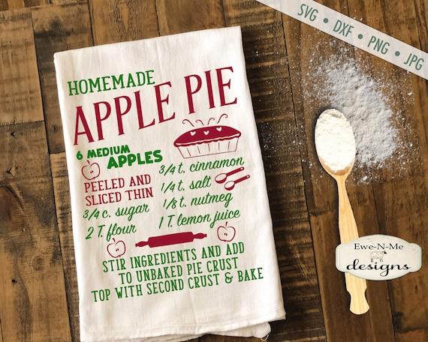
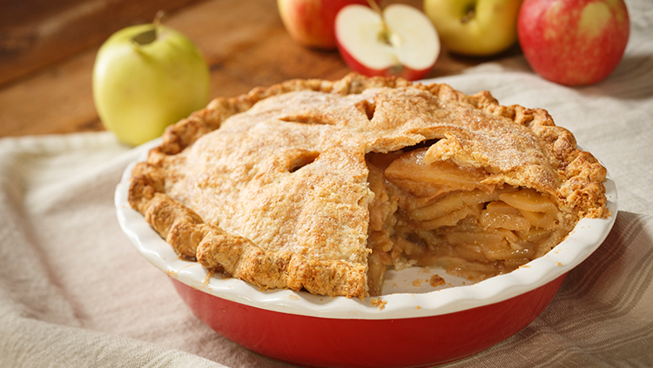
Constructors (2 of 2)
The relationship between classes and objects is like that of:
Apple pie recipe
Class
Apple pies
Object

Slide 30
Constructors (2 of 2)
A constructor with no parameters is referred to as a no-arg constructor.
Constructors must have the same name as the class itself.
Constructors do not have a return type—not even void.
Constructors are invoked using the new operator when an object is created. Constructors play the role of initializing objects.

Slide 31
Creating Objects Using Constructors
new ClassName();
Example:
new Circle();
new Circle(5.0);

Slide 32
Default Constructor
A class may be defined without constructors. In this case, a no-arg constructor with an empty body is implicitly defined in the class. This constructor, called a default constructor, is provided automatically only if no constructors are explicitly defined in the class.

Slide 33
Declaring Object Reference Variables
To reference an object, assign the object to a reference variable.
To declare a reference variable, use the syntax:
ClassName objectRefVar;
Example:
Circle myCircle;

Slide 34
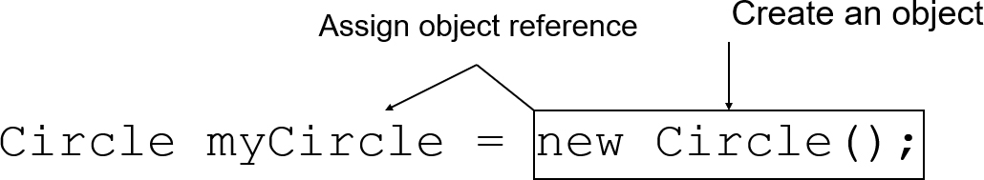
Declaring/Creating Objects in a Single Step
ClassName objectRefVar = new ClassName();
Example:
You have done this before:
Scanner input = new Scanner(System.in);
Notes:
An arrow from right side to the left side of = is labeled, assign object reference. The object new circle left parenthesis right parenthesis semi colon is labeled, create an object.

Slide 35
Example: Defining Classes and Creating Objects
Objective: Demonstrate creating objects, accessing data, and using methods.
TestSimpleCircle
Notes:
TestSimpleCircle: https://liveexample.pearsoncmg.com/html/TestSimpleCircle.html
We have a class created here, we can have multiple classes within one class file
Create 3 Circles
The first circle uses the default constructor
The next two use convenience constructors
And for each circle we are going to print the area to the console

Slide 36
Creating Instances of Objects
Circle circ = new Circle();
• Happens in another program or a main method
• Circle.java needs to be in same directory
• Instantiates an object – creates a
single instance of that object
• Each instance has their own “copy” of
all data attributes and methods from
the class definition
Notes:
TestSimpleCircle: https://liveexample.pearsoncmg.com/html/TestSimpleCircle.html

Slide 37
Creating Instances of Objects
Circle circ = new Circle();
• Because we are dealing with a single
instance of that object:
• Data attributes are also called instance
variables
• Methods are also called instance methods
• Collectively (data+methods) called
instance members
Notes:
TestSimpleCircle: https://liveexample.pearsoncmg.com/html/TestSimpleCircle.html

Slide 38
Creating Instances of Objects
Circle circ = new Circle();
• Declare:
Circle circ;
• Instantiate:
circ = new Circle();
• Declare & Instantiate:
Circle circ = new Circle();
Notes:
TestSimpleCircle: https://liveexample.pearsoncmg.com/html/TestSimpleCircle.html

Slide 39
Activity
Download CircleSimple.zip and get Circle.java into a project
• Create a CircleTest.java file with a main method to test instantiation
•Instantiate two Circles with the new keyword (make sure they have different names)
Notes:
TestSimpleCircle: https://liveexample.pearsoncmg.com/html/TestSimpleCircle.html

Slide 40
What you’ll see…
class Circle {
/** The radius of this circle */
double radius = 1.0;
/** Return the diameter of this circle */
double getDiameter() {
return 2.0 * radius;
}
/** Return the area of this circle */
double getArea() {
return radius * radius * Math.PI;
}
/** Return the perimeter (circumference) of this circle */
double getPerimeter() {
return 2.0 * radius * Math.PI;
}
}
Notes:
TestSimpleCircle: https://liveexample.pearsoncmg.com/html/TestSimpleCircle.html

Slide 41
Accessing Object’s Members
Referencing the object’s data:
objectRefVar.data
e.g., myCircle.radius
Invoking the object’s method:
objectRefVar.methodName(arguments)
e.g., myCircle.getArea()

Slide 42
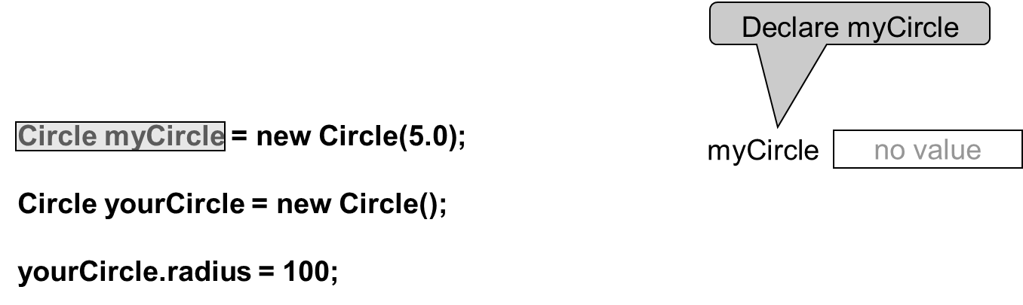
Trace Code (1 of 7)
Notes:
Line 1, indicates Circle my Circle equal to new Circle open parenthesis 5.0 close parenthesis semicolon. Line 2, blank. Line 3, Circle my Circle equal to new Circle open parenthesis close parenthesis semicolon.ine 4, blank. Line 5, your Circle period radius equal to hundred semicolon. A right side text box shows the 1 Row for Declare my Circle i.e. no value.

Slide 43
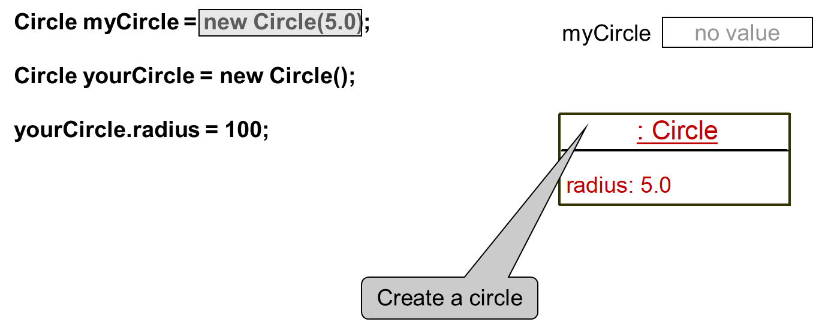
Trace Code (2 of 7)
Notes:
The computer code consists 5 lines. Line 1, indicates Circle my Circle equal to new Circle open parenthesis 5.0 close parenthesis semicolon. Line 2, blank. Line 3, Circle my Circle equal to new Circle open parenthesis close parenthesis semicolon. Line 4, blank. Line 5, your Circle period radius equal to hundred semicolon.
A right upward side text box shows 1 Row for my Circle i.e. no value. A right downward side text box shows the 2 rows. Row 1 shows the Create a circle by coding i.e. colon Circle. Row 2 shows the radius colon 5.0.

Slide 44
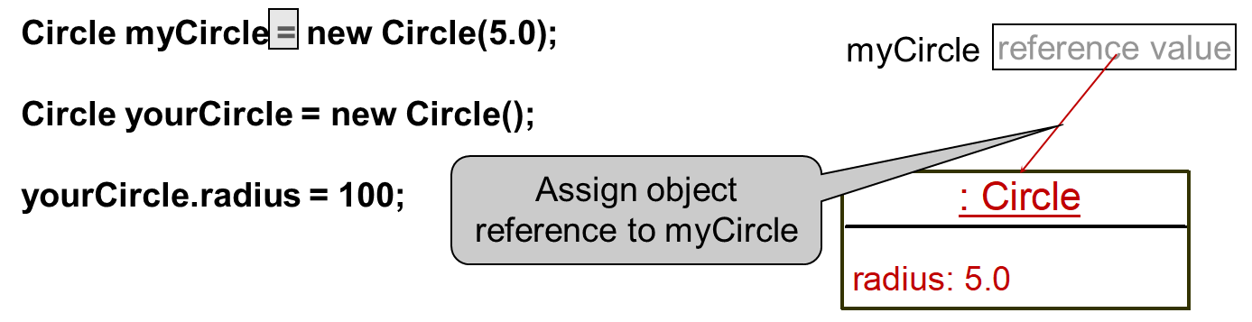
Trace Code (3 of 7)
Notes:
The computer code consists 5 lines. Line 1, indicates Circle my Circle equal to new Circle open parenthesis 5.0 close parenthesis semicolon. Line 2, blank. Line 3, Circle my Circle equal to new Circle open parenthesis close parenthesis semicolon. Line 4, blank. Line 5, your Circle period radius equal to hundred semicolon.
A right upward side text box shows 1 Row for my Circle i.e. reference value and it also shows an arrow of red colour which is for Assign object reference to my Circle. A right downward side text box shows the 2 rows. Row 1 shows the Create a circle by coding i.e. colon Circle. Row 2 shows the radius colon 5.0.

Slide 45
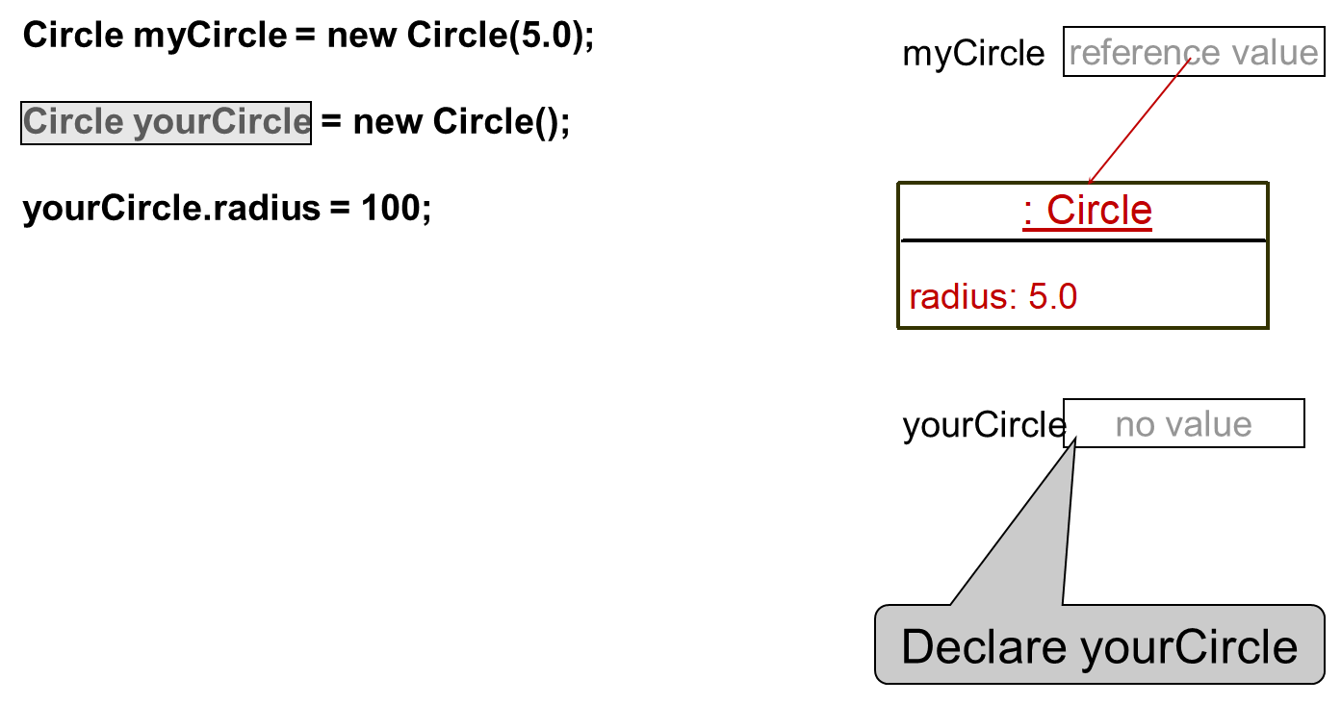
Trace Code (4 of 7)
Notes:
The computer code consists 5 lines. Line 1, indicates Circle my Circle equal to new Circle open parenthesis 5.0 close parenthesis semicolon. Line 2, blank. Line 3, Circle my Circle equal to new Circle open parenthesis close parenthesis semicolon.ine 4, blank. Line 5, your Circle period radius equal to hundred semicolon. A right upward side text box shows 1 Row for my Circle i.e. reference value and it also shows an arrow of red colour. A rightward middle text box shows the 2 rows. Row 1 shows the Create a circle by coding i.e. colon Circle. Row 2 shows the radius colon 5.0. A right downward side text box shows the 1 row for Declare your Circle i.e. no value.

Slide 46
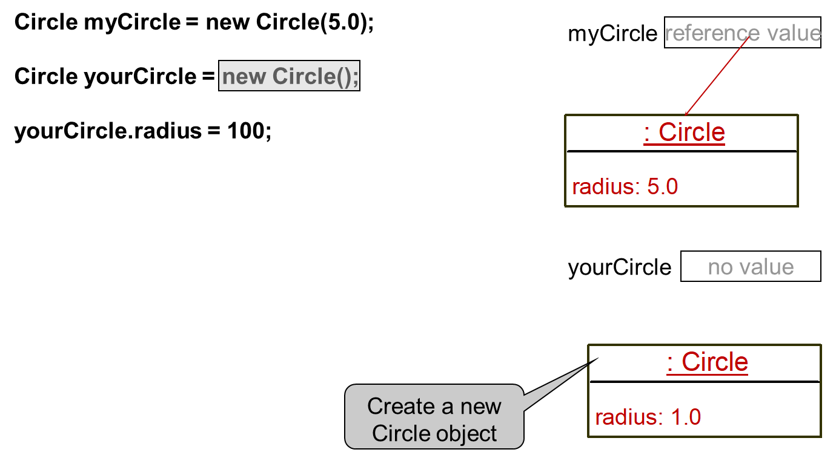
Trace Code (5 of 7)
Notes:
The computer code consists 5 lines. Line 1, indicates Circle my Circle equal to new Circle open parenthesis 5.0 close parenthesis semicolon. Line 2, blank. Line 3, Circle my Circle equal to new Circle open parenthesis close parenthesis semicolon line 4, blank. Line 5, your Circle period radius equal to hundred semicolon. A right upward side text box shows 1 Row for my Circle i.e. reference value and it also shows the red color arrow. A rightward middle text box shows the 2 rows. Row 1 shows the Create a circle by coding i.e. colon Circle. Row 2 shows the radius colon 5.0.A rightward middle side text box shows the 1 row for Declare your Circle i.e. no value. A right downward text box shows 2 rows for Create a new Circle object. Row 1 shows the colon Circle. Row 2 shows the radius colon 1.0.

Slide 47
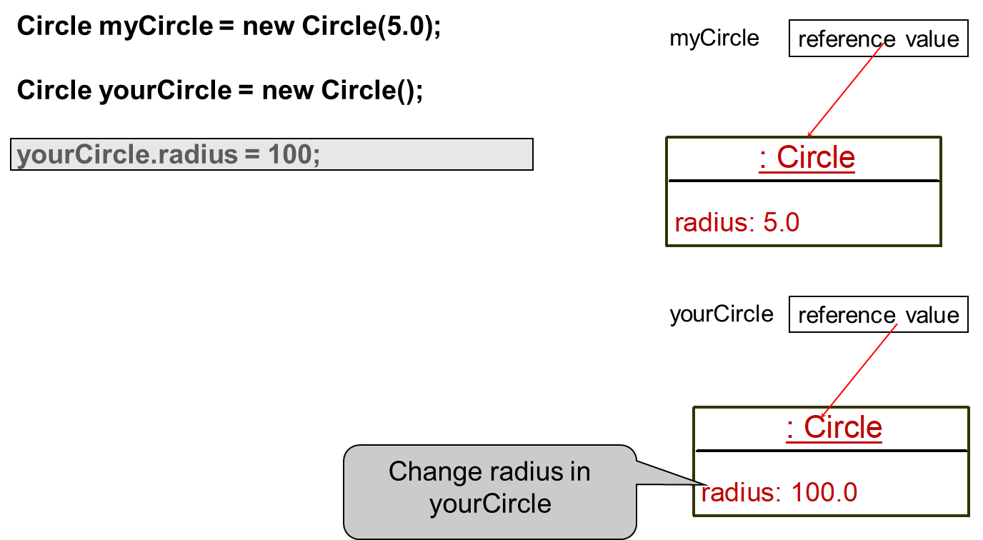
Trace Code (7 of 7)
Notes:
The computer code consists 5 lines. Line 1, indicates Circle my Circle equal to new Circle open parenthesis 5.0 close parenthesis semicolon. Line 2, blank. Line 3, Circle my Circle equal to new Circle open parenthesis close parenthesis semicolon.ine 4, blank. Line 5, your Circle period radius equal to hundred semicolon. A right upward side text box shows 1 Row for my Circle i.e. reference value and it also shows the red colour arrow. A rightward middle text box shows the 2 rows. Row 1 shows the Create a circle by coding i.e. colon Circle. Row 2 shows the radius colon 5.0.A rightward middle side text box shows the 1 row for Declare your Circle i.e. reference value and it also shows the red color arrow. A right downward text box shows 2 rows for Create a new Circle object. Row 1 shows the colon Circle. Row 2 shows the Change radius in your circle by coding i.e. radius colon 100.0.

Slide 48
Caution
Recall that you use
Math.methodName(arguments) (e.g., Math.pow(3, 2.5))
to invoke a method in the Math class. Can you invoke getArea() using SimpleCircle.getArea()? The answer is no. All the methods used before this chapter are static methods, which are defined using the static keyword. However, getArea() is non-static. It must be invoked from an object using
objectRefVar.methodName(arguments) (e.g., myCircle.getArea()).
More explanations will be given in the section on “Static Variables, Constants, and Methods.”

Slide 49
Reference Data Fields
The data fields can be of reference types. For example, the following Student class contains a data field name of the String type.
public class Student {
String name; // name has default value null
int age; // age has default value 0
boolean isScienceMajor; // isScienceMajor has default value false
char gender; // c has default value '\u0000’
}

Slide 50
The Null Value
If a data field of a reference type does not reference any object, the data field holds a special literal value, null.

Slide 51
Default Value for a Data Field
The default value of a data field is null for a reference type, 0 for a numeric type, false for a boolean type, and '\u0000' for a char type. However, Java assigns no default value to a local variable inside a method.
public class Test {
public static void main(String[] args) {
Student student = new Student();
System.out.println("name? " + student.name);
System.out.println("age? " + student.age);
System.out.println("isScienceMajor? " + student.isScienceMajor);
System.out.println("gender? " + student.gender);
}
}

Slide 52
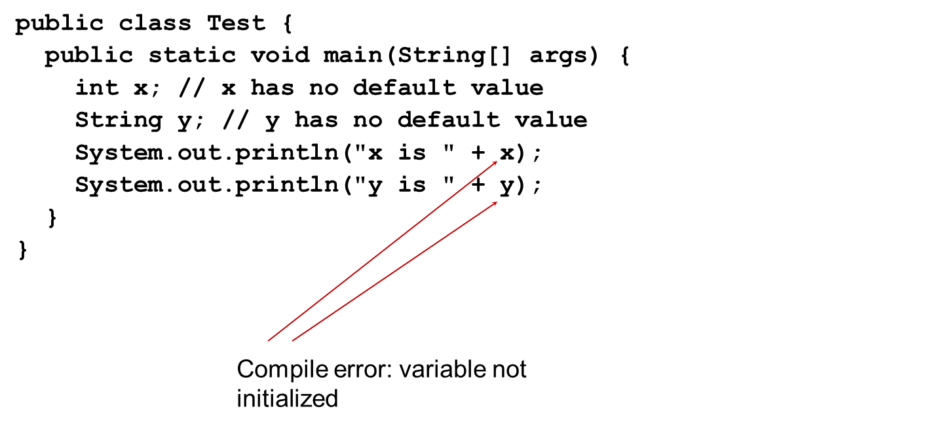
Example (1 of 3)
Java assigns no default value to a local variable inside a method.
Notes:
The computer code consists 8 lines. Line 1, public class Test open braces. Line 2, public static void main open parenthesis String open braces close braces args close parenthesis open braces. Line 3, i n t x semicolon slash forward slash forward x has no default value. Line 4, String y semicolon slash forward slash forward y has no default value. Line 5, System period out period print ln open parenthesis double quote x is double quote plus x close parenthesis semicolon. Line 6, System period out period print ln open parenthesis double quote y is double quote plus y close parenthesis semicolon. Line 7, close braces. Line 8, close braces.

Slide 53
Differences between Variables of Primitive Data Types and Object Types

Slide 54
Copying Variables of Primitive Data Types and Object Types

Slide 55
Garbage Collection (1 of 2)
As shown in the previous figure, after the assignment statement c1 = c2, c1 points to the same object referenced by c2. The object previously referenced by c1 is no longer referenced. This object is known as garbage. Garbage is automatically collected by J V M.

Slide 56
Garbage Collection (2 of 2)
TIP: If you know that an object is no longer needed, you can explicitly assign null to a reference variable for the object. The J V M will automatically collect the space if the object is not referenced by any variable.

Slide 57
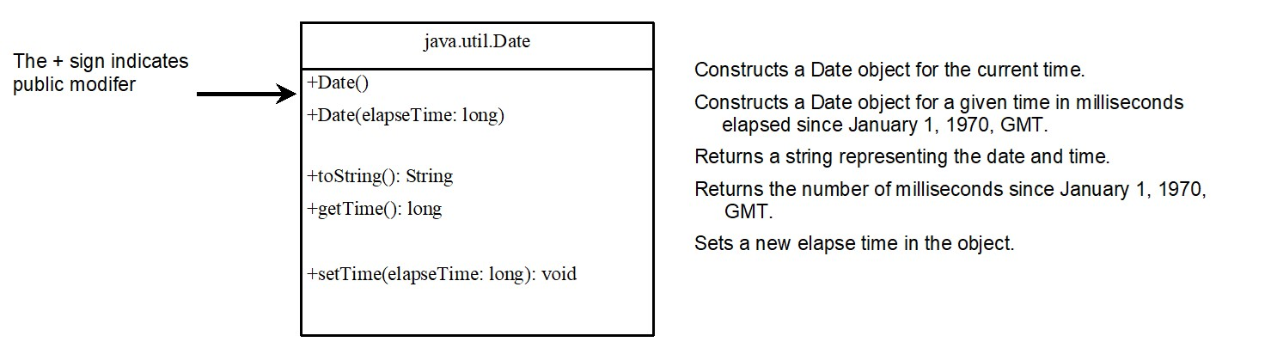
The Date Class
Java provides a system-independent encapsulation of date and time in the java.util.Date class. You can use the Date class to create an instance for the current date and time and use its toString method to return the date and time as a string.
Notes:
Row 1, shows the coding i.e. java period util period Date. Row 2, shows the coding for 5 lines and the plus sign shows the public modifier. Line 1, plus Date open parenthesis close parenthesis. Line 2, plus Date open parenthesis elapse Time colon long close parenthesis. Line 3, plus to String open parenthesis close parenthesis colon String. Line 4, plus g e t Time open parenthesis close parenthesis colon long. Line 5, plus s e t Time open parenthesis elapse Time colon long close parenthesis colon void.

Slide 58
The Date Class Example
For example, the following code
java.util.Date date = new java.util.Date();
System.out.println(date.toString());
displays a string like Sun Mar 09 13:50:19 EST 2003.

Slide 59
The Random Class
You have used Math.random() to obtain a random double value between 0.0 and 1.0 (excluding 1.0). A more useful random number generator is provided in the java.util.Random class.
Notes:
Constructs a Random object with the current time as its seed.
+Random left parenthesis seed, long right parenthesis. Constructs a Random object with a specified seed.
+nextint left parenthesis right parenthesis colon int. Returns a random int value.
+nextInt left parenthesis n, int right parenthesis colon int. Returns a random int value between 0 and n (exclusive).
+nextLong left parenthesis right parenthesis, colon long. Returns a random long value.
+nextDouble left parenthesis right parenthesis colon double. Returns a random double value between 0.0 and 1.0 (exclusive).
+nextFloat left parenthesis right parenthesis colon float. Returns a random float value between 0.0F and 1.0F (exclusive).
+nextBoolean left parenthesis right parenthesis colon Boolean. Returns a random Boolean value.

Slide 60
The Random Class Example
If two Random objects have the same seed, they will generate identical sequences of numbers. For example, the following code creates two Random objects with the same seed 3.
Random random1 = new Random(3);
System.out.print("From random1: ");
for (int i = 0; i < 10; i++)
System.out.print(random1.nextInt(1000) + " ");
Random random2 = new Random(3);
System.out.print("\nFrom random2: ");
for (int i = 0; i < 10; i++)
System.out.print(random2.nextInt(1000) + " ");
From random1: 734 660 210 581 128 202 549 564 459 961
From random2: 734 660 210 581 128 202 549 564 459 961
Notes:
A Random object does not generate numbers randomly. Instead, it uses a mathematical algorithm (a pseudorandom number generator) that produces a sequence of numbers based on an initial value called a seed.
Same seed → same starting point → same calculations → same sequence of numbers.
the key is that they’re different but repeatable.

Slide 61
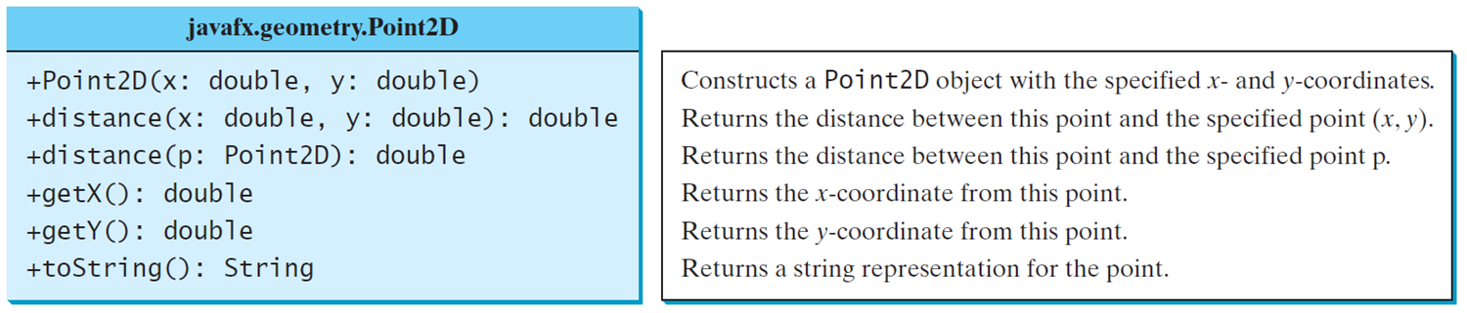
The Point2D Class
Java A P I has a conveninent Point2D class in the javafx.geometry package for representing a point in a two-dimensional plane.
TestPoint2D
Notes:
The box is divided in 2 rows. Row 1, shows the coding i.e. java fx period geometry period Point 2D. Row 2, consists 6 lines for computer coding. Line 1, indicates plus Point 2D open parenthesis x colon double comma y colon double close parenthesis. Line 2, plus distance open parenthesis x colon double comma y colon double close parenthesis colon double. Line 3, plus distance open parenthesis p colon Point 2D close parenthesis colon double. Line 4, plus g e t X open parenthesis close parenthesis colon double. Line 5, plus g e t Y open parenthesis close parenthesis colon double. Line 6, plus to String open parenthesis close parenthesis colon String.
TestPoint2D: https://liveexample.pearsoncmg.com/html/TestPoint2D.html

Slide 62
Instance Variables, and Methods
Instance variables belong to a specific instance.
Instance methods are invoked by an instance of the class.

Slide 63
Visibility Modifiers and Accessor/Mutator Methods (1 of )
By default, the class, variable, or method can be accessed by any class in the same package.
public
The class, data, or method is visible to any class in any package.
private
The data or methods can be accessed only by the declaring class.
The get and set methods are used to read and modify private properties.

Slide 64
Visibility Modifiers and Accessor/Mutator Methods (2 of 3)
public – everything can see/use
private – only instance members can
see/use
default – anything in package can access
  aka package private or package access, no keyword
protected – similar to default, more
use cases/rules later

Slide 65
Visibility Modifiers and Accessor/Mutator Methods (3 of 3)
Rules of thumb:
Constructors – almost always public
unless access has to be restricted (Math
library is best example)
Data members – almost always private;
will only be accessed through methods
  Error checking, setting boundaries,
  preventing unwanted changes, etc

Slide 66
Visibility Modifiers - UML
(+)Public – everything can see/use
(-)Private – only instance members can
see/use
(nothing specified) Default– anything in
package can access – package private or
package access
(#)Protected – similar to default, more
use cases/rules late

Slide 67
Accessor/Mutator
Accessor (get) and mutator (set)
methods give us public access to private
data members
/** Set a new radius for this circle (mutator) */
public void setRadius(double newRadius) {
radius = newRadius;
}
/** Return the radius of this circle (accessor)*/
public double getRadius() {
return radius;
}

Slide 68
Accessor/Mutator
Provides ability to control access to data
members and provide error checking
/** Set new radius for this circle (mutator) */
public void setRadius(double newRadius) {
if (newRadius > 0) {
radius = newRadius;
} else {
radius = 0;
}
}

Slide 69
Accessor/Mutator
Tertiary (ternary) operator often used
for brevity
/** Set new radius for this circle (mutator) */
public void setRadius(double newRadius) {
if (newRadius > 0) {
radius = newRadius;
} else {
radius = 0;
}
}

Slide 70
Accessor/Mutator
Must use mutators for error checking
/** Default, no-arg constructor */
public Circle() {
setRadius(1.0);
numOfCircles++;
}
/** Conv. constructor to set radius */
public Circle(double newRadius) {
setRadius(newRadius);
numOfCircles++;
}

Slide 71
Accessor/Mutator
By Java convention, all private data
members receive an accessor and a
mutator
Can exclude accessor/mutator based
on desired access of that data
member

Slide 72
Why should data fields be private?
Obfuscating or “hiding” data fields is
called data field encapsulation
Done to protect data and avoid
tampering with an object’s internal state
Makes code easy to maintain, do not
have to modify all clients, just class
definition since they use your provided
access points (accessors/mutators

Slide 73
Why Data Fields Should Be Private?
To protect data.
To make code easy to maintain.

Slide 74
Why Data Fields Should Be Private?
Can a negative radius circle exist?
Can you set one if you have direct access?
Can the class prevent it (or even detect it)
when a client has direct access?
Just a few reasons why Java classes provide
accessor/mutator methods for data
members
Consistency is another, Java developers (and
other OO devs) expect it

Slide 75
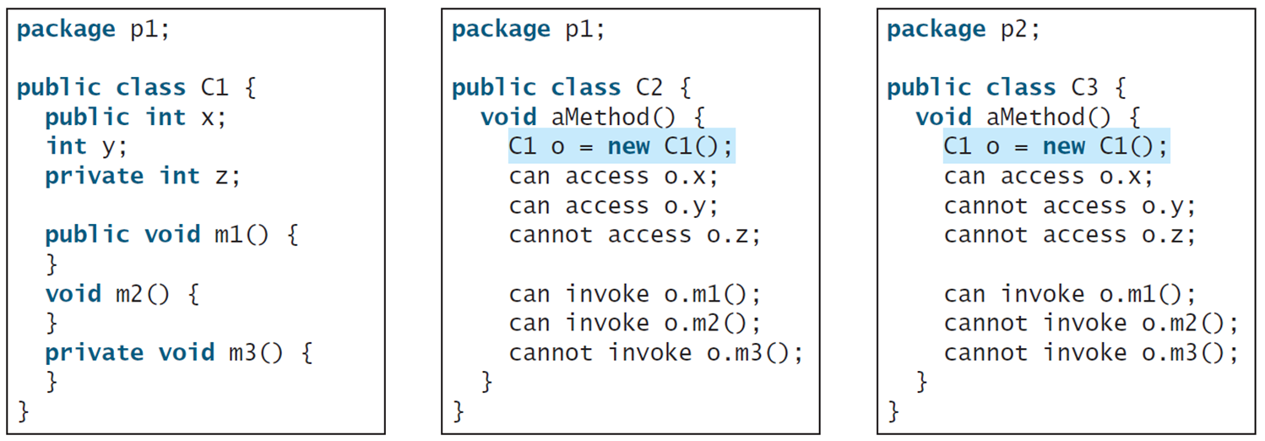
Visibility Modifiers and Accessor/Mutator Methods
The private modifier restricts access to within a class, the default modifier restricts access to within a package, and the public modifier enables unrestricted access.
Notes:
The computer code consists 14 lines. Line 1, indicates package p1 semicolon. Line 2, blank. Line 3, public class C1 open braces. Line 4, public i n t x semicolon. Line 5, i n t y semicolon. Line 6, private i n t z semicolon. Line 7, blank. Line 8, public void m1 open parenthesis close parenthesis open braces. Line 9, close braces. Line 10, void m2 open parenthesis close parenthesis open braces. Line 11, close braces. Line 12, private void m3 open parenthesis close parenthesis open braces. Line 13, close braces. Line 14, close braces. A middle text box shows the coding for the default modifier restricts access to within a package. The computer code consists 14 lines. Line 1, indicates package p1 semicolon. Line 2, blank. Line 3, public class C2 open braces. Line 4, void a Method open parenthesis close parenthesis open braces. Line 5, C1 o equal to new C1 open parenthesis close parenthesis semicolon. Line 6, can access o period x semicolon. Line 7, can access o period y semicolon. Line 8, cannot access o period z semicolon. Line 9, blank. Line 10, can invoke o period m1 open parenthesis close parenthesis semicolon. Line 11, can invoke o period m2 open parenthesis close parenthesis semicolon. Line 12, cannot invoke o period m3 open parenthesis close parenthesis semicolon. Line 13, close braces. Line 14, close braces. A right side text box shows the coding for the public modifier enables unrestricted access. It consists 14 lines. Line 1, indicates package p2 semicolon. Line 2, blank. Line 3, public class C3 open braces. Line 4, void a Method open parenthesis close parenthesis open braces. Line 5, C1 o equal to new C1 open parenthesis close parenthesis semicolon. Line 6, can access 0 period x semicolon. Line 7, cannot access 0 period y semicolon. Line 8, cannot access 0 period z semicolon. Line 9, blank. Line 10, can invoke o period m1 open parenthesis close parenthesis semicolon. Line 11, cannot invoke 0 period m2 open parenthesis close parenthesis semicolon. Line 12, cannot invoke 0 period m3 open parenthesis close parenthesis semicolon. Line 13, close braces. Line 14, close braces.

Slide 76
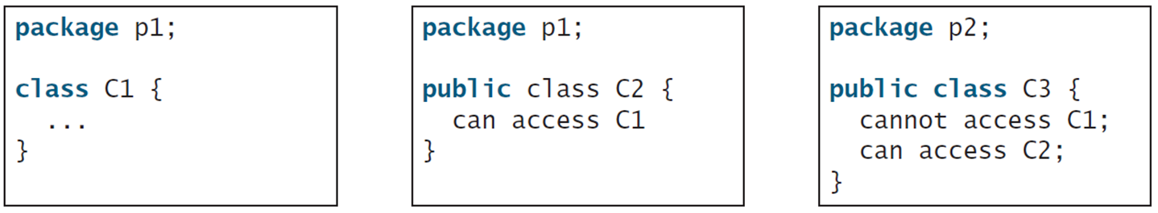
Visibility Modifiers and Accessor/Mutator Methods
The default modifier on a class restricts access to within a package, and the public modifier enables unrestricted access.
Notes:
The box contains 5 lines. Line 1, indicates package p1 semicolon. Line 2, blank. Line 3, class C1 open braces. Line 4, dot dot dot. Line 5, close braces. A middle text box also shows the default modifier on a class restricts access to within a package. The box contains 5 lines. Line 1, indicates package p1 semicolon. Line 2, blank. Line 3, public class C2 open braces. Line 4, can access C1. Line 5, close braces. A left side text box shows the public modifier enables unrestricted access. The box contains 6 lines. Line 1, package p2 semicolon. Line 2, blank. Line 3, public class C3 open braces. Line 4, cannot access C1 semicolon. Line 5, can access C2 semicolon. Line 6, close braces.

Slide 77
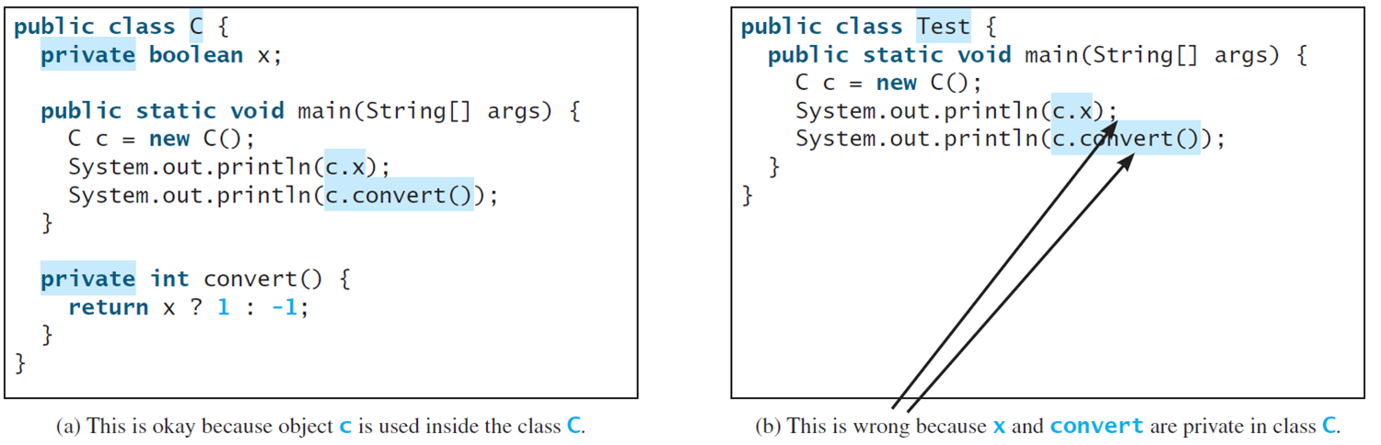
Note
An object cannot access its private members, as shown in (b). It is OK, however, if the object is declared in its own class, as shown in (a).
Notes:
The box contains 13 lines. Line 1, indicates public class C open braces. Line 2, private Boolean x semicolon. Line 3, blank. Line 4, public static void main open parenthesis String open braces close braces args close parenthesis open braces. Line 5, C c equal to new C open parenthesis close parenthesis semicolon. Line 6, System period out period print ln open parenthesis c period x close parenthesis semicolon. Line 7, System period out period print ln open parenthesis c period convert open parenthesis close parenthesis close parenthesis semicolon. Line 8, close braces. Line 9, blank. Line 10, private i n t convert open parenthesis close parenthesis open braces. Line 11, return x question mark 1 colon minus 1 semicolon. Line 12, close braces. Line 13, close braces. A text box (b) shows an object cannot access its private members. This box contains 7 lines. Line 1, indicates public class Test open braces. Line 2, public static void main open parenthesis String open parenthesis close parenthesis args close parenthesis open braces. Line 3, C c equal to new C open parenthesis close parenthesis semicolon. Line 4, System period out period print ln open parenthesis c period x close parenthesis semicolon. Line 5, System period out period print ln open parenthesis c period convert open parenthesis close parenthesis close parenthesis semicolon. Line 6, close braces. Line 7, close braces.

Slide 78
Monday & Wednesday 8/31-9/4 Announcements
Continue to work through Pearson Revel Ch.9
Lab03 Friday, 2:30PM in rm. 3210
PAssign01 due Sep. 4th @ 2:30PM
Ch.10 Available – due Sep. 11th @ 2:30PM
Exam1 next week Friday(Chs 9 and 10), Sep 11^{th @2:30PM}

Slide 79
Static Variables, Constants, and Methods (1 of 3)
Static variables are shared by all the instances of the class.
Static methods are not tied to a specific object.
Static constants are final variables shared by all the instances of the class.

Slide 80
Static Variables, Constants, and Methods (2 of 3)
To declare static variables, constants, and methods, use the static modifier.

Slide 81
Why Data Fields Should Be Private?
Need to control access for things we
do not want users/clients changing
  e.g. numberOfCircles should only be set
  by constructors
How can we view value?
  Provide a method to view value

Slide 82
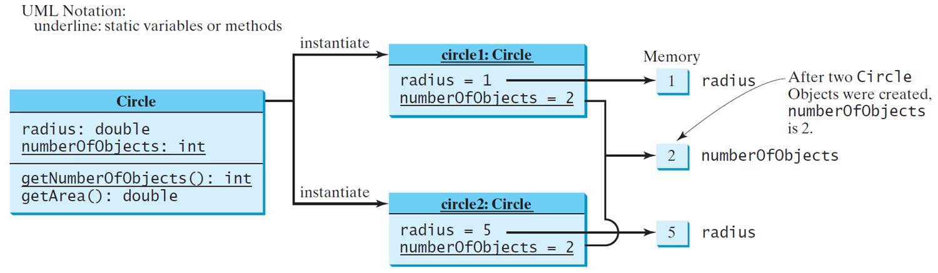
Static Variables, Constants, and Methods (3 of 3)

Slide 83
Example of Using Instance and Class Variables and Method
Objective: Demonstrate the roles of instance and class variables and their uses. This example adds a class variable numberOfObjects to track the number of Circle objects created.
CircleWithStaticMembers
TestCircleWithStaticMembers
Notes:
CircleWithStaticMembers: https://liveexample.pearsoncmg.com/html/CircleWithStaticMembers.html
TestCircleWithStaticMembers: https://liveexample.pearsoncmg.com/html/TestCircleWithStaticMembers.html

Slide 84
Example of Data Field Encapsulation
CircleWithPrivateDataFields
TestCircleWithPrivateDataFields
Notes:
This box has divided in 3 rows. Row 1 indicates Circle. Row 2 shows the coding for 2 lines and minus sign indicates private modifier. Line 1, minus radius colon double. Line 2, minus number of Objects colon i n t. Row 3, also shows the coding and it consists 6 lines. Line 1, plus Circle open parenthesis close parenthesis. Line 2, plus Circle open parenthesis radius colon double close parenthesis. Line 3, plus g e t Radius open parenthesis close parenthesis colon double. Line 4, plus s e t Radius open parenthesis radius colon double close parenthesis colon void. Line 5, plus g e t Number Of Objects open parenthesis close parenthesis colon i n t. Line 6, plus g e t Area open parenthesis close parenthesis colon double.
CircleWithPrivateDataFields: https://liveexample.pearsoncmg.com/html/CircleWithPrivateDataFields.html
TestCircleWithPrivateDataFields: https://liveexample.pearsoncmg.com/html/TestCircleWithPrivateDataFields.html

Slide 85
Passing Objects to Methods (1 of 2)
Passing by value for primitive type value (the value is passed to the parameter)
Passing by value for reference type value (the value is the reference to the object)
TestPassObject
Notes:
TestPassObject: https://liveexample.pearsoncmg.com/html/TestPassObject.html

Slide 86
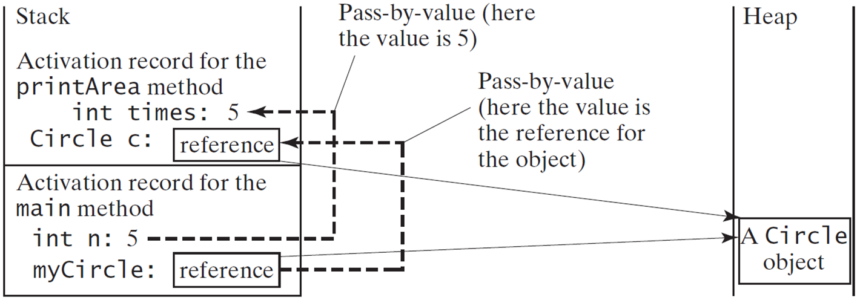
Passing Objects to Methods (2 of 2)
Notes:
Activation record for the main method. int n, 5. myCircle, reference.
An arrow from n, 5 to int times 5 is labeled, pass by value (here the value is 5). An arrow from reference in the activation record to reference in the stack is labeled, pass by value (here the value is the reference for the object).
The reference in both the sections lead to heap, a Circle object.

Slide 87
Array of Objects (1 of 3)
Circle[] circleArray = new Circle[10];
An array of objects is actually an array of reference variables. So invoking circleArray[1].getArea() involves two levels of referencing as shown in the next figure. circleArray references to the entire array. circleArray[1] references to a Circle object.

Slide 88
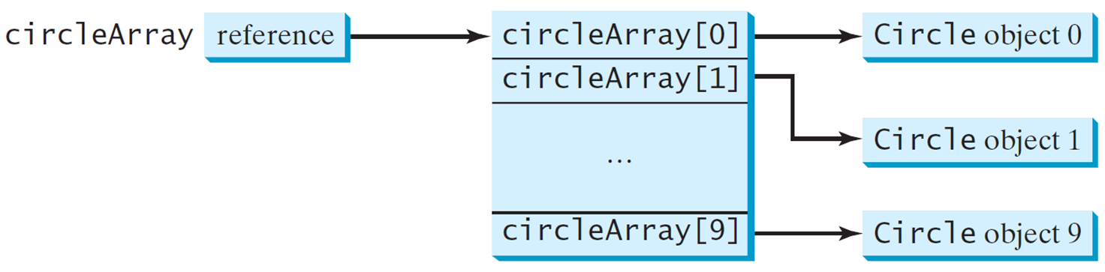
Array of Objects (2 of 3)
Circle[] circleArray = new Circle[10];

Slide 89
Array of Objects (3 of 3)
Summarizing the areas of the circles
TotalArea

Slide 90
Immutable Objects and Classes
If the contents of an object cannot be changed once the object is created, the object is called an immutable object and its class is called an immutable class. If you delete the set method in the Circle class in Listing 8.10, the class would be immutable because radius is private and cannot be changed without a set method.
A class with all private data fields and without mutators is not necessarily immutable. For example, the following class Student has all private data fields and no mutators, but it is mutable.

Slide 91
What Class is Immutable?
For a class to be immutable, it must:
mark all data fields private
provide no mutator methods
provide no accessor methods that would return a reference to a mutable data field object.
  This can be done due to
  aggregation/composition as studied in
  Chapter 10 and shown next slide

Slide 92
Example
public class Student {
private int id;
private BirthDate birthDate;
public Student(int ssn,
int year, int month, int day) {
id = ssn;
birthDate = new BirthDate(year, month, day);
}
public int getId() {
return id;
}
public BirthDate getBirthDate() {
return birthDate;
}
}
public class BirthDate {
private int year;
private int month;
private int day;
public BirthDate(int newYear,
int newMonth, int newDay) {
year = newYear;
month = newMonth;
day = newDay;
}
public void setYear(int newYear) {
year = newYear;
}
}

Slide 93
Example
public class Test {
public static void main(String[] args) {
Student student = new Student(111223333, 1970, 5, 3);
BirthDate date = student.getBirthDate(); date.setYear(2010); // Now the student birth year is changed!
}
}

Slide 94
Scope of Variables
The scope of instance and static variables is the entire class. They can be declared anywhere inside a class.
The scope of a local variable starts from its declaration and continues to the end of the block that contains the variable. A local variable must be initialized explicitly before it can be used.

Slide 95
Scope of Variables - lifetime of vars
The scope of instance and static variables is the entire class. They can be declared anywhere inside a class.
The scope of a local variable starts from its declaration and continues to the end of the block that contains the variable. Local variables take precedence in methods
Because of this, some instance variables can be hidden:
/** Set a new radius for this circle */
public void setRadius(double radius) {
radius = radius;
}
Notes:
Can make you ask which radius is being referred to here. The reference variable or the actual data member

Slide 96
Scope of Variables - lifetime of vars
We have been using different
variable/parameter names to avoid:
/** Set a new radius for this circle */
public void setRadius(double newRadius) {
radius = newRadius;
}
Notes:
Naming conflicts

Slide 97
The this Keyword
The this keyword is the name of a reference that refers to an object itself. One common use of the this keyword is reference a class’s hidden data fields.
/** Set a new radius for this circle */
public void setRadius(double radius) {
this.radius = radius;
}

Slide 98
The this Keyword
Can omit if no name conflicts:
/** Return the radius of this circle */
public double getRadius() {
return radius;
}

Slide 99
The this Keyword
Can error check inside mutator methods, but must USE them for it to be effective:
/** Set a new radius for this circle */
public void setRadius(double radius) {
if (radius >= 0) {
this.radius = radius;
} else {
this.radius = 0;
}
}

Slide 100
The this Keyword
Must use mutators for error checking
/** Default, no-arg constructor */
public Circle() {
setRadius(1.0);
numOfCircles++;
}
/** Conv. constructor to set radius */
public Circle(double newRadius) {
setRadius(newRadius);
numOfCircles++;
}

Slide 101
Activity - Person
Add code to your default no-arg constructor so that it sets default values for each data field using mutators
Modify each constructor to use mutators
In Person.java, use the this keyword to create
mutator methods for all data members within
the class
Add any missing accessors and run your test program

Slide 102
Activity - Person
Add code to your birthYear mutator to make sure the birthYear is not before 1910 or after 2022
If either of those values are returned, set the birthYear for the person to 2022
Test this error checking with your test program

Slide 103
The this Keyword
Another common use of the this keyword to enable a constructor to invoke another constructor of the same class.

Slide 104
The this Keyword
Can also call other constructors using this keyword for consistency:
/** Construct a circle object, default no-argument */
public Circle() {
setRadius(1.0);
Circle.numberofCircles++;
}
/** Construct a circle object and set the radius */
public Circle(double radius) {
this();
setRadius(radius);
}

Slide 105
The this Keyword
Must be first line in constructor:
/** Construct a circle object, default no-argument */
public Circle() {
setRadius(1.0);
Circle.numberofCircles++;
}
/** Construct circle object, set radius on constr. */
public Circle(double radius) {
this();
setRadius(newRadius);
}

Slide 106
The this Keyword
Can interchange which calls which:
/** Construct a circle object, default no-argument */
public Circle() {
this(1.0); // set default of 1
}
/** Constr. circle object and set radius on constr. */
public Circle(double radius) {
setRadius(newRadius);
Circle.numberofCircles++;
}

Slide 107
The this Keyword
Can error check inside mutator methods, but must USE them, even in constructors!
/** Construct a circle object, default no-argument */
public Circle() {
this(1.0); // set default of 1
}
/** Construct a circle object and set the radius */
public Circle(double radius) {
this.setRadius(radius);
Circle.numberofCircles++;
}

Slide 108
The this Keyword
Modify each constructor so that they call the default no-arg constructor using the this keyword
Modify the convenience constructors to then use mutator methods to set any parameters passed in
Add accessors for all data fields
Modify all methods to use mutators
Could also use accessors everywhere
Add a getInfo() method to Person that returns all information about the Person with descriptive text
Call this method in the test program

Slide 109
The this Keyword
Constructor this:
this();
this(param1, param2) - these match the parameter list of th associated constructor

Slide 110
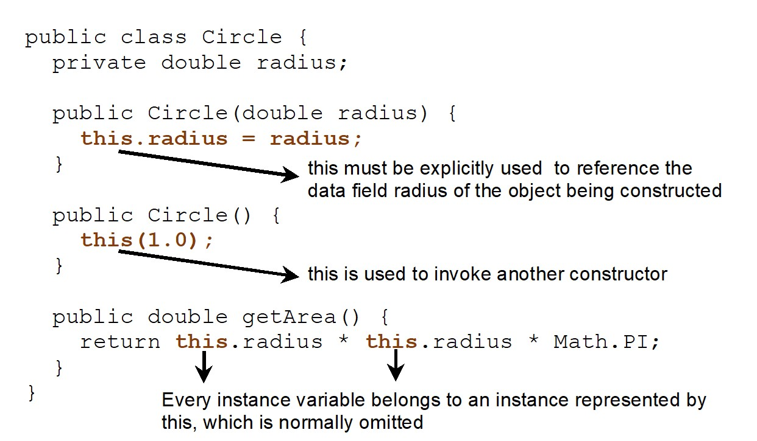
Calling Overloaded Constructor
Notes:
It consists 15 lines. Line 1, indicates public class Circle open braces. Line 2, private double radius semicolon. Line 3, blank. Line 4, public Circle open parenthesis double radius close parenthesis open braces. Line 5, t h i s period radius equal to radius semicolon where this must be explicitly used to reference the data field radius of the object being constructed. Line 6, close braces. Line 7, blank. Line 8, public Circle open parenthesis close parenthesis open braces. Line 9, t h i s open parenthesis 1 period 0 close parenthesis semicolon where this is used to invoke another constructor. Line 10, close braces. Line 11, public double g e t Area open parenthesis close parenthesis open braces. Line 12, return t h i s period radius address t h i s period radius address Math period PI semicolon where Every instance variable belongs to an instance represented by this, which is normally omitted. Line 13, close braces. Line 14, close braces.

Slide 111
Copyright
This work is protected by United States copyright laws and is provided solely for the use of instructors in teaching their courses and assessing student learning. Dissemination or sale of any part of this work (including on the World Wide Web) will destroy the integrity of the work and is not permitted. The work and materials from it should never be made available to students except by instructors using the accompanying text in their classes. All recipients of this work are expected to abide by these restrictions and to honor the intended pedagogical purposes and the needs of other instructors who rely on these materials.

