Slide 1

Semantic Information Management (SIM)
Controlling Complexity with a Central Information Hub
Securities Industry Middleware Council
October 28, 2003

Slide 2
Data Problems: Data Islands
Local syntax – unclear structure
Local semantics – unclear meaning
Unclear relationships
Cause discrepancies and confusion
Inconsistent usage
Cause $600 billion a year in losses for US businesses

Slide 3
Data Problems: Standards
Many systems designed with proprietary formats
Even where standards are defined, integration is needed

Slide 4
Messaging Standards
FIX, Swift, etc. : Standards wit some overlap, with strengths in different areas
Standards gradually converging:
FIX/FpML, Swift , ISO 15022/XML
Organizations need to integrate/migrate
  Proprietary approaches to standards
  Between overlapping standards
  Older to newer/converged standards

Slide 5
Real-Time Integration Standards
T+1, STP
Full integration between heterogeneous business partners
Need to formalize a full understanding of business processes and data assets
No human in-transaction “interpretation” is possible.

Slide 6
The Solution:
Semantic Information Management (SIM)

Slide 7
Vision
Semantic Information Management inspires the vision of a tomorrow where data carries universal business meaning
and may be found and used without regard to its physical format.

Slide 8
High Level Business Goals
The Transparent Enterprise
  Enterprise-wide on-demand information
  Information quality
  Traceability of information
  Adopt industry wide standards (FIX, FPML, Swift, ISO 15022/XML, etc.)
  Comply with regulations (T+1, STP, etg.)
The Real-Time Enterprise
Processes respond instantly to enterprise-wide and cross-enterprise information

Slide 9
Successful Implementations
SIM has been successfully applied at
MetLife
Department of Defense – Transportation Command
Fiat
Department of Defense – Logistics Agency
Avis
Boeing

Slide 10

Semantic Information Management (SIM)
Set up information architecture
Find/decommission redundant assets
Apply data policy
Information Resource Managers
Find/understand data
Data integration
Impact analysis
Information Technology Professionals
What information is available?
What does it mean?
How reliable is it?
Knowledge Workers
Active Services
Utilize the Semantic Information Architecture to actively support data users
Information Model:
Desired business vocabulary: entities, relationships and rules
Information Model/Ontology
(agreed IT model of business)
Customer
Individual
Customer
Business
Customer
Semantics:
Capture meaning of data structures by mapping to Information Model
Data Semantics
Metadata:
Catalog of data assets, their structures and usage
Metadata
(understand data environment)
Notes:
Metadata – documenting the environment
Roll out in stages – have done deployments as short as 2 weeks. Typically a few months for first domain.
They are already mapping point-to-point – this is a much more efficient approach to what they do already

Slide 11
SIM – Actively Solving the Pain
Business Agility
  Full understanding of environment
  Automatic integration (transform generation)
  Impact analysis
Information Quality
  Unambiguous data definitions
  Automatic consistency checking
  Systematic data cleansing
IT Productivity & Efficiency
  Identification and decommissioning of redundant assets
  Automatic code generation

Slide 12

Platform for SIM
Information Resource Managers
Chief Data Officers
Data Architects & Administrators
IT Professionals
Developers
DBAs
Knowledge Workers
Information Producers
Information Consumers
Application
Web Interface
Web Services Broker
Templates
Reports
Server
Data
Management
Features
Data
Quality
Features
Data
Integration
Features
Run-Time Interface
Metadata loading
Information Modeling
Semantic Mapping
Testing & Simulation
Data Administration
Governance & Policy
Asset Discovery
Impact Analysis
Schema Generation
Data Definition
Data Comparison
Data Cleansing
Defect Prevention
Transformation
Generation
Transformation
Planner
Query Generation
Administrator
Applications
Data Cleansing
ETL
EAI Broker
Repository
External
Repository
Information Model
Metamodel
Libraries
Metadata
Interface
Data Semantics
Data Storage
Asset
Metadata
Platform Versioning, Collaboration, Permissions, Configuration
Message
Format
Run-Time
Metadata
Semantic Information Management
© Unicorn Solutions Inc.
Private & Confidential

Slide 13
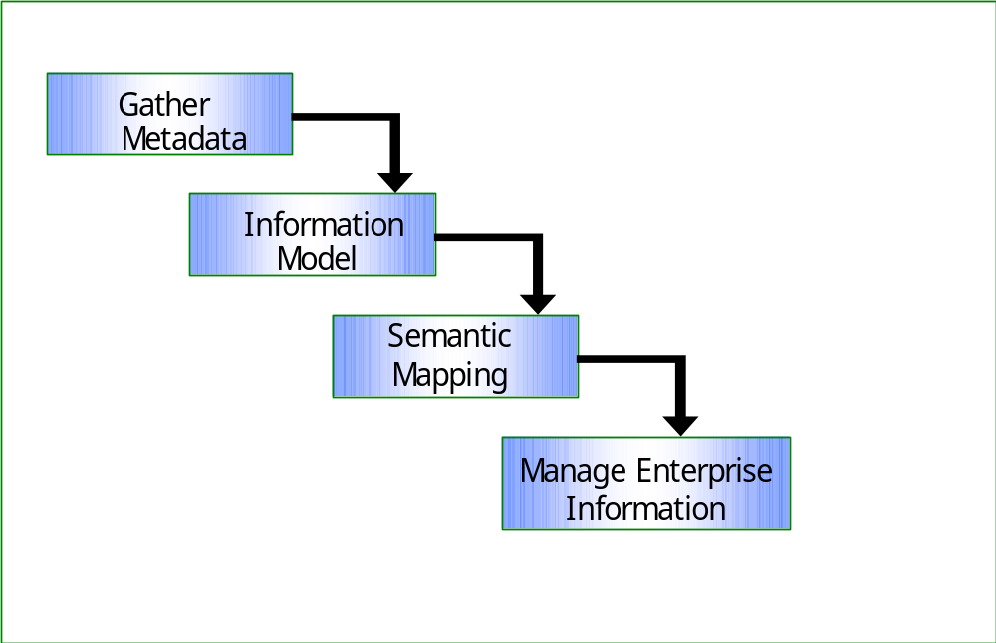
Process Overview

Slide 14
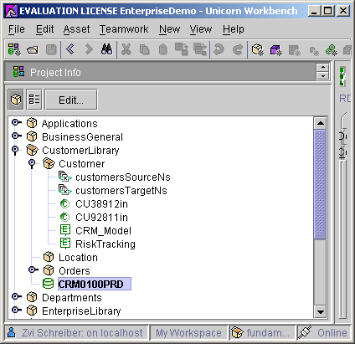
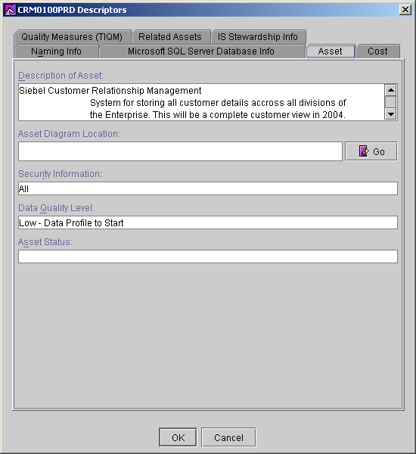
1. Gather Metadata
Flat Files, COBOL Copy Books, RDBMSs, XML Schemas, UML Models, and ERwin models are cataloged by category (packages - left) and metadata is collected (right)

Slide 15
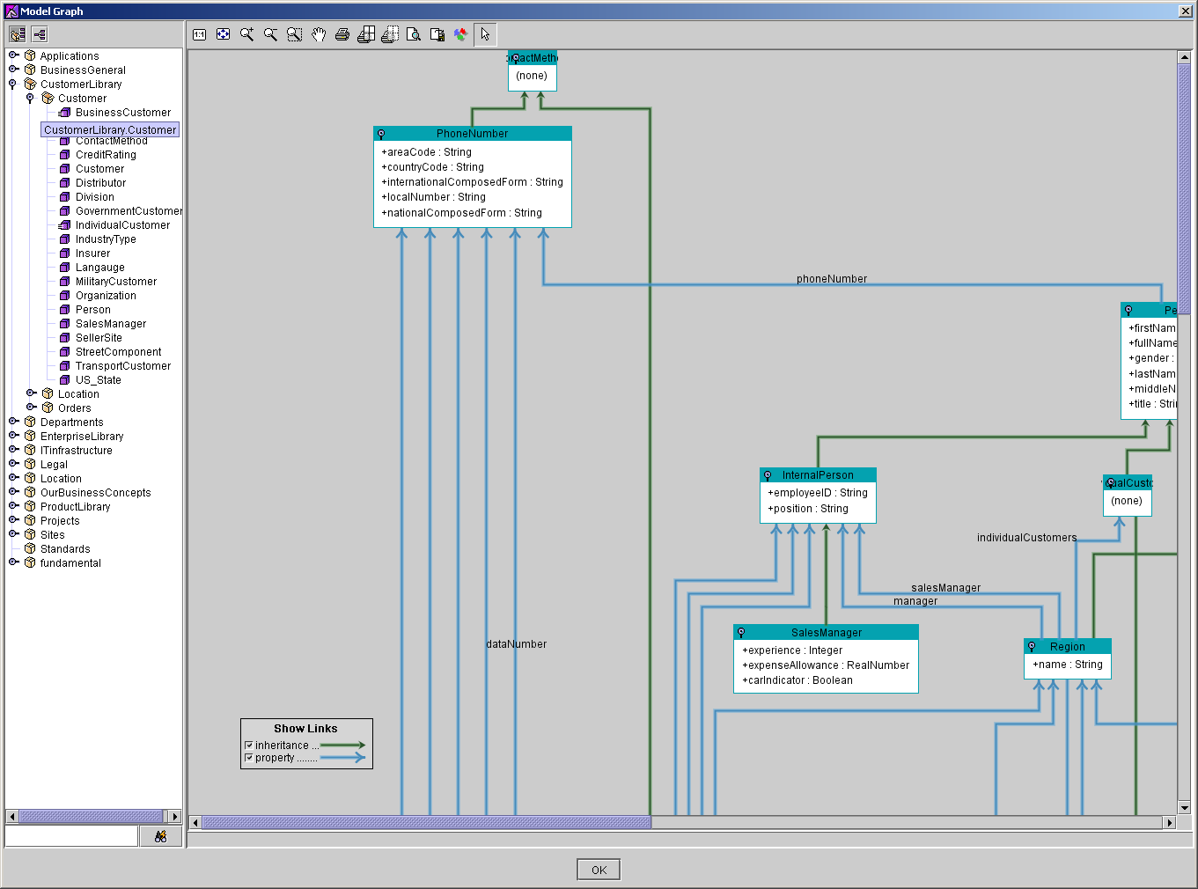
2. Build Information Model/Ontology
The structures of the enterprise, its relationships and rules and desired vocabulary is captured in an Information Model

Slide 16
Ontology: Classes
Class:
  A collection, or classification, of real-world objects
  Comparable to a database table, XSD complex type, etc.
Inheritance / Multiple Inheritance

Slide 17
Ontology: Properties
Characteristics of a class
Relationships between classes
The “has a” relationship
Properties are inherited

Slide 18
Ontology: Business Rules
Interrelate classes or properties
Examples:
  Net = gross (1 - taxRate/100)
  Value of state is one of {“Alabama,” “Alaska,” … ”Wyoming”}

Slide 19
Constructing an information model
Understanding the data sources and the model is critical.
Information must be (and remain) current, accurate, and comprehensive
Use libraries of industry-specific models
Reverse-engineer schemas, especially standards
Information model will develop iteratively as metadata is better understood

Slide 20
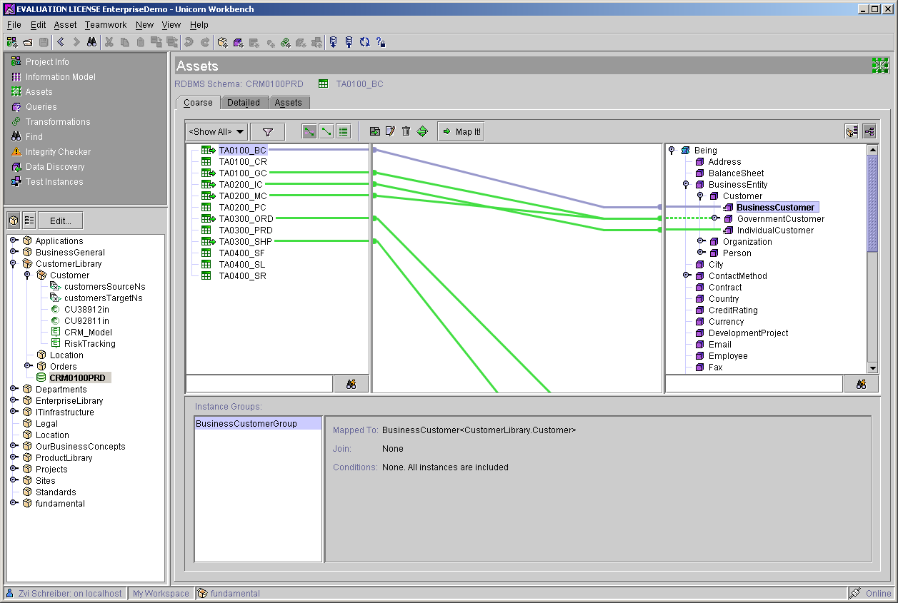
3. Semantic Mapping
The business meaning of each database is captured by mapping the physical schema as a spoke to the information-model hub

Slide 21

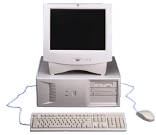


Mapping: Architectural Perspective
RDBMS
Schema
VAN
Data
Warehouse
Schema
Web Services
Information
Model
CORBA / RMI / DCOM Objects
COBOL
XML
ERwin Schema
API
Rosetta-Net
Custom XML Schema
ERP, CRM, PDM,
…

Slide 22
Mapping Schemas to Ontological Models
Map RDB Columns, XML Simple Types, etc, to Properties.
Map RDB Tables, XML Complex Types, etc., to Classes
Map enumerations, uniqueness declarations and other rules to Business Rules

Slide 23
4. Manage Enterprise Information
Discovery
Integration
Maintenance

Slide 24
Discovery
For any business concept, discover a list of physical data asset which contain data about that concept. Reliably find, e.g.
  All data sources that contain classified information.
  Data sources
For any schema concepts, discover concepts in other schemas that convey the same or similar information.
  Redundant data in other data sources.
  Contradictory data sources

Slide 25
Data Integration
For any two message formats/databases that have been mapped as spokes to the ontology, an accurate end-to-end data translation script may be inferred automatically
  XSLT
  SQL
  Other transformation languages
  Human-readable transformation planner

Slide 26







Maintenance: Data Life Cycle
How many times will you map it?

Slide 27
Maintenance
Adapt to changes
When physical database or business concept or rule changes
Recognize the impact of the change
Re-generate transformations
Generate schemas to reflect changes

Slide 28
Standards: Understanding Message Formats
Rich semantics aid in understanding the complex schemas and data field dictionaries of proprietary message formats and standards such as Swift, FIX, ISO 15022/XML, etc.
Even in the context of a standard, multiple data field dictionaries and overlapping schemas can exist and need to be unified in a single, clear view.
Build on recent work in modeling messages with UML or conceptual models; fit these models into a semantic information methodology.

Slide 29
Standards: Integration/Migration
A semantic infrastructure aids in locating relevant schemas, and in transforming between formats.
SIM enable the seamless no-delay integration required for T+1 or STP

Slide 30
Benefits of SIM
Business units & IT speak same language
Data assets understood and reused
Redundant data assets identified & decommissioned
Business rules stored explicitly-change in one place
Accurate data transforms produced automatically
Business & technical changes supported in real time
Reduced reliance on specific EAI/ETL infrastructure
Integration/migration between proprietary definitions and standards
Integration/migration between standards

Slide 31

Thank You
Joshua Fox
Unicorn Solutions, Inc.
New York, NY 10003
www.unicorn.com
joshua.fox@unicorn.com
Tel. +1 866 2 UNICOR(N) x 115

