Slide 1


Mining Meaning from JavaTM Code with the Java Data Mining API
Joshua Fox
Chief Technologist, Metadata Analytics
BOF-4915

Slide 2
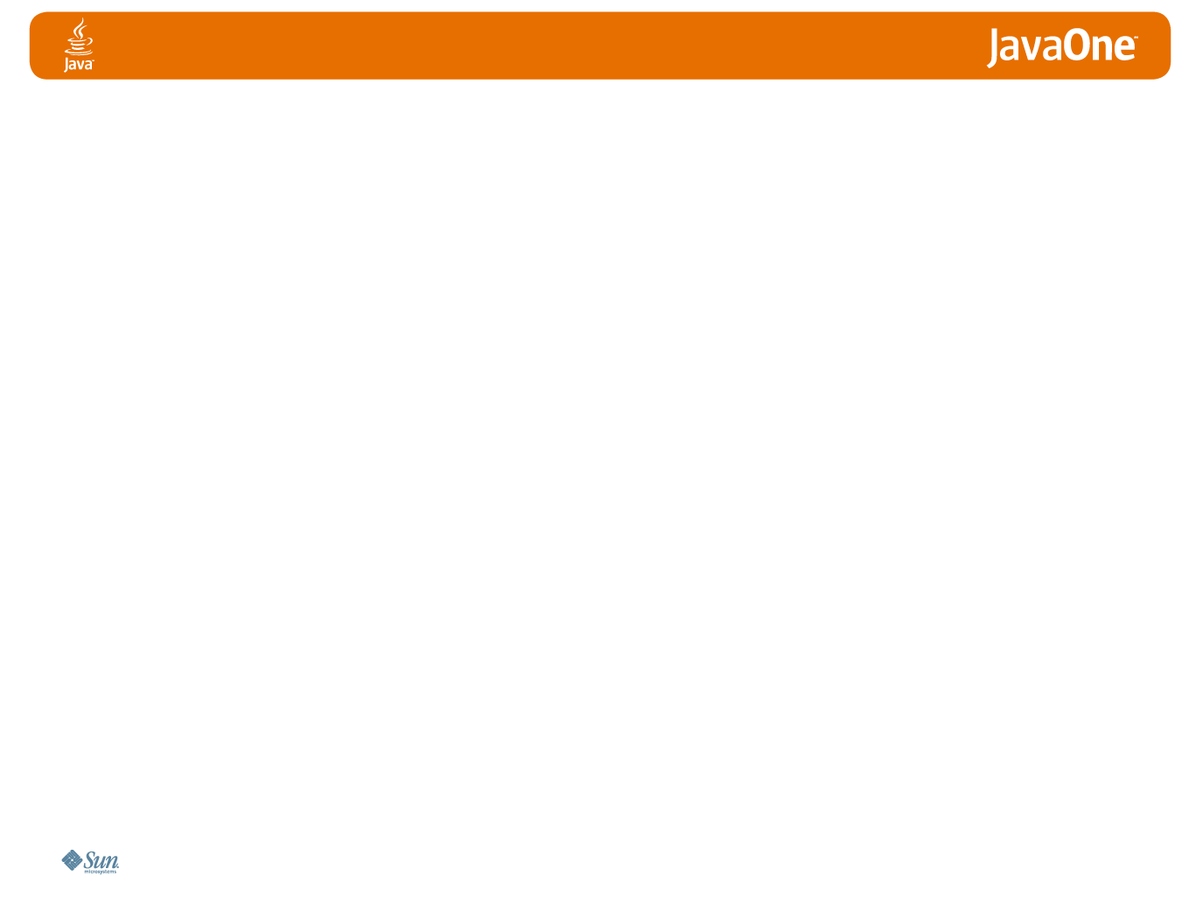
Following on an earlier talk:
JavaOne 2004:
JavaTM Metadata (JSR 175)
and the Semantic Web

Slide 3


Where’s the Code I Need?
Real World
Code
public class Invoice{…}

Slide 4
Discover Reusable Code
according to Real-World Meaning

Slide 5
I Need Some Code!
Code Repository
Xyz.java
Xyz.java
Xyz.java
Xyz.java
Xyz.java
Xyz.java
Xyz.java
Xyz.java
Xyz.java
Xyz.java
Xyz.java
Xyz.java
Xyz.java
Xyz.java
Xyz.java
Xyz.java
Xyz.java
Xyz.java
Xyz.java
Xyz.java
Xyz.java
Xyz.java
Xyz.java
Xyz.java
Xyz.java
Xyz.java
Xyz.java
Xyz.java
Xyz.java
Xyz Service
Xyz.java
Pqr EJB
Abc.java

Slide 6
I know what I want!
Discovery
according
to functional
requirements
Media
Technology
Business
Industry
Blogging
Movie
Geographical
Corporation
Zip
Financials
Real Estate
Politics
Account
Automotive
Invoice
Political
Party
Car
Notes:
- Looking for business oriented concepts
- Distinct from the search for technical infrastructure components, a field which has received more attention.

Slide 7

Historical Situation for Codebases
Small quantities
Scattered among development projects
Service
X
EJB
P
public class A {…}
EJB
Q
public class B{…}
Service
Y
Service
Z
EJB
R
public class C{…}

Slide 8
Java is Big!
Trends
  large,
  cross-functional
    code repositories
    enterprise & open-source
SCC++

Slide 9

But…
The repository is a victim of its own success

Slide 10
Mess
A.java
B.java
…
C.java
…
X EJB
D.java
S WSDL
…
R EJB
…
…
…
E.java
V EJB
F.java
U EJB
Z EJB
…
M EJB
…
…
W EJB
EJB
R WSDL
H.java
…
Y EJB
…
…
G.java
J. java
…
K.java
P WSDL
Notes:
What is the business meaning of each code unit: class, EJB, Service, etc?

Slide 11

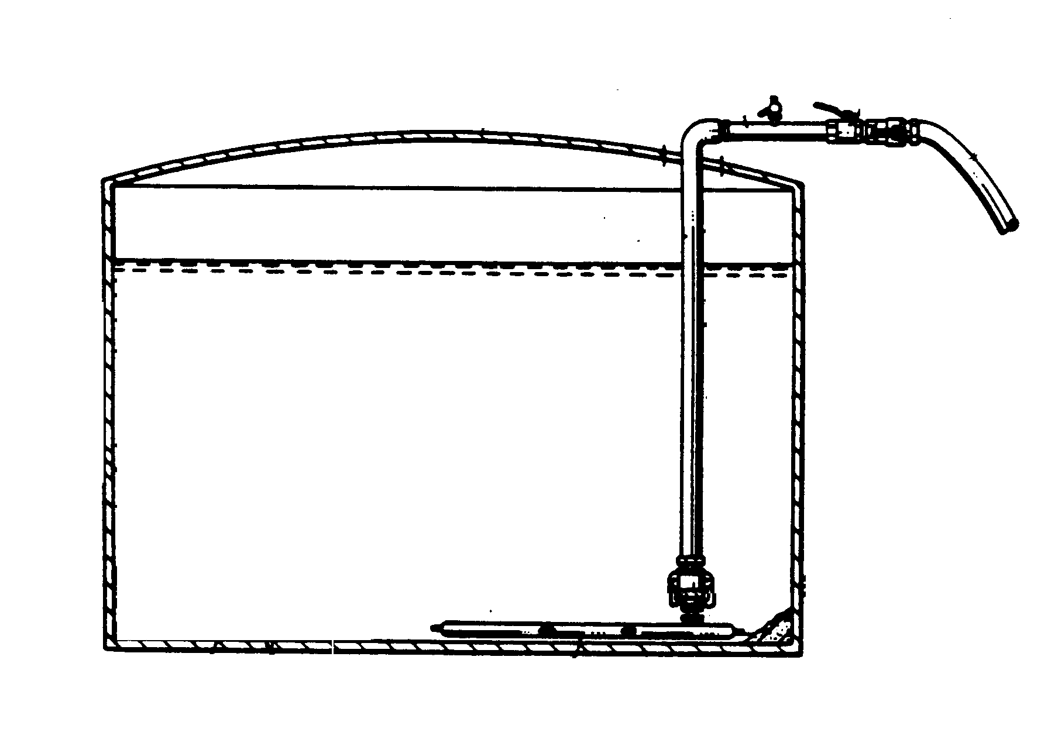

Confused semantics
Tank?
Army
Navy

Slide 12
Unclear meanings
JavaBean Q282X2.java, converted from COBOL which was created by a generator
What does it mean?
© Unicorn Solutions Inc.
Private & Confidential

Slide 13
Huge Quantities
A.java
B.java
…
C.java
…
X EJB
D.java
S WSDL
…
R EJB
…
…
…
E.java
V EJB
F.java
U EJB
Z EJB
…
M EJB
…
…
W EJB
EJB
R WSDL
H.java
…
Y EJB
…
…
G.java
J. java
…
K.java
P WSDL

Slide 14
Capture the Meaning
Semantic Model: Ontology, taxonomy, glossary, dictionary
Map the code to this ontology
Notes:
We use a simplified ontology of Domains and Entities

Slide 15
Simplified Ontology: Domains
Media
Technology
Environment
Blogging
Mapping
Financials
Real Estate
Politics
Automotive

Slide 16
Simplified Ontology: Entities
Power Plant
Account
Corporation
Car
Industry
Zip
Invoice
Political Party
Movie

Slide 17
Simplified Ontology: Domains and Entities
Media
Technology
Business
Industry
Blogging
Movie
Geographical
Corporation
Zip
Financials
Real Estate
Politics
Account
Automotive
Invoice
Political
Party
Car

Slide 18
Coarser-Grained: Mapping Code to Domains
Code
Semantic Domain
SECReporting
EJB
Financial
BillingService
WSDL
NewHire
POJO
Human Resources
ElectricOutagesReport
POJO
Power Generation

Slide 19
Finer-Grained: Mapping Code to Entities
Semantic
Entity
Code
SECReporting
EJB
AnnualReport
BillingService
WSDL
Invoice
NewHire
POJO
Employee
ElectricOutagesReport
POJO
Outage

Slide 20
Implementation with Annotations
Linking Java code to its meaning
Java Class <=> Semantic Entity
Can be POJO, EJB, etc.
@SemanticEntity(url=“http://ecommerce.org/
bankingmodel.xml#RetailBankingAccount”)
public class Account {
}

Slide 21
Implementation with Annotations
Java Package <=> Semantic Domain (Category)
package-info.java
@SemanticDomain(url=“http://ecommerce.org/
bankingmodel.xml#RetailBanking”)
package retailBanking;

Slide 22
Mapping Architectures
Strictness
  Formal, precise mappings
  Informal
Encoding the mappings
  Mapping tools
  Tagging
Persisting the mappings
  External
  Annotations

Slide 23
Older Approaches Don’t Work

Slide 24

Older Approaches Don’t Work
Painstaking human labor

Slide 25
Older Approaches Don’t Work
Painstaking human labor
High-cost labor: Java & business knowledge
$
$
$
$

Slide 26
Older Approaches Don’t Work
Painstaking human labor
High-cost labor: Java & business knowledge
Beyond human limits
:-(
$
:-(
:-(
$
:-(
$
:-(
$

Slide 27
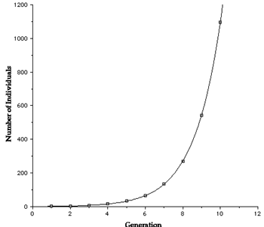
New Opportunities
Exponential growth in computer power
Great progress in searching, classifying and organizing
  Data Mining
  Recent innovative uses: Web 2.0, Google, Fraud detection, market basket analysis

Slide 28
The Time is Right
Well-known data mining and other information-management techniques
Now, apply them to Java code

Slide 29
Your Future in Software
Managing Complexity

Slide 30
Functional Architecture
Business
Functionality
Code Reuse Tool
Engine
Semi-automation of
mapping
Real-Life
Meaning
Ontology
Mapping
(Ontology <->Code)
Persistence
Code
Repository

Slide 31

Contrast to Search Engines
Search Engines
  Free-text search
  No human intervention
  Basic search lacks semantic capabilities
Classification
  Bundle related items into defined categories
  Allow human input
  Express semantics

Slide 32
Java Data Mining API
JSR 73: JDM 1.0, passed Final Approval Jun. 2004
JSR 247: JDM 2.0, passed Public Review Dec. 2006
Notes:
Meant to support expert and novice users,
Dynamic, reflective API: Ideal for scripting

Slide 33
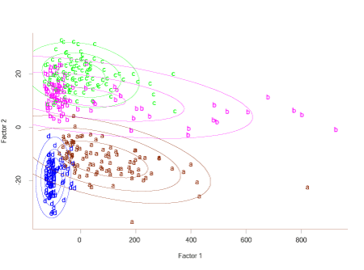
JDM Supports
Wide variety of functionality
Supervised/Unsupervised
Descriptive/Predictive
Regression, Clustering, Association, Classification, …
We’ll focus on Classification

Slide 34
JDM Basics
Implementations from Oracle and KXEN
Reference implementation– for compatibility testing
Can execute in DB or in application-layer, but with a data orientation
Exposes data-mining to programmers—outside the DB
App
APIs
DB
SQL

Slide 35
Some JDM API Key Classes
Connection
PhysicalDataSet
Attribute
TransformationModel
Model
CategorySet
MiningTask
Settings
MiningAlgorithm
TestMetrics

Slide 36
JDM 2.0
Features include Time Series, Feature Extraction, Multi-Target Models,…
And, relevant to our task:
Transformation
Text Mining
Notes:
So, not implementing for now in JDM; also, IBM is not supporting JDM for now. But we can look to the future power of JDM 2.0.

Slide 37
Methodology
Prepare
Codebase
Set up
Ontology
Build
Classification
Model
Set up ontology
Prepare the codebase
Build Classification Model
Evaluate Classification Model
Deploy: Find the code you need
Evaluate
Classification
Model
Deploy:
Capture meaning
Notes:
CRISP-DM: CRoss Industry Standard Process for Data Mining
Categories come from our domains/entities
Transformations defined in JSR 247
We dividing up the data set into training and testing sets; also there will be the production data.
“Train”= Build Model
“Classify” = “Predict a category”

Slide 38
(1) Set up Ontology
Human Resources
Semantic Model
Domains and entities
Keep it coarse-grained
Keep it simple
Use industry standards
Categorize by Domain, then by Entity
Employee
JobPosition
javax.datamining.data
CategorySet

Slide 39
(2) Prepare the Codebase
Transform the code
Extract Terms
JavaCC/JJTree
Take the identifiers and of comments
    E.g. ”Account”, ”balance”
Tokenize by camel-case
    E.g., ”firstName” → ”first”, “Name”
Optional: Take the structure into account
Load results into data model
javax.datamining.data
PhysicalDataSet
Notes:
Transformation in JSR 247
Can use JavaCC

Slide 40
(2) Prepare the Codebase: JDM 2.0
javax.datamining.transformations
TransformationModel
AttributeSelectionSettings
ExpressionSettings
TransformationSettings
SampleSettings
Atomic attributes for terms
  OR
Free-text attributes
Vendors may provide specialized text-oriented transformations in JDM 2.0 implementations
Notes:
Transformation in JSR 247
Can use JavaCC

Slide 41
(3) Build the Classification Model
Training/Machine Learning
Use a sample of code with manual mapping
Classification algorithms include naïve Bayesian, SVM
Run tests on test data set
BuildSettings
AlgorithmSettings
BuildTask
SupervisedSettings
NaiveBayesSettings
ClassificationSettings
Notes:
How to select an algorithm: JSR 247 gives model selection feature

Slide 42
Naïve Bayesian
“Bayesian”: Start with prior probability
Adjust probability given the common/uncommon words in each category
Choose most probable category for each file
“Naïve”: Assume that, in each category, the frequency of each word is independent of the others’
Java file A has the terms:
Tax, interest, income,
Wisconsin, cost, Fred,
deduction,…
Java file B has the terms:
Alabama, Indiana, tax,
Wisconsin, Wyoming,
state, Fred,…
Financial
Geographical

Slide 43
(4) Evaluate the Classification Model
Evaluate the model
The test-set is a different part of the codebase
Tweak and repeat
ClassificationTestMetricsTask
ClassificationTestMetrics
Lift
ConfusionMatrix
ReceiverOperatingCharacteristics
Notes:
How to select an algorithm: JSR 247 gives model selection feature

Slide 44
(5) Deploy: Find the Code you need
Deploy to production environment
Integrate with GUI
Prepare codebase with the same transformations
“Apply” the pre-built classification model
Classify: Get a suggested category
Validate manually
ApplyTask
ClassificationApplySettings
DataSetApplyTask
RecordApplyTask

Slide 45
Mining for Meaning
The Suits don’t understand the code
The Coders don’t understand the business
Automated classification brings them together
Notes:
A small step….

Slide 46

Mining for Meaning
Remember when Java Reflection first came out in Java 1.1?
Code could “understand” its own syntax!
Now, code can “understand” its own real-world meaning
Notes:
A small step….

Slide 47
Summary
Data mining and machine learning are the future
You can apply automated classification to the Java code itself
Automated understanding
Notes:
A small step….

Slide 48

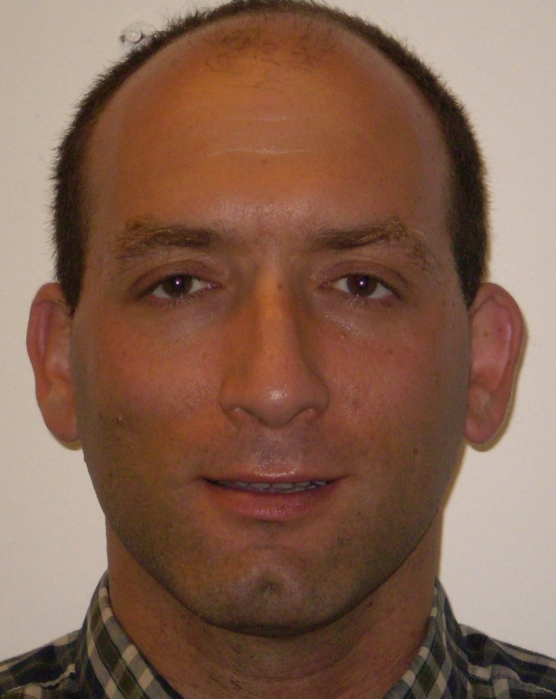
Joshua Fox
Chief Technologist, Metadata Analytics
SOA Advanced Technologies, IBM
http://www.joshuafox.com

