Slide 1
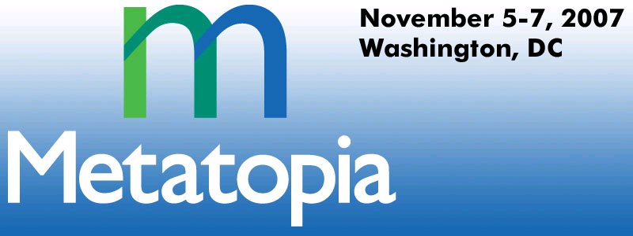
Joshua Fox
Regulatory Compliance through Metadata Mining
Notes:
To replace the title / subtitle with your own:
Click on the title block -> select all the text by pressing Ctrl+A -> press Delete key -> type your own text

Slide 2
What Does My IT System Mean?
Real World
Metadata

Slide 3
Use Case: Security Marking
A simplified example
Security labeling has many drivers
Focusing here on the semantics

Slide 4
Use Case: Security Marking
Not
Weaponization-
related
Not
Weaponization-
related
Not
Weaponization-
related
Weaponization-
related
Not
Weaponization-
related
Weaponization-
related
Not
Weaponization-
related
Not
Weaponization-
related
Not
Weaponization-
related
Not
Weaponization-
related
Weaponization-
related
Notes:
Compliance: A CIO must find all assets relevant to a telco's financial processes to comply with Sarbanes Oxley. He has a formal Business Glossary of terms attached to his instance of IBM IIS Metadata Server which defines terms in the financial sphere, and the assets are scattered in WSRR, RAM, and Metadata Server instances in the form of COBOL copybooks, and XSDs. The assets do not conform to the Glossary in their naming conventions, making it impossible to search for specific strings such as "FINANCE." Metadata Mining technology identifies all metadata assets relevant to finance based on common characteristics and similar fields. This is done not only by training on a sample of this telco's metadata , but also by drawing on a statistical training mapping database which was trained statistically from similar engagements (without retaining the training-set information itself.)

Slide 5
Biotech Lab
A lab takes its first DoD contract
Needs DIACAP approval; cannot risk non-compliance
Needs to apply security markings for access control in the Information Sharing Environment

Slide 6
The Metadata
Metadata for structured (machine-read) data
Database schemas
Web service WSDLs
COBOL copybooks
UML & DoDAF Models

Slide 7
Security Markings: Find Subject
Find all info services in semantic area of, e.g. “weaponization”
Metadata Repository holds service descriptions, database schemas, other metadata
Repository also holds standard categories from data dictionary
Tool proposes categorization
Analyst uses this as input, saving valuable manual-analysis time
Semantics
Metadata

Slide 8
Historical MD Situation
MD in small quantities
Scattered in
  DBA teams
  Development teams
<>…
<>
<>…
<>
<>…
<>

Slide 9
Background
Trends in leading-edge enterprises
  Large,
  cross-organization,
    metadata repositories

Slide 10
The Promise:
Governance across the organization,
but…

Slide 11
Mess of Metadata
<xsd>
…
<xsd>
…
<xsd>
…
<xsd>
<xsd>
…
…
<xsd>
<xsd>
…
…
<xsd>
<xsd>
<xsd>

Slide 12
Heterogeneity in Metadata
Different technologies: XML, RDB, UML
Different structures and terminologies
<xsd>
…
<xsd>
…
<xsd>
…
<xsd>
<xsd>
…
…
<xsd>
<xsd>
…
…
<xsd>
<xsd>

Slide 13

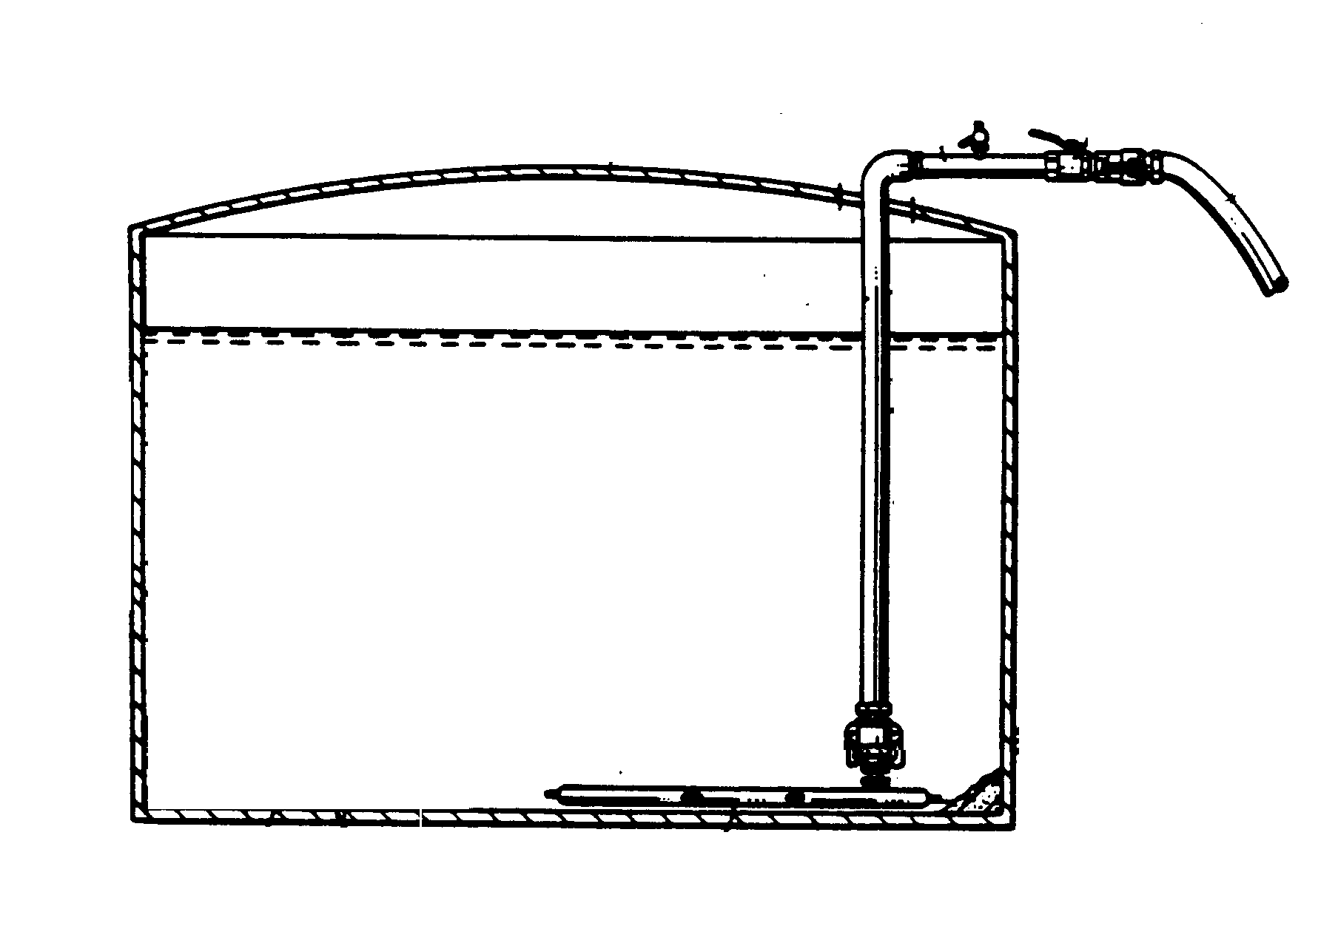
Confused Semantics in Metadata
Tank?
Army
Navy

Slide 14



Confused Semantics in Metadata
“Secure”
NSA: No eavesdropping
Air Force: Buy it
Army: Guard the perimeter
Marines: Storm it
Navy: Lock the door, turn off the lights

Slide 15
Huge Quantities of Metadata
<xsd>
…
<xsd>
…
<xsd>
…
<xsd>
<xsd>
…
…
<xsd>
<xsd>
…
…
<xsd>
<xsd>

Slide 16
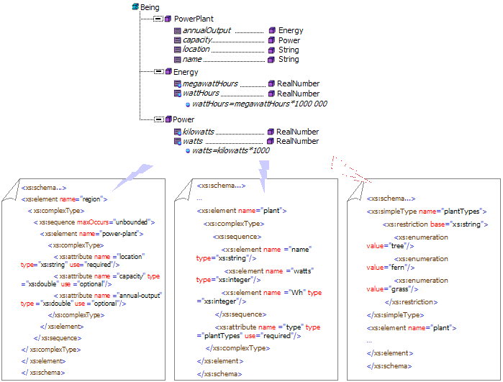
Older Approaches
Build taxonomy/ontology
Map it to the metadata
Ontology
Metadata (e.g., XSD)

Slide 17
Older Approaches Don’t Work

Slide 18

Older Approaches Don’t Work
Painstaking human labor

Slide 19
Older Approaches Don’t Work
Painstaking human labor
High-cost labor: IT+ business knowledge
$
$
$
$

Slide 20
Older Approaches Don’t Work
Painstaking human labor
High-cost labor: IT+ business knowledge: Consultants!
$
$
$
$

Slide 21
Older Approaches Don’t Work
Painstaking human labor
High-cost labor with IT+ business knowledge: Consultants!
Beyond human limits
:-(
$
:-(
:-(
$
:-(
$
:-(
$

Slide 22
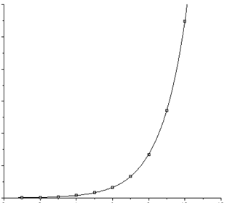
New Opportunities Created By:
Moore’s Law
Great progress in Data Mining
  Searching, classifying and organizing
  Recent innovative uses: Terrorist Threat Analysis Security, Web 2.0, Google

Slide 23
The Time is Right
Well-known search and information-management techniques
Now, apply them to metadata

Slide 24
Functional Architecture
Business
Functionality
Compliance
Access
Reporting
Engine
Semi-automation of
mapping
Real-Life
Meaning
Ontology
(AKA taxonomy, dictionary,
glossary, logical model, categories)
Mapping
(ontology <->metadata)
Persistence
Metadata
Repository

Slide 25
Methodology
Prepare Metadata
Set up Categories
Machine Learning
Suggest Category

Slide 26
(1) Prepare Metadata
Load metadata into repository
Pre-process metadata into
  Text: e.g., “Deployment”, “Location”
  Structure: e.g., “Deployment:Location” to represent Table and Column

Slide 27
(2) Set up Categories
(AKA taxonomy, ontology, glossary, data dictionary, business model, domain model)
Follow Security Classification Guide
May use Community-of-Interest (CoI) vocabulary
Defense Discovery Metadata Standard for categories
Keep it simple!

Slide 28
(3) Machine Learning
Training on a sample of metadata samples
Provide semantic category mappings for this sample
Standard Bayesian classification algorithms learn common or uncommon words in a category

Slide 29
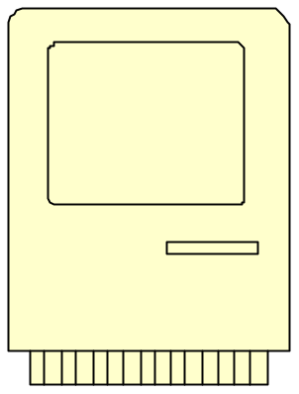

(4) Suggest Category for Metadata Item
Preprocess metadata
Submit to classification engine
Receive suggested category
Proceed with analysis
Metadata
Classification
Engine
Analyst
Humans and machines complementing each other

Slide 30
Understand Your IT: Use Cases
Legacy Transformation: What business services are hiding in your legacy applications?
Reuse: Where is a service with this business functionality?
Fast Start for Community of Interest

Slide 31
Use Case: SOX Reporting
Non-Financial
Non-Financial
Non-Financial
Non-Financial
Non-Financial
Financial
Non-Financial
Financial
Non-Financial
Non-Financial
Non-Financial
Notes:
Compliance: A CIO must find all assets relevant to a telco's financial processes to comply with Sarbanes Oxley. He has a formal Business Glossary of terms attached to his instance of IBM IIS Metadata Server which defines terms in the financial sphere, and the assets are scattered in WSRR, RAM, and Metadata Server instances in the form of COBOL copybooks, and XSDs. The assets do not conform to the Glossary in their naming conventions, making it impossible to search for specific strings such as "FINANCE." Metadata Mining technology identifies all metadata assets relevant to finance based on common characteristics and similar fields. This is done not only by training on a sample of this telco's metadata , but also by drawing on a statistical training mapping database which was trained statistically from similar engagements (without retaining the training-set information itself.)

Slide 32
SOX Compliance
Real World
Metadata
A Telco needs to comply with SOX to avoid penalties
Build reports from all info services with “financial” information
Metadata repository holds services, DB schemas, etc.
Tool proposes categorization
Analyst can find relevant data sources more quickly, then build report

Slide 33
Why Mine the Metadata
Services: Invocation-level data is transient
Metadata already expresses semantics of the data
Metadata uncoupled from ever-changing data
Table: | Troop_ Deployment
Column: | Total
Troop_Deployment
… | … | … | Total
 |  |  | 154,650
 |  |  | 25,390

Slide 34
Mining the Metadata: More Secure
Tool & human analyst do not access actual data
Human analyst can avoid accessing even the metadata
Table: | Troop_ Deployment
Column: | Total
Troop_Deployment
… | … | … | Total
 |  |  | 154,650
 |  |  | 25,390

Slide 35
Data Mining
Complements metadata mining
Build metadata from data
Differentiate on the resource level
Table: | Deployment
Column: | Location
Deployment
… | … | … | Location
 |  |  | “DC LAN 1”
 |  |  | “Baghdad LAN 2”

Slide 36
Simplicity
Our focus
Metadata | Data
Structured Data | Documents
Coarse-Grained | Fine-Grained
Classification | Search, metadata-internal relationships, transformation-building
Schema-to-Semantics | Schema-to-Schema
Feasible | Long-term Research
Reusable Functionality | Specialized Functionality
Business Value | Technical Value

Slide 37
Summary
Real World
Metadata
Too much metadata: humans need help
Use your metadata repository
Understand your metadata
Identify relevant metadata
Comply with regulations using IT metadata
Metadata mining: The time is right

Slide 38
Thank you
Joshua Fox
Metadata Analytics
Israel Software Labs
IBM
joshuaf@il.ibm.com
http://www.joshuafox.com

Slide 39


