Slide 1


Generating XSLT with a Semantic Hub
Transformations for EAI and the Semantic Web
XML Conference
Baltimore, December 2002
Joshua Fox
joshua@unicorn.com
http://www.unicorn.com
Unicorn Solutions, Inc.

Slide 2
Deployments of XSLT
Architectures
  Enterprise Application Integration (EAI)
  Semantic Web servers
In each case, applications use (send/expect to receive) different XML formats (schemas) for their messages.

Slide 3
Challenges of XSLT Development

Slide 4
XSLT: Hard to Write
Cameron Laird: “[A] hurdle in XSLT’s diffusion, along with its unconventional XML-based syntax and confusing deployment, is its functional or applicative semantics."
Martin Fowler: "XSLT can …be an awkward language to master, due [to] its functional programming style coupled with its awkward XML syntax."

Slide 5
XSLT: Functional Language
Functional programming (FP): The output of a function (XSLT template depends only on input, not on any outside state such as global variables).
FP not a popular paradigm.
Many programmers do not understand FP.
FP harder to debug because of non-sequential nature, and, in fact, few debugging tools are available for XSLT.
Few functional languages are commonly used. (only XSLT and SQL).

Slide 6
XSLT: XML-Based Syntax
Nesting and tightly validated structure can be confusing: End-tags must always match exactly.
Hard to process in line-based development tools like merge.
Tags make the language verbose

Slide 7
XSLT Development Today
Manual, no Schemas
Manual, Schema-to-Schema
Tool-based, no Schemas
  Fowler: "Tools for XSLT are, at least so far, much less sophisticated" than tools for other programming languages."
Tool-based, HTML-targeted
Tool-based, Schema-to-Schema
Proposal: Generating XSLT with a Semantic Hub

Slide 8
Problem: Point-to-Point Development
Similar semantics (meaning), different schemas
3 examples presented below: sample instance documents, followed by schemas.

Slide 9
Document 1
<computer>
<harddisk>
<capacity>30</capacity>
</harddisk>
</computer>

Slide 10
Schema 1
<xs:schema xmlns:xs="http://www.w3.org/2001/XMLSchema" elementFormDefault="qualified">
<xs:element name="capacity" type="xs:integer"/>
<xs:element name="computer"> <xs:complexType>
<xs:sequence> <xs:element ref="harddisk"/> </xs:sequence>
</xs:complexType> </xs:element>
<xs:element name="harddisk"> <xs:complexType>
<xs:sequence> <xs:element ref="capacity"/> </xs:sequence>
</xs:complexType> </xs:element>
</xs:schema>

Slide 11
Document 2
<desktop_computer>
<harddrive>
<partition drive="c:" capacity="10" unit="GB"/>
<partition drive="d:" capacity="20" unit="GB"/>
</harddrive>
</desktop_computer>

Slide 12
Schema 2
<xs:schema xmlns:xs="http://www.w3.org/2001/XMLSchema" elementFormDefault="qualified">
<xs:element name="desktop_computer">
<xs:complexType> <xs:sequence> <xs:element name="harddrive"> <xs:complexType>
<xs:sequence><xs:element name="partition" maxOccurs="unbounded">
<xs:complexType>
<xs:attribute name="drive" type="xs:string" use="required"/>
<xs:attribute name="capacity" type="xs:integer" use="required"/>
<xs:attribute name="unit" type="xs:string"
use="required" fixed="GB"/>
</xs:complexType>
</xs:element> </xs:sequence>
</xs:complexType> </xs:element> </xs:sequence></xs:complexType></xs:element>
</xs:schema>

Slide 13
Document 3
<unit type="desktop">
<storage>30000</storage>
</unit>

Slide 14
Schema 3
<xs:schema xmlns:xs="http://www.w3.org/2001/XMLSchema" elementFormDefault="qualified">
<xs:element name="storage" type="xs:integer"/>
<xs:element name="unit"> <xs:complexType>
<xs:sequence> <xs:element ref="storage"/>
</xs:sequence>
<xs:attribute name="type" type="xs:string" use="required"/>
</xs:complexType> </xs:element>
</xs:schema>

Slide 15
Point-to-Point Architecture
Repeated work per source/target pair includes:
  Syntactic analysis of schemas of instance documents, if not present
  Semantic analysis of the meaning of schema elements
  Development of XSLT

Slide 16
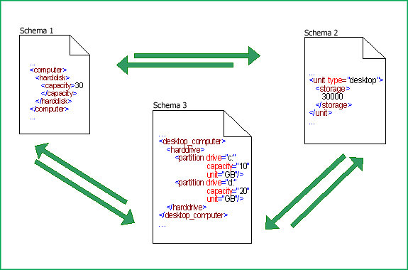
Integrating 3 Schemas: 6 XSLTs

Slide 17
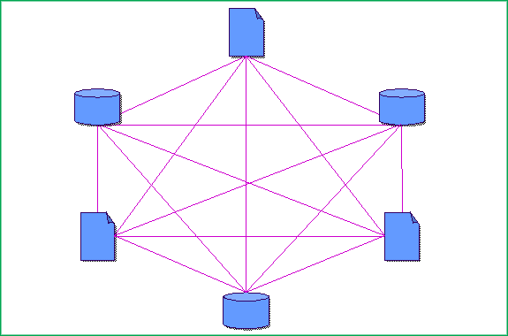
Integrating 6 Schemas: 30 XSLTs

Slide 18
Complexity of Point-to-Point Architecture
Repeated work per source/target pair
3 schemas require 6 XSLTs
6 schemas require 30 XSLTs
20 schemas 380 XSLTs for full integration!
If there are n schemas, we need to write n²-n XSLTs
O(n²)
Quadratic complexity

Slide 19
The Semantic Hub

Slide 20
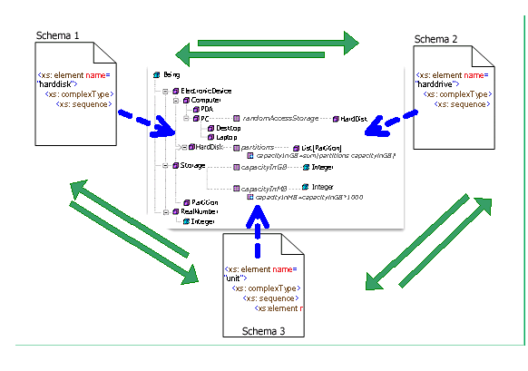
Alternative: Hub-Based Architecture

Slide 21
Structure of the Hub
Core infrastructure: Information model based on ontology.
Layered on top: Mapping between the schemas and the ontological concepts.
Output: Automated generation of XSLT

Slide 22
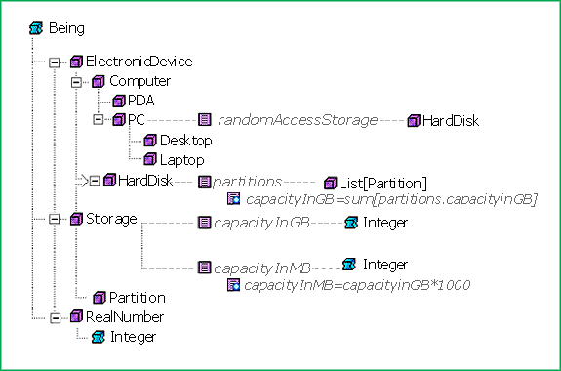
Ontology

Slide 23
Class
E.g., class DesktopComputer
A class is a set of instances.
An instance is a real-world entities. E.g., the desktop computer with the DNS address joshua1.unicorn.com is an instance of DesktopComputer.

Slide 24
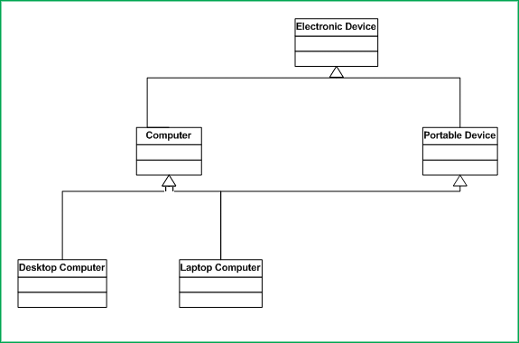
Inheritance

Slide 25
Property
Class A Class B
Desktop Computer Monitor
Property
displayedBy

Slide 26
Constraints
Restrictions on the possible values for properties
Cardinality, e.g. central_processing_units of the class Computer has cardinality 1..64.
Enumerate, e.g.,, only "Alaska", "Alabama", “Arkansas", ..., "Wyoming" for property name of class State.
Mathematical expression, e.g., for MemoryCapacity, capacityInGB = capacityInMB /1000.
Two properties are mutual inverses: displays and displayedBy for Desktop Computer and Monitor.

Slide 27
Adding Semantics to XSD
Mapping to Ontology

Slide 28
Mapping XSD to Ontology
XSD Concept | Ontological Concept
Complex/simple type | Class
Element/attribute | Property
Inheritance by extension | Inheritance
Inheritance by restriction | Constraint

Slide 29
Mapping Example, Schema 1
<xs:element name="harddisk">
<xs:complexType>
<xs:sequence>
<xs:element ref="capacity"/>
</xs:sequence>
</xs:complexType>
</xs:element>

Slide 30
Mapping Example
Complex type for element harddisk mapped to class HardDisk
In other schemas, where the complex type has other names, e.g., HardDrive, FixedDrive, HD, or MainStorage, we still map to HardDisk

Slide 31
Ontology: Visions and Standards

Slide 32
Vision of the Semantic Web
Tim Berners-Lee
Interoperability between Web Services
W3C (World Wide Web Consortium) developing standards for ontologies.

Slide 33
Ontology Initiative: OWL
OWL (Web Ontology Web Language), formerly known as DAML+OIL (DARPA Agent Markup Language/ Ontology Inference Language): XML-serialization format for ontologies.

Slide 34
Ontology Initiatives: RDF and RDF/S
RDF (Resource Definition Framework) is a format for expressing triplets to express semantic relationships to be expressed. E.g., mapping triplet
complex type of harddisk
maps to
ontological class HardDrive
RDF/S (Resource Definition Framework/Schema), based on RDF, alternative to OWL

Slide 35
Automatically Generated Transformations

Slide 36
Transformation
Algorithm generates XSLT between schemas
Find semantically equivalent concepts (elements/types) in the XSD’s
Or, use constraints to convert where necessary
In some cases, multiple source elements can transform to a single target
Chains of properties can link between classes

Slide 37
XSLT: Schema 3 to Schema 1
<xsl:stylesheet xmlns:xsl=
"http://www.w3.org/1999/XSL/Transform“ version="1.0">
<xsl:template match="/">
<xsl:apply-templates select="unit[1]"/>
</xsl:template>
<xsl:template match="unit">
<computer> <harddisk> <capacity>
<xsl:value-of select="floor(storage/text() div 1000)"/>
</capacity></harddisk> </computer>
</xsl:template>
</xsl:stylesheet>

Slide 38
Enterprise Use Cases

Slide 39
Deployment
EAI
Semantic Web

Slide 40
Use Case
International manufacturing Company
Inventory excesses and stock shortages
Caused by discrepancies in planning systems
Dissimilar systems transmit data in entirely different XML schemas

Slide 41
Multiple Disparate Systems
Real-time operations system.
Weekly planning system: Across time zones.
Monthly data summary: Across geographical areas.
Other applications vary similarly.

Slide 42
Semantic Hub
Information model for manufacturing planning.
Mapped to and from each of the data systems.
Exposes hidden discrepancies.
Improves quality of information.
Data can easily transformed from one system to another, with no human intervention.

Slide 43
Output: XSLT
XSLT code is of high quality
Precisely reflects underlying semantics of XSDs in the simplest possible way
Change management: When Schemas changed or added, new XSLTs generated automatically.

Slide 44
Conclusion
By giving semantics to XSD-elements, we significantly reduce the complexity of developing XSLT.
An important advance in the direction of truly dynamic integration.

Slide 45
Feedback
Joshua Fox
joshua @unicorn.com
http://www.unicorn.com
tel. 1-866-2-UNICOR(N) x115

