Slide 1



Know What Your Schemas Mean
Semantic Information Management for XML Assets
Joshua Fox
XML Conference 2003
© Unicorn Solutions Inc. – www.unicorn.com

Slide 2
Agenda
The Problem: A Needle in a Haystack
Semantic Information Management
  The Central Information Model
  Mapping
  Semantic Discovery
  An Example
Other Applications
  Generating Schemas
  Transformations
  Non-XSD Schemas
  Web Services
Conclusions

Slide 3
The Problem:
A Needle in a Haystack

Slide 4
Schemas in the Enterprise
For interfaces, message formats, and persistence
Developers and departments creating their own schemas
Standards
  Enterprise and Industry
  Often multiple overlapping standards
© Unicorn Solutions Inc.
Private & Confidential

Slide 5
Reusing Schemas
Increases quality, flexibility, agility
Reduces development costs and time
Ensures conformance to standards
But…
  How do you find a Schema for a given purpose?
© Unicorn Solutions Inc.
Private & Confidential

Slide 6
Problem
Unclear meanings
  Is “Salary” the monthly or annual salary?
  Complex type “Q282X2”, created by a generator: What does it mean?
Extent of information
  Does an “Employee” ComplexType include the relevant “salary” information needed, nested deep below?
© Unicorn Solutions Inc.
Private & Confidential

Slide 7
Time & Expense
When a Schema is needed, analysts must manually examine and understand the meaning of types and elements in hundreds of existing Schemas (XSD and otherwise).
Usually the effort is too much, and so the developers just create yet another schema.
© Unicorn Solutions Inc.
Private & Confidential

Slide 8
Semantic Information Management

Slide 9
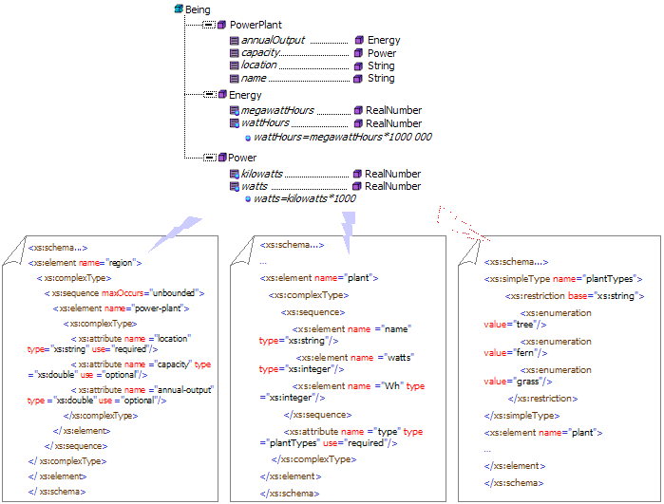
Semantic Architecture
Centered on a Semantic Hub
© Unicorn Solutions Inc.

Slide 10
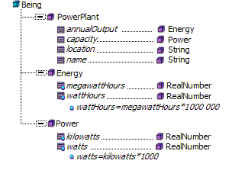
Central Information Model
© Unicorn Solutions Inc.

Slide 11
Ontology
Roughly similar to Object Oriented Design, Entity-Relationship Modeling, or UML
Focused on representing real-world entities, rather than software or DB tables
© Unicorn Solutions Inc.
Private & Confidential

Slide 12
Classes
Sets of real-world entities
  PowerPlant, the set of power plants
  Energy, the concept of energy as described in physics.
Inheritance
  State inherits from Region.
© Unicorn Solutions Inc.
Private & Confidential

Slide 13
Properties
Link together classes
Target of the property can be a ‘primitive’ class like Integer, or any other class.
  PowerPlant has an output linking it to a unit of Energy.
  PowerPlant has a name (String)
  Energy has a wattHours (Integer)
Cardinality: Each PowerPlant has exactly one name, but multiple powerLines.
© Unicorn Solutions Inc.
Private & Confidential

Slide 14
Business Rules
Constrain and link together properties
Types of Business Rules:
  Uniqueness: No two People share a socialSecurityNumber
  Enumeration: PowerPlant's type ∈ {“Hydro”, “Nuclear”, “Coal”, “Wind”}
  Mathematical or other logical relationships:
  kilowatts = watts / 1000
© Unicorn Solutions Inc.
Private & Confidential

Slide 15
Mapping
Associate Schema Types & Elements with concepts in the Semantic Model
© Unicorn Solutions Inc.

Slide 16
Mapping to A Semantic Model
XSD ComplexTypes or SimpleTypes to classes
XSD elements and attributes to properties
© Unicorn Solutions Inc.
Private & Confidential

Slide 17
Standards
OWL
  Web Ontology Language
  Standard for Ontology
  Recently finalized by W3C
RDF
  Resource Definition Framework
  Represents links between concepts
  Suitable for schema-to-ontology mapping, although not targeted at that.
© Unicorn Solutions Inc.
Private & Confidential

Slide 18
Example
<?xml version="1.0" encoding="UTF-8"?>
<xs:schema . . . >
<xs:element name="region">
<xs:complexType>
<xs:sequence maxOccurs="unbounded">
<xs:element name="power-plant">
<xs:complexType>
<xs:attribute name="location" . . . />
<xs:attribute name="capacity" . . . "/>
<xs:attribute name="annual-output" . . . />
</xs:complexType>
</xs:element>
</xs:sequence>
</xs:complexType>
</xs:element>
</xs:schema>
© Unicorn Solutions Inc.
Private & Confidential

Slide 19
Semantic Discovery
Relevant!
Irrelevant!
Relevant!
© Unicorn Solutions Inc.

Slide 20
Other Applications of Semantic Information Management

Slide 21
Generating Schemas
The business needs, as represented in the Semantic model, drive the automated construction of a Schema

Slide 22
Transformation
Given source and target Schemas, the semantic architecture “understands” them and so can generate XSLT to transform from the one to the other.

Slide 23




Non-XSD Schemas
RDBMS
Schema
VAN
Data
Warehouse
Schema
Web Services
Information
Model
CORBA / RMI / DCOM Objects
COBOL
XML
ERwin Schema
API
Rosetta-Net
Custom XML Schema
ERP, CRM, PDM,
…

Slide 24
Non-XSD Schemas
RDB Schemas, COBOL Copybooks, UML, Entity-Relationship Diagrams, etc.
The principles of mapping, discovery are the same as for XSD.
For example, an RDB Table is mapped to a Class, and an RDB Column is mapped to a Property

Slide 25
Web Services
Web services are described by WSDL.
The Input and Output messages of each operation are described by XSDs.
UDDI helps discover Web services that meet precise interface specifications, but the Semantic information architecture, can augment that and discover Web services according to business needs, transforming where necessary.

Slide 26
Semantic Information Management:
Conclusions

Slide 27
Semantic Information Management (SIM)
  SIM enables
  Reuse of existing schemas, especially enterprise and standards
  Generation of schemas and XSLT
  Discovery and integration Web services

Slide 28
SIM Business Benefits
  Reusability, quality, and standards conformance
  Reduced costs and development time
  Agility in integration and development

Slide 29
Thank You!
Please contact me with questions and comments
Joshua Fox
joshua@unicorn.com
www.unicorn.com

