Slide 1
Fantasy Football Resource
  Presenters: Joshua Franey, Joe Hill, Evan Tizard, and Gabriel Hamilton
  Presentation Date: November 4, 2016

Slide 2
Business Case
Summary
  Currently, filing a non-medical appeal is a pen and paper manual process. Automating non-medical appeals will allow the public to file appeals online and aligns with Agency goals of innovative quality services and increased self-service
  Non-medical appeal paper workloads currently lack a centralized system to store and track information. Developing a centralized system will enable SSA to process these appeals more quickly & efficiently

Slide 3
Project Goals
Automate the non-medical appeals documentation collection process
Provide document attachment upload ability
Provide customer confirmation after appeal submission
Automate tracking of non-medical appeals
Allow front line staff to have access to case status information
Reduce the amount of physical mailing of forms to each Field Office
Expand internet self-service options for claimants and representatives
Provide usage management information (MI) collected for non-medical appeals
PIV Card Compliance (HSPD-12 credentials)

Slide 4
Functions To Be Delivered
  Internet application (iApplNMD) for submitting non-medical appeals
  Online non-medical appeal users will have ability to attach and upload documents
  Usage Management Information (MI) will be collected for the non-medical appeal application
  Intranet application (aApplNMD) for processing non-medical appeals
  Provide SSA staff with a centralized location to assign, track, and organize non-medical appeals
  SSA staff will have ability to query, view, print, or mark appeals cases as complete
  SSA staff will have access to attached documents associated with non-medical appeals
  Workload Management Information (WMI) will be expanded to assist Field Office work flow

Slide 5
Background
  Applicant submits an online appeal via iApplNMD application, attaching / uploading supporting document(s) as part of the process
  iApplNMD performs document virus scan & TIFF conversion, leveraging existing Document Management Architecture (DMA) Work-in-Process
  iApplNMD notifies WMI a new non-medical appeal has been filed
Attachment Utility (ATTU) stores document(s) in a USS folder structure
ATTU sends a WAS message to iApplNMD MQ, stating results of document(s) submission
iApplNMD receives & processes message, storing document(s) meta-data in iSession DB2 Relational XML database

Slide 6
Background
  Field Office managers review non-medical appeals to be processed, with ability to assign specific appeals to designated field personnel
Field personnel work the appeal, using Document Manager Architecture (DMA) API to view claimant’s supporting appeal document(s)
Field office personnel record final disposition of the appeal

Slide 7
Fantasy Football System Flow

Slide 8
Data Architecture
New/Restructured Data Requirements
  iSession (appeal data) – New iApplNMD specific tables
  MWMI (work-flow) – Expanded to support iApplNMD, aApplNMD
  MESODS (Usage MI) – New iApplNMD specific table
Internal data interfaces
  User Info Component (CICS) – NUMIDENT
  Attachment Utility (ATTU)
  MQ messaging
  Ocelot Persistence for iSession database access
  Document Management Architecture (DMA)
  DMA Viewer

Slide 9
Application Architecture
iApplNMD application will be built using existing standard framework components:
  DCS Framework
  Ocelot
  UEF
  iSession
  STRUTS 2
  MQ Listener
  CICS Authentication
aApplNMD
  DCS Framework
  Ocelot
  UEF
  iSession
  STRUTS 2
  DMA API Viewer
  Authentication – Application PIN in Top Secret
  Authentication – Application PIN in Top Secret
  PIV Card (HSPD-12 credentials)

Slide 10
Infrastructure Architecture
Application servers: WAS on z/OS
Databases: DB2
Messaging: WAS MQ
Document Management: DMA
Security: JEE, EJBRoles

Slide 11
Application Inventory Information
Application or Service Name: iApplNMD / aApplNMD
Reusable Service(s): DCS Framework v3.0, MESODS, CTWS, Ocelot, IBM Batch Data Stream Framework
Data Stores: iSession , MESODS, MWMI
Open Source Software: Log4j
Database Platform: DB2
Hardware Platform: WAS on z/OS, CICS
Programming Language: Java7, XML, COBOL CICS, Java Script, HTML, XHTML, Jython, JSON, JCL, xJCL
Messaging Service: WAS MQ

Slide 12
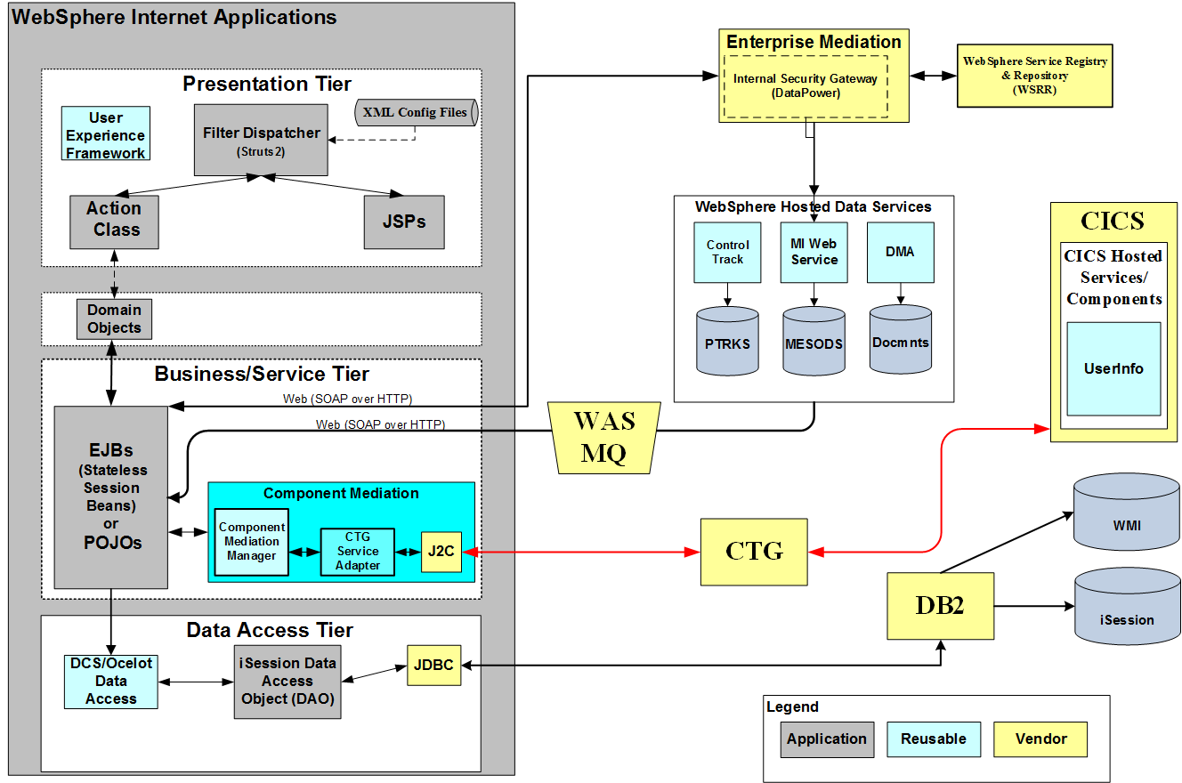
Application Architecture Diagram

Slide 13
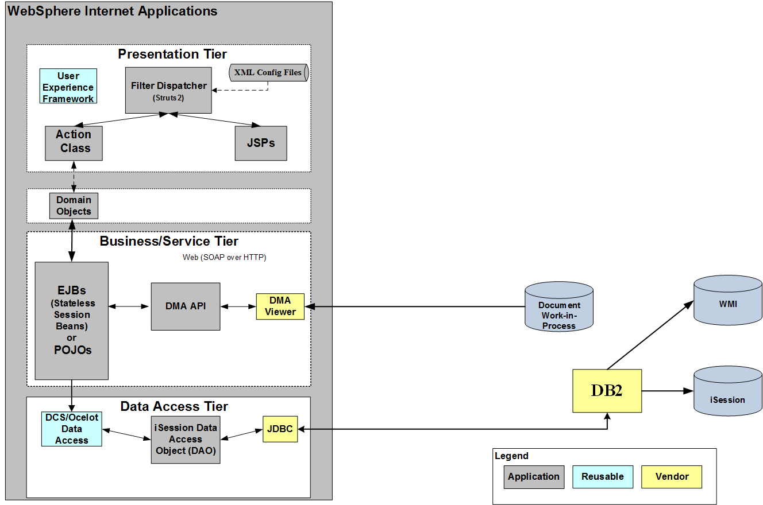
Application Architecture Diagram

Slide 14
Project Lifecycle Dates
Lifecycle Stage | Completion Date
P&A | 5/27/2016
Development | 08/26/2016
Validation | 10/28/2016
Integration | 12/9/2016
Training | N/A
Production | 12/10/2016

