Slide 1

Fakultät für Elektrotechnik und Informatik
Institut für Verteilte Systeme Fachgebiet Wissensbasierte Systeme (KBS)
Seminar: Topics in Data Mining Summer semester 2016 A framework to monitor clusters evolution applied to economy and finance problems
Zijian Zhang
May. 23. 2016

Slide 2
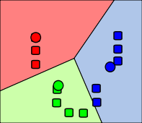
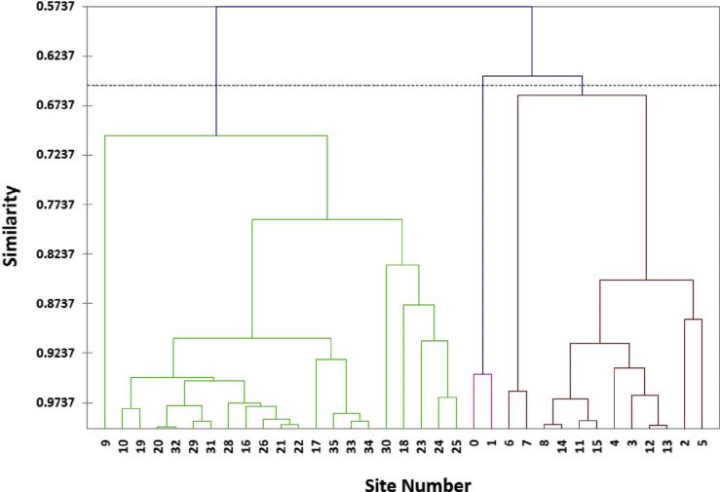
Clustering
The research about clusters has gone deep
k-means Hierachical Clustering
Zijian Zhang, Present, A framework to monitor clusters evolution applied to economy and finance problems

Slide 3
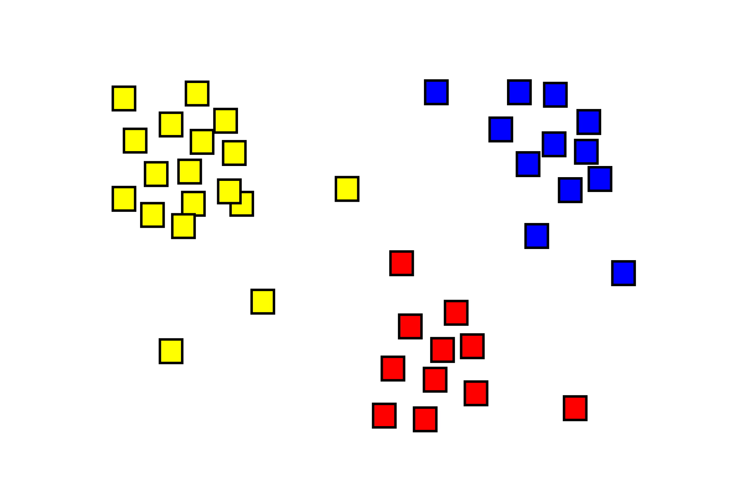
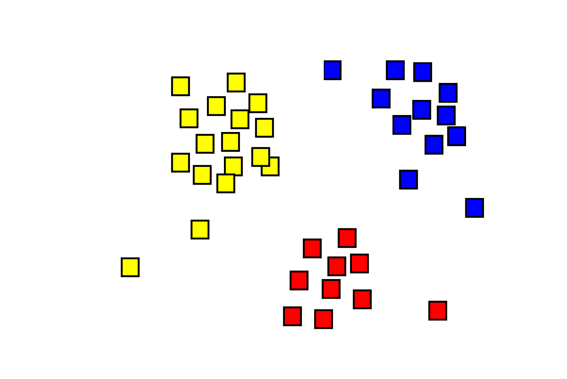
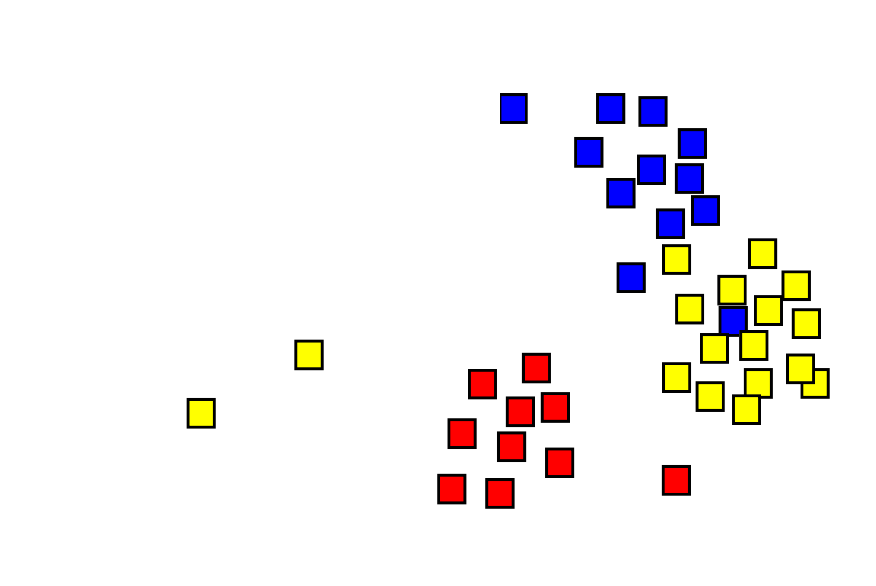
4th Dimension
But in the real world...
t=0 t=1 t=2
Zijian Zhang, Present, A framework to monitor clusters evolution applied to economy and finance problems

Slide 4
Interesting points of temporal variations
(re)detection of clusters
K-means
Hierachical cluster detection
MST clustering
...
temporal transitions
Present, Papers titlte

Slide 5
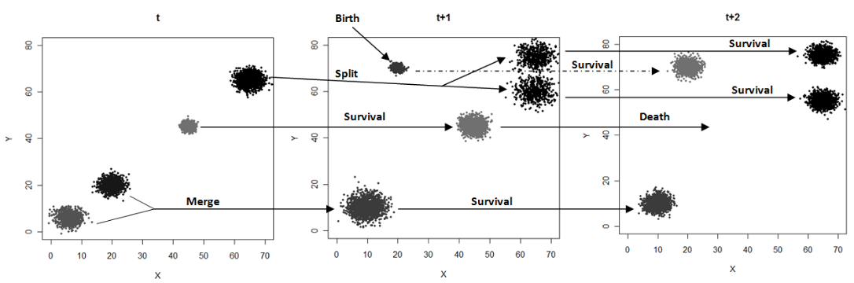
Toxonomy of transitions
according to the paper, all types of transitions of clustering are roughly categorized into five types:
birth
death
merge
split
survive
Zijian Zhang, Present, A framework to monitor clusters evolution applied to economy and finance problems

Slide 6
Tracking the points
Extensional defination of clusters
x₃
x₆
x₄
x₆
x₃
x₅
x₅
x₂
x₂
x₁
x₄
x₁
Cluster (x₁,x₂,x₃,x₄,x₅,x₆)
Cluster (x₁,x₂,x₃) and Cluster(x₄,x₅,x₆)
Zijian Zhang, Present, A framework to monitor clusters evolution applied to economy and finance problems
Notes:
Although tracking of each points sounds not so efficient, but easy to measure the familarity of clusters and thus determin the transitions.

Slide 7
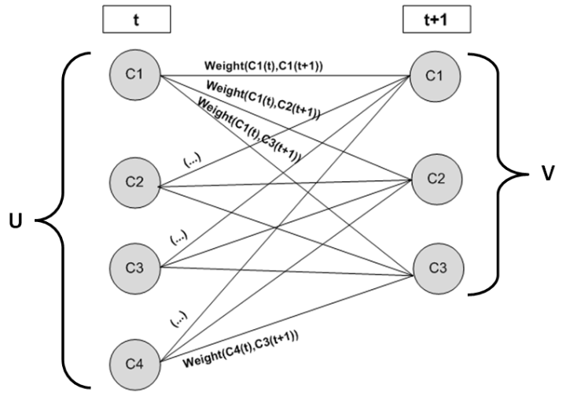
Matching the clusters
Zijian Zhang, Present, A framework to monitor clusters evolution applied to economy and finance problems
Notes:
Although tracking of each points sounds not so efficient, but easy to measure the familarity of clusters and thus determin the transitions.

Slide 8
Caculation of weight
x₃
x₆
x₃
x₅
x₇
x₂
x₂
x₆
x₁
x₄
x₁
x₄
x₅
Zijian Zhang, Present, A framework to monitor clusters evolution applied to economy and finance problems
Notes:
Although tracking of each points sounds not so efficient, but easy to measure the familarity of clusters and thus determin the transitions.

Slide 9
Birth
x₃
x₆
x₅
x₂
x₁
x₄
t_{i}
t_{i+Δt}
Present, Papers titlte

Slide 10
Death
x₃
x₆
x₅
x₂
x₄
x₁
t_{i}
t_{i+Δt}
Present, Papers titlte

Slide 11
Split
x₃
x₃
x₆
x₅
x₅
x₆
x₂
x₁
x₄
x₁
x₄
x₂
t_{i}
t_{i+Δt}
Present, Papers titlte

Slide 12
Merge
x₆
x₁
x₄
x₆
x₃
x₂
x₅
x₂
x₃
x₁
x₄
x₅
t_{i}
t_{i+Δt}
Present, Papers titlte

Slide 13
Survive
x₆
x₃
x₆
x₄
x₅
x₂
x₃
x₅
x₁
x₁
x₄
x₂
t_{i}
t_{i+Δt}
Present, Papers titlte

Slide 14
Case Study: Portuguese Activity Sectors
Over 3 years (2005, 2006, 2007)
12 Observations
9 continuous attributes
Supervised learning → in order to specify two thresholds
Present, Papers titlte

Slide 15
Learning from realworld
the author has conducted a learning of threshold with two different data set：
Banco de Portugal's Central Balance-Sheet Database and
The Data Page of New York University - Leonard N. Stern School of Business
with starting condition that the two arguments vary in correspondly interval:
τin [0.5, 1]
λin [0, 0.4]
final assignment:
τ=0.6
λ=0.2
also the affectivness of two thresholds：
split threshold values is not critical
number of transitions are more volatile and sensitive to small variations of τ
Present, Papers titlte

Slide 16
One Step Further
Application on Fuzzy Clustering...
for the formuler:
re-define the defination of intersection and join, such as:
Present, Papers titlte

Slide 17
Acknowledgement
Thank you for your attention.
Feel free to raise questions to me.
Have fun in following presentations.
Present, Papers titlte

